Slide 1
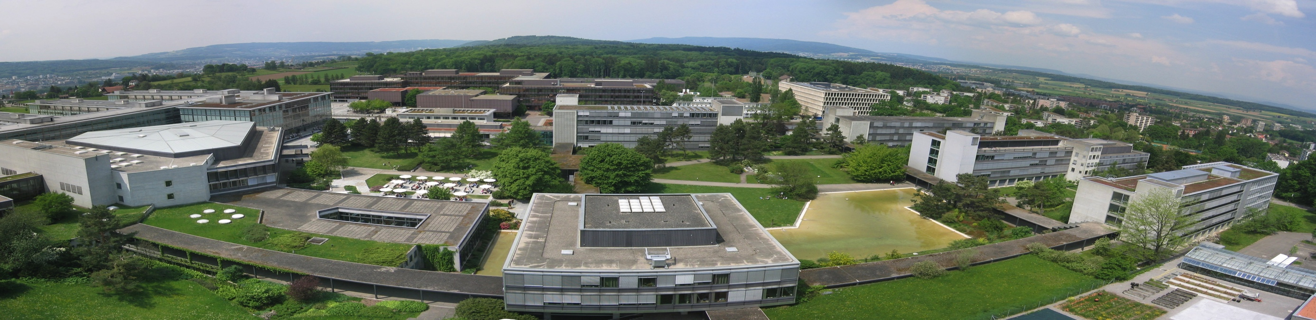
Case Studies in Process Design II Clemens Isert, Selina Schlotterbeck, Tobias Seidler, Mithurshan Tharmalingam, Pauline Oeuvray

Slide 2
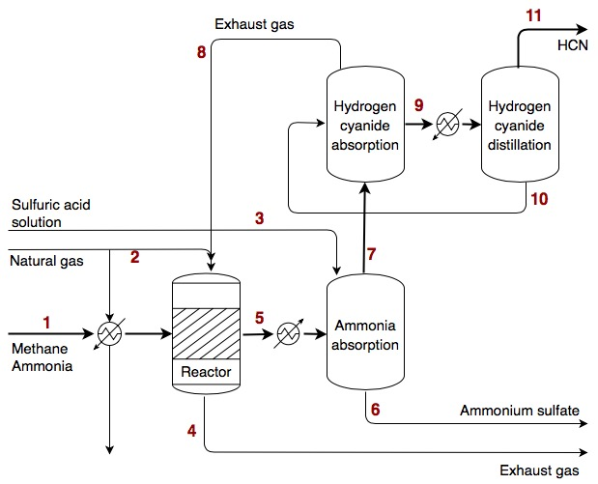
Reactor flow sheet

Slide 3
General Modelling Approach
Four cases considered:
Overall optimization with a “black box” approach
 | Case 1 | Case 2 | Case 3 | Case 4
Gas model | ideal gas law | ideal gas law | Peng-Robinson-EOS | Peng-Robinson-EOS
Heating mode | cross-current | cross-current | cross-current | co-current
Absorbers | shortcut model | shortcut model | non-ideal Eq.-model | non-ideal Eq.-model
Distillation | Fenske-Underwood-Gilliland | Fenske-Underwood-Gilliland | NRTL | NRTL
ΔP considered | no | yes | yes | yes

Slide 4
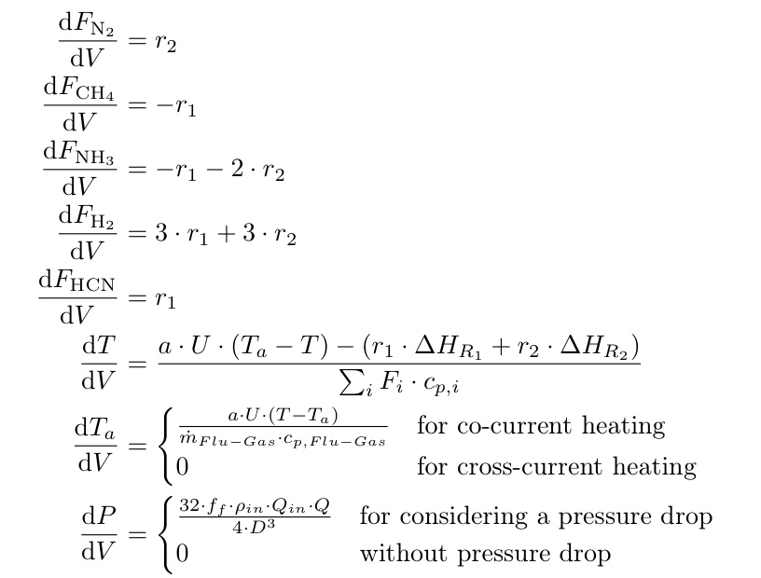
ODE-system governing the reactor

Slide 5


Assumptions for Ammonia Absorber
General
Isothermal column
Instantaneous & irreversible reaction
Heat of absorption neglected
Outlet temperature for liquid and gas alike
No HCN absorption in water
No pressure drop
20 % excess of sulfuric acid
Ideal case
Heat capacities are T independent
Non ideal case
Heat capacities are T dependent

Slide 6
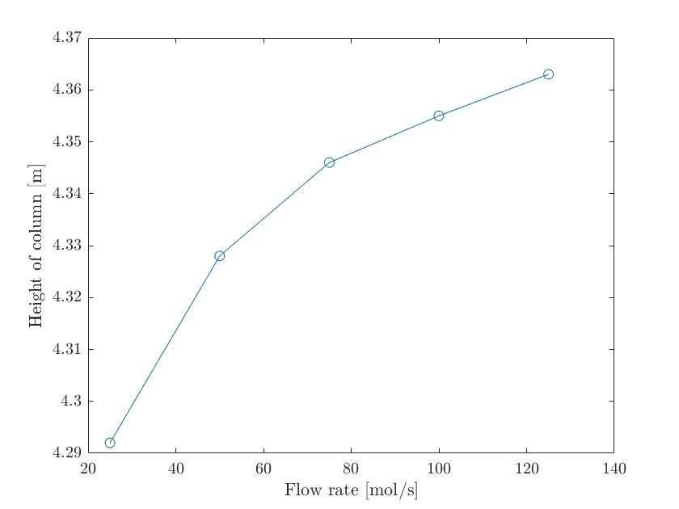
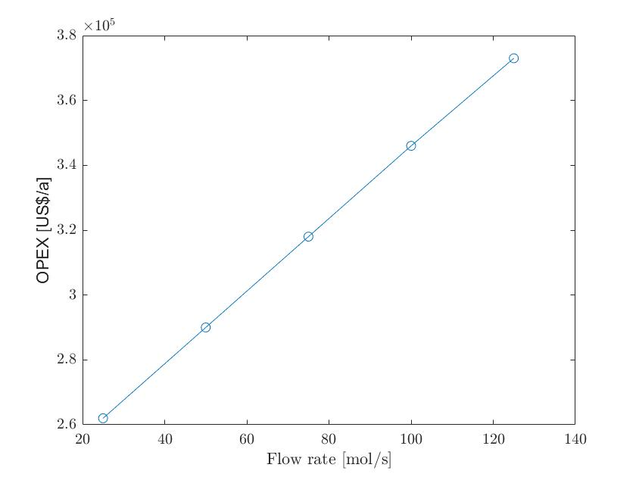
Sensitivity Analysis of the Ammonia Absorber

Slide 7
Made assumptions for the HCN absorber
Ideal case
Isothermal column
Heat of absorption neglected
Outlet temperature same for gas and liquid
Only HCN is absorbed
Heat capacities not temperature dependent
No HCN in liquid inlet stream
Resistivity in the liquid phase neglected
Non-ideal case
Isothermal column
Heat of absorption neglected
Outlet temperature same for gas and liquid
Only HCN is absorbed

Slide 8
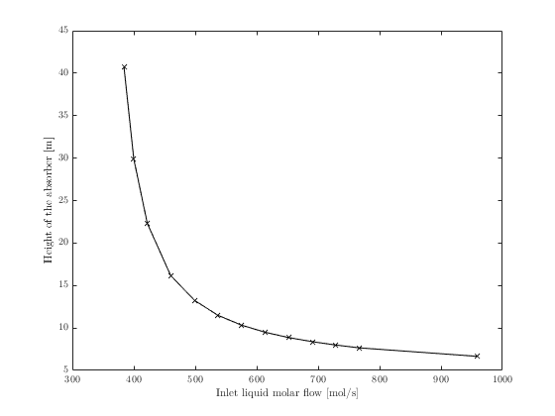
Sensitivity analysis of the HCN Absorber
Height of the column increases with decreasing inlet liquid flow
Better absorption
CAPEX decreases
OPEX increases

Slide 9
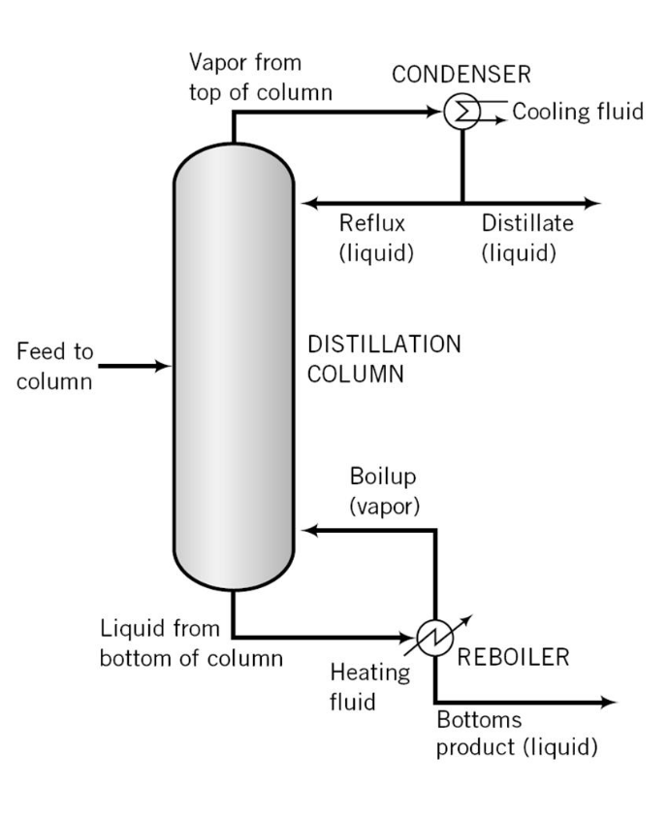
HCN Distillation
Ideal or non-ideal (NRTL for liquid phase)
No ΔP / ΔP
Fenkse-Underwood-Gilliland method (justified since relative volatilities were pretty similar)
x_{HCN}^{D} = 0.995,x_{HCN}^{B} = 10 ppm (going below these limits only makes the separation more difficult → higher CAPEX/OPEX)
total condenser, q = 1 (requires another heat exchanger before the distillation column)

Slide 10
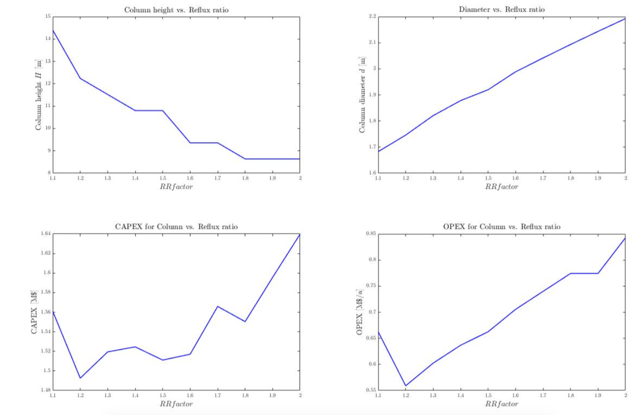
HCN Distillation

Slide 11
Results
Reactor:
Ideal vs. real (case 1/case 3)
Length: 12 m / 28 m
Number of tubes: 1’342 / 17’149
Cross- vs. co-current (case 3/case 4)
Number of tubes: 17’149 / 40’642
Heating medium flow: 0.10 / 0.05
Conversion CH₄: 0.82 / 0.59

Slide 12
Reactor profile case 3

Slide 13
Results
NH₃ absorber:
Ideal vs. real (case 1/case 3)
Column height: 2.44 m / 4.39 m
Diameter: 0.79 m / 0.79 m
Flow rate ratio 0.80 / 1.64
Temperature in the column
Volumetric fraction H₂SO₄ : 0.37 / 2.01

Slide 14
Results
HCN absorber:
Ideal vs. real (case 1/case 3)
Column height: 9.73 m / 10.31 m
Diameter: 1.11 m / 1.10 m
Outlet temperature: 294.72 K / 293.57 K
Water

Slide 15
Results
HCN distillation:
Ideal vs. real (case 1/case 3)
Column height: 9.36 m / 10.08 m
Diameter: 1.73 m / 1.92 m
Heat exchanger area: 0.057 m² / 0.056 m²

Slide 16
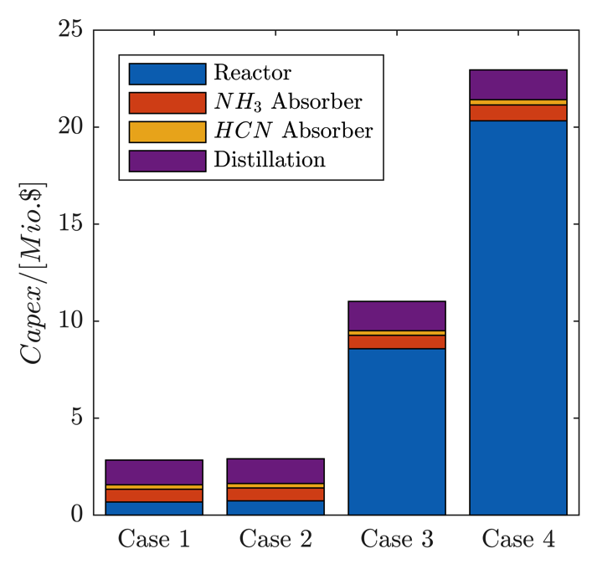
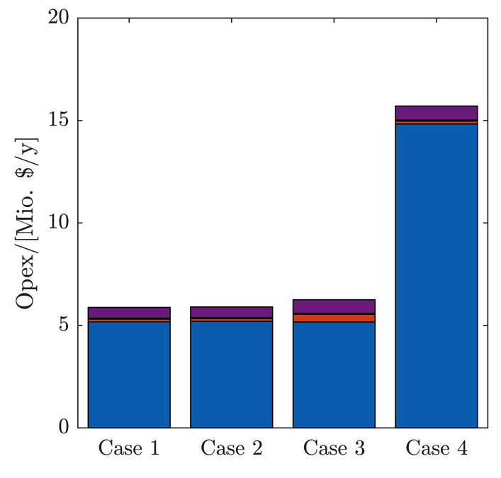
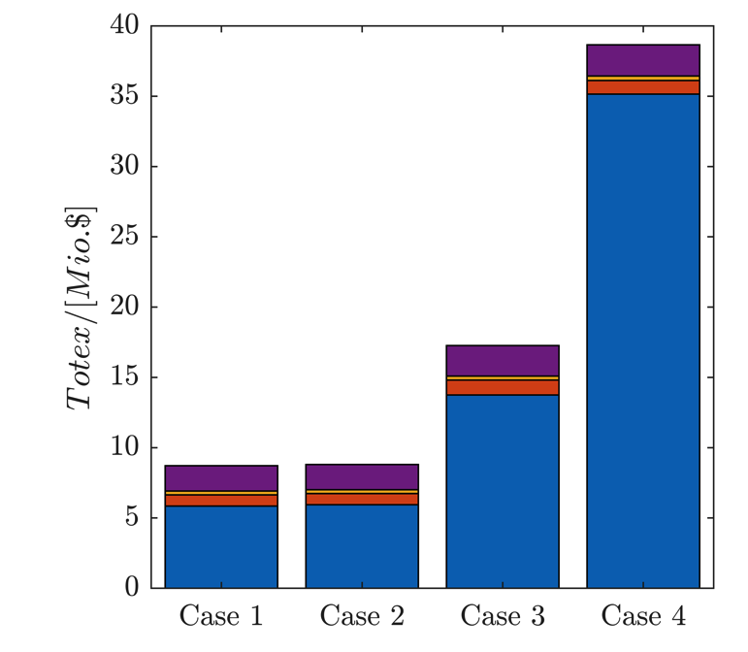
Results
Costs
Ideal vs. real (case 1/case 3)
Break-even price: 0.62 $/kg / 0.76 $/kg

Slide 17
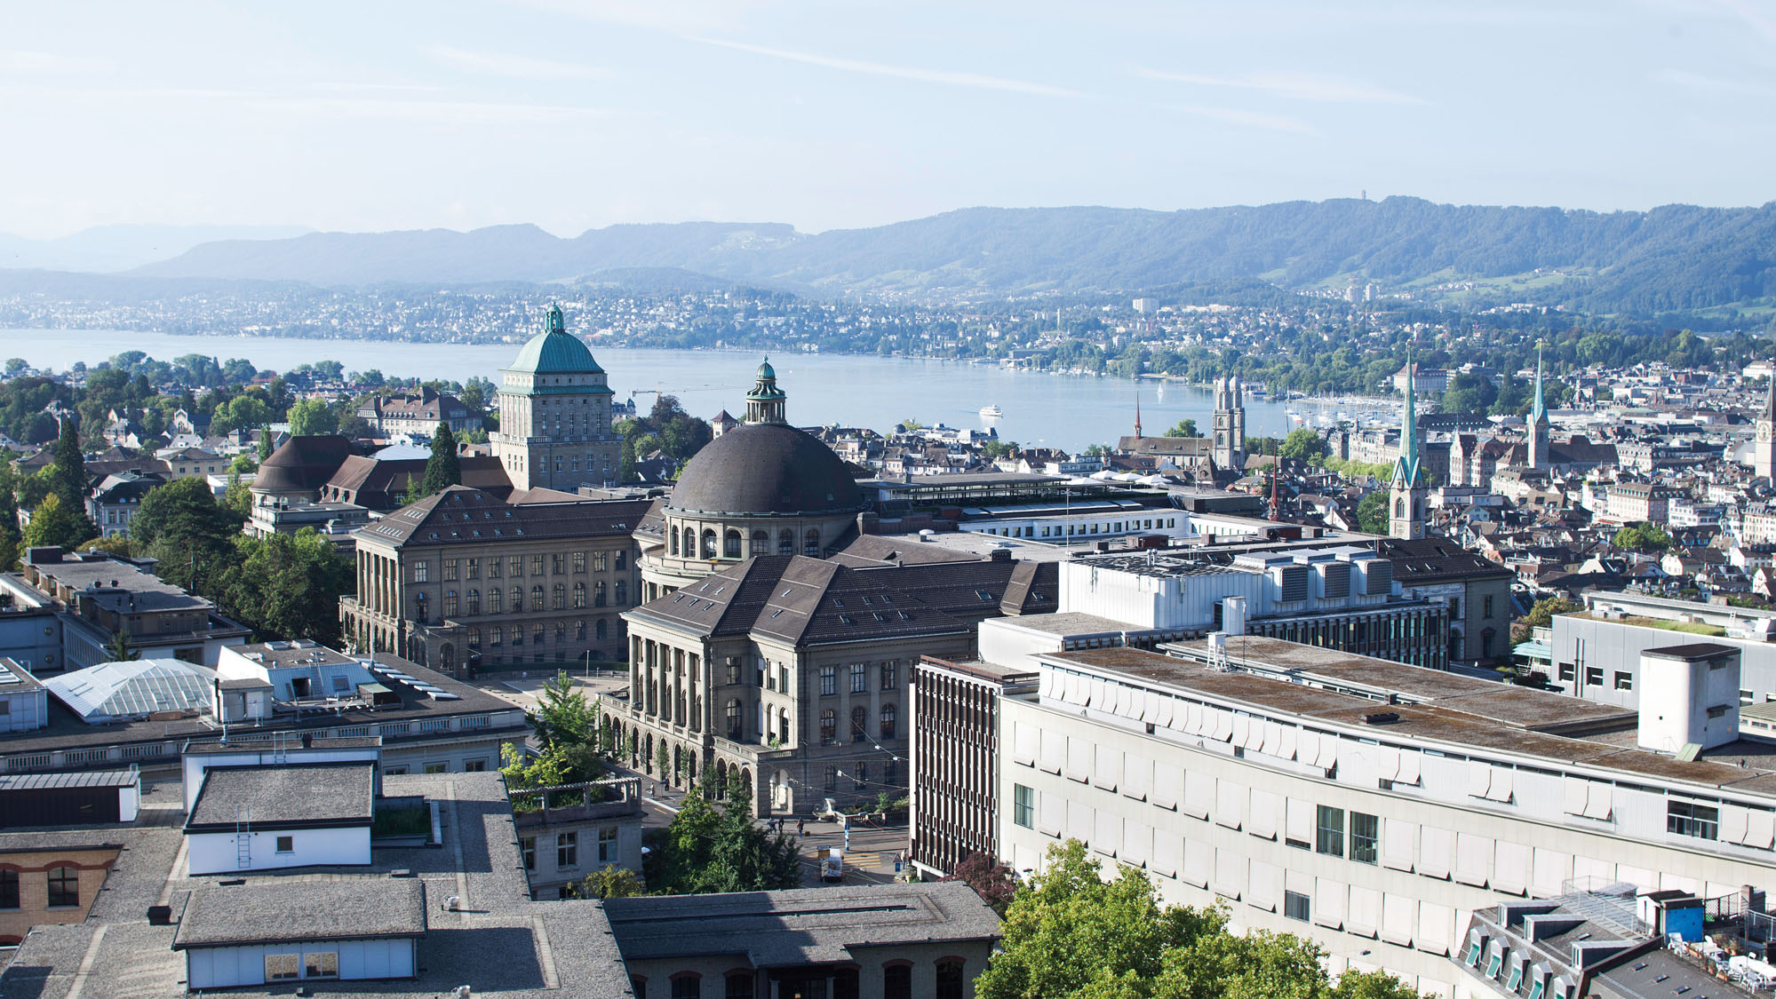
Thank you for your attention

