Slide 1
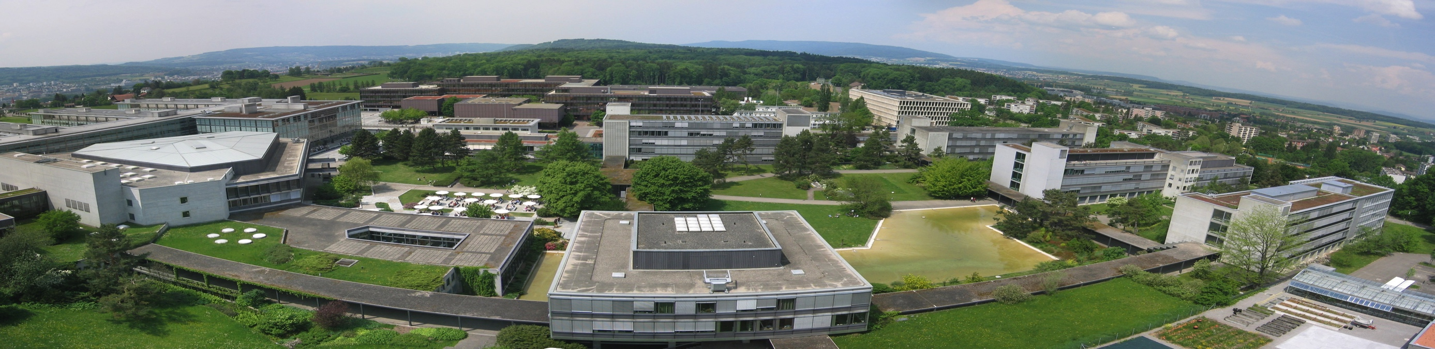
Case Studies in Process Design II Clemens Isert, Selina Schlotterbeck, Tobias Seidler, Mithurshan Tharmalingam, Pauline Oeuvray

Slide 2
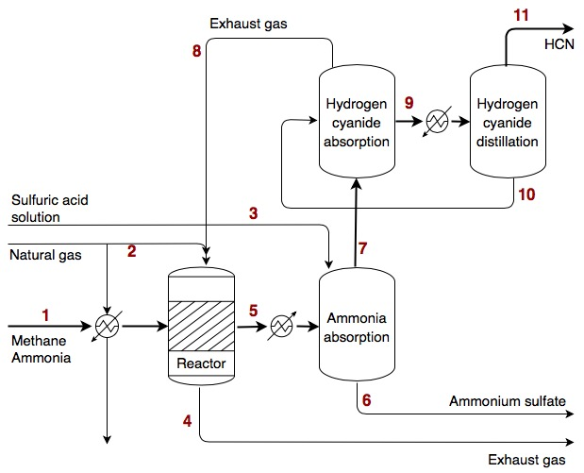
Reactor flow sheet

Slide 3
Results
Reactor:
Ideal vs. real (case 1/case 3)
Length: 12 m / 28 m
Number of tubes: 1’342 / 17’149
Co- vs. counter-current (case 3/case 4)
Number of tubes: 17’149 / 40’642
Heating medium flow: 0.10 / 0.05
Conversion CH₄: 0.82 / 0.59

Slide 4
Results
NH₃ absorber:
Ideal vs. real (case 1/case 3)
Column height: 2.44 m / 4.39 m
Diameter: 0.79 m / 0.79 m
Flow rate ratio 0.80 / 1.64
Temperature in the column
Volumetric fraction H₂SO₄ : 0.37 / 2.01

Slide 5
Results
HCN absorber:
Ideal vs. real (case 1/case 3)
Column height: 9.73 m / 10.31 m
Diameter: 1.11 m / 1.10 m
Outlet temperature: 294.72 K / 293.57 K
Water

Slide 6
Results
HCN distillation:
Ideal vs. real (case 1/case 3)
Column height: 9.36 m / 10.08 m
Diameter: 1.73 m / 1.92 m
Heat exchanger area: 0.057 m² / 0.056 m²

Slide 7
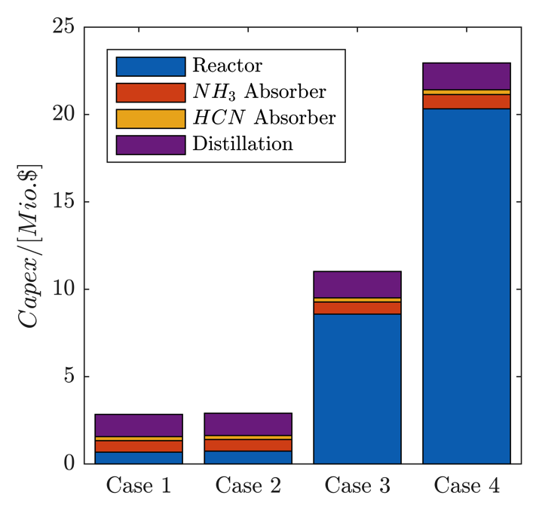
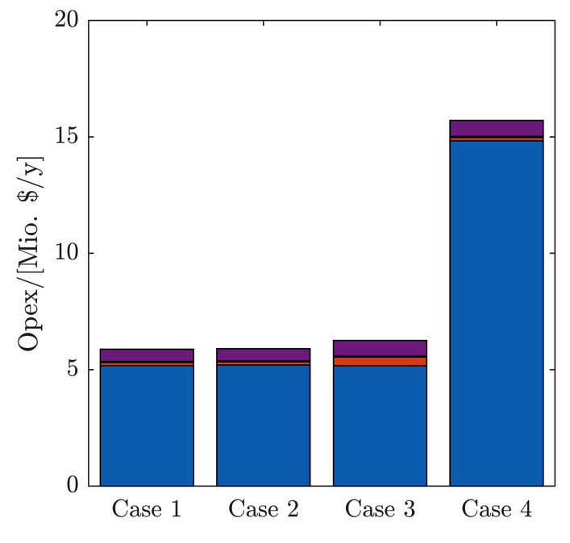
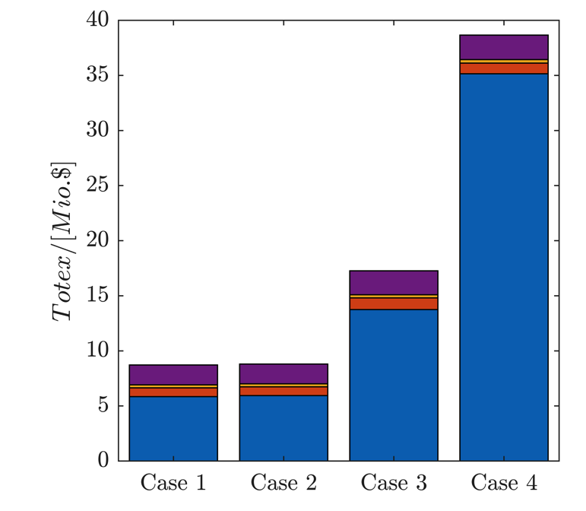
Results
Costs
Ideal vs. real (case 1/case 3)
Break-even price: 0.62 $/kg / 0.76 $/kg

Slide 10
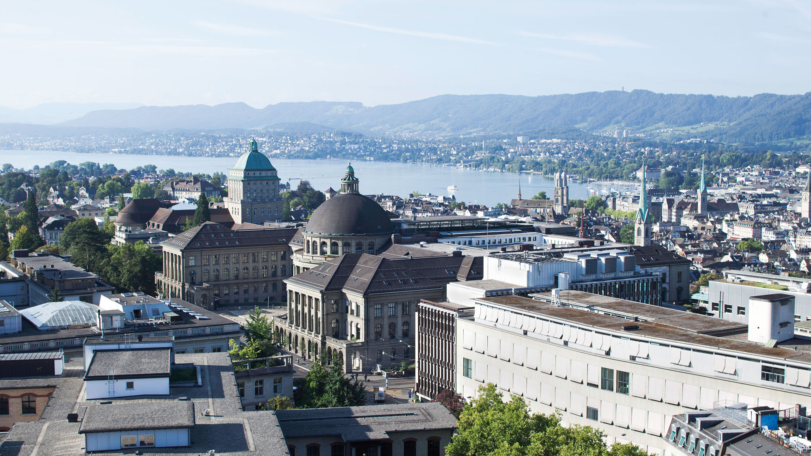

Slide 14
Contact information and credits
ETH Zurich
Organisational unit
Street address
Postcode City
www.ethz.ch/en.html
Publisher: Organisational unit of ETH Zurich
Design: Designer Name
Images: Credit (slide xx), Credit (slide xx)
© ETH Zurich, December 2013

