Slide 1
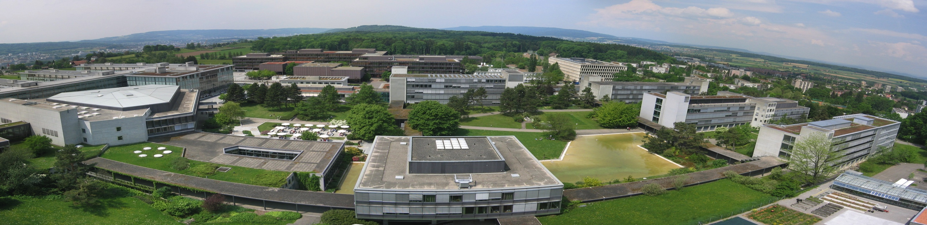
Case Studies in Process Design II Clemens Isert, Selina Schlotterbeck, Tobias Seidler, Mithurshan Tharmalingam, Pauline Oeuvray

Slide 2
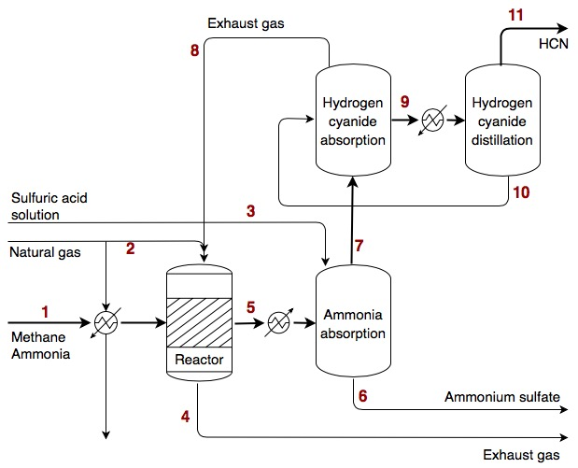
Reactor flow sheet

Slide 5


Slide 9
Contact information and credits
ETH Zurich
Organisational unit
Street address
Postcode City
www.ethz.ch/en.html
Publisher: Organisational unit of ETH Zurich
Design: Designer Name
Images: Credit (slide xx), Credit (slide xx)
© ETH Zurich, December 2013

