Slide 1
IPEDS Data Quality Audit:
Python vs. AI-Assisted Approach
A Comparative Analysis | DAMA DMBOK Six Quality Dimensions | Five IPEDS Datasets
Tricia Beaudreau | April 2026

Slide 2
Audit Scope
Comprehensive data quality audit of five Integrated Postsecondary Education Data System (IPEDS) datasets published by the US Dept of Education
IPEDS is the primary source of data on 6,000+ US higher education institutions
Framework: DAMA DMBOK six data quality dimensions
Tool: Python in Google Colab
5 datasets audited
Dataset | Description | Rows | Columns | Unique Institutions
df1 | 12-Month Enrollment | 115,026 | 72 | 5,861
df2 | Financial Data | 1,911 | 288 | 1,911
df3 | Graduation Rates | 51,011 | 66 | 3,684
df4 | Institution Directory | 6,072 | 72 | 6,072
df5 | Institution Characteristics | 5,963 | 111 | 5,963

Slide 3
Why Audit the Data?
Data quality is a governance issue — not just an IT issue.
IPEDS data supports federal financial aid, accreditation decisions, and public institutional rankings. Errors carry real institutional and regulatory risk.
Five datasets. Six quality checks. One federal standard.
Enrollment, finances, graduation rates, directory, and characteristics data were each evaluated against the DAMA DMBOK framework — the recognized standard for data governance.
Catching issues early protects the institution.
Undetected data defects can distort reporting, mislead stakeholders, and surface as compliance findings. Proactive auditing is the first line of defense.

Slide 4
Why Compare Two Methods?
A traditional audit takes ~7 working days.
Analyst-led auditing requires specialized data science skills and significant time investment making it difficult to sustain as a routine governance practice.
A new AI-assisted approach completed the same audit in 19 minutes.
AI tools can now automatically profile large datasets, flag anomalies, score quality dimensions, and generate governance reports in a fraction of the time.
The question: can AI match the rigor of expert analysis?
If AI-assisted auditing is reliable, we can run quality checks at every IPEDS data release — turning a once-a-year effort into continuous governance.

Slide 5
How the Two Approaches Differ
 | Python / Google Colab | Claude Cowork (AI-Assisted)
Who does the work? | Analyst writes and runs every test | AI profiles the data automatically; Analyst prompts AI agent, verifies results, edits reports as needed
Time to complete | ~7 working days | 19 minutes
Skills required | Data science, Python expertise | Domain knowledge to validate output, Generative AI workflow development
Best suited for | Annual deep-dive; policy interpretation; stakeholder narrative | Routine quality checks; fast turnaround; every data release
Output | Google Colab notebook with charts, scoring, and contextual analysis based on domain knowledge | Formal report with dimension scores, findings register, charts, and recommendations tailored to specific audiences

Slide 6
Where Both Methods Agreed
Critical Encoding Defect
Both methods independently identified the BOM encoding defect on DF4 as the single most critical issue requiring immediate remediation.
Compliance Risk
Both flagged 39 institutions sharing OPEIDs with administrative offices posing a federal financial aid compliance risk.
Reporting Anomaly
Both found 14 closed institutions still appearing in active enrollment and graduation data.
Strong Integrity
Both confirmed 100% referential integrity. Every institution in each dataset resolves cleanly to the master Directory.
Two very different methods. The same critical findings. Agreement signals high confidence.

Slide 7
Unique Findings by Method
Python / Google Colab Found
Claude Cowork (AI-Assisted) Found
Sector insight: for-profit institutions make up 37% of campuses but only 8.4% of enrollment
Geographic context: 7 Pacific Island institutions flagged as outliers were confirmed legitimate
Domain gatekeeping: Negative codes (-1, -2, -3, -9) span hundreds of columns with no embedded data dictionary
Data lineage risk: df1 Enrollment and df2 Finances contain no internal year column, reporting year exists only in the filename
8,069 imputed cells in df2 Finances which may be misread as actual reported data by downstream users
13.3% imputation rate in financial data, a disclosure requirement in any financial analysis
Subtle encoding inconsistency between df4 and all other four files resulting in a technical defect invisible to manual review
Together, the methods cover both institutional context and technical precision — neither replaces the other.

Slide 8
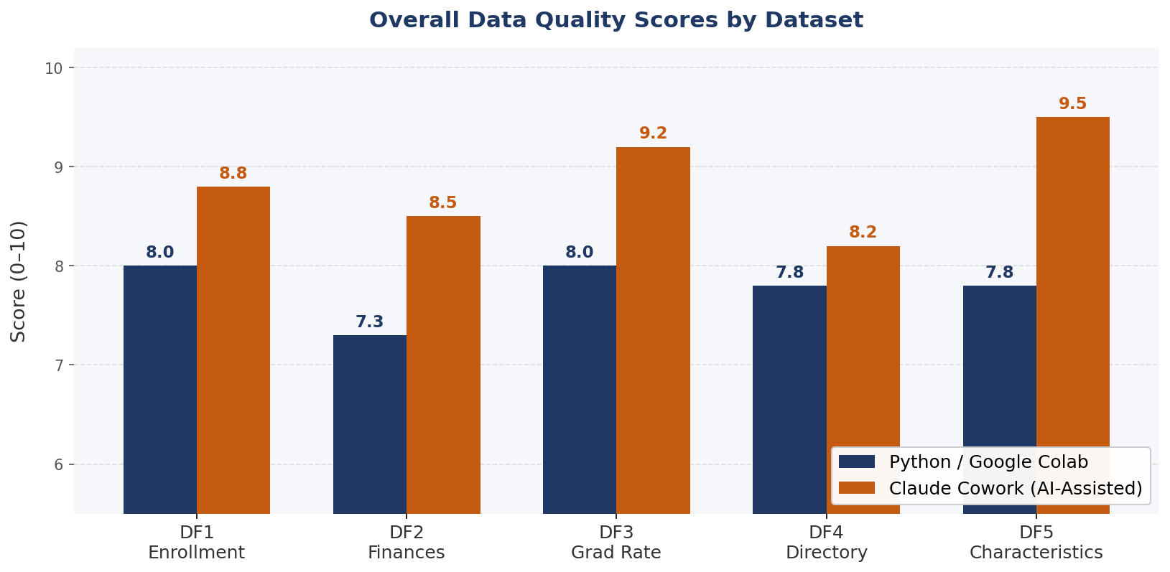
Data Quality Scores by Dataset
Notes:
Explain differences

Slide 9
Why the scores differ
Negative Values Treated as Errors
DF2 Finances: Population Scope Misread
Python flagged widespread negative values across df2, df4, and df5 as consistency defects scoring some datasets as low as 6/10
Cowork recognized that IPEDS uses negative integers as valid coded sentinel values (e.g., -2 = Not Applicable, -1 = Not Reported), lifting Consistency scores to 9–10/10 across those datasets
Python benchmarked df2's 1,911 institutions against the full 6,072-institution directory, a 68.5% gap, scoring Completeness at 4/10
Cowork understood that df2 (Form F1A) covers only public GASB-reporting institutions by design. Coverage limitation is structural, not a defect, resulting in a 7/10 Completeness score
Multi-Row Architecture Misidentified
Depth of Cross-Dataset Validation
Python flagged 109,165 'duplicate' UNITIDs in df1 Enrollment and 47,327 in df3 Grad Rates as uniqueness concerns, capping both at 9/10
Cowork recognized these as intentional design, one row per institution-demographic-level combination, and scored Uniqueness 10/10, reflecting zero true duplicates
Python's uniqueness and consistency checks were less comprehensive in cross-dataset scope, leaving more uncertainty in scoring and resulting in lower Consistency ratings overall
Cowork performed exhaustive referential integrity validation, confirming 100% UNITID alignment across all 119,911 records in four transactional datasets, an exceptional governance outcome
Notes:
Explain differences

Slide 10
Strengths & Limitations of Each Approach
Python / Google Colab
Claude Cowork (AI-Assisted)
✔ STRENGTHS
✔ STRENGTHS
Deep institutional context: sector, geography, governance frameworks
Reproducible: full Google Colab notebook with visualizations and scoring
Easily research new avenues as data reveals story
19-minute completion, practical for ad hoc audits and routine deeper analysis
Systematic defect detection: encoding errors, Z-flag risk, imputation rates
Limited data analysis experience required
✗ LIMITATIONS
✗ LIMITATIONS
7 working days, not practical for routine governance cycles
Requires data analysis and Python experience; limits accessibility
Limited institutional context, no sector-level narrative analysis
No IPEDS-specific domain knowledge embedded in audit logic

Slide 11
Conclusion
Both audits confirm IPEDS data is governance-ready.
No dataset was rated below 7.3 (Acceptable) in either method.
The two approaches are complementary, not competitive.
AI-assisted auditing excels at speed and technical detection; Python auditing excels at institutional depth and policy interpretation.
19 minutes vs. 7 working days — both have a place.
Scheduled AI audits maintain technical quality baselines; periodic analyst reviews provide strategic context for stakeholders.

Slide 12
created by Claude Cowork, Prompted and Edited by Tricia Beaudreau

