Slide 1
IPEDS Data Quality Audit
2024 Survey Cycle – Five Dataset Review
Framework: DAMA DMBOK Six Quality Dimensions
Tricia Beaudreau | 04.08.2026

Slide 2
Audit Scope & Approach
Comprehensive data quality audit of five Integrated Postsecondary Education Data System (IPEDS) datasets published by the US Dept of Education
IPEDS is the primary source of data on 6,000+ US higher education institutions
Framework: DAMA DMBOK six data quality dimensions
Tool: Python in Google Colab
5 datasets audited
Dataset | Description | Rows | Columns | Unique Institutions
df1 | 12-Month Enrollment | 115,026 | 72 | 5,861
df2 | Financial Data | 1,911 | 288 | 1,911
df3 | Graduation Rates | 51,011 | 66 | 3,684
df4 | Institution Directory | 6,072 | 72 | 6,072
df5 | Institution Characteristics | 5,963 | 111 | 5,963

Slide 3
Audit Framework: DAMA DMBOK
Six Data Quality Dimensions:
Completeness – Are all required values present?
Uniqueness – Are records free of unintended duplicates?
Timeliness – Is data current for its intended use?
Validity – Do values conform to defined rules and formats?
Accuracy – Does data correctly represent reality?
Consistency – Is data coherent across datasets?
Each dataset scored 0 – 10 per dimension
Based on DAMA International, Data Management Body of Knowledge

Slide 4
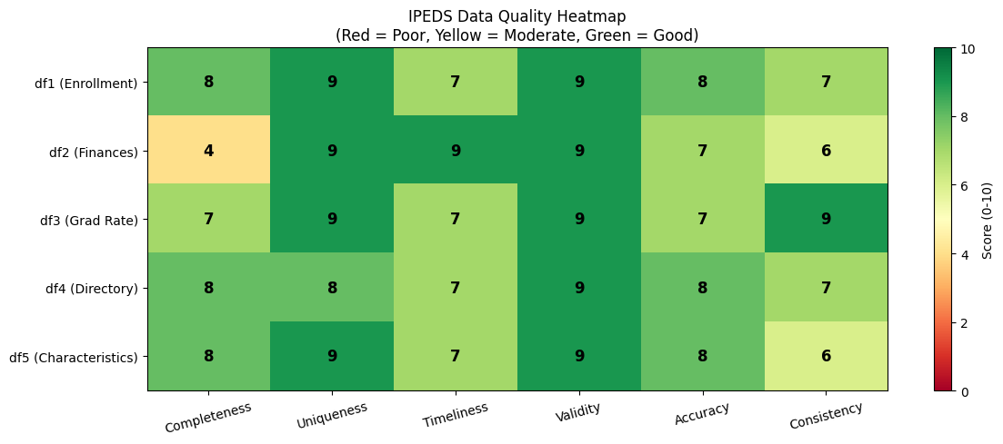
Overall Data Quality Results
Dataset | Score | Rating
df1 Enrollment | 8.0 | Good
df2 Finances | 7.3 | Acceptable
df3 Grad Rate | 8.0 | Good
df4 Directory | 7.8 | Acceptable
df5 Characteristics | 7.8 | Acceptable
Key Insights
No dataset scored below Acceptable
IPEDS data is well-structured and suitable for research and policy analysis with appropriate domain knowledge

Slide 5
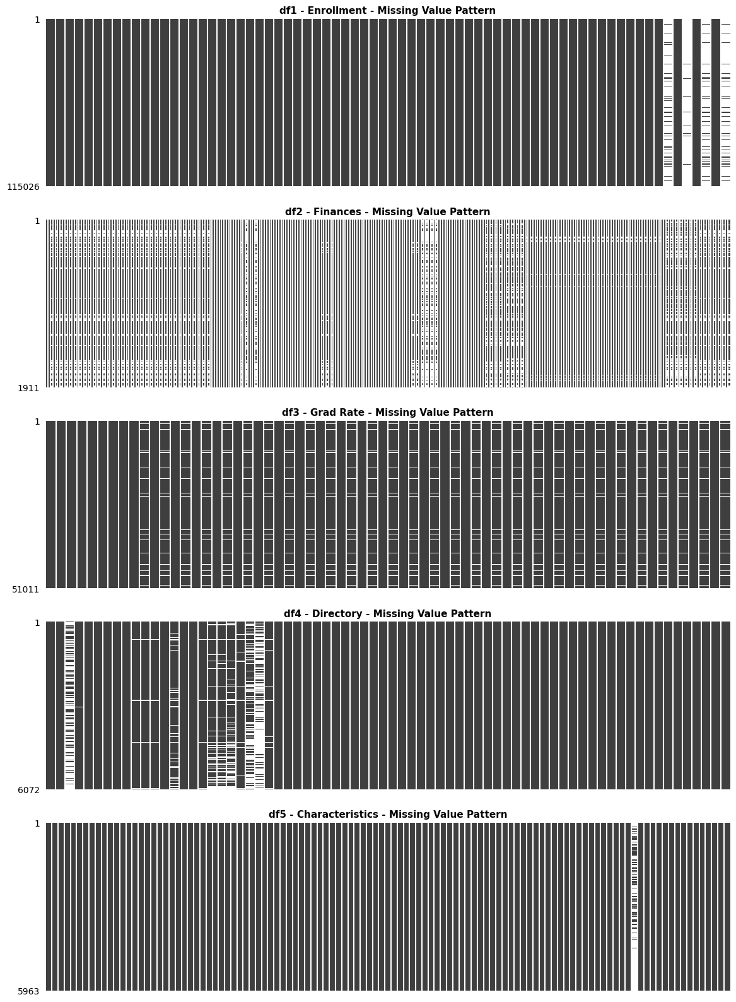
Dimension 1: Completeness
df1 Enrollment: Rare reporting situation columns 88-98% null, expected by design
df2 Finances: 1,911 of 6,072 institutions report financial data, F1A covers public GASB institutions only. 97 columns contain up to 58% missing values
df3 Grad Rate: 3,684 of 6,072 institutions report graduation data, non-degree seeking institutions do not report. All 30 demographic columns have missing count of 3,623 rows
df4 Directory: Optional URL fields 14-72% null
df5 Characteristics: DISABPCT 71.2% null, only reported when rare threshold met

Slide 6
Dimension 2: Uniqueness
Strong results across all datasets
Zero fully duplicated rows in any dataset
df2, df4, df5: Zero duplicated UNITIDs
df1, df3: Expected duplicate UNITIDs by design
Concerns
39 duplicate OPEIDs found
OPEIDs should be campus-specific and not shared across organization
Poses financial aid compliance risk
Key Insights
100% referential integrity
Zero orphaned records across all datasets
UNITID functions as reliable primary key across IPEDS system

Slide 7
Dimension 3: Timeliness
Institutions Closed in 2024 reporting period
Critical Data Gap
71 Institutions reported Closed in df4 Directory
Dataset | # institutions still reporting
df1 Enrollment | 14
df2 Finances | 0
df3 Grad Rate | 3
df5 Characteristics | 17
No internal year column in df1 Enrollment or df2 Finances datasets
Reporting year exists only in filenames
Governance risk for longitudinal analysis
Recommend IPEDS system-wide addition of internal year columns

Slide 8
Dimension 4: Validity
Checks Performed | Results
Zip code formats | 100% valid
State abbreviations | 100% valid
ICLEVEL codes | All values -3,1,2,3
CONTROL codes | All values 1,2,3
Enrollment values | No decimals found
Graduation rate values | No negatives found
Character formats | Df4 UNITID had BOM, rendering as ï»¿UNITID
Strongest dimension across all datasets
Validity scores capped at 9 as checks were thorough, but not exhaustive
Notes:
ICLEVEL = <2, 2-4, or 4 year institution or N/A. CONTROL = public, private non, private profit, Byte Order Mark resolved by switching to UTF-8-SIG instead of Latin-1 encoding

Slide 9
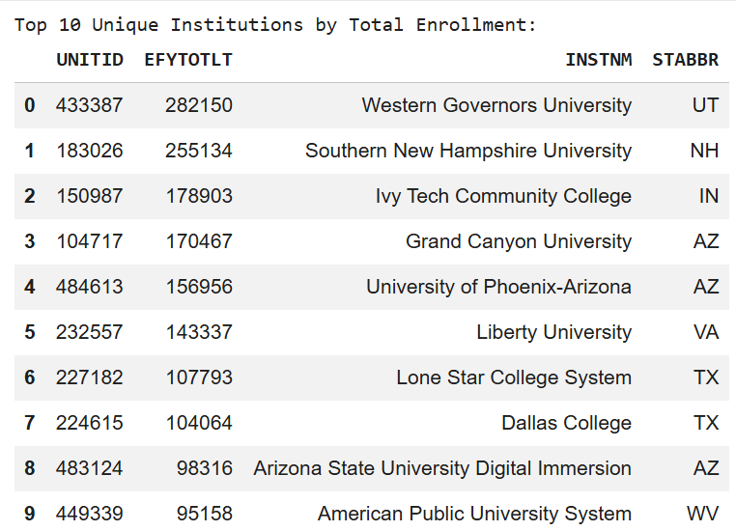
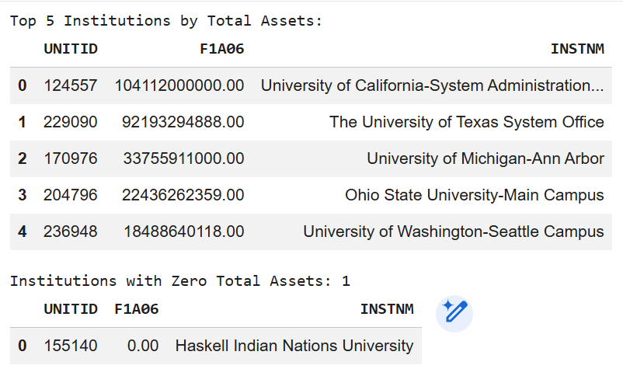
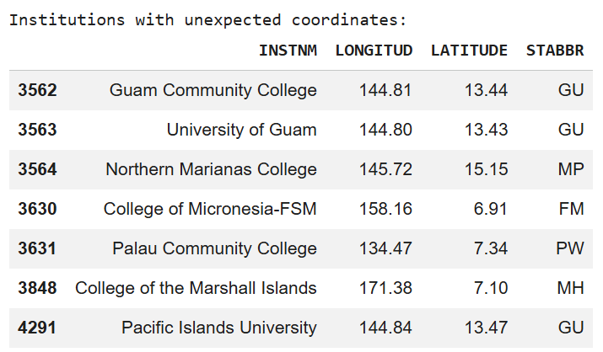
Dimension 5: Accuracy
Enrollment Outliers
Geographic Outliers
Financial Outliers
Top 10 institutions dominated by
online universities
System universities consolidate assets, Haskell reports under federal standards
7 flagged institutions are all US-affiliated Pacific Island institutions with accurate coordinates
Notes:
Financial – university systems show large combined assets, Haskell reports under federal not GASB standards

Slide 10
Dimension 6: Consistency
Key Insights
Most complex dimension
Domain knowledge required to analyze datasets
Without IPEDS data dictionary, negative values appear to be errors
Negative coding conventions are inconsistently defined in IPEDS dictionaries by dataset
Results in reduced interoperability for analysts unfamiliar with conventions
Negative Coding Conventions
-1 | Not reported
-2 | Not applicable
-3 | Not available
-9 | Not active
Dataset | # of columns affected
df1 Enrollment | 1*
df2 Finances | 41
df3 Grad Rate | 0
df4 Directory | 37
df5 Characteristics | 95
*This one enrollment column contains 88% negative values

Slide 11
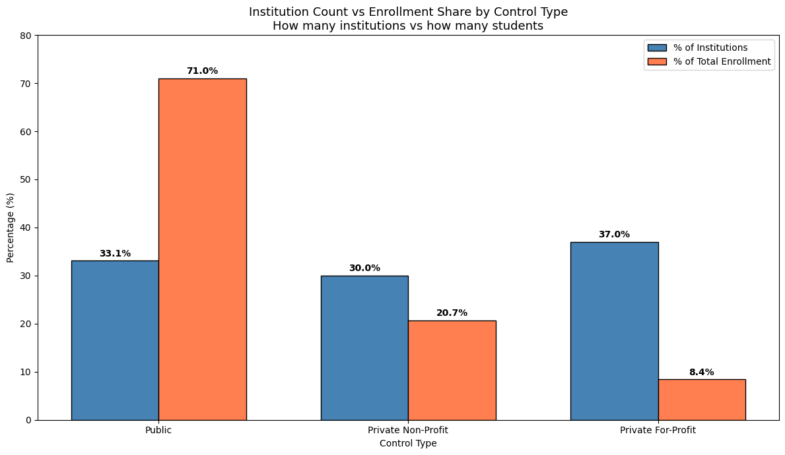
What the Data Reveals: Institutional Landscape
Key Insights
For-profit institutions are the most numerous sector, but serve only 8.4% of students
Public institutions represent one-third of institutions, but serve almost three-fourths of students
Using institution counts as a proxy for educational impact will significantly overestimate the role of for-profit institutions and underestimate the dominance of public higher education

Slide 12
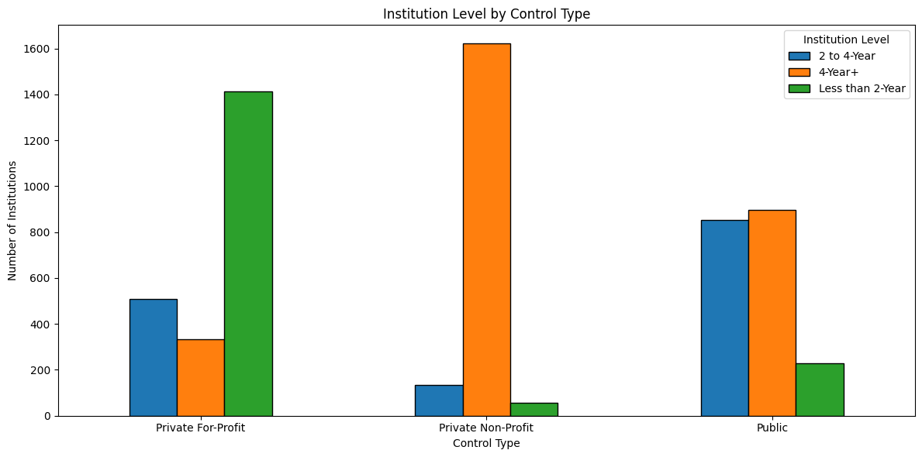
What the Data Reveals: Sector Structure
Key Insights
For-profit: Largely consists of Less than 2-Year institutions providing vocational and certificate programs
Private Non-profit: Almost entirely 4-Year+ institutions consisting of traditional degree-granting colleges and universities
Public: More balanced distribution due to 4-Year university and community college institutions
Cross-sector comparisons must account for these structural differences to arrive at meaningful results

Slide 13
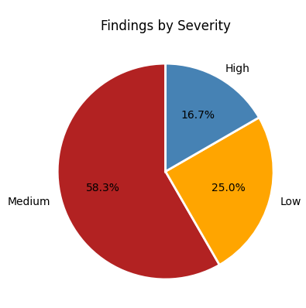
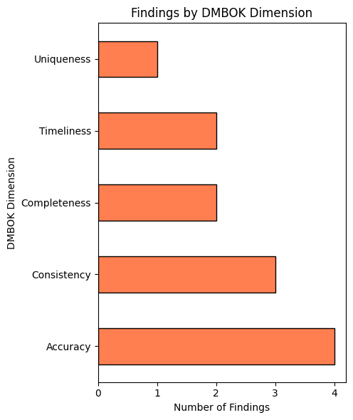
Findings Mapped to Governance Framework
12 total findings documented across 5 of the 6 DAMA DMBOK data quality dimensions
High: 2
Medium: 7
Low: 3
Relatively few data quality issues were found, with zero findings in the Validity dimension

Slide 14
Priority Recommendations
Critical
High
Only use dataset F1A alone when analyzing financial data for public universities. Combine with F2 and F3 (submitted by private institutions) for complete financial coverage
Review and correct shared OPEIDs
Add REPORT_YEAR column to all datasets for longitudinal analysis safety
Medium
Low
Create centralized sentinel value registry for all negative coding conventions
Apply DEATHYR filter before all cross-dataset analysis
Standardize all IPEDS file encoding to UTF-8-SIG
Add territory flag for Pacific Island institutions
Always pair institution counts with enrollment figures to avoid misleading conclusions

Slide 15
Key Takeaways
IPEDS data is well-structured and suitable for research, no dataset scored below Acceptable
Domain knowledge is required, most apparent anomalies are valid conventions requiring access to IPEDS data dictionary to interpret correctly
The finance file (F1A) covers 31.5% of institutions, files F2 and F3 are needed to bridge this governance gap
UNITID referential integrity is exceptional with a 100% match across all five datasets
Counting institution types and counting students tell opposite stories
Consider AI-assisted tools to overcome required human domain expertise and to rapidly surface the structural findings needed for deeper governance insights

