Slide 1
ECE 3561 Advanced Digital Design Class 27: Sequential Circuit Design 5 – State Minimization
Drew Phillips
Spring 2024

Slide 2
Sequential Circuit Design Process
State / Output Diagram / Table
Minimization of Number of States
State Variable Assignment
Transition / Output Table
Selection of Flip Flop Types
Excitation Table
Excitation Equations
Output Equations
Logic Diagram

Slide 3
Implication Chart Method Summary
Incompatible Outputs: Put X’s on squares for which the states have different outputs.
Implied Pairs: Enter the implied pairs for the remaining squares based on the next states.
Self-Redundancy: Remove implied pairs which are the same as the square they are in.
Eliminate Squares: Do multiple passes through the chart to put X’s in squares with implied pairs which have X’s in them.
Equivalent States: Identify the equivalent states as the ones with no X’s.
Reduce Table: Remove redundant states from the state table (keep 1 of each set).

Slide 4
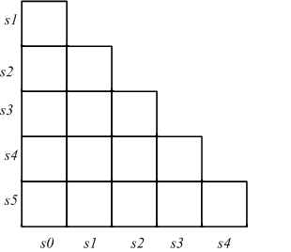
Implication Chart Ex 2
Recall this previous state machine (detects 010 or 1001)

Slide 5
Implication Chart Ex 2
Step 1) Incompatible Outputs

Slide 6
Implication Chart Ex 2
Step 2) Implied Pairs
Step 3) Self-Redundancy

Slide 7
Implication Chart Ex 2
Step 4) Eliminate Squares
First pass

Slide 8
Implication Chart Ex 2
Step 4) Eliminate Squares
Second pass

Slide 9
Implication Chart Ex 2
Step 5) Equivalent States
None: no state reduction can be done

Slide 10
Implication Chart Ex 2
Step 6) Reduce Table
The state table is already minimal

Slide 11
Equivalent Sequential Circuits
So far, we have started learning how to identify equivalent states within a single sequential circuit (state machine)
By comparing each pair of states within the machine
We can also perform a similar process for determining if two whole sequential circuits (state machines) are equivalent
By comparing each pair of states across the machines

Slide 12
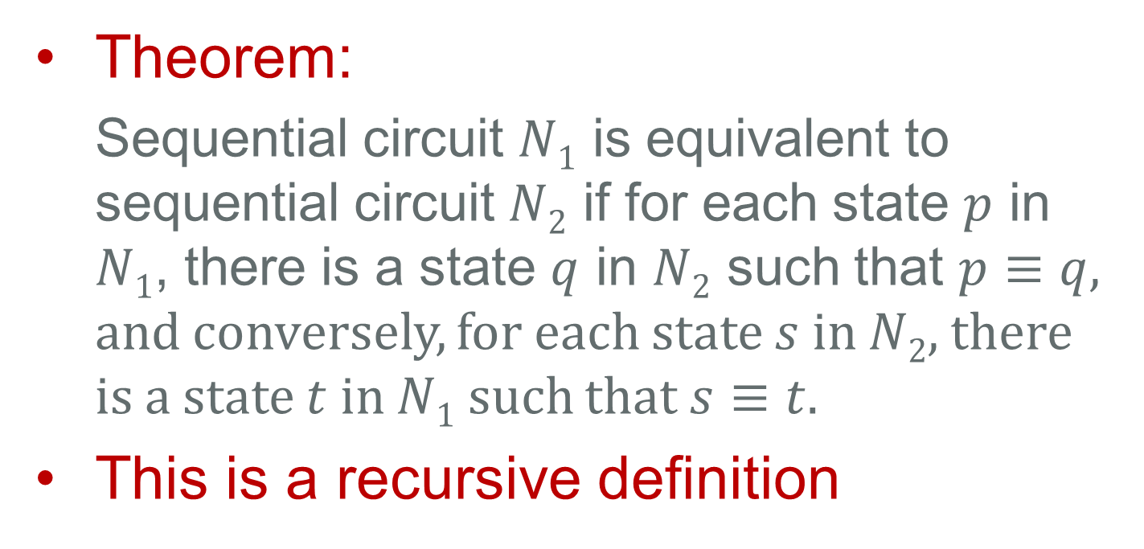
Equivalent Sequential Circuits
Theorem:
Sequential circuit $N1$ is equivalent to sequential circuit $N2$ if for each state $p$ in $N1$, there is a state $q$ in $N2$ such that $p≡q$, and conversely, for each state $s$ in $N2$, there is a state $t$ in $N1$ such that $s≡t$.
This is a recursive definition

Slide 13
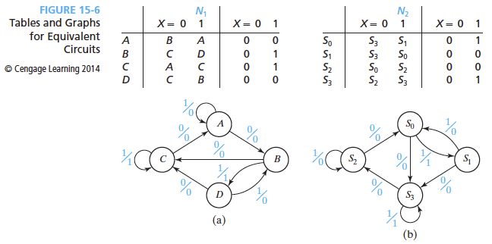
Generalization to Two Circuits
Here are two example state diagrams and state tables
Can you tell by looking at the state diagrams if these two circuits/machines are equivalent?
Which states are probably equivalent?

Slide 14
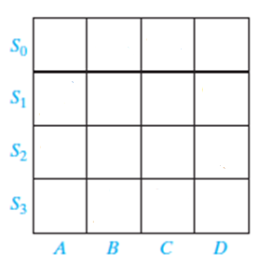
Generalization to Two Circuits
We will use a similar implication chart to compare all the state pairs across the two machines

Slide 15
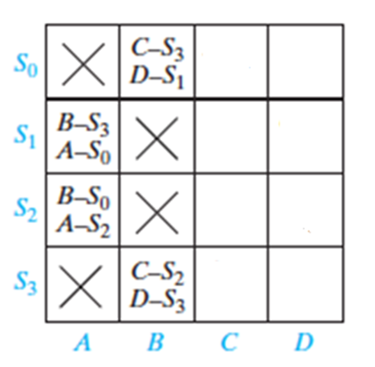
Generalization to Two Circuits
First, put X’s in all the squares for which the two states have incompatible outputs
Second, for the remaining squares, enter the implied pairs
Half of the chart is filled-in here for you as an example
You will fill-in the rest of the X’s and implied pairs in the PRE quiz
We will finish the rest of the steps after that in class

Slide 16
Equivalent Sequential Circuits Ex 1
Let’s pick up where you left off in the PRE assignment for this class with comparing two sequential circuits (state machines) to determine if the whole circuits are equivalent

Slide 17
Equivalent Sequential Circuits Ex 1
After completing Step 1) incompatible Outputs and Step 2) Implied Pairs:

Slide 18
Equivalent Sequential Circuits Ex 1
Step 3) Self-Redundancy
Step 4) Eliminate Squares

Slide 19
Equivalent Sequential Circuits Ex 1
Step 5) Equivalent States

Slide 20
Equivalent Sequential Circuits Ex 1
Step 6) Reduce Table
Because the circuits are equivalent, you could reduce/combine the state table if you want

Slide 21
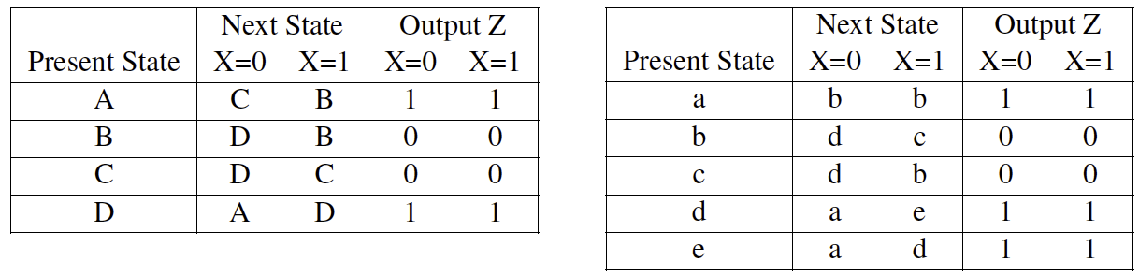
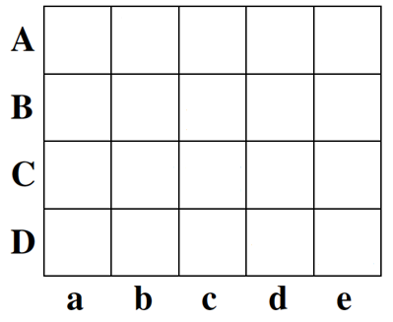
Equivalent Sequential Circuits Ex 2
Are these two state machines equivalent?
N1
N2

Slide 22
Equivalent Sequential Circuits Ex 2

