Slide 1
ECE 3561 Advanced Digital Design Class 29: Sequential Circuit Design 7 – State Assignment
Drew Phillips
Spring 2024

Slide 2
Sequential Circuit Design Process
State / Output Diagram / Table
Minimization of Number of States
State Variable Assignment
Transition / Output Table
Selection of Flip Flop Types
Excitation Table
Excitation Equations
Output Equations
Logic Diagram

Slide 3
State Assignment Procedure Summary
​Apply Guideline 1 to the state table to identify adjacency relationships for states that have the same next state for a given input.
​Apply Guideline 2 to the state table to identify adjacency relationships for the next states of the same state.
​Apply Guideline 3 to the state table to identify adjacency relationships for states that have the same output.
​Assign the initial/start state to the “all 0s” square in the assignment map.
​Place states in the assignment map to satisfy as many adjacency relationships as possible with this priority:
First: relationships from Guidelines 1 and 2 which occur multiple times
Second: remaining relationships from Guidelines 1 and 2
Third: relationships from Guideline 3
​Iterate and/or move states as needed to determine “best” mapping which best satisfies the adjacency relationships.

Slide 4
After State Assignment
After completing a state assignment (encoding), you can perform the rest of the design process steps to determine the FF excitation logic and output logic and to draw the circuit
You can use the state assignment map to populate K-maps for the excitation signals and the output

Slide 5
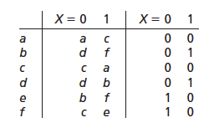
State Assignment Example 2
Here is another state table
Is this state table minimized?
b
c
d
e
f
a
b
c
d
e

Slide 6
State Assignment Example 2
b
c
d
e
f
a
b
c
d
e

Slide 7
State Assignment Example 2
1) Apply Guideline 1 to the state table to identify adjacency relationships for states that have the same next state for a given input.

Slide 8
State Assignment Example 2
2) Apply Guideline 2 to the state table to identify adjacency relationships for the next states of the same state.

Slide 9
State Assignment Example 2
3) Apply Guideline 3 to the state table to identify adjacency relationships for states that have the same output.

Slide 10
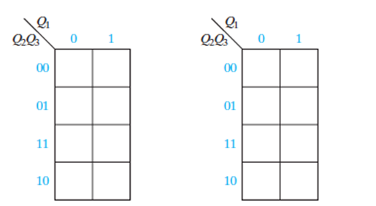
State Assignment Example 2
4) Assign the initial/start state to the “all 0s” square in the assignment map.
What is the initial state? Recall a ≡ c. Let’s do one map with a = 000 and one with c = 000.

Slide 11
State Assignment Example 2
5) Place states in the assignment map to satisfy as many adjacency relationships as possible with this priority:
First: relationships from Guidelines 1 and 2 which occur multiple times
Second: remaining relationships from Guidelines 1 and 2
Third: relationships from Guideline 3

Slide 12
State Assignment Example 2
6) Iterate and/or move states as needed to determine “best” mapping which best satisfies the adjacency relationships.

Slide 13
State Assignment Example 2
You can derive the excitation and output equations for both options and compare to determine which is cheaper
But it is actually option 2 (c = 000) which is cheaper

Slide 14
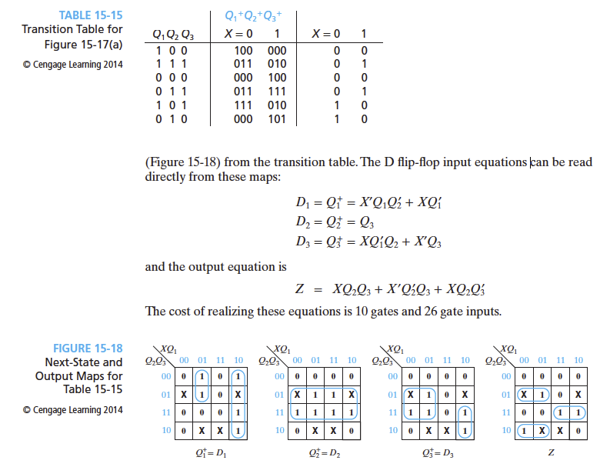
State Assignment Example 2
After we complete the state assignment for option 2, we can update the state table with the state assignments

Slide 15
State Assignment Example 2
Now we can construct the K-maps and derive the excitation equations and output equation

Slide 16
State Assignment Example 2
Finally, we can draw the circuit/logic diagram
And the design is complete!

