Slide 1
ECE 3567 Lab 5 Serial Communications
Dr. Gregg J Chapman
Autumn 2020

Slide 2
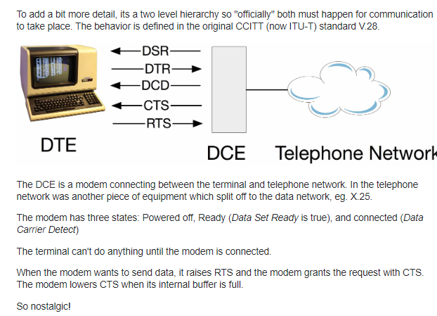
A Brief History of Serial Communications
“MODEM”

Slide 3
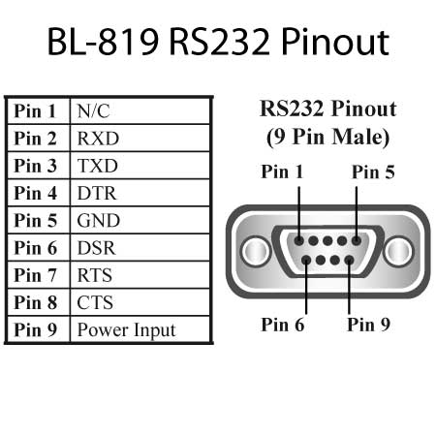
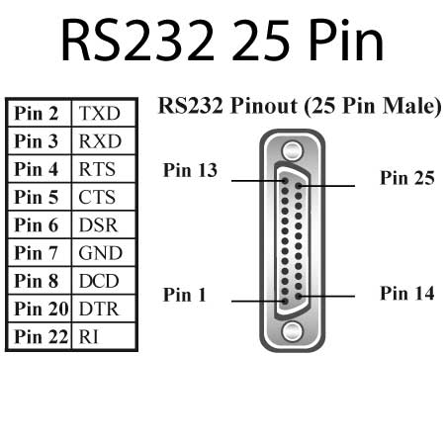
RS-232 STANDARD

Slide 4
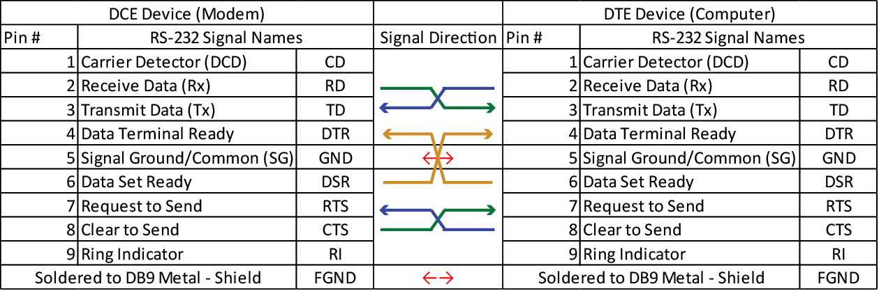
FULL MODEM Cable

Slide 5
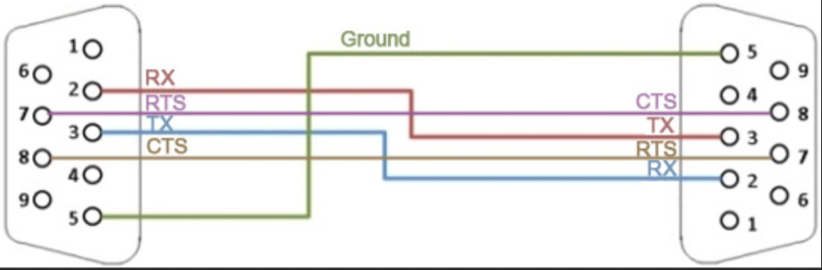
Serial Communications Interface (RS-232)
SCI MODEM CABLE

Slide 6
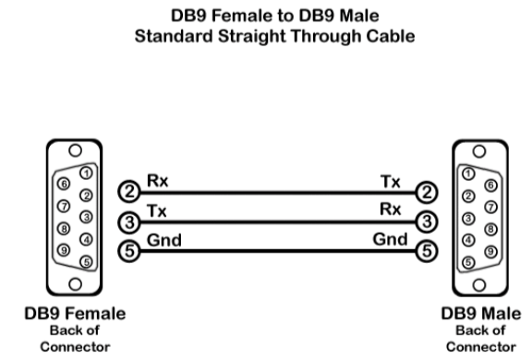
NULL MODEM CABLE

Slide 7
UART - Universal Asynchronous Receiver Transmitter
That's what describes UART. No voltage level, so you can have it at 3.3 V or 5 V, whichever your microcontroller uses. Note that the microcontrollers which want to communicate via UART have to agree on the transmission speed, the bit-rate, as they only have the start bits falling edge to synchronize. That's called asynchronous communication.
For long distance communication (That doesn't have to be hundreds of meters) the 5 V UART is not very reliable, that's why it's converted to a higher voltage, typically +12 V for a "0" and -12 V for a "1". The data format remains the same. Then you have RS-232 (which you actually should call EIA-232, but nobody does.)
The timing dependency is one of the big drawbacks of UART

Slide 8
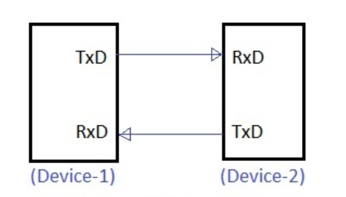
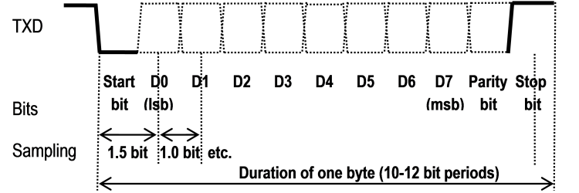
UART - Universal Asynchronous Receiver Transmitter
one of the most used serial protocols. Most controllers have a hardware UART on board.
It uses a single data line for transmitting and one for receiving data.
Most often 8-bit data is transferred, as follows: 1 start bit (low level), 8 data bits and 1 stop bit (high level).
The low level start bit and high level stop bit mean that there's always a high to low transition to start the communication.

Slide 9
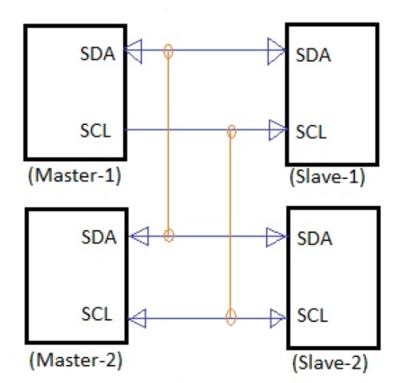
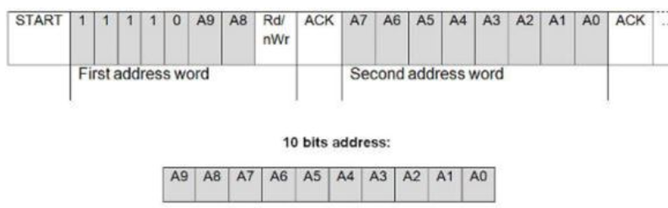
I²C - Inter-Integrated Circuit ( pronounced "I squared C")
I²C uses only 2 wires, one for the clock (SCL) and one for the data (SDA).
That means that master and slave send data over the same wire, again controlled by the master who creates the clock signal.
I²C doesn't use separate Slave Selects to select a particular device, but has addressing.
The first byte sent by the master holds a 7 bit address and a read/write bit, indicating whether the next byte(s) will also come from the master or should come from the slave.
After each byte, the receiver must send a "0" to acknowledge the reception of the byte
If the master wants to write a byte, the same process repeats
If the master wants to receive data it only generates the clock pulses.
The slave has to take care that the next bit is ready when the clock pulse is given.
ACK

Slide 10
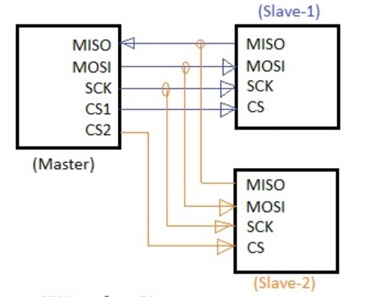
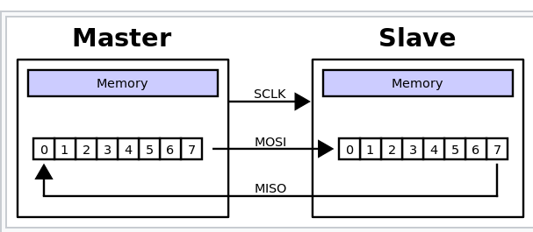
Serial Peripheral Interface

Slide 11
Which Serial Protocol is Best?
 | UART | I²C | SPI
Complexity | Simple | Easy to chain many devices. | Complex as device increases
Speed | Slowest | Faster than UART | Fastest
1.5 Mbps
3.4 Mbit/s
48-100 Mbps

Slide 12
Create a new project for Lab 5, download all files from the website and copy them into the project.
Project Set-up

Slide 13
What’s New?
3567.h
myGpio.c
myClocks.c
myUart.c
Command.c
With additions to Display.c

Slide 14
Where are all the variables?

Slide 15
Adding UART Communications

Slide 16
Checkpoint #1 – Compile the program and demonstrate that it cycles through the LED colors.

Slide 17
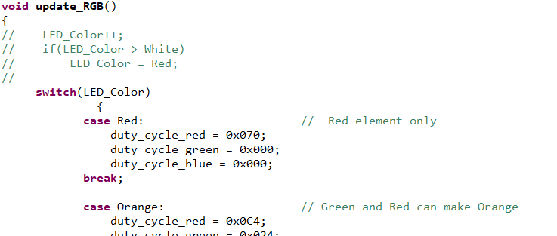
1. Delete update_RGB() from main(). copy them into the project. 2. Comment out the following code at the beginning of update_RGB()
Project Set-up

Slide 18
Connecting the Serial Communications

Slide 19
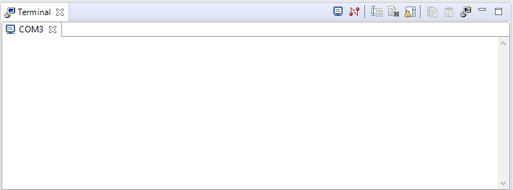
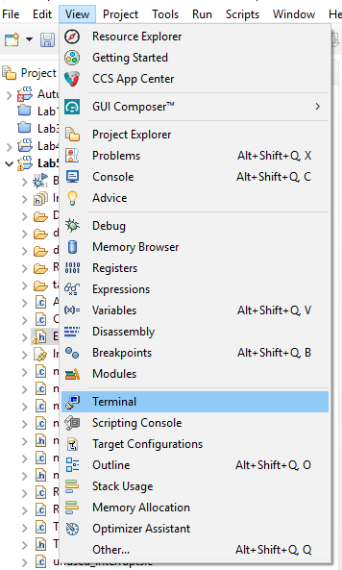
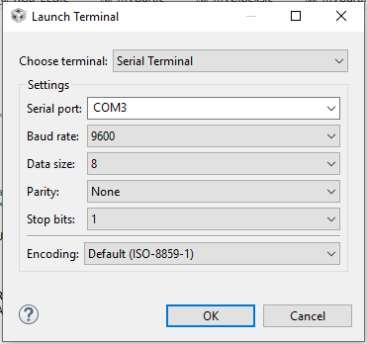
You can also use the Terminal inside CCS:
click
choose one

Slide 20
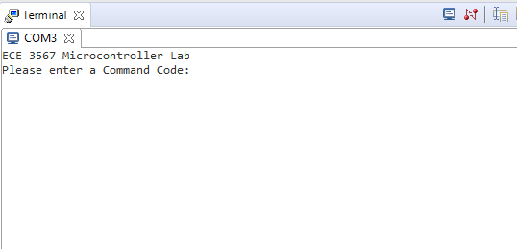
When you run the project, the following messages will appear in the Terminal window:

Slide 21
Checkpoint #2 – Demonstrate the ECE 3567 Start-up Message on the Terminal

Slide 22
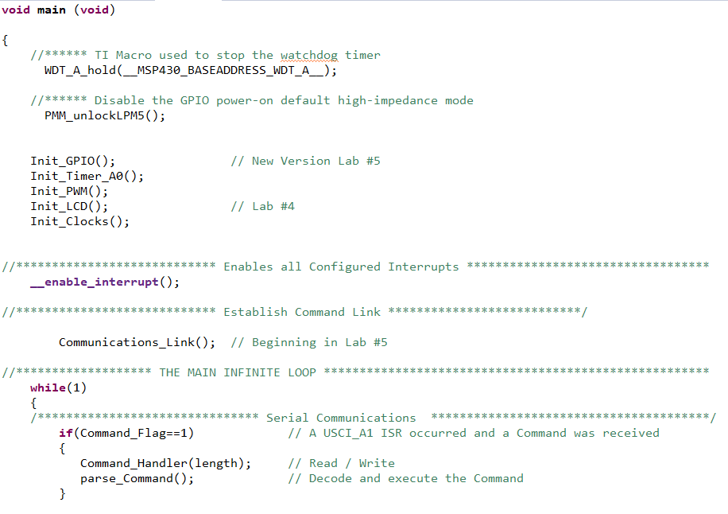
The main() function

Slide 23
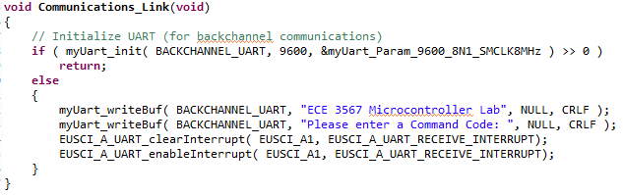
Initializes UART Communications on the MCU

Slide 24
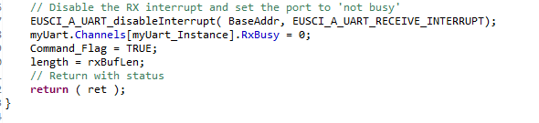
myUart.c

Slide 25
Command.c
Command_Handler (Already written)
parse_Command (You will write this)

Slide 26
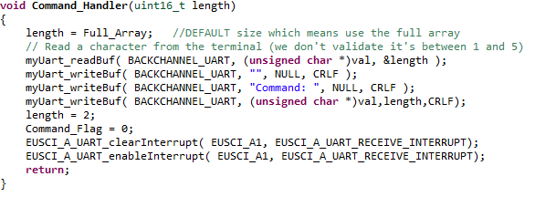
The Command Handler
Data is in an array called val
Most commands are 2 characters
Setpoint commands for feedback are up to 6 characters
Communications are interrupt driven
Gets set in
myUart_readBuf

Slide 27
Display.c
displayTemp() – Turn on degree symbol and F in pos6 for Fahrenheit
displayVolts() – Turn on the decimal point and V in pos6 for Volts

Slide 28
The Three Modes
LED Test Mode
Temperature Mode
RC Voltage Mode

Slide 29
Lab 5
Write parse_Command() to:
Read the first two characters from the val[ ] array and convert to a 2-character command.
If length is >2, convert val[2], val[3], and val[4] to a single 3-difit number. val[5] is currently not used.
Reset length to 2, and clear val[ ];
Create a SWITCH statement for Command and place actions for the command under each case: Implement the following Commands:
LE – Places the software in LED Test Mode. LED off.
RE – Places the software in RC Voltage Mode. Writes 2.50V to the LCD
TE – Places the software in Temperature Mode. Writes 75.0°F to the LCD
LH – Makes the LED FLASH RED if you are in LED Test Mode
LR – Makes the LED RED if you are in LED Test Mode
LO – Makes the LED ORANGE if you are in LED Test Mode
LY – Makes the LED Yellow if you are in LED Test Mode
LG – Makes the LED Green if you are in LED Test Mode
LB – Makes the LED Blue if you are in LED Test Mode
LV – Makes the LED Violet if you are in LED Test Mode
LC – Makes the LED FLASH Violet if you are in LED Test Mode

Slide 30
Flashing
Easiest way to do this is alternate the P2DIR and P3DIR bits for each of the RGB elements in the 1 Second delay section of the main loop
NOTE: If you exit the FLASH mode when the LED is OFF, it won’t ever turn on again. To solve the problem use:
if(Flash == TRUE) { //Alternate the DIRs }
else {
//Set the DIRs back to outputs
}

Slide 31
Building a Command

Slide 32
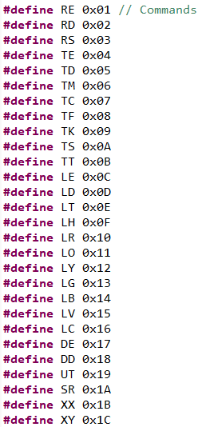
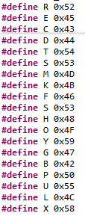
The Commands
Consist of 2 alphabetical characters
Letters used must be #defined in 3567.h
Two character commands must be #defined as a unique number in 3567.h

Slide 33
The Commands
The Command_Handler loads ASCII characters into an array called val[ ]
val[0] and val[1] contain the command characters
For two commands, TS and RS, val[2], val[3], val[4], and val[5] contain numerical characters
For TS the number is a temperature setpoint for regulation. The 2 most significant digits are displayed before the decimal, the last two digits are not displayed on the LCD in this lab.
For RS the number is a setpoint for voltage regulation in millivolts. Only the 3 most

Slide 34
parse_Command
void parse_Command()
{
if(val[0] == A)
{
if(val[1] == B )
Command = AB;
else if(val[1] == D)
Command = AD;
}
else if(val[0] == B)
{
if(val[1] == E )
Command = BE;
else if(val[1] == D)
Command = BD;
}
else
{
Command = NULL;
myUart_writeBuf( BACKCHANNEL_UART, "UNKNOWN COMMAND ", NULL, CRLF );
New_Data=0;
myUart_writeBuf( BACKCHANNEL_UART, "", NULL, CRLF );
// Ask for the next Command
}
if(length >=5) // Included for SetPoint Command data
{
New_Data = 0;
New_Data = (val[2]-48)*100 + (val[3]-48)*10 + (val[4]-48);
length = 2;
val[2]=0;
val[3]=0;
val[4]=0;
}
first character
second character
Command
Unpack the data and convert to decimal numbers

Slide 35
Still in parse_Command
/************************************************** Act on the Command *************************************************/
switch(Command)
{
case AB: // Act on Command AB
break;
case BD: // Act on Command BD
break;
case XX: // etc.
break;
default:
break;
}
Command = NULL;
myUart_writeBuf( BACKCHANNEL_UART, "Please enter the next Command Code: ", NULL, CRLF );
return;
}
All actions for the Command go here

Slide 36
LE Command
Enable LED_Test_Mode
Disable Temp_Mode and RC_Voltage_Mode
Clear the LCD
Turn off the LED
Set Flash to FALSE
Set LED_Color to No_Color

Slide 37
Lx Commands
Only perform if LED_Test_Mode is TRUE
Set LED_Color to the appropriate label
Flash is FALSE for everything except LH an LC

Slide 38
Checkpoint #3 – Demonstrate the LED Test Mode (LE, LH, LR, LO, LY, LG, LB, LV, LC)

Slide 39
TE Command
Enable Temp_Mode
Disable RC_Voltage_Mode and LED_Test_Mode
Clear the LCD
Turn off the LED
Set Flash to FALSE
Set LED_Color to No_Color
Set deg = 750
Call displayTemp() (NOTE: You must write this)
There will be additions to this in a latter lab

Slide 40
Checkpoint #4 – Demonstrate the Temperature Mode Command

Slide 41
RE Command
Enable RC_Voltage_Mode
Disable Temp_Mode and LED_Test_Mode
Clear the LCD
Turn off the LED
Set Flash to FALSE
Set LED_Color to No_Color
Set volts = 2500
Call displayVolts() (NOTE: You must write this)
There will be additions to this in a latter lab

Slide 42
Checkpoint #5 – Demonstrate the RC Voltage Mode Command

