Slide 1
ECE 3567 Microcontrollers Lab
Laboratory #1 – Blinking LEDs (A Simple Practicum in Code Composer Studio v 9.1.0)
Spring 2021 Dr. Gregg Chapman

Slide 2
Laboratory 1 – Blinking LEDs
Goals:
1) Learn to set-up a new Project in Code Composer Studio
2) Learn to code, compile and run a project in Code Composer Studio
3) Gain experience with the Bitwise C operators to control external hardware.
4) Learn how to re-configure your project when the code is moved to a different path.

Slide 3
Laboratory 1 – Blinking LEDs, Overview
Write a program that will illuminate the red and green LEDs on the MSP430FR6989 Launchpad board.
Which LED is illuminated should alternate at approximately one second intervals.
For this lab, we will not use timers or interrupts. Write a delay function and call it in the main loop for the 1 second delay.
Configure the proper output pins using a function called Init_GPIO(), located in a separate file called myGpio.c the proper output pins to the LEDs using generalized I/O ports 1 and 9 (see schematic).
Once your project is working. You will be asked to change the location of your code and make the necessary changes to get the code running again.

Slide 4
Lab #1 Project Set-up
Create a workspace folder on you U: drive in the path called ECE3567

Slide 5

Lab #1 Project Set-up
2. Open Code Composer Studio v 9.1.0 by double clicking the ICON located on your lab computer desktop:

Slide 6
Lab #1 Project Set-up
3. Select the ECE3567 folder on your U: drive as your workspace.
File → Switch Workspace, and navigate to ECE3567

Slide 7
Lab #1 Project Set-up
4. Follow the steps outlined in Lecture #3 to create the Lab1 project:

Slide 8
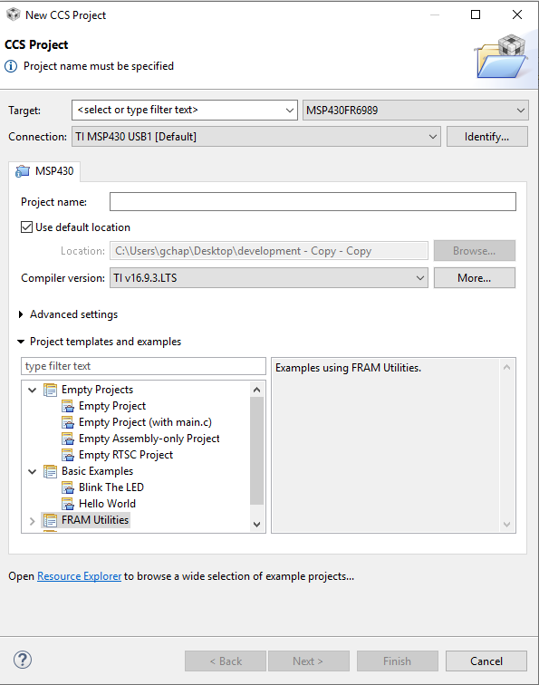
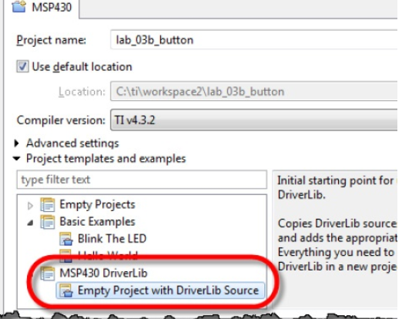
Project Set-up
Don’t forget to select the Empty Project with DriverLib Source
Don’t Forget to select this template.

Slide 9
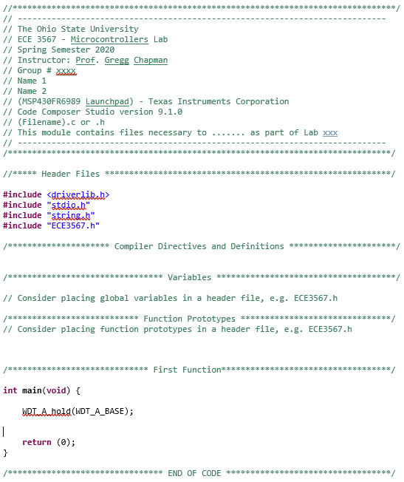
Lab #1 Project Set-up
Select File → New → Source File
Download the ECE 3567 file header from the course website (under Useful Info), copy it to the source file, and save the source file as main.c

Slide 10
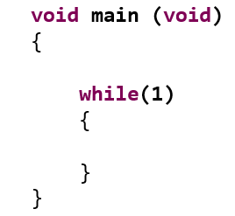
main.c
ALWAYS use this model for main.c.
Compiler Directives
Variable Declarations
& Function Prototypes
Function Calls to Initialization Routines
Infinite Process Loop

Slide 11
ECE 3567 – Lab #1
6. Create the main function as shown
void main (void)
{
while(1)
{
}
}

Slide 12
ECE 3567 – Lab #1
7. Before the main loop, but inside main(), you will need to call two TI macros with the following lines of code:
WDT_A_hold(__MSP430_BASEADDRESS_WDT_A__); // Disable watchdog timer
PMM_unlockLPM5(); // Release all pins on MCU

Slide 13
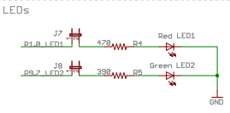
ECE 3567 – Lab #1
8. Based on the following schematic, configure the two GPIO pins as outputs using the register and bitwise operators discussed in Lecture #2 and 3.
9. Before the loop in main(), turn ON the GREEN LED and turn OFF the RED LED.
P1.0
P9.7
Jumpers are installed

Slide 14
ECE 3567 – Lab #1
Checkpoint #1: Demonstrate that the Lab that the GREEN LED is on and the RED LED is off before adding code to alternate the LEDs every 1 second.

Slide 15
ECE 3567 – Lab #1
11. Write a delay function capable of delaying up to 1 (or more) seconds. Call the function:
delay(unsigned int x). The argument passed into the function will need to be an (unsigned long). Declare the argument variable delay_count as a local variable in main(); Don’t forget to prototype the function.

Slide 16
ECE 3567 – Lab #1
12. Inside the infinite loop of main(), call the delay function with the appropriate value of delay_count for a 1 second delay.
13. After the one second delay, alternate which of the 2 LEDs is illuminated using the ^= operator recommended in Lecture #2.

Slide 17
ECE 3567 – Lab #1
14. Compile, Program and Run your Lab #1 project.

Slide 18
ECE 3567 – Lab #1
Checkpoint #2: Demonstrate that the Lab #1 project is operating correctly.
One LED should flash at a time.
The GREEN LED should be the default after initialization.
The LEDs should alternate, RED .. GREEN .. RED at 1 Hz.

Slide 19
ECE 3567 – Lab #1
Once your program is working correctly, create a second workspace folder on the U: drive, and copy the entire Lab 1 project folder into the new workspace.
Change the Workspace in Code Composer Studio to the new location for your project.
Recompile your project in the new workspace and run the code. NOTE: If this doesn’t work, investigate why not from the Lecture #3 notes.

Slide 20
ECE 3567 – Lab #1
Checkpoint #3: Demonstrate that the Lab #1 project operates correctly in the new workspace.
One LED should flash at a time.
The GREEN LED should be the default after initialization.
The LEDs should alternate, RED .. GREEN .. RED at 1 Hz.

Slide 21
REMEMBER
If finished, initial your Checkpoints on the Checkpoint Sheet.
Remember to COMMENT and submit your CODE in the Assignment section of the Carmen Website.
DON’T FORGET TO TAKE THE LAB #1 QUIZ before MIDNIGHT.

Slide 22
ECE 3567 – Lab #1
This is the end of Laboratory #1

