Slide 1
ECE 3561
Advanced Digital Design
Class 12: Counters 3 – MSI Chip Counter Design
Drew Phillips
Spring 2024

Slide 2
Counter Design Procedure Summary
Determine counting sequence.
Determine number (and type) of FFs or MSI chips.
Construct truth table with state and next state combinations.
Determine FF/MSI chip input excitations for each state to next state transition and add to truth table.
Determine FF/MSI chip input excitation equations using K-map.
Draw the counter circuit logic diagram using the FFs/MSI chips and the combinational logic from the excitation equations.

Slide 3
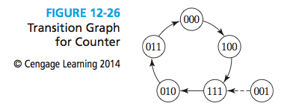
Self-Starting Counters
When the counter is powered on, the initial states of the FFs are not determined
When designing, need to make sure there is exactly one ring in the state space
All other unused states should transition to a state in the ring eventually

Slide 4

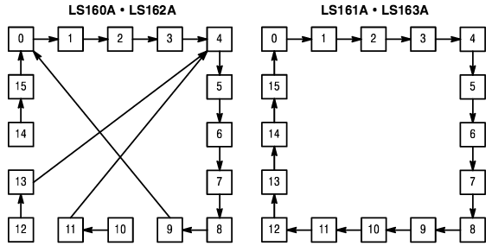
MSI Counters
4-bit binary counters: MOTOROLA 74LS160/2, 74LS161/3
State diagram:
Self-starting
(http://pdf.datasheetcatalog.com/datasheet/motorola/SN54LS162J.pdf)

Slide 5
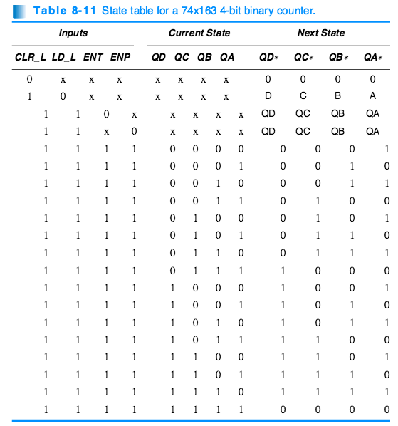
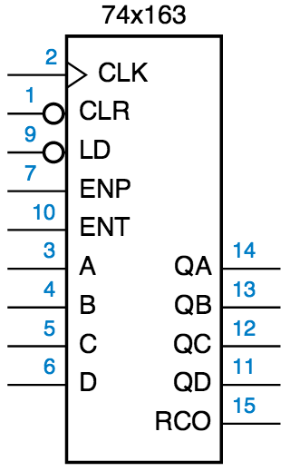
MSI Synchronous Counter 74x163

Slide 6
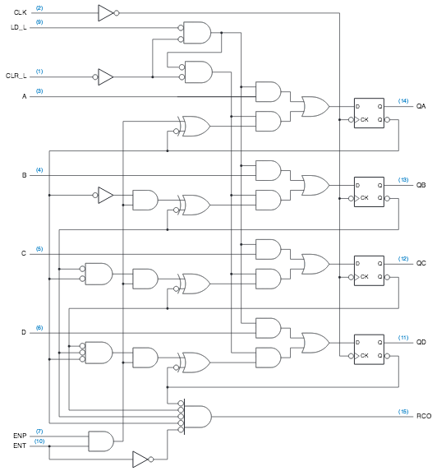
MSI Synchronous Counter 74x163
RCO (ripple carry out)
When is RCO=1?

Slide 7
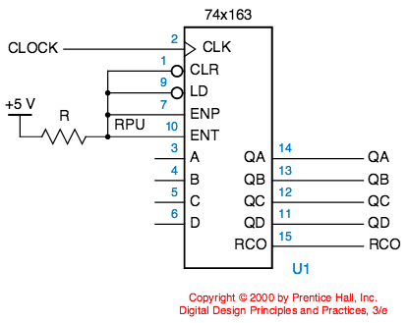
Connections for 74x163 Free Running Mode
Recall up counter
RCO (ripple carry out) signal is 1 when QA = QB = QC = QD = 1 and ENT = 1.

Slide 8
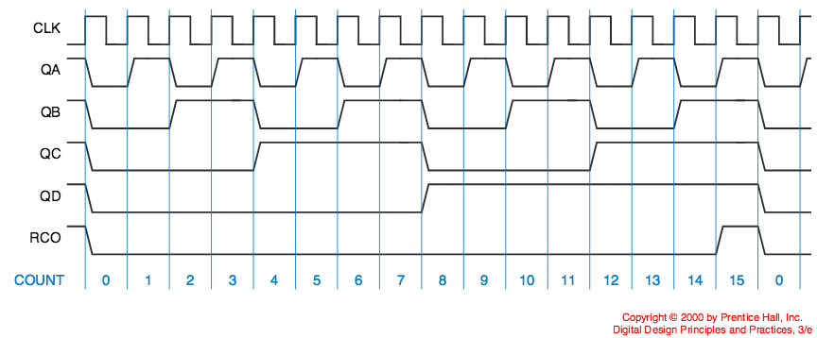
Output Waveform for 74x163 Free Running Mode
When does each signal change?
QA changes every cycle → mod-2 counter (1 bit)
QB changes when QA=1 → mod-4 counter (2 bits)
QC changes when QB=QA=1 → mod-8 counter (3 bits)
QD changes when QC=QB=QA=1 → mod-16 counter (4 bits)
How can we make a mod-32 counter (8 bits) using two 74x163?

Slide 9
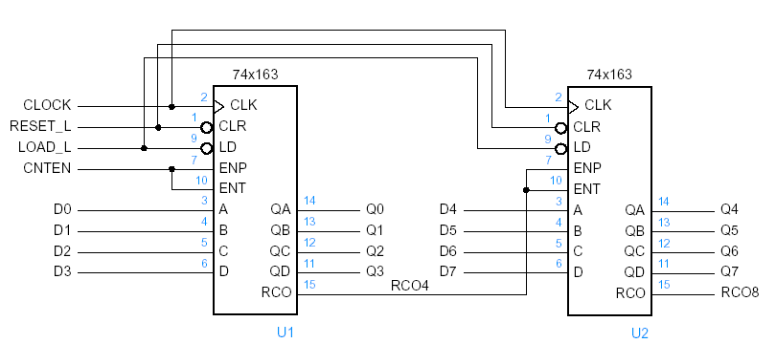
8-Bit Counter Design Using 74x163
Cascade using RCO → when first four bits are all 1, the next four bits will count up once

Slide 10
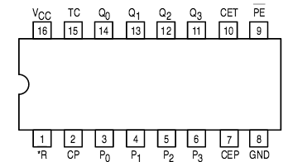
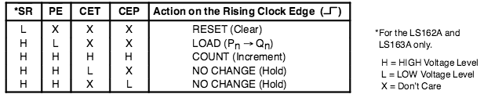
How Could We Convert 74x163 Mod-16 Counter into Mod-13 Counter?
Two options:
Use synchronous reset/clear after count to 12
Load in 0000 after count to 12

Slide 11
Ex 7: Design Counter with 74x163
Wrapper Approach
Design a circuit using a 74x163 and at most 3 NAND gates to count the following sequence in binary:
  0 → 1 → 2 → 3 → 4 → 9 → 10 → 11 → 12 → 0 → …
Use wrapper approach by adding combinational circuitry to the chip inputs
Combinational circuit
Control=F(.)

Slide 12
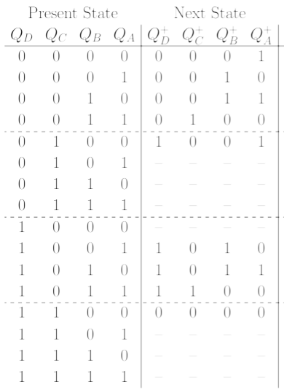
Ex 7: Design Counter with 74x163
CLR LD D C B A
0 0 X X X X
0 0 X X X X
0 0 X X X X
0 0 X X X X
0 1 1 0 0 1
X X X X X X
X X X X X X
X X X X X X
X X X X X X
0 0 X X X X
0 0 X X X X
0 0 X X X X
1 X X X X X
X X X X X X
X X X X X X
X X X X X X
0 → 1 → 2 → 3 → 4 → 9 → 10 → 11 → 12 → 0 → …
1) Truth Table

Slide 13
Ex 7: Design Counter with 74x163
2) K-Maps

Slide 14
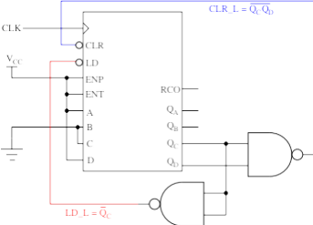
Ex 7: Design Counter with 74x163
3) Circuit

Slide 15
Counter Design Procedure Summary
Determine counting sequence.
Determine number (and type) of FFs or MSI chips.
Construct truth table with state and next state combinations.
Determine FF/MSI chip input excitations for each state to next state transition and add to truth table.
Determine FF/MSI chip input excitation equations using K-map.
Draw the counter circuit logic diagram using the FFs/MSI chips and the combinational logic from the excitation equations.

