Slide 1
ECE 3567 Lab 6 Analog-to-Digital Converters
Dr. Gregg J Chapman
Autumn 2020

Slide 2
The Users Manual
Chapter 33 REF_A………………………………….pp 858-864
Chapter 34 ADC12_B……………………………..pp 865-911

Slide 3
Laboratory #6 Goals
Implement a TWO channel conversion sequence, one channel for the RC_Voltage (A5), and a second channel for the internal Temperature Sensor (A30).
Display the temperature in Fahrenheit on the Liquid Crystal Display.
Use the new PWM channel and ramp the RC Voltage by incrementing the duty cycle from 0-100%. The RC Voltage is connected to ADC channel A5.
Display the RC Voltage on the Liquid Crystal Display
Configure main() to switch between the Temperature Sensor, RC_Voltage, and LED Test Mode using TE, RE, and LE commands.

Slide 4
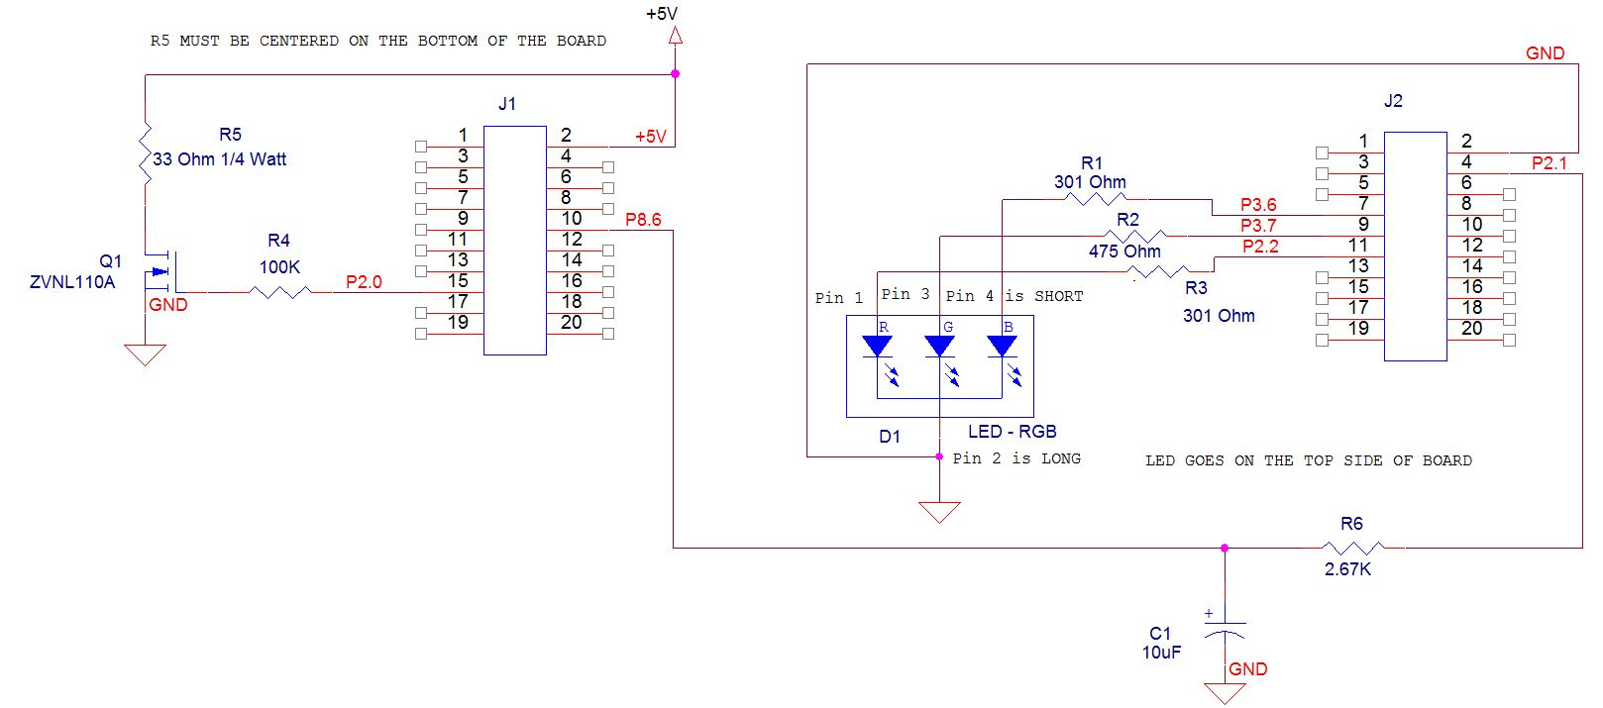
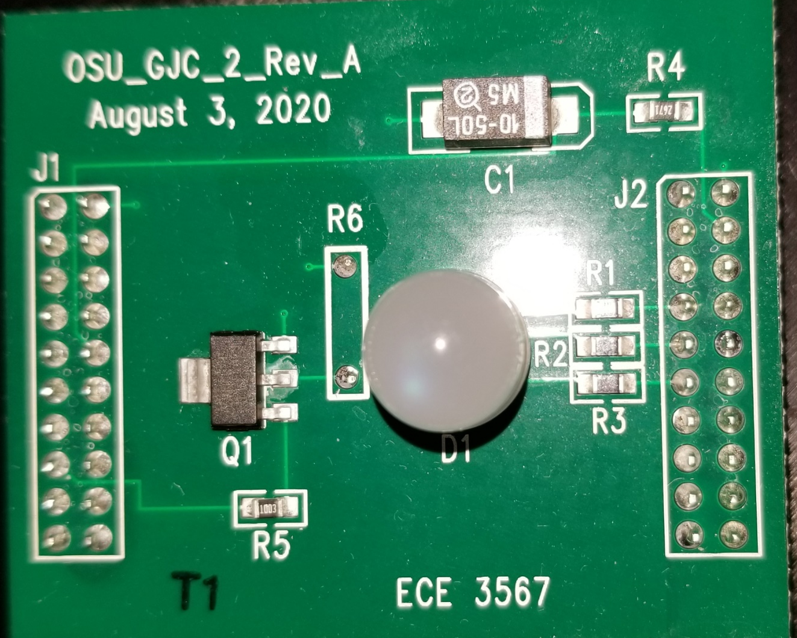
The RC Circuit
RC charging circuit
A5 input on ADC12
P2.1 PWM output
ADC A5
f_{cutoff} = 6 Hz

Slide 5
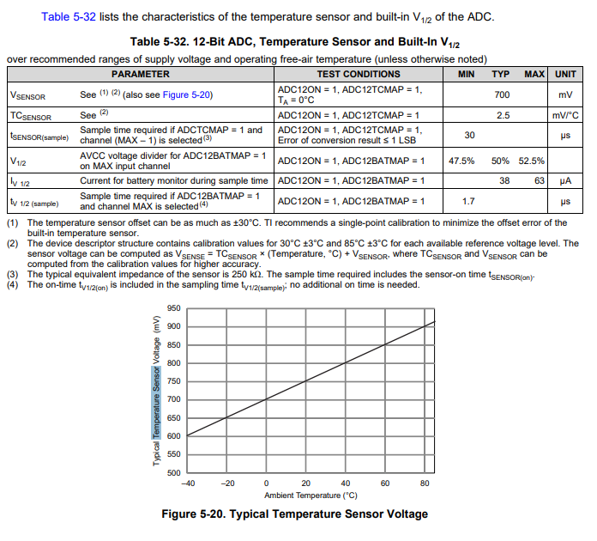
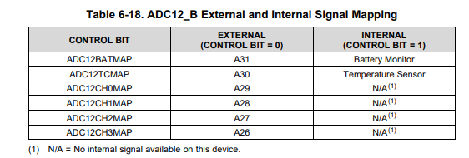
The Temperature Sensor

Slide 6
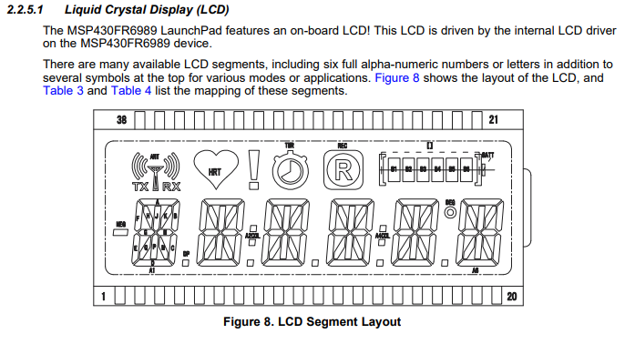
LaunchPad LCD Display

Slide 7
Lab #6 Downloaded Project Files
New files: ADC12.c
TempSenseMode.c
TempSenseMode.h
RCMode.c
main() has been modified
Display.c has been replaced with display routines defined in TempSenseMode.c and RCMode.c
Init PWM is set up for a white LED when the code first runs
Some additions to TE and RE in Command.c have been made for you.

Slide 8
ADC12.c
void Init_ADC12(void)
__interrupt void ADC12_ISR(void)
Template with declarations and headers is included in the Lab 6 Code Additions download.

Slide 9
ADC12 Initialization Init_ADC12()
Set up Timer A1 as the ADC SAMPLE CLOCK
Configure the Internal Voltage Reference.
Set pin 8.6 as the ANALOG INPUT for A-to-D channel A5
Configure the ADC12 for a 2-channel repeated sequence, beginning with A30 and ending with A5 and Activate the Internal Temperature Sensor (must be on ADC12 channel A30)
Set up MEM0 buffer to receive channel A30 data values.
Set up MEM1 buffer to receive channel A5 data values.
Clear MEM1 interrupts.
Enable interrupts and start the repeated conversion sequence. NOTE: Don’t forget to call Init_ADC12() at the beginning of main().

Slide 10
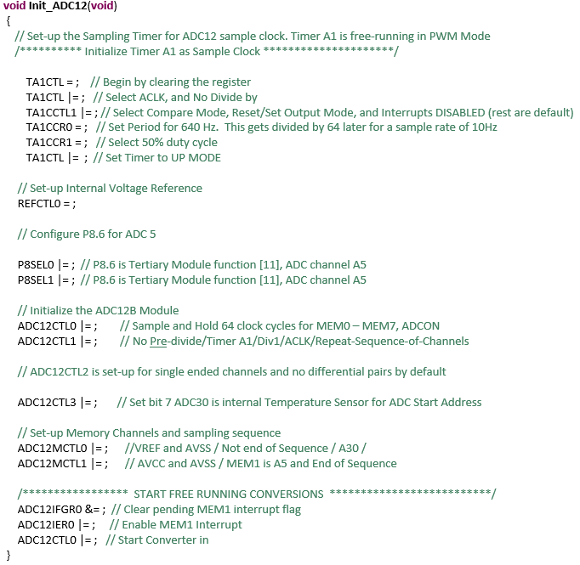
ADC12.c
void Init_ADC12(void)

Slide 11
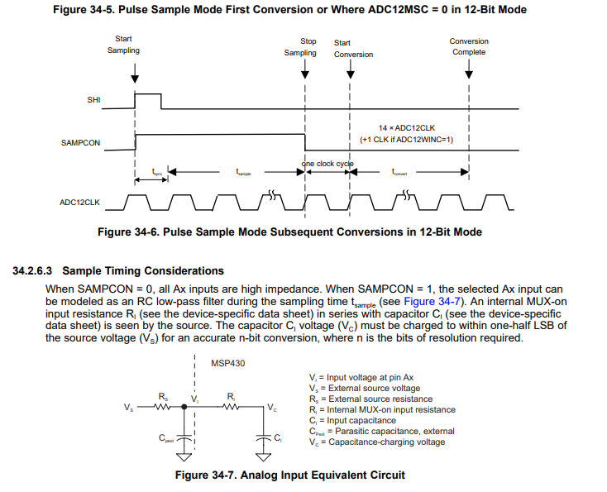
ADC12.c
Background

Slide 12
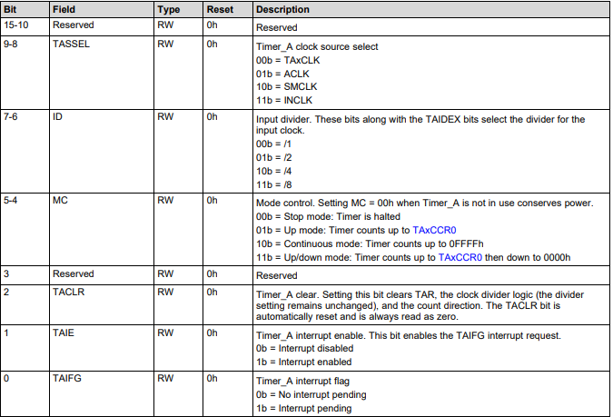
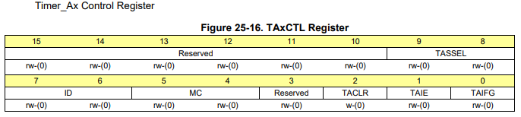
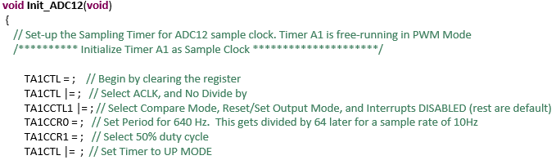
1. Set-up Timer A1 as Sample Clock
Clear TA1CTL
Select ACLK and No Pre-Divide in TA1CTL

Slide 13
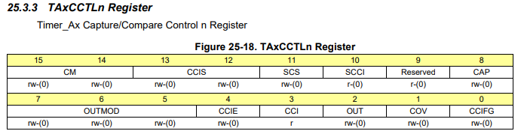
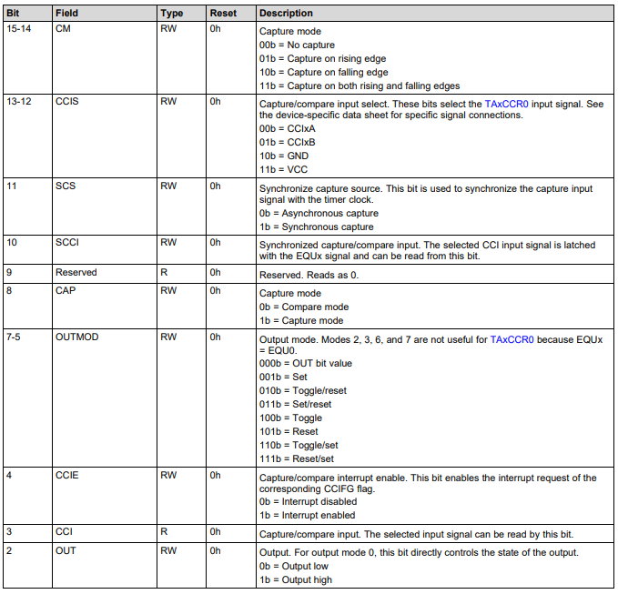
1. Set-up Timer A1 as Sample Clock
In TA1CCTL1, Select Compare Mode, Reset/Set Output Mode, Interrupts Disabled

Slide 14
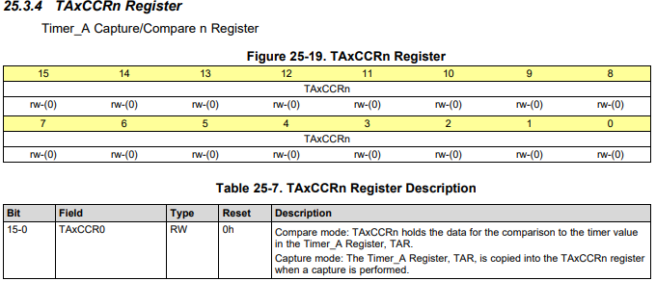
1. Set-up Timer A1 as Sample Clock
In TA1CCR0, Set Period for a Frequency of 640 Hz. This gets /64 later for a 10Hz sample rate
In TA1CCR1, Set Duty Cycle to 50%

Slide 15
1. Set-up Timer A1 as Sample Clock
Start Timer in UP Mode by writing Bits 5-4 to [01]

Slide 16
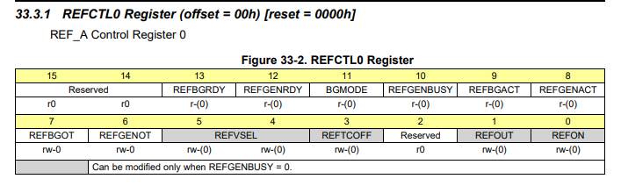
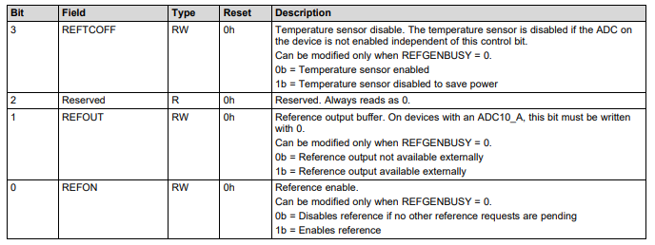
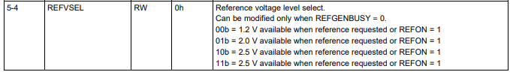
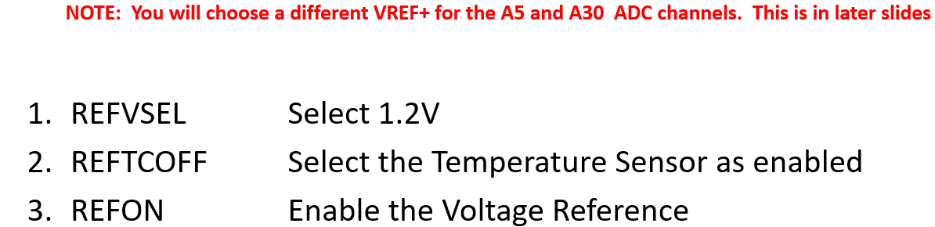
2. Configure Internal Voltage Reference

Slide 17
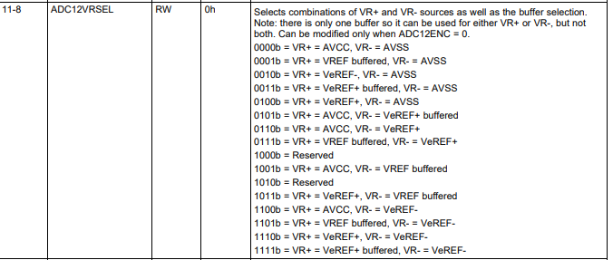
2. Configure Internal Voltage Reference
Register – ADC12MCTLx

Slide 18

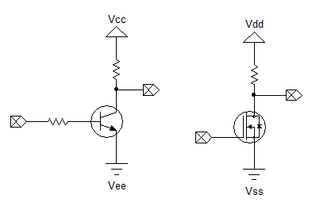
De-Mystifying Voltage Labels
VCC - Positive Voltage, Analog
VEE - Negative Voltage (or GND), Analog VDD - Positive Voltage, Digital
VSS - Negative Voltage (or GND), Digital

Slide 19
2. Configure Internal Voltage Reference
Register – ADC12MCTLx

Slide 20
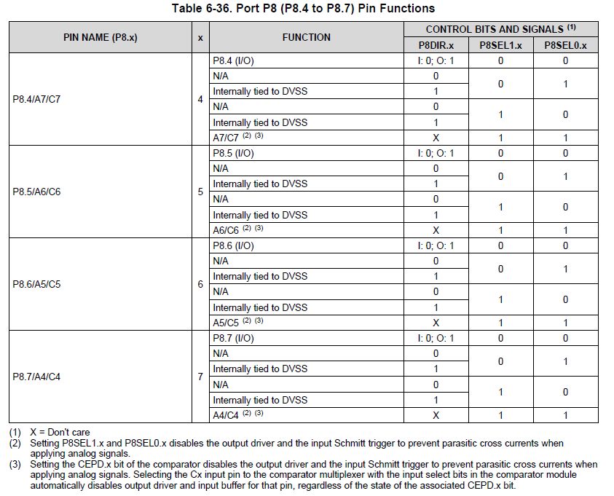
3. Set-up P8.6 as Channel A5
1 1
Tertiary
Note: It is not necessary to set the P8DIR register, bit 6, as an input when you select the A5 (Tertiary) function.

Slide 21
4.Configure ADC12 for 2-Channel Repeated Sequence and Activate the Internal Temperature Sensor
There are FOUR Configuration Registers for the ADC12_B:
ADC12CTL0 – ADC12CTL3.

Slide 22
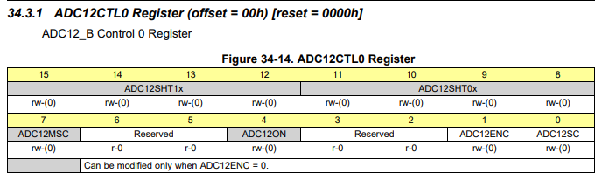
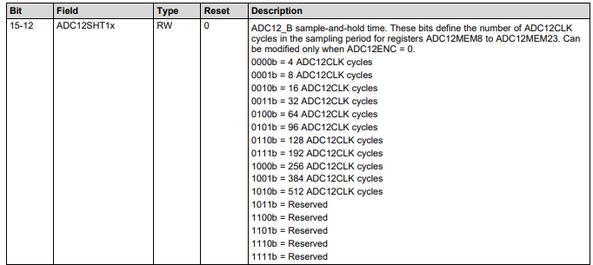
4. ADC12 Configuration
Register – ADC12CTL0
Leave the clock cycles for sample-and-hold for MEM8-MEM23 to4 (Bits 15-12) 0000 since we are not using these memory buffers.

Slide 23
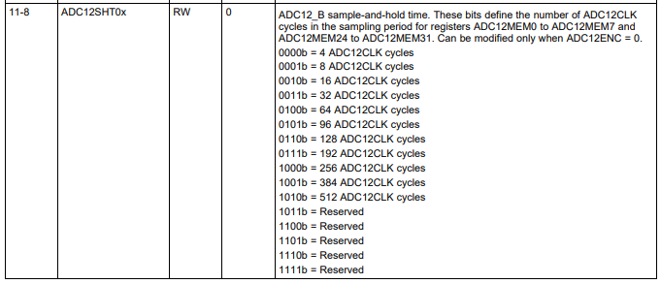
Register – ADC12CTL0
Set the clock cycles for sample-and-hold for MEM0-MEM7 to 64 (Bits 11-8) 0100

Slide 24
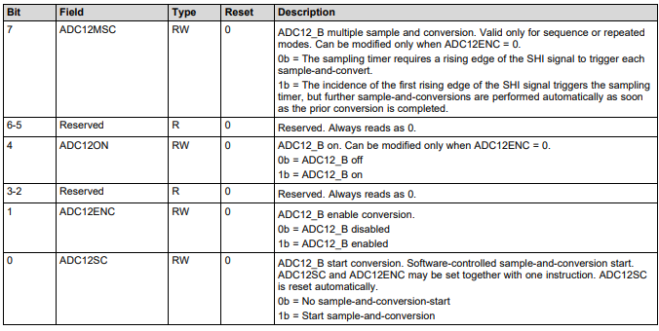
Register – ADC12CTL0
Set Bit 7 to cause the first rising edge of the SHI to initiate sampling and continue automatically
Turn on the ADC12 Module (Bit 4)XX1X
Disable Conversion (Bit 1)

Slide 25
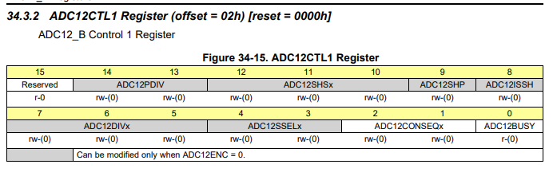
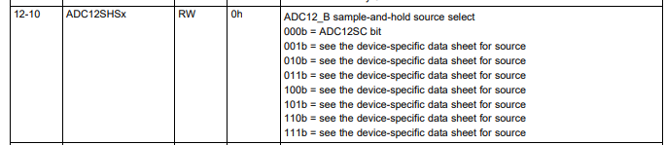

Register – ADC12CTL1
* SEE NEXT SLIDE for this incredible example of the inefficiency in the TI documentation!
Select Timer A1 as the clock source by configuring Bits 12-10 to [100] *

Slide 26
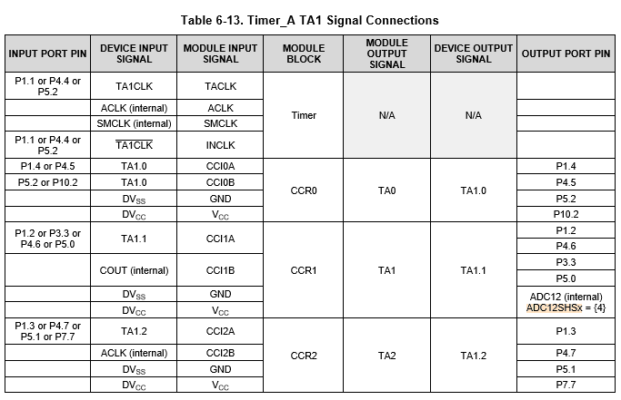
Register – ADC12CTL1
* ADC12SHSx - Select Timer A1 as the clock source by configuring Bits 12-10 to [100] *
This setting depends on which microcontroller model you have.
The setting is in a completely different manual for each MCU!!
I have placed a copy of the MSP430FR6989.PDF on the course website
Page 88
= 0x100

Slide 27
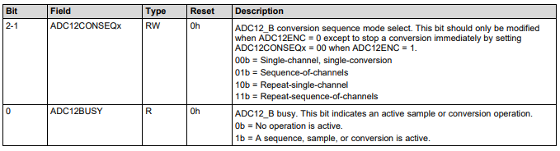
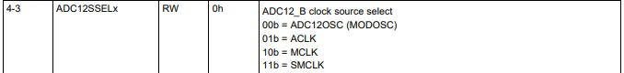
Register – ADC12CTL1
Select Timer A1 as the clock source by configuring Bits 12-10 to [100] *
Configure Bits 4-3 to select ACLK as the source clock

Slide 28
Register – ADC12CTL1
Select Timer A1 as the clock source by configuring Bits 12-10 to [100] *
Configure Bits 4-3 to select ACLK as the source clock
Select the Repeated-Sequence-of-Channels option for Bits 2-1

Slide 29
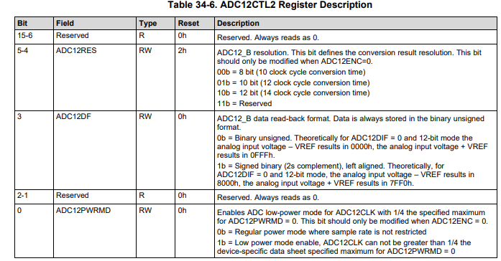
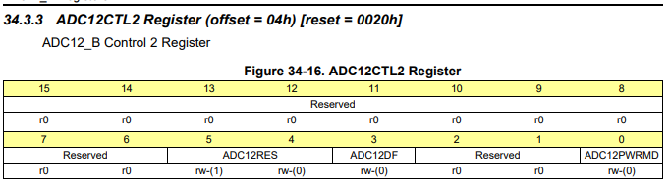
Register – ADC12CTL2
This register controls bit resolution and data readback format. There are no changes from the default values in this register

Slide 30
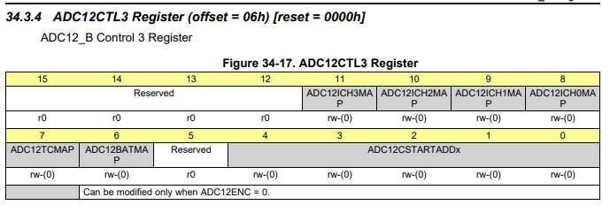
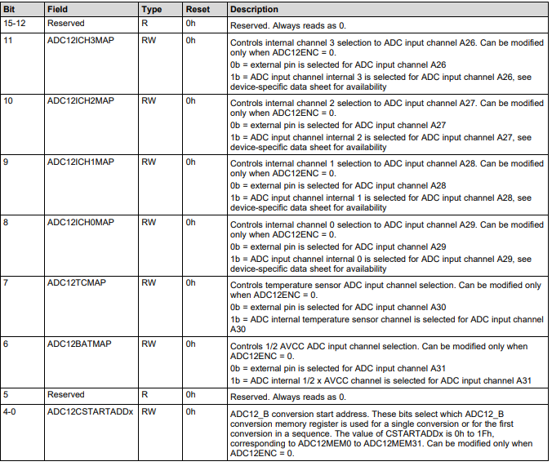
Register – ADC12CTL3
1. Set Bit 7. This selects the Temperature Sensor for ADC channel A30

Slide 31
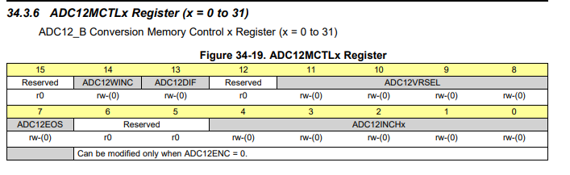
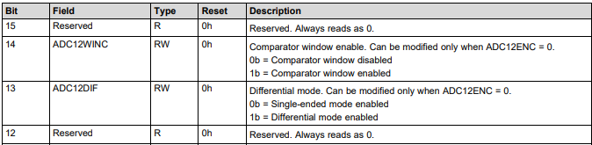
5.Set MEM0 Buffer for A30 Data
Register – ADC12MCTL0
Disable the Comparator Window
Enable Single-ended Mode

Slide 32
5. Set MEM0 Buffer for A30 Data
Register – ADC12MCTL0
Set voltage source combination to VR+ = VREF buffered, VR- = AVSS

Slide 33

5. Set MEM0 Buffer for A30 Data
Register – ADC12MCTL0
MEM0 is NOT the end of the sequence

Slide 34
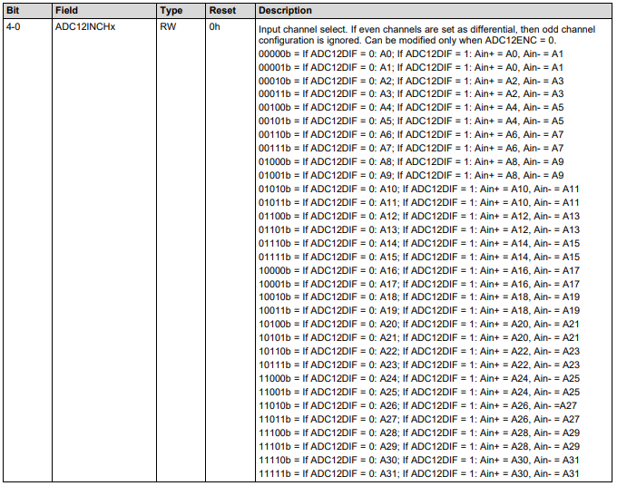
5. Set MEM0 Buffer for A30 Data
Register – ADC12MCTL0
Select A30 (the temperature probe) as the Input Source.

Slide 35
6. Set MEM1 Buffer for A5 Data
Register – ADC12MCTL1
Disable the Comparator Window
Enable Single-ended Mode

Slide 36
6. Set MEM1 Buffer for A5 Data
Register – ADC12MCTL1
Set voltage source combination to VR+ = AVCC, VR- = AVSS

Slide 37
6. Set MEM1 Buffer for A5 Data
Register – ADC12MCTL1
MEM1 IS the end of the sequence

Slide 38
6. Set MEM1 Buffer for A5 Data
Register – ADC12MCTL1
Select A5 as the Input Source.

Slide 39
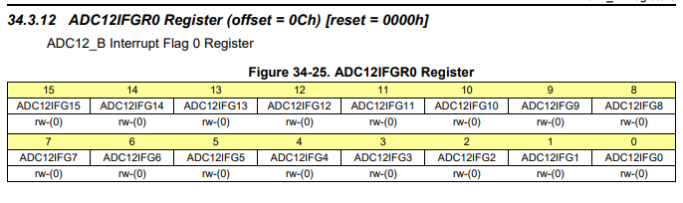
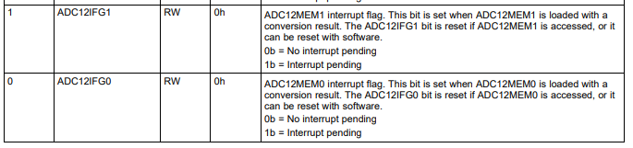
7. Clear MEM1 Interrupts (write 0)

Slide 40
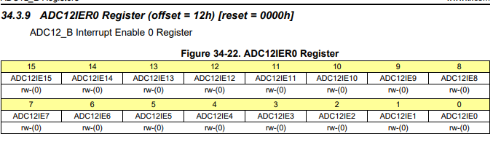
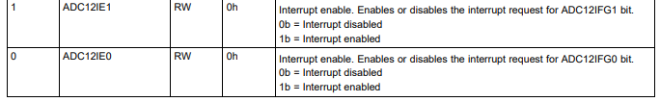
8a. Enable Interrupts

Slide 41
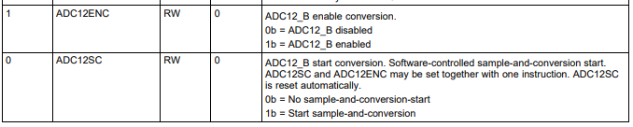
8b. Enable Conversion

Slide 42
Checkpoint #1 (Graded)
Init_ADC12() should be correct

Slide 43
ADC12 Configuration – Interrupt Service Routine
In the ADC12 Interrupt Service Routine, for the ADCMEM1 interrupt case:
a. Clear the Interrupt:
ADC12_B_clearInterrupt(ADC12_B_BASE, 0, ADC12_B_IFG1);
b. Transfer MEM0 and MEM1 values to the following variables:
ADCValue0 = ADC12MEM0;
ADCValue1 = ADC12MEM1;
2. In unused_interrupts.c, check to make sure that the #pragma for the Timer A1 vector and the ADC12 vector are commented out.

Slide 44
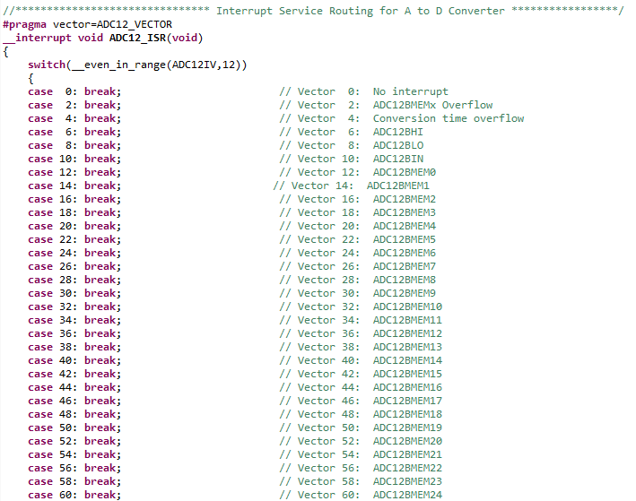
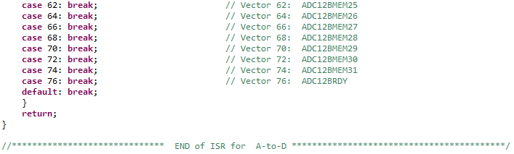
The ADC12
Interrupt Service Routine

Slide 45
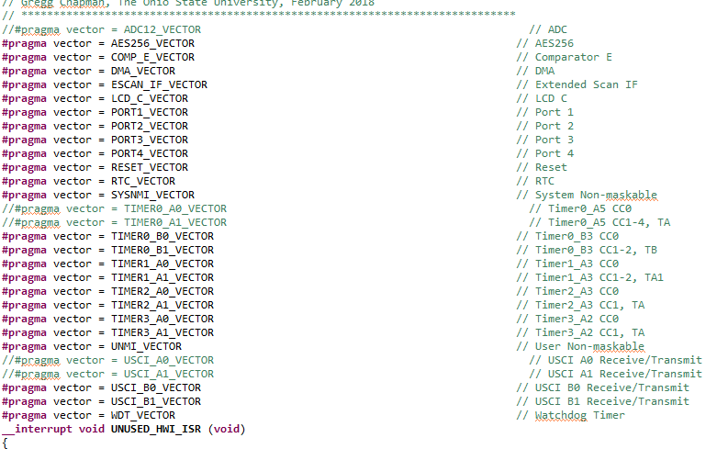
ADC12 Configuration – Don’t forget to comment out used #pragma in unused_interrupts.c

Slide 46
Checkpoint #2 (Graded)
ADC12_ISR() should be correct

Slide 47
TempSensorMode.c

Slide 48
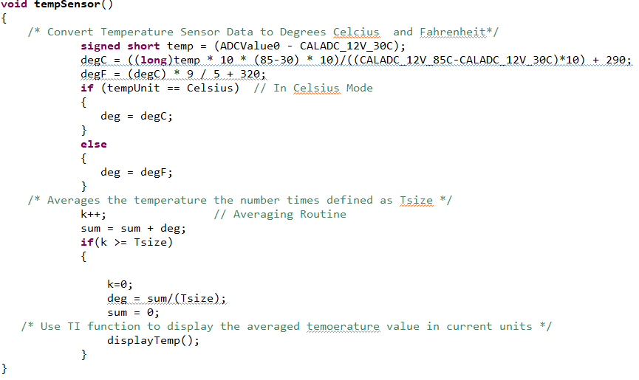
TempSensorMode.c Functions

Slide 49
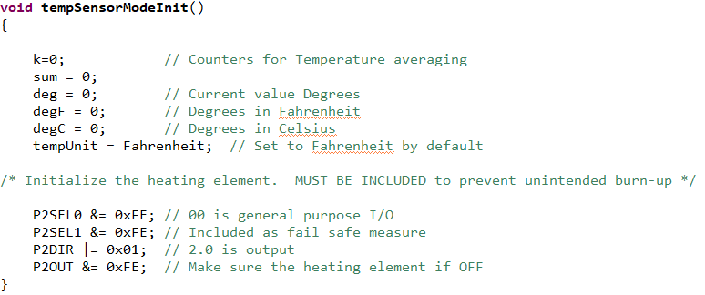
TempSensorMode.c Functions

Slide 50
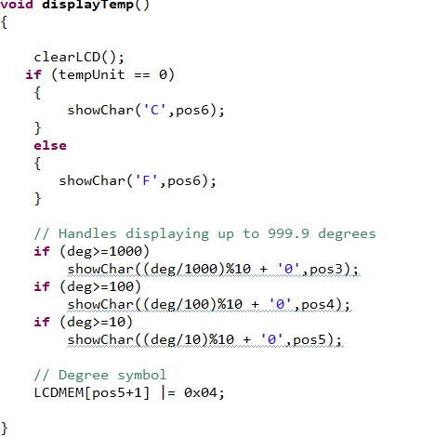
TempSensorMode.c Functions

Slide 51
Checkpoint #3
In TE Mode, the code should display the temperature sensor on the LCD (display) in Fahrenheit with 20 averages and update once every second.

Slide 52
RCMode.c

Slide 53
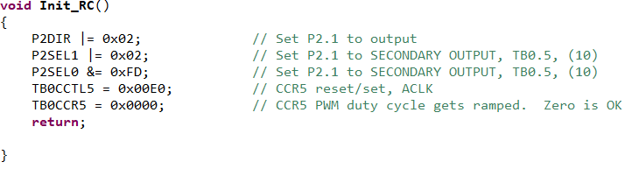
RCMode.c Functions

Slide 54
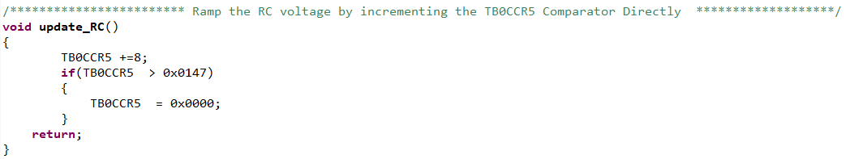
RCMode.c Functions

Slide 55
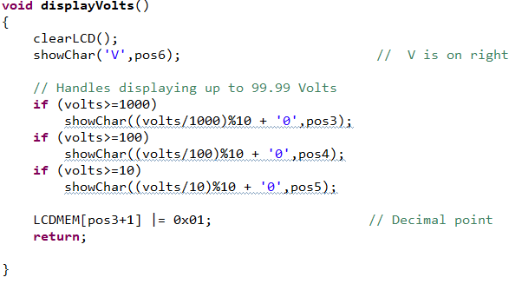
RCMode.c Functions

Slide 56

Changes to Command.c

Slide 57
Checkpoint #4
In RE Mode, the filtered RC voltage should ramp from 0 to 3.3V on the LCD Display

Slide 58
Update the main() Initializations
//*********************The Initializations*************************************/
Init_LCD();
Init_GPIO();
Init_Clocks();
Init_PWM();
Init_LCD();
tempSensorModeInit(); // Given. Add this.
Init_ADC12(); // New. You write this
Init_RC(); // Given. Add this.

Slide 59
Checkpoint #5
The LE function and all color selections are still operative using the defined commands in Command.c
Also verify that the LED is White after initialization and before TE, RE, or LE commands are sent.

