Slide 1
ECE 3561
Advanced Digital Design
Class 28: Sequential Circuit Design 6 – State Assignment
Drew Phillips
Spring 2024

Slide 2
Sequential Circuit Design Process
State / Output Diagram / Table
Minimization of Number of States
State Variable Assignment
Transition / Output Table
Selection of Flip Flop Types
Excitation Table
Excitation Equations
Output Equations
Logic Diagram

Slide 3
3) State Assignment
After the state table is minimized, states will be assigned (mapped) to binary codes (state variable values) for implementation
The assignments we choose will affect the complexity and therefore cost of the circuit
Some assignments are equivalent (see PRE slides and quiz for this class)

Slide 4
Number of Possible Circuits
For N FFs and K states, this is the equation for the total number of possible assignments / circuits

Slide 5


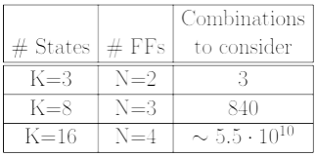
Number of Equivalent Circuits
For N FFs and K states, there are N! ways to interchange N FFs, and there are 2^{N} ways to complement FFs. In total:
Conclusions:
Testing all state assignments is not practical!
So, we need guidelines on how to make smart assignments.

Slide 6
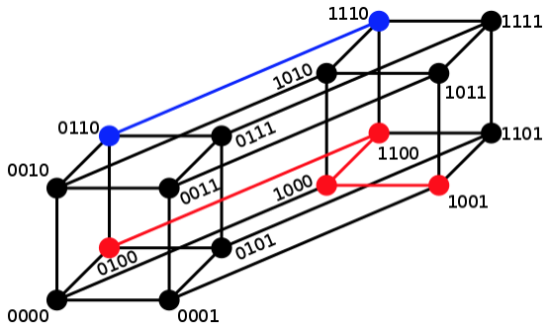
Hamming Distance
100→011 has distance 3
010→111 has distance 2
For two binary encodings, the Hamming distance is the number of bits that are different
Two states A and B are adjacent if their Hamming distance is 1
  D(A,B) = 1
0100→1001 has distance 3
0110→1110 has distance 1

Slide 7
State Assignment Guidelines
The following states should be assigned adjacent to reduce cost:
States that have the same next state for a given input
The next states of the same state
States that have the same output (lowest priority)

Slide 8
State Assignment Guideline 1
States that have the same next state for a given input
A
X
A and B => adjacent
C
X
Hamming distance D(A,B) = 1.
B

Slide 9
State Assignment Guideline 2
The next states of the same state
X
A
A and B => adjacent
C
Hamming distance D(A,B) = 1.
X’
B

Slide 10
State Assignment Guideline 3
States that have the same output
Priority should be given to guidelines 1 and 2
A and B are suggested to be adjacent,
if not violating guidelines 1 and 2.
X/Z⁽¹⁾
C₁
X/Z⁽¹⁾
D₁
A
B
X’/Z⁽²⁾
C₂
X’/Z⁽²⁾
D₂
Hamming distance D(A,B) = 1.
Z⁽¹⁾ and Z⁽²⁾ in {0, 1}

Slide 11
Applying the 3 Guidelines
How to easily tell adjacent encodings
  Two adjacent cells in a K-map have a Hamming distance of 1
  If you have more than 2 encodings, consider a regular 2^{N} block of cells (K-map)
Design an algorithm on the truth table to implement guidelines 1-3
  Just check the rows and columns

Slide 12
Assigning the Start State
Assign the start state to the “0” square on an assignment map
Reasons:
  Clear input on FFs can be used for initialization
  Clear input can also be used for a reset
  The alternative is error prone because using a combination of presets and clears to initialize/reset to a specific non-zero state can lead to implementation errors (the user/controller has to do it correctly)

Slide 13
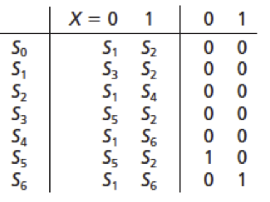
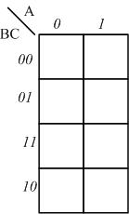
State Assignment Example 1
Here is an example state table for a circuit we are designing
Here is a regular 2³=8 block of cells to use as our assignment map

Slide 14
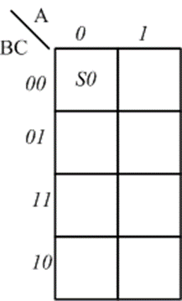
State Assignment Example 1
Assign the start state to “0” square
Assume that S0 is the start state

Slide 15
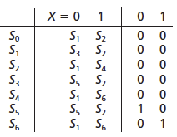
State Assignment Example 1
Apply guideline 1: States that have the same next state for a given input
next states
outputs
Adjacent:
{S0, S2, S4, S6}
{S0, S1, S3, S5}
{S4, S6}
{S3, S5}

Slide 16
State Assignment Example 1
Apply guideline 2: The next states of the same state
next states
outputs
Adjacent:
{S1, S2}
{S3, S2}
{S1, S4}
{S5, S2} x 2
{S1, S6} x 2

Slide 17
State Assignment Example 1
Apply guideline 3: States that have the same output
next states
outputs
Adjacent:
{S0, S1, S2, S3, S4}

Slide 18
State Assignment Example 1
States grouped by parentheses should be adjacent
Adjacency conditions from guidelines 1 and 2 that are required 2 or more times should be satisfied first
next states
outputs

Slide 19
State Assignment Example 1
Use trial and error (guess and check) to determine possible assignments / ways of satisfying the guidelines
Solutions are not necessarily unique
Solutions are not necessarily optimal

Slide 20
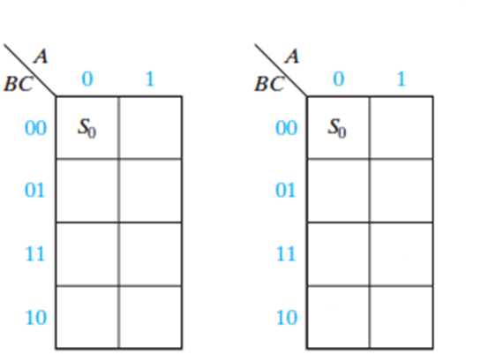
State Assignment Example 1
Possible assignments:
next states
outputs
S2 S5
S4 S3
S6 S1
S1 S6
S3 S4
S5 S2

Slide 21
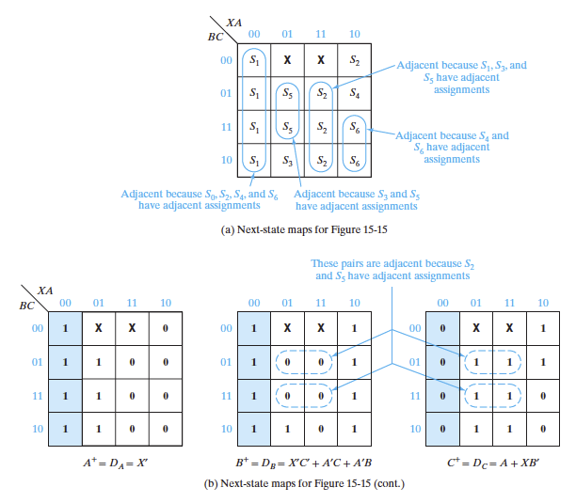
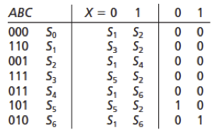
State Assignment Example 1
Check the first encoding

Slide 22
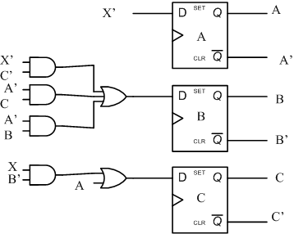
State Assignment Example 1
Implementation using gates and D FFs:
  All FF outputs are used
  7 gates needed (1 additional inverter for X) for next state generations
  Only 1 gate has 3 inputs

Slide 23
State Assignment Procedure Summary
​Apply Guideline 1 to the state table to identify adjacency relationships for states that have the same next state for a given input.
​Apply Guideline 2 to the state table to identify adjacency relationships for the next states of the same state.
​Apply Guideline 3 to the state table to identify adjacency relationships for states that have the same output.
​Assign the initial/start state to the “all 0s” square in the assignment map.
​Place states in the assignment map to satisfy as many adjacency relationships as possible with this priority:
  First: relationships from Guidelines 1 and 2 which occur multiple times
  Second: remaining relationships from Guidelines 1 and 2
  Third: relationships from Guideline 3
​Iterate and/or move states as needed to determine “best” mapping which best satisfies the adjacency relationships.

