Slide 1
Machine Learning Capstone project: Hanoi house price prediction
Instructor: Assoc. Prof. Than Quang Khoat

Slide 2
Members
Nguyen Trung Hieu – 20204877
Nguyen Lan Cuong – 20204872
Tran Duc Tri – 20204893
Nguyen Duc Thanh – 20203913
Cu Duy Hiep - 20200212

Slide 3
Content
Introduction.
Data analysis and data preprocessing
Machine learning approaches
Experiment
Conclusion

Slide 4
1. Introduction
Predicting the price of real estate is a very intriguing problem that attracts many scientists, economists, politicians trying to tackle them because of its importance in securing financial security, controlling the economy, and guaranteeing the social security.
With the explosion of Artificial Intelligence, especially in the field of Machine Learning(ML), many people try to apply ML algorithms into solving this problem

Slide 5
1. Introduction
In this project, we will try to predict the house price in Hanoi using some of ML methods including:
Random Forest
Kernel Ridge Regression
Gaussian Process
Ensemble neural network

Slide 6
Content
Introduction.
Data analysis and data preprocessing
Machine learning approaches
Experiment
Conclusion

Slide 7
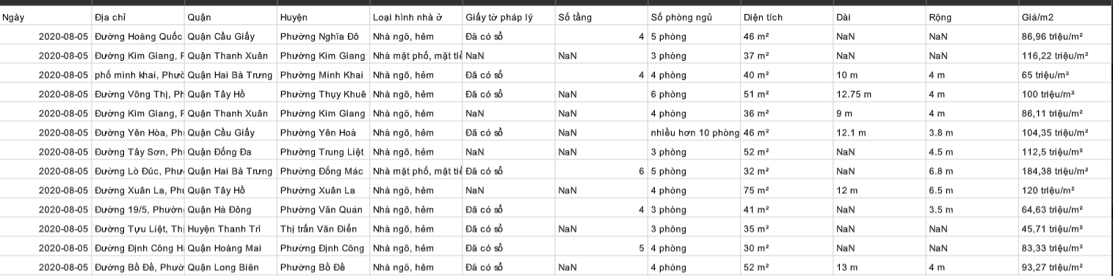
Data analysis
Hanoi Housing Dataset 2020 is a raw dataset containing 82.5 thousand records with 12 variables: Date, Address, District, Ward, House type, Legal status, Number of floors, Number of bedrooms, Area, Length, Width, Price per square meters.

Slide 8
Data analysis
Remove outer district
> 8 floors
<30 and >300
Remove record has null value

Slide 9
Data preprocessing
With ward data, we use Binary encoding to process.
Transform categorical value to ordinal value with is the number of unique wards.
Transform the ordinal value to binary, which is a sequence of 1 and 0 lengths.
With house type data and legal status data, we will use ordinal encoding for 2 columns: house types and legal status

Slide 10
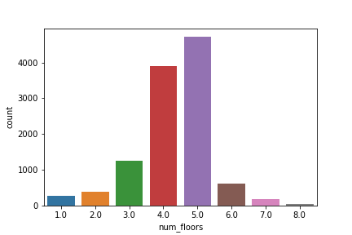
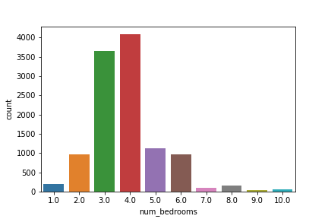
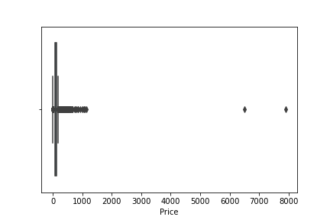
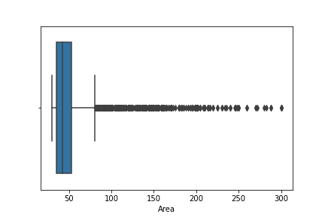
Data preprocessing
Fig 1: Number of floors count plot
Fig 2: Number of bedrooms count plot
Fig 3: Boxplot of Price
Fig 4: Boxplot of Area

Slide 11
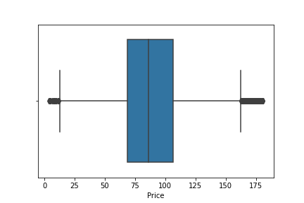

Data preprocessing
IQR outlier detection:
We see that the Price variable have some extreme outliers, so we need to remove outliers of price. We run IQR outlier detection on price column by removing the value $x$ that:
$x<Q_{1}−1.5∗IQR or x>Q_{3}+1.5∗IQR$
where $Q_{1}$: ${25}^{th}$ percentiles, $Q_{3}$: ${75}^{th}$ percentiles, $IQR=Q_{3}−Q_{1}$.
Fig 5: Boxplot on Price after running IQR

Slide 12
Content
Introduction.
Data analysis and data preprocessing
Machine learning approaches
Experiment
Conclusion

Slide 13
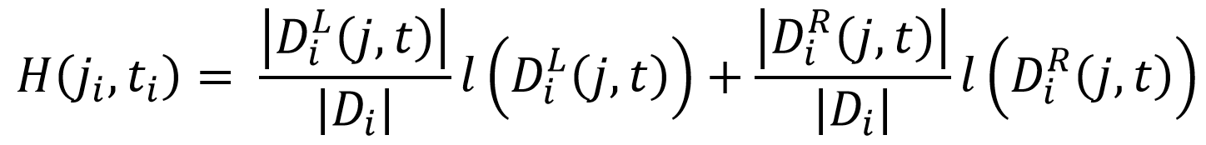
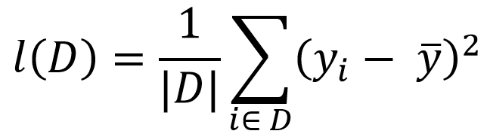
3.1. Random forest regressor
3.1.1. Decision tree regressor
- CART (Classification and Regression Trees) algorithm to handle both numeric and categorical data. The idea is choosing an attribute at each sub-tree to split into left and right branch
- For our house price problem, we use the loss function:

Slide 14
3.1. Random forest regressor
3.1.2. Random forest regressor
We grow K decision trees when learning random forests:
For each tree, we generate a dataset to train by sampling with replacement from .
When we grow each individual tree, when choosing attributes and threshold to split a node, we only consider from a subset of attributes.
We can limit the depth of each tree with a hyperparameter.
The final output is the average results obtained from those trees

Slide 15
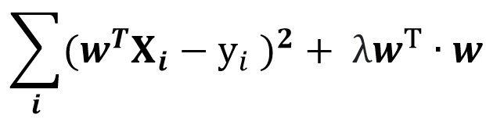
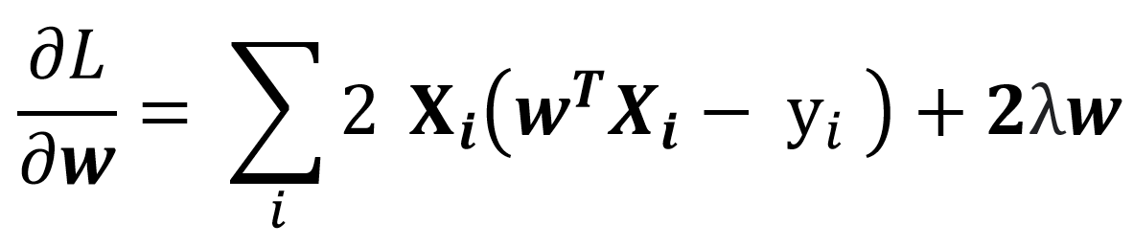
3.2. Kernel Ridge Regression
First, we recall the method of ridge regression:
- Suppose we have the set of inputs {(X_{i}, y_{i})}. We need to minimize :
L =

Slide 16
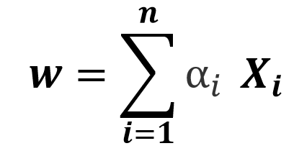

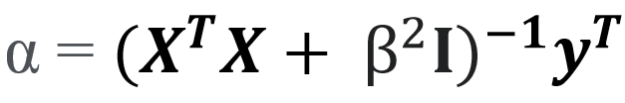
3.2. Kernel Ridge Regression
We can express w as a linear combination of all input vectors (using induction hypothesis):
We also have the solution of the ridge regression:
From two equations above, we can write

Slide 17

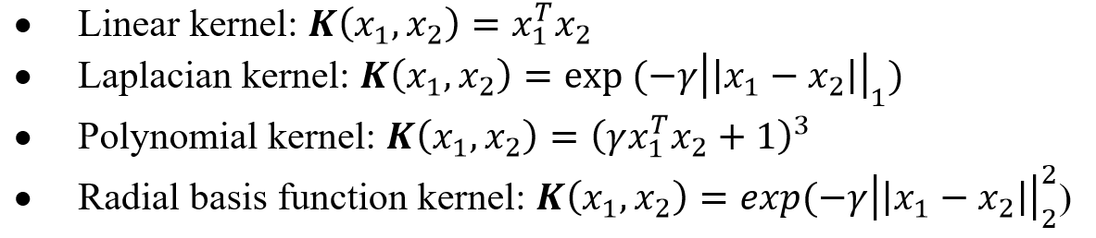
3.2. Kernel Ridge Regression
Now, we can let and replace K by some kernel matrix such as :

Slide 18
3.3. Gaussian Process
In general, the posterior predictive distribution is given by the following formula:
Ridge regression : Gaussian prior and likelihood, MAP
Gaussian process: Learn all the function

Slide 19
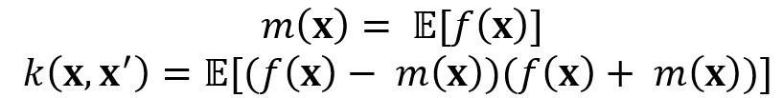

3.3. Gaussian Process
3.3.1. Gaussian Process definition
We can define the mean function m(x) and their covariance matrix k(x, x') of a real process f(x) as:
Without loss of generality, we usually take the mean function to be zero.
In detail, if we choose several input points, we can generate a random Gaussian vector with covariance matrix

Slide 20
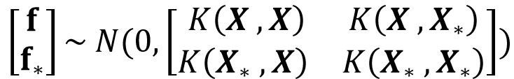
3.3. Gaussian Process
3.3.2. Gaussian Process prediction
- Prediction for noise – free observations
The distribution of conditioning on the observations can be written as follows:

Slide 21


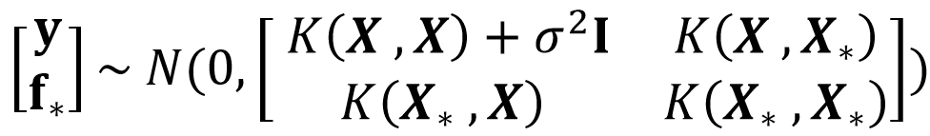

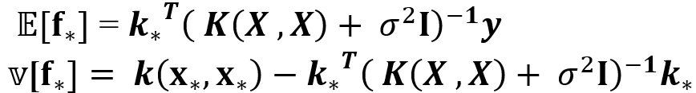
3.3. Gaussian Process
3.3.2. Gaussian Process prediction
- Prediction of noisy observation
We derive the mean and variance of

Slide 22

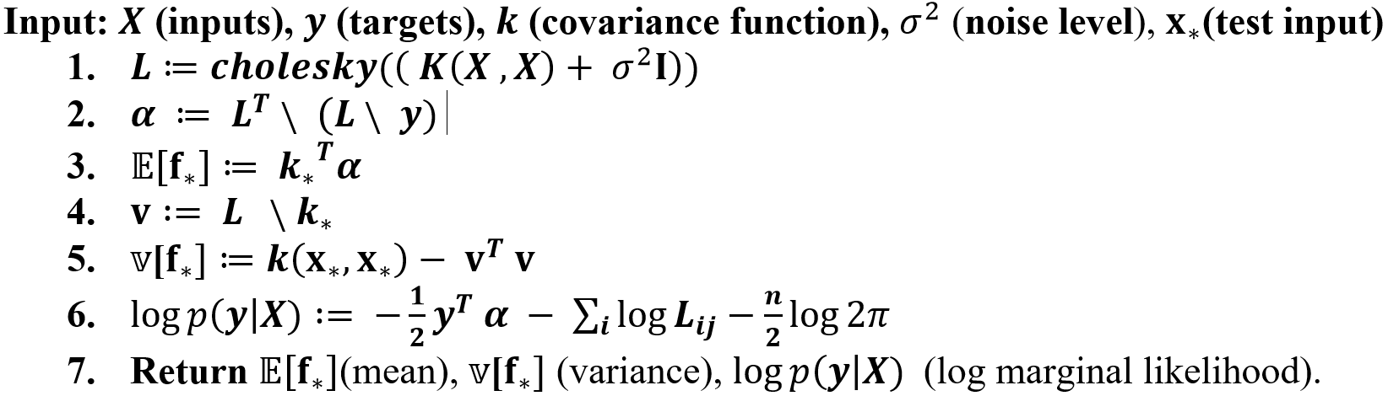
3.3. Gaussian Process
3.3.2. Gaussian Process prediction
- Cholesky factorization:
When A is a real symmetric positive-definite matrix, we can decompose it as
Where L is a real lower triangular matrix with positive diagonal entries.
- Algorithm for Gaussian Process regression
Where

Slide 23
3.3. Gaussian Process
3.3.3. The covariance function
There are three main ways to choose a good covariance function:
Expert knowledge (awesome to have, difficult to get)
Bayesian model selection (more possibly to face intractable integrals)
Cross-validation (time consuming but easy to implement)
We can choose the covariance matrix as a kernel matrix since there are many similar properties

Slide 24
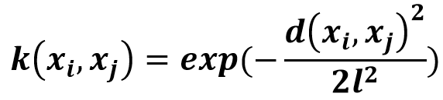

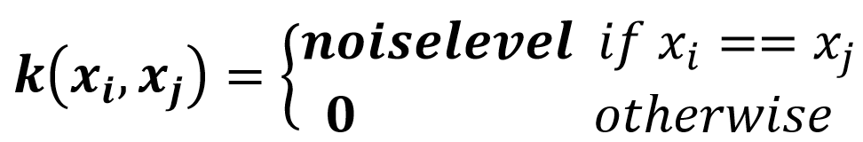
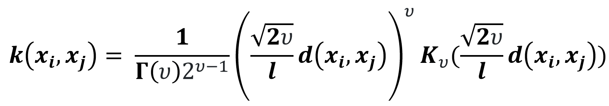
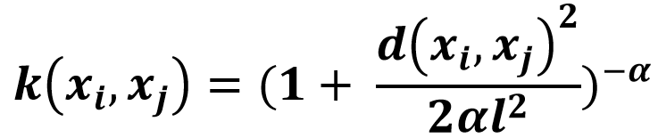
3.3. Gaussian Process
3.3.3. The covariance function
RBF kernel:
Dot product and white kernel:
Dot product kernels:
White kernels:
Matérn kernel:
Rational Quadratic kernel

Slide 25
3.4. Ensemble neural network
A
Input
Hidden Layer
Hidden Layer
Hidden Layer
Output

Slide 26
3.4. Ensemble neural network
A
Input
Hidden Layer
Hidden Layer
Hidden Layer
Output

Slide 27
3.4. Ensemble neural network
A
Input
Hidden Layer
Hidden Layer
Hidden Layer
Output

Slide 28
3.4. Ensemble neural network
A
Input
Hidden Layer
Hidden Layer
Hidden Layer
Output

Slide 29
3.4. Ensemble neural network
A
Input
Hidden Layer
Hidden Layer
Hidden Layer
Output

Slide 30
3.4. Ensemble neural network
A
Input
Hidden Layer
Hidden Layer
Hidden Layer
Output

Slide 31
3.4. Ensemble neural network
A
Input
Hidden Layer
Hidden Layer
Hidden Layer
Output

Slide 32
3.4. Ensemble neural network
N
N
N
Optimal
Hidden Layer
Hidden Layer
Hidden Layer
Lower Testing Error :)
Time Complexity!!! :(
N
: Neuron

Slide 33
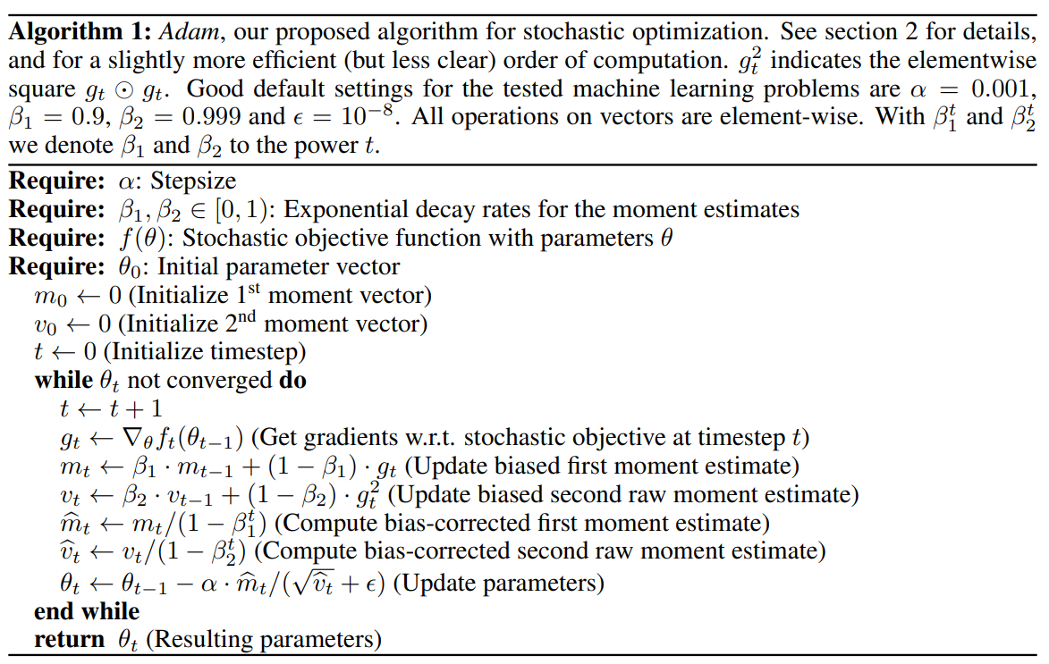
3.4. Ensemble neural network
Adam optimization
Source: Diederik Kingma, Jimmy Ba Adam: A Method for Stochastic Optimization (2014) arXiv:1412.6980

Slide 34
Content
Introduction.
Data analysis and data preprocessing
Machine learning approaches
Experiment
Conclusion

Slide 35
4. Experiments
Experiments setup
- We split the data into 2 parts: training data and testing data, with ratio 8:2
- We use 4 folds cross – validation on the training data set
- We use 3 different metrics for model assessment:
+ Mean absolute percentage error (MAPE).
+ Mean absolute error (MAE)
+ Root mean squared error (MSE)

Slide 36
4. Experiments
Random forest regressor model
 | N = 50 | N = 100 | N = 150 | N = 200 | N = 250 | N = 300 | N = 350 | N = 400
MAPE | 0.277 | 0.276 | 0.276 | 0.276 | 0.276 | 0.276 | 0.276 | 0.276
RMSE | 25.513 | 25.461 | 25.440 | 25.427 | 25.429 | 25.424 | 25.426 | 25.422
MAE | 19.014 | 18.976 | 18.959 | 18.953 | 18.960 | 18.952 | 18.951 | 18.949
Table 1: Random Forest performance on different number of trees

Slide 37
4. Experiments
Random forest regressor model
 | d = 5 | d = 8 | d = 11 | d = 14 | d = 17 | d = 20 | d = 23 | d = 26 | d = inf
MAPE | 0.309 | 0.290 | 0.274 | 0.268 | 0.267 | 0.267 | 0.267 | 0.267 | 0.267
RMSE | 27.530 | 26.530 | 25.280 | 24.904 | 24.864 | 24.854 | 24.856 | 24.865 | 24.865
MAE | 21.003 | 19.846 | 18.874 | 18.846 | 18.389 | 18.379 | 18.380 | 18.385 | 18.384
Table 2: Random Forest performance on different maximum depth of each tree

Slide 38
4. Experiments
Kernel ridge regression
 | Linear | Laplacian | RBF | Polynomial
MAPE | 0.307 | 0.268 | 0.276 | 0.279
RMSE | 28.12 | 26.08 | 26.48 | 26.38
MAE | 28.12 | 19.31 | 19.48 | 19.61
Table 3: Kernel ridge performance on different kernels
 | 0.001 | 0.025 | 0.05 | 0.1 | 0.25 | 0.5 | 1.0 | 2.0
MAPE | 0.298 | 0.281 | 0.281 | 0.281 | 0.282 | 0.283 | 0.284 | 0.286
RMSE | 29.13 | 26.59 | 26.34 | 26.35 | 26.35 | 26.35 | 26.42 | 26.55
MAE | 20.93 | 19.73 | 19.69 | 19.70 | 19.73 | 19.82 | 19.91 | 20.02
Table 4: Kernel ridge performance on different alpha

Slide 39
4. Experiments
Gaussian process
 | Rational Quadratic | DotProduct | RBF | Matérn
MAPE | 0.269 | 0.306 | 0.284 | 0.279
RMSE | 26.03 | 27.84 | 26.53 | 26.30
MAE | 19.16 | 21.16 | 19.82 | 19.42
Table 5: Gaussian process performance on different kernels

Slide 40
4. Experiments
Ensemble neural network
 | n = 5 | n = 10 | n = 15 | n = 20 | n = 25 | n = 30
MAPE | 0.260 | 0.245 | 0.241 | 0.233 | 0.231 | 0.236
RMSE | 27.52 | 26.29 | 26.39 | 25.44 | 25.27 | 25.87
MAE | 20.84 | 19.66 | 19.61 | 18.77 | 18.53 | 19.10
Table 6: Ensemble neural network on different number of neurons

Slide 41
4. Experiments
Model training and comparison
 | Random forest |  | Ridge Kernel |  | Gaussian process |  | Ensemble NN
 | Train | Test | Train | Test | Train | Test | Train | Test
MAPE | 0.196 | 0.225 | 0.216 | 0.233 | 0.122 | 0.233 | 0.227 | 0.227
RMSE | 18.37 | 24.32 | 20.46 | 25.64 | 11.73 | 25.43 | 22.27 | 25.23
MAE | 13.58 | 17.67 | 17.16 | 18.77 | 8.62 | 18.42 | 16.43 | 18.44
Table 7: Different model performance on train – test set

Slide 42
Content
Introduction.
Data analysis and data preprocessing
Machine learning approaches
Experiment
Conclusion

Slide 43
THE END!

