Slide 1


Data Analysis Presentation
Uncovering Insights from User reactions
Trideep Roy, Data Analyst Intern
14th December,2023

Slide 2


Today's agenda
Project recap
Problem
The Analytics team
Process
Insights
Summary

Slide 3


Key points from the brief:
Three datasets: Content, Reactions and Reaction Type
Project Recap
Cleaning and Merging Data
Analyzing User Engagement and Content Popularity
Determining Top performing Categories

Slide 4
Problem
Understanding User Engagement and Content Popularity
Identifying Top-performing categories
Providing Insights for Business decision-making

Slide 5



Andrew Fleming ,
Chief Technical Architect
The Analytics team
Marcus Rompton ,
Senior Principle
Trideep Roy ,
Data Analyst

Slide 6

Process
Data Cleaning
Removing Missing values
Changing Data Types
Dropping irrelevant columns
Merging Datasets
Using Reaction as the base table
Joining Content and Reaction Types
Analysis Steps
User Engagement
Content Popularity
Top Performing Categories

Slide 7

Insights
Month having highest no. of posts
Total Unique Categories
Category having highest Reactions
JANUARY
16
ANIMAL

Slide 8
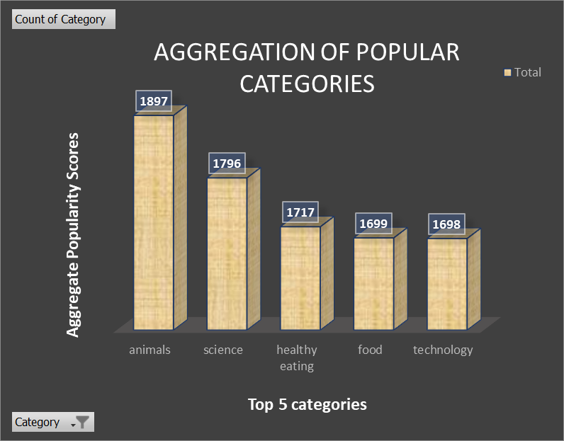

Slide 9
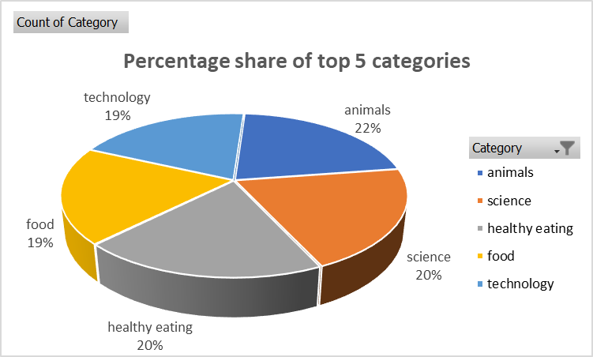

Slide 10

ANALYSIS
The observed proximity in values between "Healthy Eating" and "Food" suggests that these categories are often interconnected in the minds of individuals. This correlation could be attributed to the prevalent association between food choices and overall health consciousness.
Summary
Additionally, it is noteworthy that "Animals" emerges as the most favored category. Possible reasons include the widespread appeal of content related to pets, wildlife, or ethical considerations in animal-related content.

Slide 11
Thank you!
ANY QUESTIONS?

