Slide 1
S’MORE
store more, save more

Slide 2



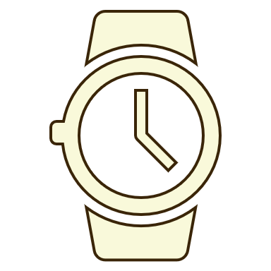
?
problem
Air conditioners use about 6% of all the electricity produced in the United States, at an annual cost of about $29 billion to homeowners. As a result, roughly 117 million metric tons of carbon dioxide are released into the air each year.
Many people aren’t willing to spend cash on unused storage space.
There doesn’t appear to be any uniform approach to security measures across the self-storage industry.
Don’t underestimate the time you’ll spend sorting through your items in the storage room to find the things you need at that particular moment. Also, admit the possibility of losing extra time under unforeseen circumstances, like heavy traffic or jams, bad weather, car issues, etc.

Slide 3
what we do
A
.
Don’t have space?
A
S’more App
A
Pick up or Drop-Off
A
Access Anytime

Slide 4



our company values
At S”More, we value our customers’ time and money by providing storage for the modern world and tomorrow’s homeowners. Additionally, we conduct our business with Mother Nature in mind, as we strive to reduce our carbon footprint.
reduced costs
accessibility
sustainability

Slide 5
target market
students
Live in a dorm or student housing lacking in storage space? S’More provides low-cost, student friendly microstorage for items that are important, but difficult to store.
T
urbanized areas
The average size of new apartments in the U.S. in 2018 is 941 square feet, 5 percent smaller than ten years ago, with studio apartments shrinking the most, by more than 10 percent. With barely enough room for yourself, where does all of your stuff go?
A
small budget
R
The average national storage unit costs are: $40-$50 per month for a 5-by-5-foot unit. $75-$140 per month for a 10-by-15-foot unit. $115-$150 per month for a climate-controlled 10-by-15-foot unit. Is that how you want to spend your money?
life changes
G
Sometimes life catches you by surprise. If you need to store something short-term, S’More provides various short-term storage options for your convenience.
E
M
A
R
K
E
T

