Slide 1
FESTIVALS IN BANGLADESH

Slide 2
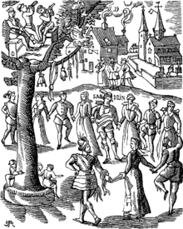
WHAT IS FESTIVALS?
A festival is an event ordinarily celebrated by a community and centering on some characteristic aspect of that community and its religion or cultures. It is often marked as a local or national holiday, such as : mela, or Eid. A festival constitutes typical cases of globalization, as well as the high culture-low culture interrelationship. Food is such a vital resource that many festivals are associated with harvest time.

Slide 3
MEJOR FESTIVALS IN BANGLADESH
Bangladesh is a land of festivals. There is a popular saying in Bangla ‘Baro Mashe Tero Paban’ meaning 13 festivals in 12 months. It is interesting to note that many of our festivals are linked to religions, seasons and specials occasions. In recent times, international festivals have also been added to the list. However, festivals can be grouped broadly into religious, nonreligious, indigenous and nonindigenous.
Festivals are common to all societies and cultures. With the change of social and economic structures, the natures of festivals also change. But some festivals are so deeply rooted in the social organism that they continue to entertain from generation to generation. The festivals, which got started in the primitive society centering on the prayer for food, have now been filled with various colors and varieties.

Slide 4
MAJOR FASTIVALS:
POHELA BOISHAKH
POHELA FALGUN
LALON MELA
THE KITE FLYING FESTIVAL
INDEPENDENCE DAY
WORLD MOTHER LANGUAGE DAY
NABANNA
Ekushey Boi Mela:
Dhaka International Trade Fair:
Eid Ul Fitr
Eid Ul Adha
MUHARRAM
CHIRSTMAS
DURGA PUJA

Slide 5
POHELA BOISHAKH
The first day of Bangla year is celebrated as Pahela Boishakh. The day is celebrated with festivity across the country. It is celebrated in villages and towns. People in the village celebrate this day according to their age-old customs. Special meals are arranged at home.
Baisakhi melas are held in different places. In towns, various socio-cultural organizations arrange interesting programs on this day. At Ramna Batamul, it is celebrated gorgeously. Many urban people wake up early in the morning and go to the function to enjoy poem reciting, songs, stage drama, lecture, etc.
Many people eat panta hilisa in the morning. Children put on colorful dresses. They go to the Boishakhi Mela and buy sweets, toys, dolls, and handmade things. They enjoy the day with great pleasure.

Slide 6
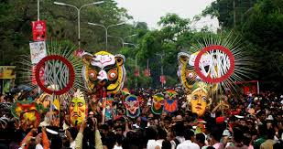
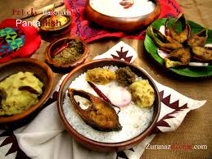
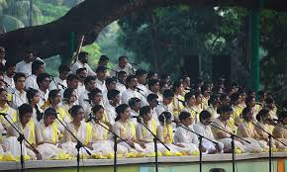

Slide 7
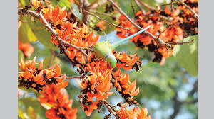
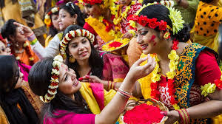
POHELA FALGUN
Bangladesh is a country where colorful fairs and festivals. In our Bangladesh the spring season stays for two months [Falgun and Chaitra]. A colorful festival held to welcome Bashanto. Attired in reddish-yellow saris with red border and hairs decorated with flowers, young women and girls as well as young men and boys in traditional pajama and punjabi, carrying flowers, took part in the colorful march. A good number of kids also got their attractive faces painted with different motifs including birds, national flag, butterflies etc. Pahela Falgun is celebrated on February 13. It is called the ‘Rituraj Bashonto’.

Slide 8
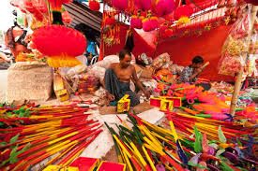
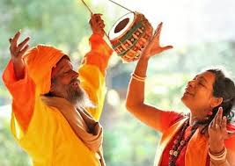
LALON MELA
Lalon song is called the song of a spiritual anthem. Every year, a five-day long fair is organized at Kushtia on the eve of Baul Fakir Lalon Shah’s birth anniversary otherwise known as ‘Tirodhn Dibosh.’ The akhara (a place where Lalon lived) is colorfully decorated where thousands of Lalon devotees gather from different locations of the country to celebrate his philosophical thoughts by performing his thousands of compositions.

Slide 9
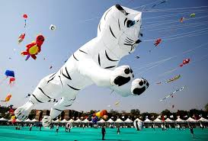
THE KITE FLYING FESTIVAL
In Bangladesh, each season has its individual way of representing nature here. All over the country, the Kite Flying Festival also known as the Shakrain Festival takes place to celebrate spring (Bashanta). The clear blue sky gets packed with high-flying kites in different colors and shapes

Slide 10
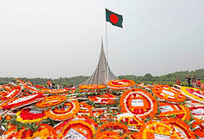
INDEPENDENCE DAY
The biggest state festival, the Independence day (March 26) is observed throughout the country. All major cities wear a festive look. It is a public holiday. The citizens of Dhaka wake up early in the morning to the sound of booming guns heralding the day. Leaders of the government, political and social organizations, freedom fighters and ordinary citizens alike place floral wreaths at the National Martyrs' Memorial at Savar.

Slide 11
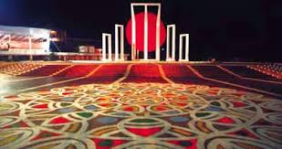
WORLD MOTHER LANGUAGE DAY
21 February of every year is observed throughout the country in remembrance of the martyrs' of Language Movement of 1952. Blood was shed on this day at the Central Shahid Minar area to establish Bangla as a state language of Pakistan. On this day, everybody holds a black badge and walk to the Shaheed Minar barefooted. They go there to offer flowers on the altar of the Shaheed Minar to show respect to the martyrs.

Slide 12
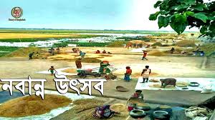
NABANNA
Navanna [nava + anna] literally, new food] a harvest festival celebrating the harvesting the new crop- aman paddy. Most agricultural societies tend to celebrate the harvesting of their main crop.

Slide 13
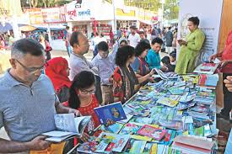
Ekushey Book Fair
Ekushey Book Fair is now a popular festival in the life of people. It is held only once in a year. Ekushey Book Fair or Amor Ekushey Grontho Mela (“Book Fair of the Immortal 21st"), commonly known as Ekushey Boi Mela (“Book Fair of the 21st"), is the national book fair of Bangladesh. It takes place over the entire month of February every year,

Slide 14
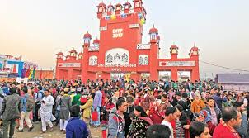
Dhaka International Trade Fair
Dhaka International Trade Fair is an international trade fair in Bangladesh. It is organized by the Export Promotion Bureau together with the Ministry of Commerce of the Government of Bangladesh. DITF is held from the first week of January to the first week of February every year.

Slide 15
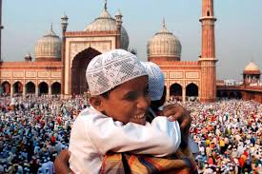
Eid Ul Fitr
The joyous three-day celebration, Eid ul-Fitr falls on the first day of Shawwal, the month which follows Ramadan in the Islamic calendar. However, the celebrations begin upon the sighting of the new moon which marks the end of the month of fasting and prayer.

Slide 16
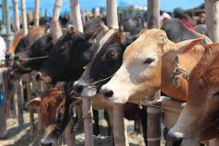
Eid Ul Adha
Eid ul-Adha also known as the Feast of sacrifice falls on the 10th day of the Islamic calendar’s last month, Dhu al-Hijjah. All over the world, Muslims who can afford a cow, goat or sheep sacrifice it as a reminder of Ibrahim’s obedience to Allah.

Slide 17
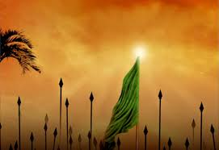
MUHARRAM
Muharram is the first month, which marks the beginning of a new year in Islamic calendar. Muslims all across the world begin the Islamic New Year with the month of Muharram, which started on September 1 this year. In fact, the month of Muharram is considered the second most holy month after Ramzan.

Slide 18
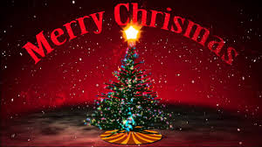
CHIRSTMAS
Christmas, known as "Bara Din" or The Big Day in Bangla is celebrated with festivities in Dhaka and elsewhere in the country. Functions include illumination of churches, decorating Christmas tree & other festivities.

Slide 19
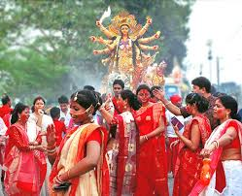
DURGA PUJA
Durga Puja, the biggest festival of the Hindu community in the country, continues for ten days with the last three days being the most joyful. The festivities culminate with the idol of goddess Durga immersed in the river.

Slide 20
THAT IS ALL. THANK YOU

