Slide 1
DATA RATE LIMITS
Course Code: COE 3201
Course Title: Data Communication
Dept. of Computer Engineering
Faculty of Engineering
Lecture No: | 4 | Week No: | 4 | Semester: | Spring 19-20
Lecturer:

Slide 2
Lecture Outline
Information as Digital Signal
Transmission of Digital Signals
Bit Rate
Data Rate
Nyquist Bit Rate
Shannon Capacity
Network Performance

Slide 3
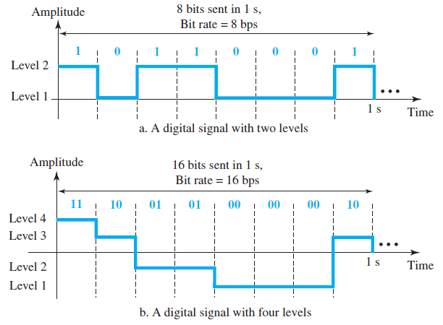
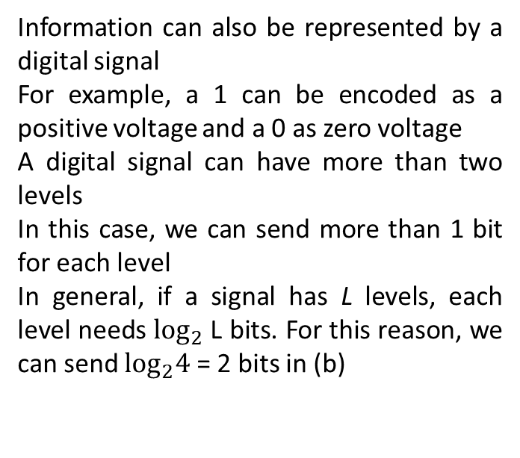
Information as Digital Signal
Information can also be represented by a digital signal
For example, a 1 can be encoded as a positive voltage and a 0 as zero voltage
A digital signal can have more than two levels
In this case, we can send more than 1 bit for each level
In general, if a signal has L levels, each level needs $\log_{2}$L bits. For this reason, we can send $\log_{2}4$ = 2 bits in (b)

Slide 4
Transmission of Digital Signals
let us consider a nonperiodic digital signal, similar to the ones we encounter in data communications
The fundamental question is, How can we send a digital signal from point A to point B?
We can transmit a digital signal by using
baseband transmission
broadband transmission

Slide 5
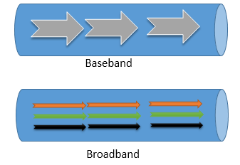
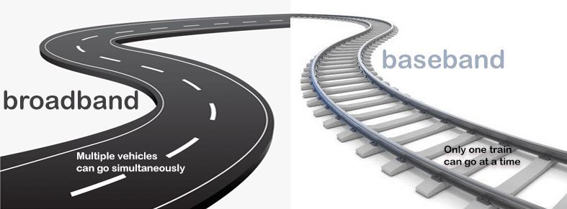
Both baseband and broadband describe how data is transmitted between two nodes.
Baseband technology transmits a single data signal/stream/channel at a time while broadband technology transmits multiple data signals/streams/channels simultaneously at the same time.

Slide 6
Differences Between Baseband and Broadband Transmissions
Baseband transmission | Broadband transmission
Transmit digital signals | Transmit analog signals
To boost signal strength, use repeaters | To boost signal strength, use amplifiers
Can transmit only a single data stream at a time | Can transmit multiple signal waves at a time
Support bidirectional communication simultaneously | Support unidirectional communication only
Support TDM based multiplexing | Support FDM based multiplexing
Use coaxial, twisted-pair, and fiber-optic cables | Use radio waves, coaxial cables, and fiber optic cables
Mainly used in Ethernet LAN networks | Cable TV, Wi-Fi, and Power Line communication are some examples

Slide 7
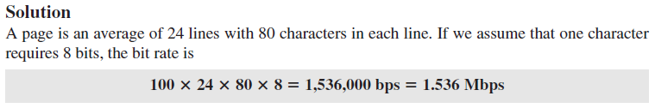
Bit Rate
Most digital signals are nonperiodic, and thus period and frequency are not appropriate characteristics
To describe digital signals another term—bit rate (instead of frequency)
Bit rate is the number of bits sent in 1s
Expressed in bits per second (bps)
Example: Assume we need to download text documents at the rate of 100 pages per second. What is the required bit rate of the channel? A page is of 24 lines with 80 characters in each line.

Slide 8
Data Rate
Factors Impacting Data Rate
An important consideration in data communications is how fast we can send data, in bits per second over a channel. Data rate depends on three factors:
The bandwidth available
The level of the signals we use
The quality of the channel (the level of noise)

Slide 9
Formulas to Calculate Data Rate
Two theoretical formulas were developed to calculate the data rate:
Nyquist Bit Rate for a noiseless channel.
Shannon Capacity for a noisy channel.

Slide 10
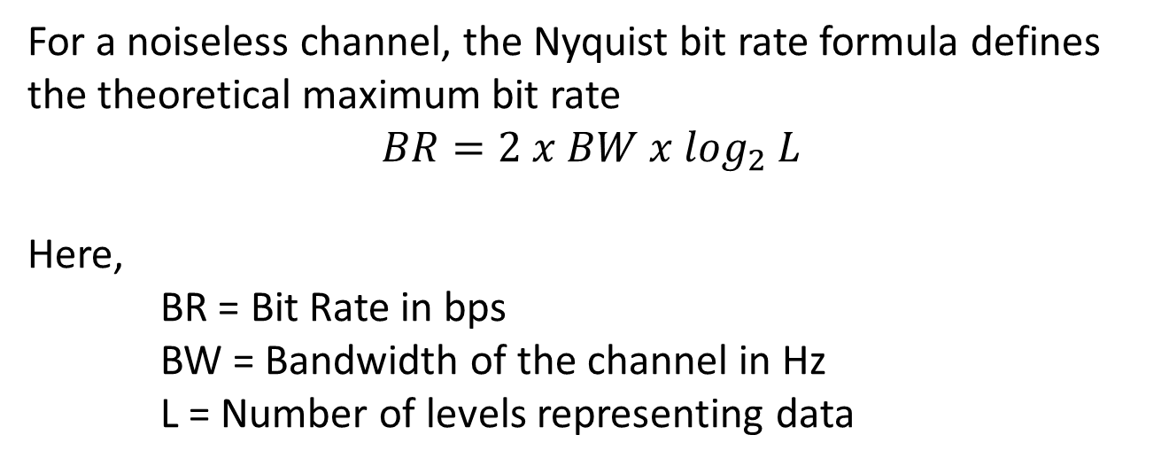
Noiseless Channel: Nyquist Bit Rate
For a noiseless channel, the Nyquist bit rate formula defines the theoretical maximum bit rate
$$BR=2 x BW x \log_{2} L$$
Here,
BR = Bit Rate in bps
BW = Bandwidth of the channel in Hz
L = Number of levels representing data

Slide 11
Noiseless Channel: Nyquist Bit Rate
From the formula it seems like, given a specific bandwidth, we can have any bit rate we want by increasing number of levels. The idea is theoretically correct, but practically there is a limit.
By increasing number of levels, we impose a burden on the receiver. If the number of levels in a signal is just 2, the receiver can easily distinguish between a 0 and a 1.
If the level of a signal is 64, the receiver must be very sophisticated to distinguish between 64 different levels. So, increasing the levels of a signal reduces the reliability of the system.

Slide 12
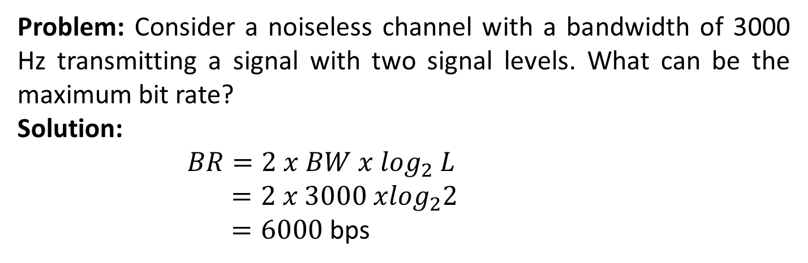
Noiseless Channel: Nyquist Bit Rate
Problem: Consider a noiseless channel with a bandwidth of 3000 Hz transmitting a signal with two signal levels. What can be the maximum bit rate?
Solution:
$$BR=2 x BW x \log_{2} L$$
$=2 x 3000 x\log_{2}2$
$=6000$ bps

Slide 13
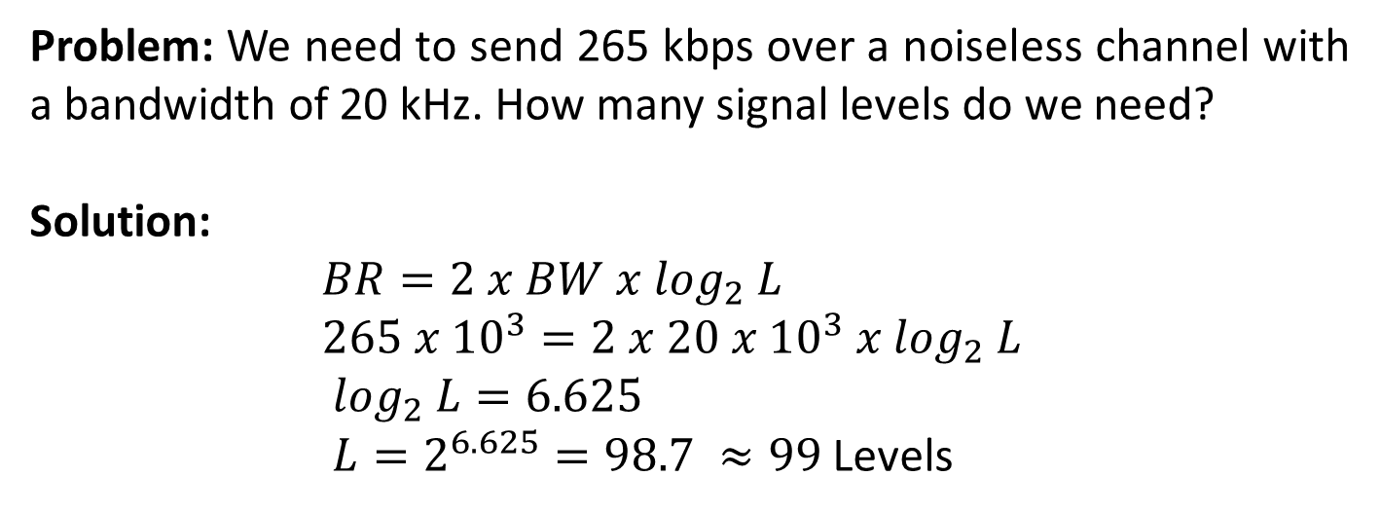
Noiseless Channel: Nyquist Bit Rate
Problem: We need to send 265 kbps over a noiseless channel with a bandwidth of 20 kHz. How many signal levels do we need?
Solution:
$BR=2 x BW x \log_{2} L$
$265 x {10}^{3}=2 x 20 x {10}^{3} x \log_{2} L$
$\log_{2} L=6.625$
$L=2^{6.625}=98.7 ≈99$ Levels

Slide 14
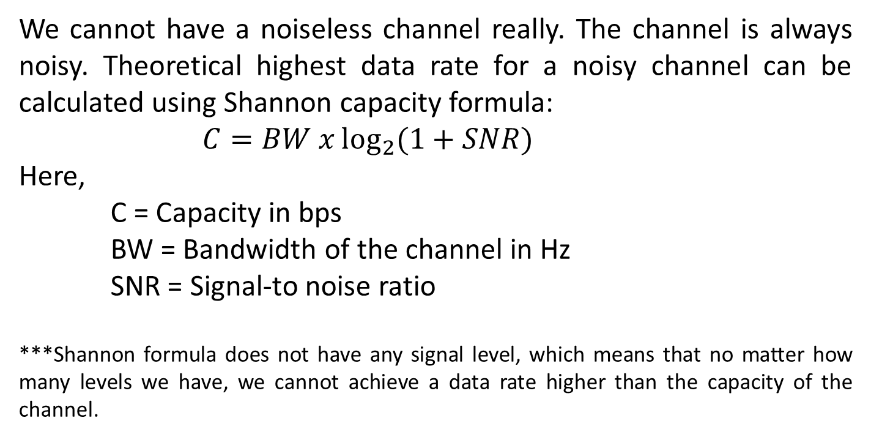
Noisy Channel: Shannon Capacity
We cannot have a noiseless channel really. The channel is always noisy. Theoretical highest data rate for a noisy channel can be calculated using Shannon capacity formula:
$C=BW x\log_{2}{(1+SNR)}$
Here,
C = Capacity in bps
BW = Bandwidth of the channel in Hz
SNR = Signal-to­ noise ratio
***Shannon formula does not have any signal level, which means that no matter how many levels we have, we cannot achieve a data rate higher than the capacity of the channel.

Slide 15
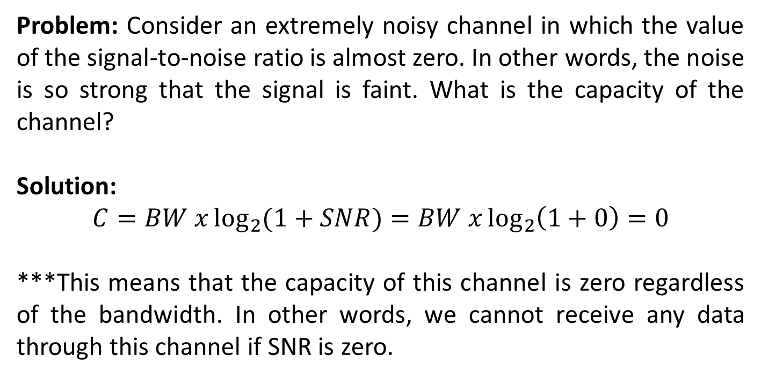
Noisy Channel: Shannon Capacity
Problem: Consider an extremely noisy channel in which the value of the signal-to-noise ratio is almost zero. In other words, the noise is so strong that the signal is faint. What is the capacity of the channel?
Solution:
$$C=BW x\log_{2}{(1+SNR)}=BW x\log_{2}\left(1+0\right)=0$$
***This means that the capacity of this channel is zero regardless of the bandwidth. In other words, we cannot receive any data through this channel if SNR is zero.

Slide 16
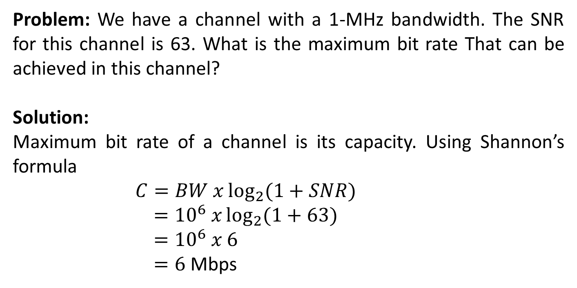
Noisy Channel: Shannon Capacity
Problem: We have a channel with a 1-MHz bandwidth. The SNR for this channel is 63. What is the maximum bit rate That can be achieved in this channel?
Solution:
Maximum bit rate of a channel is its capacity. Using Shannon’s formula
$C=BW x\log_{2}{(1+SNR)}$
$={10}^{6} x\log_{2}{(1+63)}$
$={10}^{6} x 6$
$=6$Mbps

Slide 17
Using Both Limits
Example
In practice, we need to use both methods to find the limits and signal levels.
Problem: We have a channel with a 1-MHz bandwidth. The SNR for this channel is 63. What are the appro­priate bit rate and signal level?
Solution:
From previous example we know capacity of the channel is 6 Mbps. This is the upper limit. For better performance we choose something lower, 4 Mbps, for example. Then using Nyquist formula we can find the number of signal levels.

Slide 18
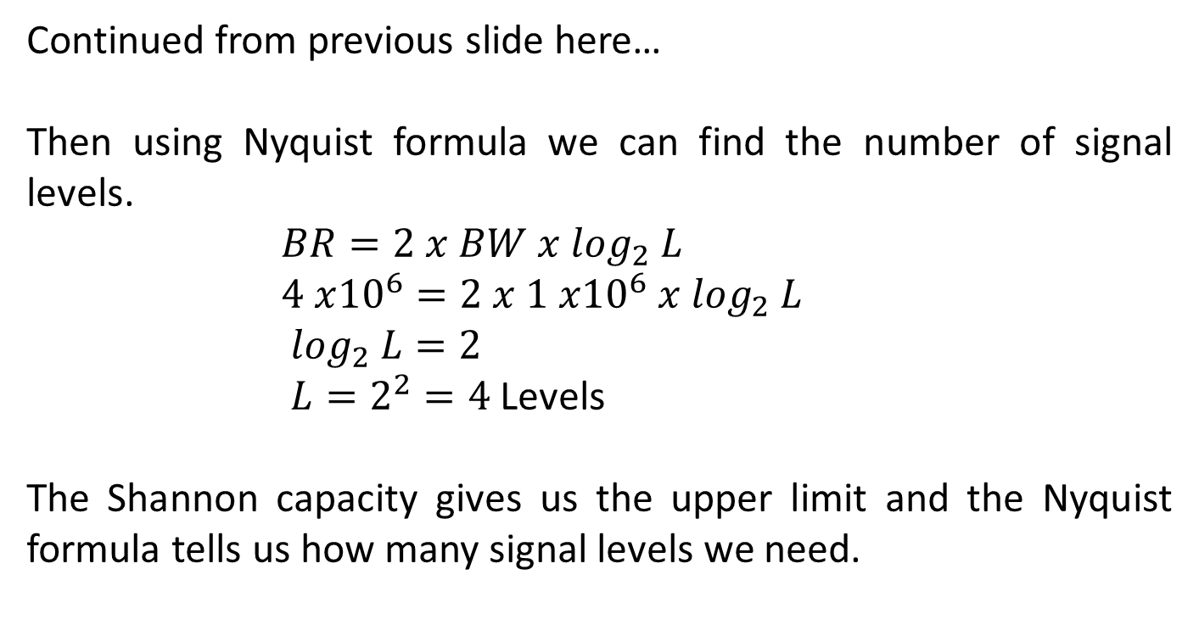
Using Both Limits
Continued from previous slide here…
Then using Nyquist formula we can find the number of signal levels.
$BR=2 x BW x \log_{2} L$
$4 x{10}^{6}=2 x 1 x{10}^{6} x \log_{2} L$
$\log_{2} L=2$
$L=2^{2}=4$ Levels
The Shannon capacity gives us the upper limit and the Nyquist formula tells us how many signal levels we need.

Slide 19
Network Performance
Quality of Service (QoS) Parameters
The Internet and its underlying local area and wide area networks must include a QoS capability to provide various levels of service to different types of application traffic. A QoS capability can deal with priority, delay constraints, delay variability constraints, and other similar requirements. Some common parameters determining the quality of network performance are:
Bandwidth
Throughput
Latency or Delay
Bandwidth-Delay Product

Slide 20
Bandwidth
One characteristic that measures network performance is bandwidth. However, the term can be used in two different contexts with two different measuring values: bandwidth in hertz and bandwidth in bits per second.
Bandwidth in Hertz: Bandwidth in hertz is the range of frequencies con­tained in a composite signal or the range of frequencies a channel can pass. For exam­ple, we can say the bandwidth of a subscriber telephone line is 4 kHz.
Bandwidth in Bits per Seconds: The term bandwidth can also refer to the number of bits per second that a channel, a link, or even a network can transmit. For example, one can say the bandwidth of a Fast Ethernet network (or the links in this network) is a maximum of 100 Mbps.

Slide 21
Bandwidth
Example 1:
The bandwidth of a subscriber line is 4 kHz for voice or data. The bandwidth of this line for data trans­mission can be up to 56,000 bps using a sophisticated modem to change the digital signal to analog.
Example 2:
If the telephone company improves the quality of the line and increases the bandwidth to 8 kHz, we can send 112,000 bps by using the same technology as mentioned in Example 1.

Slide 22
Throughput
Throughput is a measure of how fast we actually can send data through a network.
At first glance, bandwidth in bits per second and throughput seem the same, they are different.
A link may have a bandwidth of B bps, but we can only send T bps through this link with T always less than B.
In other words, the bandwidth is a potential measurement of a link; the throughput is an actual measurement of how fast we can send data.

Slide 23
Throughput
Example 1:
Imagine a highway designed to transmit 1000 cars per minute from one point to another. However, if there is congestion on the road, this figure may be reduced to 100 cars per minute. The bandwidth is 1000 cars per minute; the throughput is 100 cars per minute.
Example 2:
We may have a link with a bandwidth of 1 Mbps, but the devices connected to the end of the link may handle only 200 kbps. This means that we cannot send more than 200 kbps through this link.

Slide 24
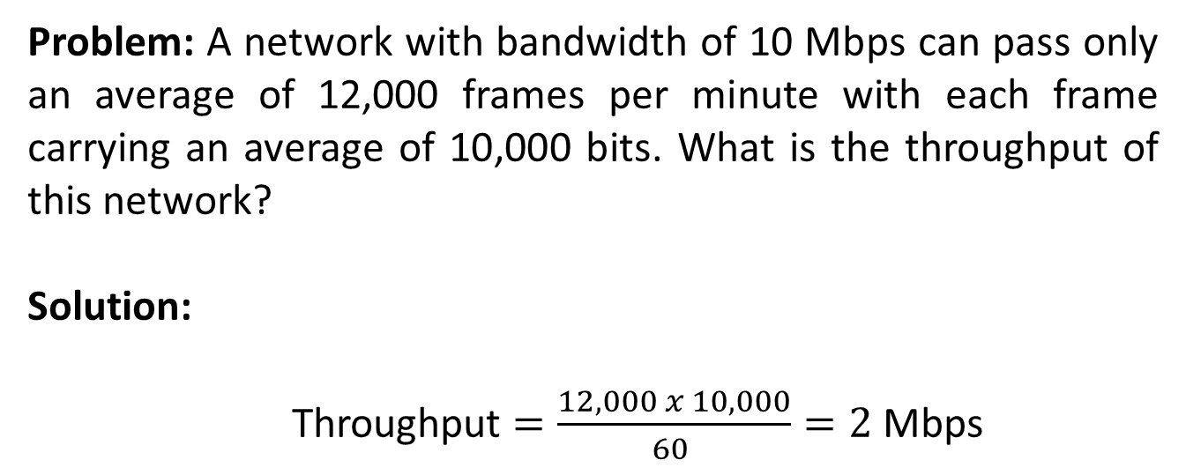
Throughput
Problem: A network with bandwidth of 10 Mbps can pass only an average of 12,000 frames per minute with each frame carrying an average of 10,000 bits. What is the throughput of this network?
Solution:
Throughput $=\frac{12,000 x 10,000}{60 }=2$ Mbps

Slide 25
Latency or Delay
The latency or delay defines how long it takes for an entire message to completely arrive at the destination from the time the first bit is sent out from the source. We can say that latency is made of four components: propagation time, transmission time, queuing time and processing delay.
Latency = propagation time + transmission time + queuing time + processing delay
*Propagation delay is how long it takes one bit to travel from one end of the "wire" to the other. (it's proportional to the length of the wire).
*Transmission delay is how long it takes to get all the bits from sender to receiver.

Slide 26
Bandwidth-Delay Product
Bandwidth and delay are two performance metrics of a link. However, a very important performance metrics in data communications is the product of the two, the bandwidth-delay product. We will elaborate on this issue, using two hypothetical cases as examples in next slides.
The bandwidth-delay product defines the number of bits that can fill the link.

Slide 27
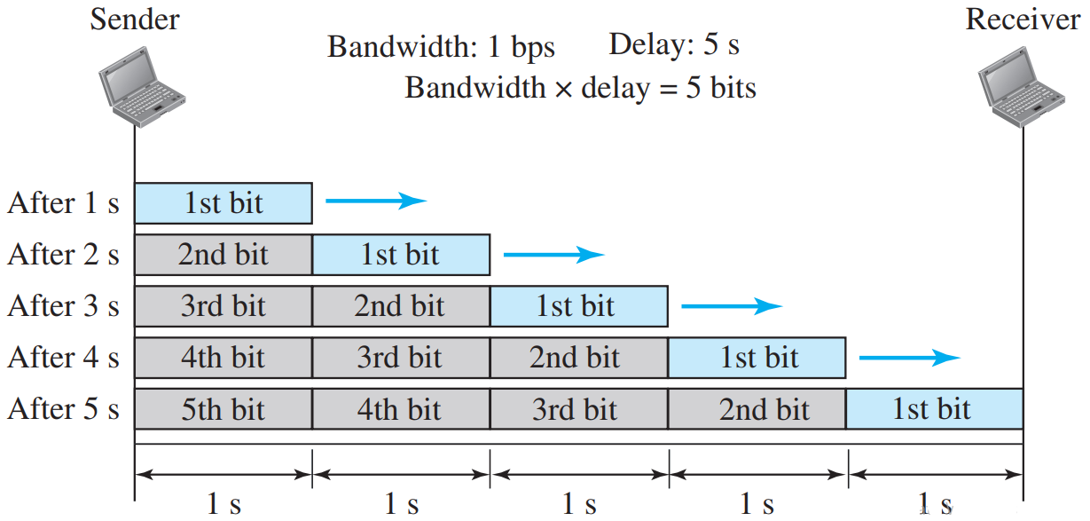
Case 1

Slide 28
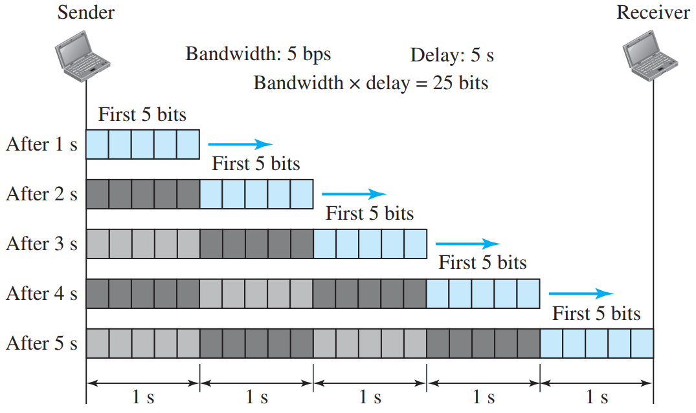
Case 2

Slide 29
Case Study Outcome
Looking at case 1, we can say that this product 1 x 5 or 5 is the maximum number of bits that can fill the link. There can be no more than 5 bits at any time on the link.
Looking at case 2, we can say that this product 5 x 5 or 25 is the maximum number of bits that can fill the link. There can be no more than 25 bits at any time on the link.
The bandwidth-delay product defines the number of bits that can fill the link.

Slide 30
Books
1. Forouzan, B. A. "Data Communication and Networking. Tata McGraw." (2005).

Slide 31
References
1. Prakash C. Gupta, “Data communications”, Prentice Hall India Pvt.
2. William Stallings, "Data and Computer Communications”, Pearson
3. Forouzan, B. A. "Data Communication and Networking. Tata McGraw." (2005).

