Slide 1
Data & Signals (Part 2)
Course Code: COE 3201
Course Title: Data Communication
Dept. of Computer Engineering
Faculty of Engineering
Lecture No: | 6 | Week No: | 6 | Semester:
Lecturer:

Slide 2
Lecture Outline
Analog to Digital Conversion
Pulse Code Modulation (PCM)

Slide 3
Analog to Digital Conversion
Sometimes we may want to change an analog signal in our hand to a digital signal (analog to digital conversion) before transmission due to digital signal’s superiority over analog signal. Some of the reasons why digital signal is preferable over analog signal are as follows:
Digital is more robust than analog to noise and interference
Digital is more viable to using regenerative repeaters
Digital hardware more flexible by using microprocessors and VLSI
Can be coded to yield extremely low error rates with error correction
Easier to multiplex several digital signals than analog signals
Digital is more efficient in trading off SNR for bandwidth

Slide 4
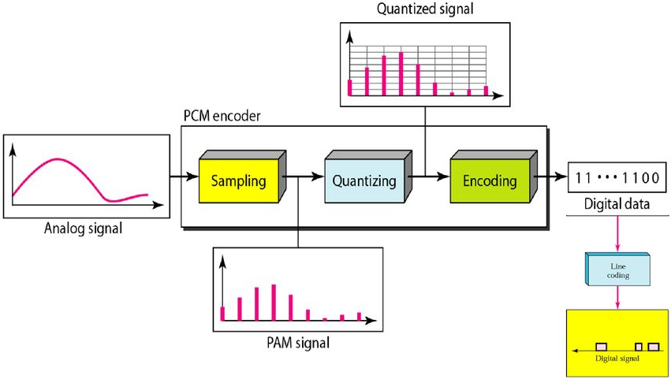
Pulse Code Modulation

Slide 5
Pulse Code Modulation (PCM)
A PCM encoder has three processes:
The analog signal is sampled.
The sampled signal is quantized.
The quantized values are encoded as streams of bits.
Sampling:
The first step in PCM is sampling. The analog signal is sampled every T_{s} s, where T_{s} is the sample interval or period.
The inverse of the sampling interval is called the sampling rate or sampling frequency and denoted by f_{s}, where f_{s} = 1/T_{s}.

Slide 6
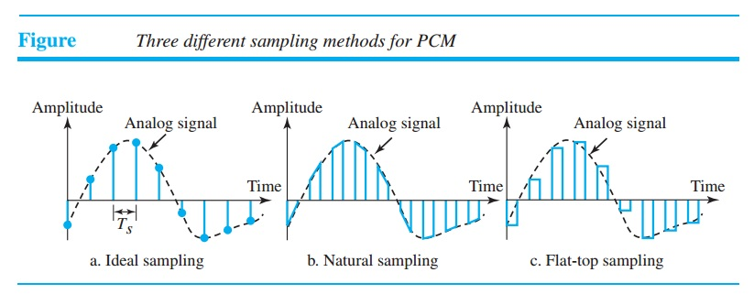
Pulse Code Modulation (PCM)
There are three sampling methods—ideal, natural, and flat-top—as shown in the figure below

Slide 7
Pulse Code Modulation (PCM)
In ideal sampling, pulses from the analog signal are sampled. This is an ideal sampling method and cannot be easily implemented.
In natural sampling, a high-speed switch is turned on for only a small period when the sampling occurs. The result is a sequence of samples that retains the shape of the analog signal.
The most common sampling method, called sample and hold, however, creates flat-top samples by using a circuit.
The sampling process is sometimes referred to as pulse amplitude modulation (PAM).

Slide 8
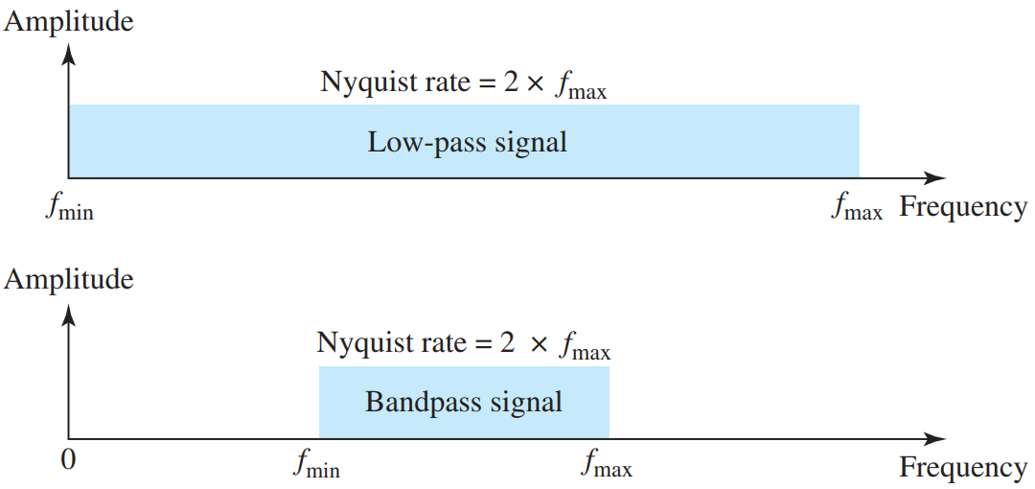
Pulse Code Modulation (PCM)
According to the Nyquist theorem, the sampling rate must be at least 2 times the highest frequency contained in the signal.

Slide 9
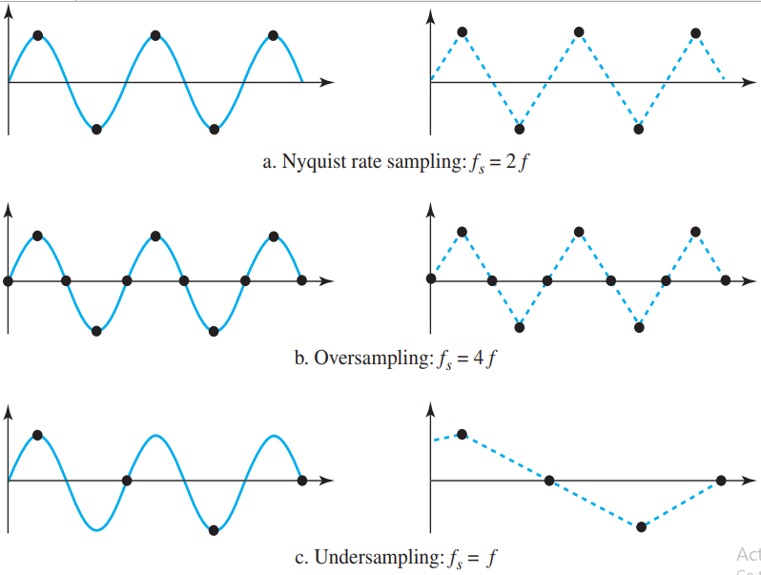
Pulse Code Modulation (PCM)
The following figure shows the sampling and the subsequent recovery of a sinusoidal signal.

Slide 10
Pulse Code Modulation (PCM)
Quantization:
The result of sampling is a series of pulses with amplitude values between the maximum and minimum amplitudes of the signal. The set of amplitudes can be infinite with non-integral values between the two limits. These values cannot be used in the encoding process.

Slide 11
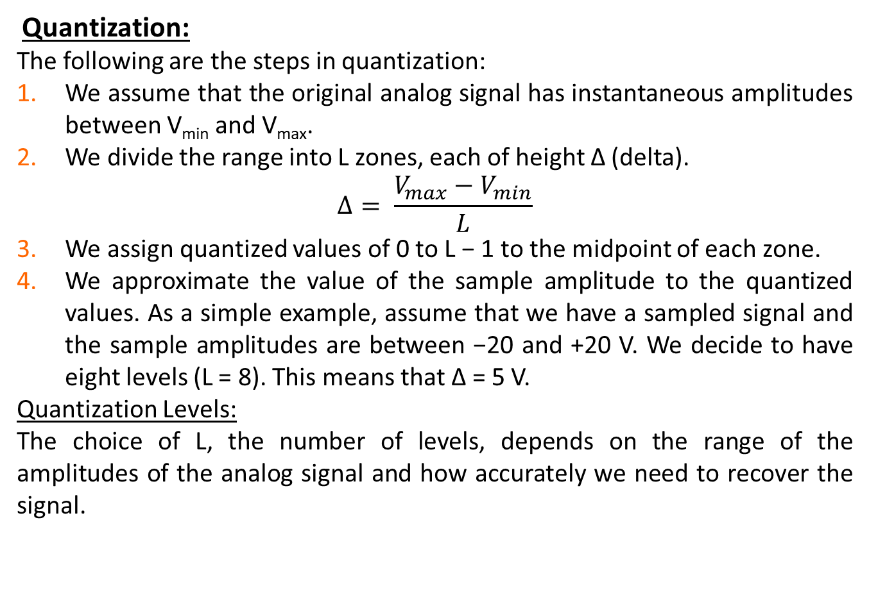
Pulse Code Modulation (PCM)
Quantization:
The following are the steps in quantization:
We assume that the original analog signal has instantaneous amplitudes between V_{min} and V_{max}.
We divide the range into L zones, each of height Δ (delta).
$$Δ= \frac{V_{max}−V_{min}}{L}$$
We assign quantized values of 0 to L − 1 to the midpoint of each zone.
We approximate the value of the sample amplitude to the quantized values. As a simple example, assume that we have a sampled signal and the sample amplitudes are between −20 and +20 V. We decide to have eight levels (L = 8). This means that Δ = 5 V.
Quantization Levels:
The choice of L, the number of levels, depends on the range of the amplitudes of the analog signal and how accurately we need to recover the signal.

Slide 12
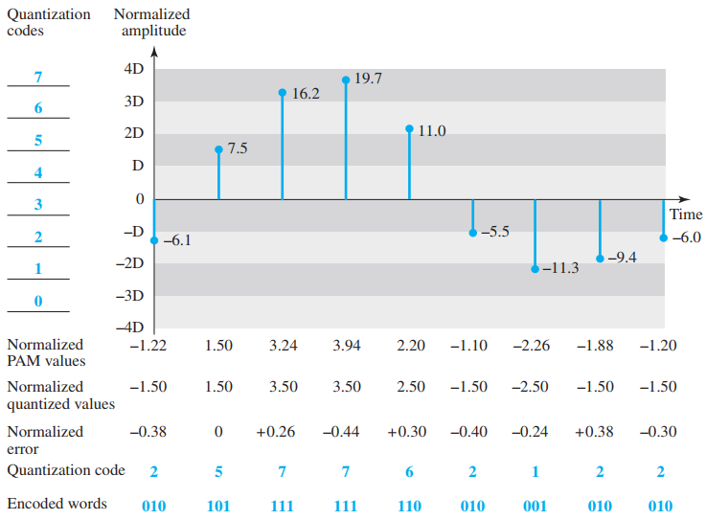
Quantization Example

Slide 13
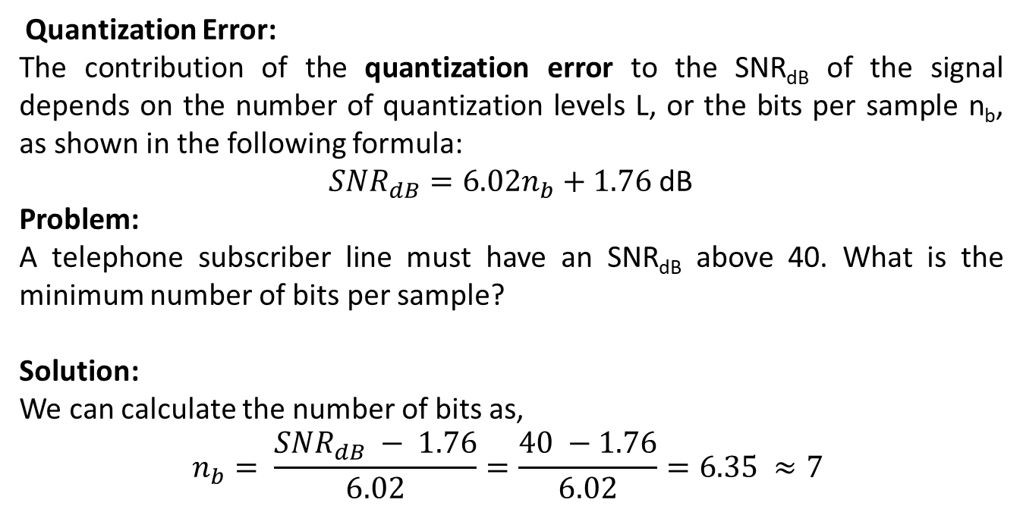
Pulse Code Modulation (PCM)
Quantization Error:
The contribution of the quantization error to the SNR_{dB} of the signal depends on the number of quantization levels L, or the bits per sample n_{b}, as shown in the following formula:
${SNR}_{dB}=6.02n_{b}+1.76$ dB
Problem:
A telephone subscriber line must have an SNR_{dB} above 40. What is the minimum number of bits per sample?
Solution:
We can calculate the number of bits as,
$$n_{b}= \frac{{SNR}_{dB} − 1.76}{6.02}=\frac{40 −1.76}{6.02}=6.35 ≈7$$

Slide 14
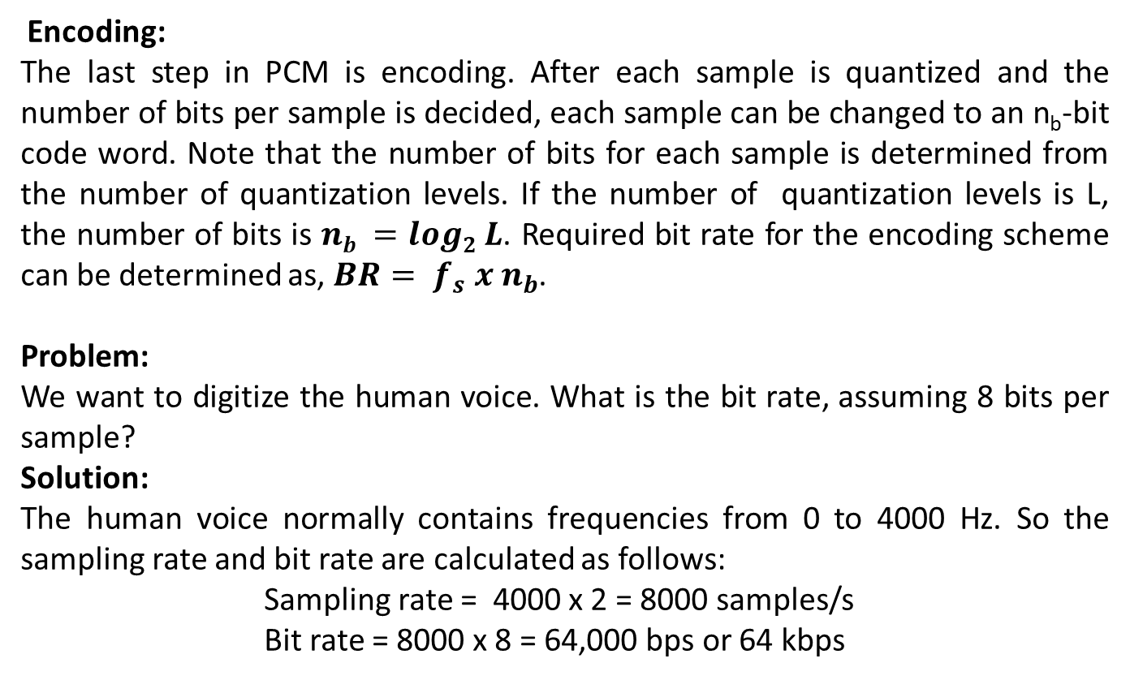
Pulse Code Modulation (PCM)
Encoding:
The last step in PCM is encoding. After each sample is quantized and the number of bits per sample is decided, each sample can be changed to an n_{b}-bit code word. Note that the number of bits for each sample is determined from the number of quantization levels. If the number of quantization levels is L, the number of bits is $nb =log2 L$. Required bit rate for the encoding scheme can be determined as, $BR= f_{s} x n_{b}$.
Problem:
We want to digitize the human voice. What is the bit rate, assuming 8 bits per sample?
Solution:
The human voice normally contains frequencies from 0 to 4000 Hz. So the sampling rate and bit rate are calculated as follows:
Sampling rate = 4000 x 2 = 8000 samples/s
Bit rate = 8000 x 8 = 64,000 bps or 64 kbps

Slide 15
Pulse Code Modulation (PCM)
Original Signal Recovery:
The recovery of the original signal requires the PCM decoder. The decoder first uses circuitry to convert the code words into a pulse that holds the amplitude until the next pulse.
After the staircase signal is completed, it is passed through a low-pass filter to smooth the staircase signal into an analog signal.
The filter has the same cutoff frequency as the original signal at the sender. If the signal has been sampled at (or greater than) the Nyquist sampling rate and if there are enough quantization levels, the original signal will be recreated.
Note that the maximum and minimum values of the original signal can be achieved by using amplification.

Slide 16
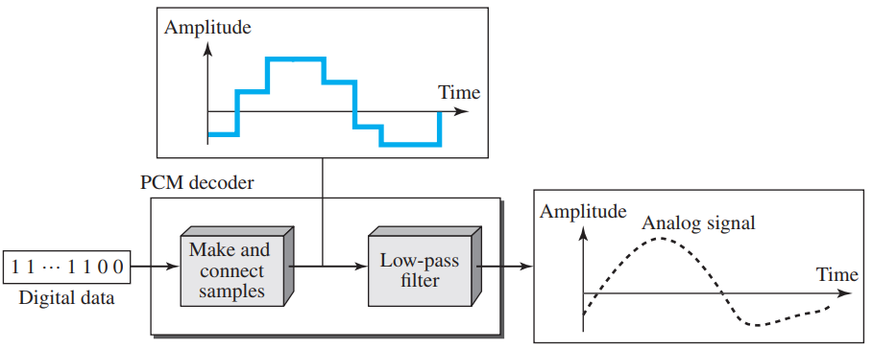
Pulse Code Modulation (PCM)
Components of a PCM Decoder:

Slide 17
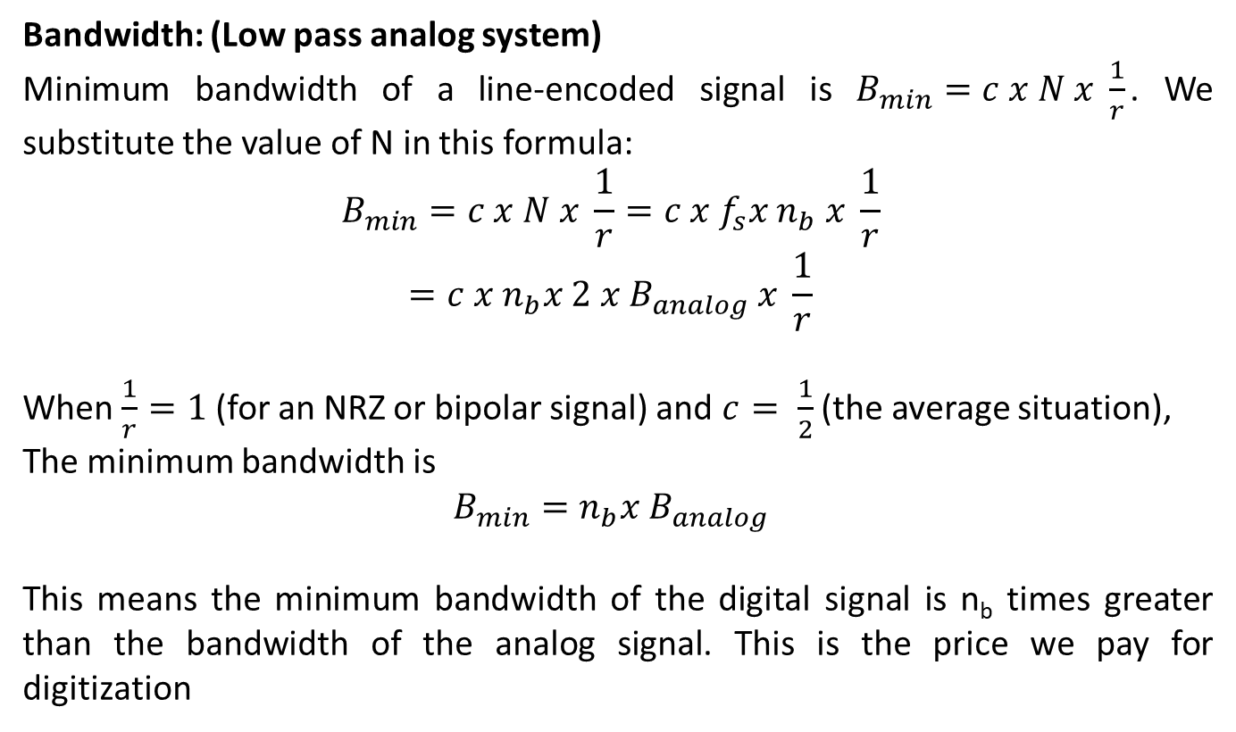
Pulse Code Modulation (PCM)
Bandwidth: (Low pass analog system)
Minimum bandwidth of a line-encoded signal is $B_{min}=c x N x \frac{1}{r}$. We substitute the value of N in this formula:
$$B_{min}=c x N x \frac{1}{r}=c x f_{s}x n_{b} x \frac{1}{r}$$
$$=c x n_{b}x 2 x B_{analog} x \frac{1}{r}$$
When $\frac{1}{r}=1$ (for an NRZ or bipolar signal) and $c= \frac{1}{2}$(the average situation),
The minimum bandwidth is
$$B_{min}=n_{b}x B_{analog}$$
This means the minimum bandwidth of the digital signal is n_{b} times greater than the bandwidth of the analog signal. This is the price we pay for digitization

Slide 18
Books
1. Forouzan, B. A. "Data Communication and Networking. Tata McGraw." (2005).

Slide 19
References
1. Prakash C. Gupta, “Data communications”, Prentice Hall India Pvt.
2. William Stallings, "Data and Computer Communications”, Pearson
3. Forouzan, B. A. "Data Communication and Networking. Tata McGraw." (2005).

