Slide 1
Data Structure
Graph

Slide 2
Graphs - Background
A graph is a pictorial representation of a set of objects where some pairs of objects are connected by links.
The interconnected objects are represented by points termed as vertices, and the links that connect the vertices are called edges.

Slide 3
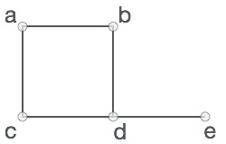
Graphs - Background
Graphs = a set of nodes (vertices) with edges (links) between them.
Notations:
G = (V, E) - graph
V = set of vertices ⎜V ⎜= total vertex
E = set of edges ⎜E ⎜= total edges
In the above graph,
V = {a, b, c, d, e}
E = {ab, ac, bd, cd, de}
1
2
1
2
1
2
3
4
3
4
3
4
Directed
graph
Undirected
graph
Acyclic
graph

Slide 4
Graph Introduction
Graph G = (V, E)
  V = {1,…n} = set of vertices, E = set of e edges, | E | = total edges, | V | = total vertex.
  Undirected graph:
    edge (u, v) = edge (v, u)
    no self-loops
  Directed graph (digraph):
    edge (u, v) goes from vertex u to vertex v
  Degree of a vertex v:
    degree(v) = number of edges adjacent on v (in-degree and out-degree for directed graphs)

Slide 5
Why self-loops are forbidden in undirected graph?
Simple answers would be that
      It contradicts with Sum of degree theorem.
now what is Sum of degree theorem :-
it states that total sum of degree of all the vertices in a graph is equal to twice the number of total edges .

Slide 6
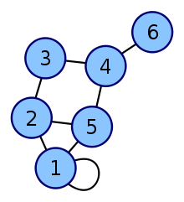
Why self-loops are forbidden in undirected graph?
let us assume the following graph:-
here vertex 1 has self loop and self loop is also considered as an Edge.
so total number of edges(including self loop) = 8
so sum of degree = 2*8=16
But degree(1)=3, degree(2)=3, degree(5)=3
degree(3)=2 degree(4)=3 degree(6)=1
so total sum of degree= 3+3+3+2+3+1=15,which
is a contradiction to degree calculated as
in Sum of degree theorem .
That’s why self-loops are forbidden in undirected graph.

Slide 7
Graph Data Structure
Mathematical graphs can be represented in data-structure.
We can represent a graph using an array of vertices and a two dimensional array of edges.
Some important terms −
  Vertex − Each node of the graph is represented as a vertex.
  Edge − Edge represents a path between two vertices or a line between two vertices.
  Adjacency − Two node or vertices are adjacent if they are connected to each other through an edge. In example given earlier, b is adjacent to a, d; c is adjacent to a, b and so on.
  Path − Path represents a sequence of edges between two vertices. In example given previous, abde represents a path from a to e.

Slide 8
Kinds of Graphs
Various flavors of graphs have the following specializations and particulars about how they are usually drawn.
Undirected Graphs - In an undirected graph, the order of the vertices in the pairs in the Edge set doesn't matter. Undirected graphs usually are drawn with straight lines between the vertices. The adjacency relation is symmetric in an undirected graph, so if u ~ v then it is also the case that v ~ u.
Directed Graphs - In a directed graph the order of the vertices in the pairs in the edge set matters. For directed graphs we usually use arrows for the arcs between vertices. An arrow from u to v is drawn only if (u,v) is in the Edge set.

Slide 9
Graphs...
Weighted graph: associates weights with either the edges or the vertices
Acyclic: if a graph contains no cycles
DAG: Directed acyclic graphs
Connected: if every vertex of a graph can reach every other vertex, i.e., every pair of vertices is connected by a path
Strongly connected: every 2 vertices are reachable from each other (in a digraph)

Slide 10


Forests, DAG, Components
Weighted Graph

Slide 11
Applications—Communication Network
2
3
8
1
10
4
5
9
11
6
7
Vertex = city, edge = communication link.

Slide 12
Applications—Driving Distance/Time Map
2
4
3
8
8
1
6
10
2
4
5
4
4
3
5
9
11
5
6
6
7
7
Vertex = city, edge weight = driving distance/time.

Slide 13
Applications—Street Map
2
3
8
1
10
4
5
9
11
6
7
Some streets are one way.

Slide 14
Undirected Graph
2
3
8
1
10
4
5
9
11
6
7
In the above graph,
V = {1,2,3,4,5,6,7,8,9,10,11}
E = {12, 14, 25, 35, 46, 57, 67, 89, (8,11), (10,11)}

Slide 15
Directed Graph (Digraph)
2
3
8
1
10
4
5
9
11
6
7

Slide 16
Applications
It has applications in diverse fields of science and engineering:
Computer Science − Graph theory is used for the study of various algorithms. For example, Shortest path calculation.
Computer Network − The relationships among interconnected computers in the network follows the principles of graph theory.
The graphic representation of world wide web (www)
Resource allocation graph for processes that are active in the system.
The graphic representation of a map
Scene graphs: The contents of a visual scene are also managed by using graph data structure.
The concepts of graph theory is used extensively in designing circuit connections. Some examples for topologies are star, bridge, series, and parallel topologies.

Slide 17
Continuation………
Science − The molecular structure and chemical structure of a substance, the DNA structure of an organism, etc., are represented by graphs.
Linguistics − The parsing tree of a language and grammar of a language uses graphs.
General − Routes between the cities can be represented using graphs. Depicting hierarchical ordered information such as family tree can be used as a special type of graph called tree.

Slide 18
Driving Distance/Time Map
2
4
3
8
8
1
6
10
2
4
5
4
4
3
5
9
11
5
6
6
7
7
Vertex = city, edge weight = driving distance/time.

Slide 19
Undirected Graph Representation:
Adjacency Matrix representation
0/1.. n x n matrix, where n = # of vertices
A(x,y) = 1 iff (x,y) is an edge, otherwise A(x,y)=0
1
2
3
4
5
2
1
0
1
0
1
0
3
2
1
0
0
0
1
1
3
0
0
0
0
1
4
4
1
0
0
0
1
5
5
0
1
1
1
0

Slide 20
Adjacency Matrix Properties
1
2
3
4
5
2
1
0
1
0
1
0
3
2
1
0
0
0
1
1
3
0
0
0
0
1
4
4
1
0
0
0
1
5
5
0
1
1
1
0
Diagonal entries are zero.
Adjacency matrix of an undirected graph is symmetric.
  A(i,j) = A(j,i) for all i and j.

Slide 21
Graph Representation
Adjacency matrix: represents a graph as n x n matrix A:
  A[i, j] = 1 if edge (i, j) ∈ E (or weight of edge)
  = 0 if edge (i, j) ∉ E
  Storage requirements: O(n²)
    A dense representation
    But, can be very efficient for small graphs
      Especially if store just one bit/edge
      Undirected graph: only need half of matrix
Adjacency list: list of adjacent vertices
  For each vertex v ∈ V, store a list of vertices adjacent to v
  Storage requirements: O(n+e)
    Good for large graphs

Slide 22
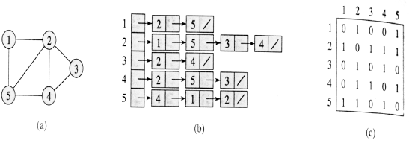
Representing Graph
Two representations of an undirected graph.
  An undirected graph G having five vertices and seven edges.
  An adjacency-list representation of G.
  The adjacency-matrix representation of G.

Slide 23
Implementation of Graph by Two-dimensional Array
#include<iostream>
using namespace std;
#define CONNECTED 1
#define DISCONNECTED 0
int main()
{
int nodes, edges, x,y;
cout<<"How many nodes? "<<endl;
cin>>nodes;
//Declere the matrix for graph
int Graph[nodes+1][nodes+1];

Slide 24
Continuation………
// initializing matrix by zero using no. of nodes
int i,j;
for( i=1;i<=nodes; i++)
for( j=1; j<=nodes; j++)
{
Graph[i][j]= DISCONNECTED;
}
cout<<"How many edges? ";
cin>>edges;
// take connected edge info from user and initialize graph
for(i=1; i<=edges; i++)
{
cout<<"Enter node x and y for edge "<<i<<endl;
cin>>x>>y;
Graph[x][y]=Graph[y][x]= CONNECTED;
}

Slide 25
Continuation….
//Print the adjacent matrix
cout<<"Adjacent Matrix: "<<endl;
for( i=1;i<=nodes; i++)
{
for( j=1; j<=nodes; j++)
{
cout<<Graph[i][j]<<" ";
}
cout<<endl;
}
return 0;
}

Slide 26
Spanning Tree
A spanning tree is a subset of Graph G, which has all the vertices covered with minimum possible number of edges.
Hence, a spanning tree does not have cycles and it can not be disconnected.
Subgraph is a tree.
  If original graph has n vertices, the spanning tree has n vertices and n-1 edges.

Slide 27
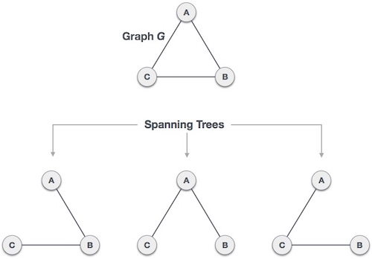
A complete undirected graph can have maximum n^{n-2} number of spanning trees,
where n is number of nodes. In addressed example, n is 3, hence 3³⁻² = 3 spanning trees are possible.

Slide 28
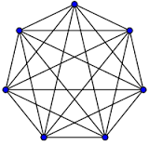
What is a Complete graph ?
In the mathematical field of graph theory, a complete graph is a simple undirected graph in which every pair of distinct vertices is connected by a unique edge.

Slide 29
General properties of spanning tree
Below are few properties of spanning tree of given connected graph G −
A connected graph G can have more than one spanning tree.
All possible spanning trees of graph G, have same number vertices.
Spanning tree does not have any cycle (loops)
Removing one edge from spanning tree will make the graph disconnected i.e. spanning tree is minimally connected.
Adding one edge to a spanning tree will create a circuit or loop i.e. spanning tree is maximally acyclic.

Slide 30
Mathematical properties of spanning tree
Spanning tree has n-1 edges, where n is number of nodes (vertices)
From a complete graph, by removing maximum e-n+1 edges, we can construct a spanning tree.
A complete graph can have maximum n^{n-2} number of spanning trees.

Slide 31
A Spanning Tree
2
4
3
8
8
1
6
10
2
4
5
4
4
3
5
9
8
11
5
6
2
6
7
7

Slide 32
A Spanning Tree
2
4
3
8
8
1
6
10
2
4
5
4
4
3
5
9
8
11
5
6
2
6
7
7
Spanning tree cost = 51.

Slide 33
Minimum Cost Spanning Tree
2
4
3
8
8
1
6
10
2
4
5
4
4
3
5
9
8
11
5
6
2
6
7
7
Spanning tree cost = 41.
Notes:
In the communication networks area, we are interested in finding minimum cost spanning trees.

Slide 34
Application of Spanning Tree
Spanning tree is basically used to find minimum paths to connect all nodes in a graph. Common application of spanning trees are −
  Civil Network Planning
  Computer Network Routing Protocol
  Cluster Analysis

Slide 35
Graph Traversal/Search Methods
Many graph problems solved using a search method.
  Path from one vertex to another.
  Is the graph connected?
  Find a spanning tree ….Etc.
Commonly used search methods:
  Breadth-first search (BFS).
  Depth-first search (DFS).

Slide 36
Graph Searching/Traversing
Given: a graph G = (V, E), directed or undirected
Goal: methodically explore every vertex and edge
Ultimately: build a tree on the graph
  Pick a vertex as the root
  Choose certain edges to produce a tree
  Note: might also build a forest if graph is not connected
Many graph problems solved using a search method.
  Path from one vertex to another.
  Is the graph connected?
  Find a spanning tree.
  Etc.
Commonly used search methods:
  Breadth-first search
  Depth-first search

Slide 37
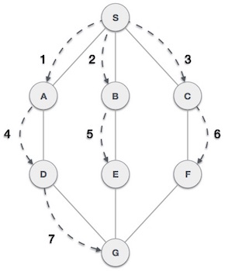
Breadth First Traversal (BFS)
Breadth First Search algorithm(BFS) traverses a graph in a breadth wards motion and uses a queue to remember to get the next vertex to start a search when a dead end occurs in any iteration.
As in example given above, BFS algorithm traverses from A to B to C to D first then to E and F lastly to G.

Slide 38
BFS Algorithm
Rule 1 − Visit adjacent unvisited node. Mark the node and Insert it in a queue.
Rule 2 − If no adjacent node found unvisited, remove the first node from the queue.
Rule 3 − Repeat Rule 1 and Rule 2 until queue is empty.

Slide 39
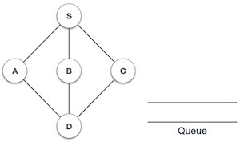
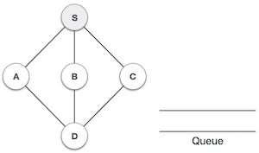
Step | Traversal | Description
1. |  | Initialize the queue.
2. |  | We start from visiting S(starting node), and mark it visited.

Slide 40
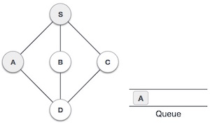
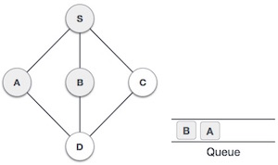
Continuation………
3. |  | We then see unvisited adjacent node from S. In this example, we have three nodes but alphabetically we choose A mark it visited and enqueue it.
4. |  | Next unvisited adjacent node from S is B. We mark it visited and enqueue it.

Slide 41
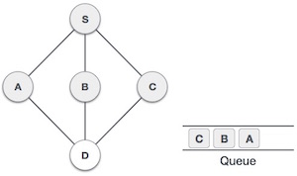
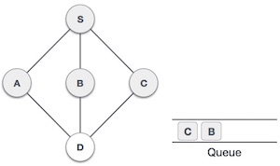
Continuation………
5. |  | Next unvisited adjacent node from S is C. We mark it visited and enqueue it.
6. |  | Now S is left with no unvisited adjacent nodes. So we dequeue and find A.

Slide 42
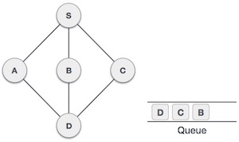
Continuation………
7. |  | From A we have D as unvisited adjacent node. We mark it visited and enqueue it.
At this stage we are left with no unmarked (unvisited) nodes. But as per algorithm we keep on dequeuing in order to get all unvisited nodes. When the queue gets emptied the program is over.

Slide 43

BFS Example

Slide 44

BFS Example

Slide 45

BFS Example

Slide 46

BFS Example

Slide 47

BFS Example

Slide 48

BFS Example

Slide 49

BFS Example

Slide 50

BFS Example

Slide 51

BFS Example

Slide 52

BFS Example

Slide 53

BFS Example

Slide 54

BFS Example

Slide 55
The implementation of BFS algorithm in C++
#include<iostream>
using namespace std;
#define unvisited -1
#define marked 0
#define visited 1
#define CONNECTED 1
#define DISCONNECTED 0
#define SIZE 100
int graph[SIZE+1][SIZE+1], label[SIZE+1];
int queue[SIZE], head, tail;
int nodes, edges;
void initialize_queue()
{
head = tail = 0;
}
void enqueue(int node)
{
queue[tail++] = node;
}
int dequeue()
{
return queue[head++];
}
bool queue_empty()
{
return head == tail;
}
void BFS(int source, int nodes);

Slide 56
The implementation of BFS algorithm in C++ (continuation…)
int main()
{
int x, y, source;
cout<<"No. of nodes: ";
cin>>nodes;
for(int i=1; i<=nodes; i++)
for(int j=1; j<=nodes; j++)
graph[i][j] = DISCONNECTED;
cout<<"No. of edges: ";
cin>>edges;
for(int i=1; i<=edges; i++)
{
cout<<"Enter vertes x and y for edge: "<< i;
cin>>x >>y;
graph[x][y] = graph[y][x] = CONNECTED;
}
initialize_queue(); // initialize queue before using
cout<<"Give source:" ; cin>>source;
BFS(source, nodes); // call bfs for graph
return 0;
}
// initializing graph with 0 using no. of nodes
// take edge info from user and initialize graph

Slide 57
void BFS(int source, int nodes)
{
for(int i=1; i<=nodes; i++)
label[i] = unvisited;
enqueue(source);
label[source] = marked;
while(!queue_empty()) // repeat until queue is empty
{
int vn = dequeue();
cout<< vn;<< " "; // print nodes in visiting sequence i.e. spanning tree
for(int v=1; v<=nodes; v++) // check all nodes for neighbour
{
if(graph[vn][v] == CONNECTED) // check connected node
{
if(label[v] == unvisited) // check if node is undiscovered
{
label[v] = marked; // mark node as discovered
enqueue(v); // insert neighbour into the queue}
}
}
label[vn] = visited; // mark node as finished
}
cout<<endl;
}
// initially mark all nodes as undiscovered
// inserting source into the queue and modifying relevant values

Slide 58
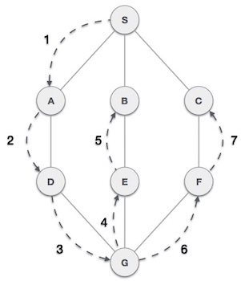
Depth First Traversal (DFS)
Depth First Search algorithm(DFS) traverses a graph in a depth ward motion and uses a stack to remember to get the next vertex to start a search when a dead end occurs in any iteration.

Slide 59
DFS Algorithm
Rule 1 − Visit adjacent unvisited vertex. Mark it visited. Display it. Push it in a stack.
Rule 2 − If no adjacent vertex found, pop up a vertex from stack. (It will pop up all the vertices from the stack which do not have adjacent vertices.)
Rule 3 − Repeat Rule 1 and Rule 2 until stack is empty.

Slide 60
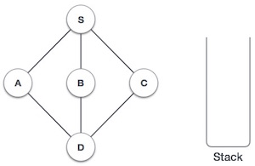
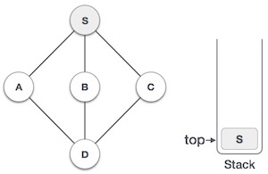
Step | Traversal | Description
1. |  | Initialize the stack
2. |  | Mark S as visited and put it onto the stack. Explore any unvisited adjacent node from S. We have three nodes and we can pick any of them. For this example, we shall take the node in alphabetical order.

Slide 61
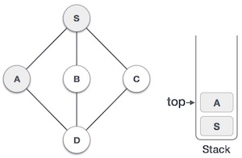
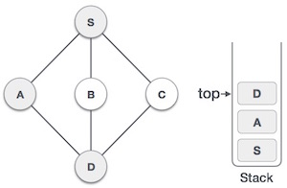
Step | Traversal | Description
3. |  | Mark A as visited and put it onto the stack. Explore any unvisited adjacent node from A. Both S and D are adjacent to A but we are concerned for unvisited nodes only.
4. |  | Visit D and mark it visited and put onto the stack. Here we have B and C nodes which are adjacent to D and both are unvisited. But we shall again choose in alphabetical order.

Slide 62
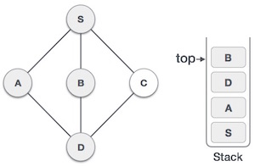
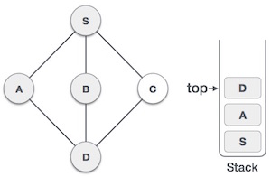
Step | Traversal | Description
5. |  | We choose B, mark it visited and put onto stack. Here B does not have any unvisited adjacent node. So we pop B from the stack.
6. |  | We check stack top for return to previous node and check if it has any unvisited nodes. Here, we find D to be on the top of stack.

Slide 63
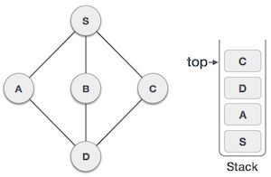
Continuation………
7. |  | Only unvisited adjacent node is from D is C now. So we visit C, mark it visited and put it onto the stack.
As C does not have any unvisited adjacent node so we keep popping the stack until we find a node which has unvisited adjacent node. In this case, there's none and we keep popping until stack is empty.

Slide 64
Depth-First Search (DFS)
Explore “deeper” in the graph whenever possible
  Edges are explored/visited out of the most recently discovered vertex v that still has unexplored/unvisited edges (LIFO)
  When all of v’s edges have been explored, backtrack to the vertex from which v was discovered.
  computes 2 timestamps: d[ ] (discovered) and f[ ] (finished)
  builds one or more depth-first tree(s) (depth-first forest)
Algorithm colors each vertex
  WHITE: undiscovered
  GRAY: discovered, in process
  BLACK: finished, all adjacent vertices have been discovered

Slide 65
Depth-First Search: The Code
DFS( G ){
  for each vertex u ∈ V
  color[u] = WHITE;
  time = 0;
  for each vertex u ∈ V
  if (color[u] == WHITE)
  DFS_Visit( u );
}
DFS_Visit( u ){
  color[u] = GREY;
  time = time+1;
  d[u] = time; // compute d[]
  for each v adjacent to u
    if (color[v] == WHITE)
      p[v]= u // build tree
      DFS_Visit(v);
  color[u] = BLACK;
  time = time+1;
  f[u] = time; // compute f[]
}

Slide 66
DFS Example: Classification of Edges
DFS can be used to classify edges of G:
  Tree edges: edges in the depth-first forest.
  Back edges: edges (u, v) connecting a vertex u to an ancestor v in a depth-first tree.
  Forward edges: non-tree edges (u, v) connecting a vertex u to a descendant v in a depth-first tree.
  Cross edges: all other edges.
DFS yields valuable information about the structure of a graph.

Slide 67
DFS Example: Classification of Edges
DFS can be used to classify edges of G:
  Tree Edge, if in edge (u,v), v is first discovered, then (u, v) is a tree edge.
  Back Edge, if in edge (u,v), v is discovered already and v is an ancestor, then it's a back edge. (gray to gray)
  Forward Edge, if in edge (u,v), v is discovered already and v is a descendant of u, forward edge it is. (gray to black)
  Cross Edge, all edges except for the above three.

Slide 68
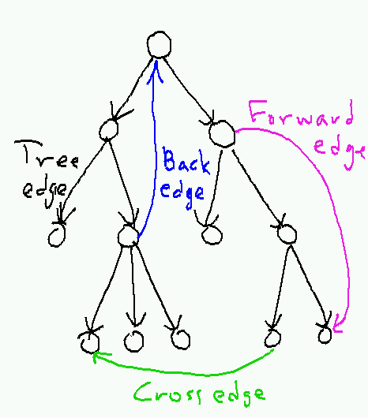
Classification of Edges
Edge type of uv | start times | end times
Tree edge | start[u] < start[v] | end[u] > end[v]
Back edge | start[u] > start[v] | end[u] < end[v]
Forward edge | start[u] < start[v] | end[u] > end[v]
Cross edge | start[u] > start[v] | end[u] > end[v]

Slide 69
DFS Example: Classification of Edges
u
v
w
Undiscovered
Discovered, On Process
Finished, all adjacent vertices have been discovered
x
y
z
Discover time/ Finish time

Slide 70
DFS Example: Classification of Edges
u
u
v
v
w
w
Undiscovered
1/
Discovered, On Process
Finished, all adjacent vertices have been discovered
x
x
y
y
z
z
Discover time/ Finish time

Slide 71
DFS Example: Classification of Edges
u
u
u
v
v
v
w
w
w
Undiscovered
1/
1/
2/
Discovered, On Process
Finished, all adjacent vertices have been discovered
x
y
z
x
x
y
y
z
z
Tree edge
Discover time/ Finish time

Slide 72
DFS Example: Classification of Edges
u
u
u
u
v
v
v
v
w
w
w
w
Undiscovered
1/
1/
1/
2/
2/
Discovered, On Process
Finished, all adjacent vertices have been discovered
3/
x
y
z
x
x
x
y
y
y
z
z
z
Tree edge
Discover time/ Finish time

Slide 73
DFS Example: Classification of Edges
u
u
u
u
u
v
v
v
v
v
w
w
w
w
w
Undiscovered
1/
1/
1/
1/
2/
2/
2/
Discovered, On Process
4/
3/
Finished, all adjacent vertices have been discovered
3/
x
y
z
x
x
x
x
y
y
y
y
z
z
z
z
Tree edge
Discover time/ Finish time

Slide 74
DFS Example: Classification of Edges
u
u
u
u
u
u
v
v
v
v
v
v
w
w
w
w
w
w
Undiscovered
1/
1/
1/
1/
1/
2/
2/
2/
2/
Discovered, On Process
4/
3/
4/
3/
Finished, all adjacent vertices have been discovered
3/
x
y
z
x
y
z
x
x
x
x
y
y
y
y
z
z
z
z
Tree edge
Back Edge
Discover time/ Finish time

Slide 75
DFS Example: Classification of Edges
u
u
u
u
u
u
u
v
v
v
v
v
v
v
w
w
w
w
w
w
w
Undiscovered
1/
1/
1/
1/
1/
1/
2/
2/
2/
2/
2/
Discovered, On Process
4/
3/
4/
4/5
3/
3/
Finished, all adjacent vertices have been discovered
3/
x
y
z
x
y
z
x
x
x
x
x
y
y
y
y
y
z
z
z
z
z
Tree edge
Back Edge
Discover time/ Finish time

Slide 76
DFS Example: Classification of Edges
u
u
u
u
u
u
u
u
v
v
v
v
v
v
v
v
w
w
w
w
w
w
w
w
Undiscovered
1/
1/
1/
1/
1/
1/
1/
2/
2/
2/
2/
2/
2/
Discovered, On Process
4/
3/
4/
4/5
4/5
3/
3/
3/
Finished, all adjacent vertices have been discovered
3/6
x
y
z
x
y
z
x
x
x
x
x
x
y
y
y
y
y
y
z
z
z
z
z
z
Tree edge
Back Edge
Discover time/ Finish time

Slide 77
DFS Example: Classification of Edges
u
u
u
u
u
u
u
u
u
v
v
v
v
v
v
v
v
v
w
w
w
w
w
w
w
w
w
Undiscovered
1/
1/
1/
1/
1/
1/
1/
1/
2/
2/
2/
2/
2/
2/
2/7
Discovered, On Process
4/
3/
4/
4/5
4/5
4/5
3/
3/
3/
3/6
Finished, all adjacent vertices have been discovered
3/6
x
y
z
x
y
z
x
x
x
x
x
x
x
y
y
y
y
y
y
y
z
z
z
z
z
z
z
Tree edge
Back Edge
Discover time/ Finish time
AIUB::CSC2105::Algorithms

Slide 78
DFS Example: Classification of Edges
u
u
u
u
u
u
u
u
u
u
u
v
v
v
v
v
v
v
v
v
v
v
w
w
w
w
w
w
w
w
w
w
w
Undiscovered
1/
1/
1/
1/
1/
1/
1/
1/
1/
1/8
2/
2/7
2/
2/
2/
2/
2/
2/7
2/7
Discovered, On Process
4/
3/
4/5
3/6
4/
4/5
4/5
4/5
4/5
3/
3/
3/
3/6
3/6
Finished, all adjacent vertices have been discovered
3/6
x
y
z
x
y
z
x
y
z
x
x
x
x
x
x
x
x
y
y
y
y
y
y
y
y
z
z
z
z
z
z
z
z
Tree edge
Back Edge
Discover time/ Finish time
Forward Edge

Slide 79
DFS Example: Classification of Edges
u
u
u
u
u
u
u
u
u
u
u
v
v
v
v
v
v
v
v
v
v
v
w
w
w
w
w
w
w
w
w
w
w
Undiscovered
1/
1/8
1/
1/
1/
1/
1/
1/
1/
1/8
2/
2/7
2/
2/
2/
2/
2/
2/7
2/7
Discovered, On Process
4/
3/
4/5
3/6
4/
4/5
4/5
4/5
4/5
3/
3/
3/
3/6
3/6
Finished, all adjacent vertices have been discovered
3/6
x
y
z
x
y
z
x
y
z
x
x
x
x
x
x
x
x
y
y
y
y
y
y
y
y
z
z
z
z
z
z
z
z
Tree edge
Back Edge
Discover time/ Finish time
Forward Edge
AIUB::CSC2105::Algorithms

Slide 80
DFS Example: Classification of Edges
u
u
u
u
u
u
u
u
u
u
u
u
v
v
v
v
v
v
v
v
v
v
v
v
w
w
w
w
w
w
w
w
w
w
w
w
Undiscovered
1/
1/8
1/
1/
1/
1/
1/
1/
1/
1/8
1/8
2/
2/7
2/
2/
2/
2/
2/
2/7
2/7
2/7
9/
Discovered, On Process
4/
3/
4/5
3/6
4/
4/5
4/5
4/5
4/5
4/5
3/
3/
3/
3/6
3/6
3/6
Finished, all adjacent vertices have been discovered
3/6
x
y
z
x
y
z
x
y
z
x
x
x
x
x
x
x
x
x
y
y
y
y
y
y
y
y
y
z
z
z
z
z
z
z
z
z
Tree edge
Back Edge
Discover time/ Finish time
Forward Edge

Slide 81
DFS Example: Classification of Edges
u
u
u
u
u
u
u
u
u
u
u
u
u
v
v
v
v
v
v
v
v
v
v
v
v
v
w
w
w
w
w
w
w
w
w
w
w
w
w
Undiscovered
1/
1/8
1/
1/8
1/
1/
1/
1/
1/
1/
1/8
1/8
2/
2/7
2/
2/7
2/
2/
2/
2/
2/7
2/7
2/7
9/
9/
Discovered, On Process
4/
3/
4/5
3/6
4/5
3/6
4/
4/5
4/5
4/5
4/5
4/5
3/
3/
3/
3/6
3/6
3/6
Finished, all adjacent vertices have been discovered
3/6
x
y
z
x
y
z
x
y
z
x
y
z
x
x
x
x
x
x
x
x
x
y
y
y
y
y
y
y
y
y
z
z
z
z
z
z
z
z
z
Tree edge
Back Edge
Discover time/ Finish time
Forward Edge
Cross Edge

Slide 82
DFS Example: Classification of Edges
u
u
u
u
u
u
u
u
u
u
u
u
u
u
v
v
v
v
v
v
v
v
v
v
v
v
v
v
w
w
w
w
w
w
w
w
w
w
w
w
w
w
Undiscovered
1/
1/8
1/
1/8
1/
1/
1/
1/
1/
1/
1/8
1/8
1/8
2/
2/7
2/
2/7
2/
2/
2/
2/
2/7
2/7
2/7
2/7
9/
9/
9/
Discovered, On Process
4/
3/
4/5
3/6
4/5
3/6
4/
4/5
4/5
4/5
4/5
4/5
4/5
3/
3/
3/
3/6
3/6
3/6
3/6
Finished, all adjacent vertices have been discovered
3/6
10/
x
y
z
x
y
z
x
y
z
x
y
z
x
x
x
x
x
x
x
x
x
x
y
y
y
y
y
y
y
y
y
y
z
z
z
z
z
z
z
z
z
z
Tree edge
Back Edge
Discover time/ Finish time
Forward Edge
Cross Edge

Slide 83
DFS Example: Classification of Edges
u
u
u
u
u
u
u
u
u
u
u
u
u
u
u
v
v
v
v
v
v
v
v
v
v
v
v
v
v
v
w
w
w
w
w
w
w
w
w
w
w
w
w
w
w
Undiscovered
1/
1/8
1/
1/8
1/8
1/
1/
1/
1/
1/
1/
1/8
1/8
1/8
2/
2/7
2/
2/7
2/7
2/
2/
2/
2/
2/7
2/7
2/7
2/7
9/
9/
9/
9/
Discovered, On Process
4/
3/
4/5
3/6
4/5
3/6
4/5
4/
4/5
4/5
4/5
4/5
4/5
4/5
3/6
3/
3/
3/
3/6
3/6
3/6
3/6
3/6
10/
Finished, all adjacent vertices have been discovered
10/
x
y
z
x
y
z
x
y
z
x
y
z
x
x
x
x
x
x
x
x
x
x
x
y
y
y
y
y
y
y
y
y
y
y
z
z
z
z
z
z
z
z
z
z
z
Tree edge
Back Edge
Discover time/ Finish time
Forward Edge
Cross Edge

Slide 84
DFS Example: Classification of Edges
u
u
u
u
u
u
u
u
u
u
u
u
u
u
u
u
v
v
v
v
v
v
v
v
v
v
v
v
v
v
v
v
w
w
w
w
w
w
w
w
w
w
w
w
w
w
w
w
Undiscovered
1/
1/8
1/
1/8
1/8
1/8
1/
1/
1/
1/
1/
1/
1/8
1/8
1/8
2/
2/7
2/
2/7
2/7
2/7
2/
2/
2/
2/
2/7
2/7
2/7
2/7
9/
9/
9/
9/
9/
Discovered, On Process
4/
3/
4/5
3/6
4/5
3/6
4/5
4/5
4/
4/5
4/5
4/5
4/5
4/5
4/5
3/6
3/6
3/
3/
3/
3/6
3/6
3/6
3/6
3/6
10/
10/11
Finished, all adjacent vertices have been discovered
10/
x
y
z
x
y
z
x
y
z
x
y
z
x
x
x
x
x
x
x
x
x
x
x
x
y
y
y
y
y
y
y
y
y
y
y
y
z
z
z
z
z
z
z
z
z
z
z
z
Tree edge
Back Edge
Discover time/ Finish time
Forward Edge
Cross Edge

Slide 85
DFS Example: Classification of Edges
u
u
u
u
u
u
u
u
u
u
u
u
u
u
u
u
u
v
v
v
v
v
v
v
v
v
v
v
v
v
v
v
v
v
w
w
w
w
w
w
w
w
w
w
w
w
w
w
w
w
w
Undiscovered
1/
1/8
1/
1/8
1/8
1/8
1/8
1/
1/
1/
1/
1/
1/
1/8
1/8
1/8
2/
2/7
2/
2/7
2/7
2/7
2/7
2/
2/
2/
2/
2/7
2/7
2/7
2/7
9/
9/
9/
9/12
9/
9/
Discovered, On Process
4/
3/
4/5
3/6
4/5
3/6
4/5
4/5
4/5
4/
4/5
4/5
4/5
4/5
4/5
4/5
3/6
3/6
3/6
3/
3/
3/
3/6
3/6
3/6
3/6
3/6
10/
10/11
10/11
Finished, all adjacent vertices have been discovered
10/
x
y
z
x
y
z
x
y
z
x
y
z
x
x
x
x
x
x
x
x
x
x
x
x
x
y
y
y
y
y
y
y
y
y
y
y
y
y
z
z
z
z
z
z
z
z
z
z
z
z
z
Tree edge
Back Edge
Discover time/ Finish time
Forward Edge
Cross Edge

Slide 86
Classification of Edges
Edge type of uv | start times | end times
Tree edge | start[u] < start[v] | end[u] > end[v]
Back edge | start[u] > start[v] | end[u] < end[v]
Forward edge | start[u] < start[v] | end[u] > end[v]
Cross edge | start[u] > start[v] | end[u] > end[v]

Slide 87
More Example for BFS & DFS

Slide 88
Breadth-First Search (BFS)
Visit
  start vertex and put into a FIFO queue.
Repeatedly
  remove a vertex from the queue,
  visit its unvisited adjacent vertices,
  put newly visited vertices into the queue.

Slide 89
Breadth-First Search Example
2
3
8
1
4
5
9
10
6
7
11
Start search at vertex 1.

Slide 90
Breadth-First Search Example
2
FIFO Queue
1
3
8
1
1
4
5
9
10
6
7
11
Visit/mark/label start vertex and put in a FIFO queue.

Slide 91
Breadth-First Search Example
2
FIFO Queue
1
3
8
1
1
4
5
9
10
6
7
11
Remove 1 from Q; visit adjacent unvisited vertices;
put in Q.

Slide 92
Breadth-First Search Example
2
FIFO Queue
2
3
2
4
8
1
1
4
4
5
9
10
6
7
11
Remove 1 from Q; visit adjacent unvisited vertices;
put in Q.

Slide 93
Breadth-First Search Example
2
FIFO Queue
2
3
2
4
8
1
1
4
4
5
9
10
6
7
11
Remove 2 from Q; visit adjacent unvisited vertices;
put in Q.

Slide 94
Breadth-First Search Example
2
FIFO Queue
2
3
3
4
5
3
6
8
1
1
4
4
5
5
9
10
6
6
7
11
Remove 2 from Q; visit adjacent unvisited vertices;
put in Q.

Slide 95
Breadth-First Search Example
2
FIFO Queue
2
3
3
4
5
3
6
8
1
1
4
4
5
5
9
10
6
6
7
11
Remove 4 from Q; visit adjacent unvisited vertices;
put in Q.

Slide 96
Breadth-First Search Example
2
FIFO Queue
2
3
3
5
3
6
8
1
1
4
4
5
5
9
10
6
6
7
11
Remove 4 from Q; visit adjacent unvisited vertices;
  put in Q.

Slide 97
Breadth-First Search Example
2
FIFO Queue
2
3
3
5
3
6
8
1
1
4
4
5
5
9
10
6
6
7
11
Remove 5 from Q; visit adjacent unvisited vertices;
  put in Q.

Slide 98
Breadth-First Search Example
2
FIFO Queue
2
3
3
3
6
9
7
8
1
1
4
4
5
5
9
9
10
6
6
7
7
11
Remove 5 from Q; visit adjacent unvisited vertices;
  put in Q.

Slide 99
Breadth-First Search Example
2
FIFO Queue
2
3
3
3
6
9
7
8
1
1
4
4
5
5
9
9
10
6
6
7
7
11
Remove 3 from Q; visit adjacent unvisited vertices;
  put in Q.

Slide 100
Breadth-First Search Example
2
FIFO Queue
2
3
3
6
9
7
8
1
1
4
4
5
5
9
9
10
6
6
7
7
11
Remove 3 from Q; visit adjacent unvisited vertices;
  put in Q.

Slide 101
Breadth-First Search Example
2
FIFO Queue
2
3
3
6
9
7
8
1
1
4
4
5
5
9
9
10
6
6
7
7
11
Remove 6 from Q; visit adjacent unvisited vertices;
  put in Q.

Slide 102
Breadth-First Search Example
2
FIFO Queue
2
3
3
9
7
8
1
1
4
4
5
5
9
9
10
6
6
7
7
11
Remove 6 from Q; visit adjacent unvisited vertices;
  put in Q.

Slide 103
Breadth-First Search Example
2
FIFO Queue
2
3
3
9
7
8
1
1
4
4
5
5
9
9
10
6
6
7
7
11
Remove 9 from Q; visit adjacent unvisited vertices;
  put in Q.

Slide 104
Breadth-First Search Example
2
FIFO Queue
2
3
3
8
7
8
1
1
4
4
5
5
9
9
10
6
6
7
7
11
Remove 9 from Q; visit adjacent unvisited vertices;
  put in Q.

Slide 105
Breadth-First Search Example
2
FIFO Queue
2
3
3
7
8
8
8
1
1
4
4
5
5
9
9
10
6
6
7
7
11
Remove 7 from Q; visit adjacent unvisited vertices;
  put in Q.

Slide 106
Breadth-First Search Example
2
FIFO Queue
2
3
3
8
8
8
1
1
4
4
5
5
9
9
10
6
6
7
7
11
Remove 7 from Q; visit adjacent unvisited vertices;
  put in Q.

Slide 107
Breadth-First Search Example
2
FIFO Queue
2
3
3
8
8
8
1
1
4
4
5
5
9
9
10
6
6
7
7
11
Remove 8 from Q; visit adjacent unvisited vertices;
  put in Q.

Slide 108
Breadth-First Search Example
2
FIFO Queue
2
3
3
8
8
1
1
4
4
5
5
9
9
10
2
3
6
8
6
1
7
7
11
4
5
9
Queue is empty. Search terminates.
6
7

Slide 109
Depth-First Search
depthFirstSearch(v)
{
Label vertex v as reached.
for (each unreached vertex u
adjacenct from v)
depthFirstSearch(u);
}
Notes:
Note that vertices adjacent from v are examined one at a time. As soon as an unreached adjacent vertex u is found, a depthFirstSearch(u) is done. Remaining vertices adjacent from v are examined after depthFirstSearch(u) completes.

Slide 110
Depth-First Search Example
2
2
3
8
1
1
4
5
9
1
stack
6
7
Start search at vertex 1.
Label vertex 1 and do a depth first search from either 2 or 4.
Suppose that vertex 2 is selected.

Slide 111
Depth-First Search Example
2
2
2
3
8
1
1
4
5
5
9
1
2
stack
6
7
Label vertex 2 and do a depth first search from either 3, 5, or 6.
Suppose that vertex 5 is selectd.

Slide 112
Depth-First Search Example
2
2
2
3
8
1
1
4
5
5
5
9
9
1
2
5
stack
6
7
Label vertex 5 and do a depth first search from either 3, 7, or 9.
Suppose that vertex 9 is selected.

Slide 113
Depth-First Search Example
2
2
2
3
8
8
1
1
4
5
5
5
9
9
9
1
2
5
9
stack
6
7
Label vertex 9 and do a depth first search from either 6 or 8.
Suppose that vertex 8 is selected.

Slide 114
Depth-First Search Example
2
2
2
3
8
8
8
1
1
4
5
5
5
9
9
9
1
2
5
9
8
stack
6
6
7
Label vertex 8 and return to vertex 9.
From vertex 9 do a dfs(6).

Slide 115
Depth-First Search Example
2
2
2
3
8
8
8
1
1
4
5
5
5
9
9
9
1
2
5
9
stack
6
6
7
Label vertex 8 and return to vertex 9.
From vertex 9 do a dfs(6).

Slide 116
Depth-First Search Example
2
2
2
3
8
8
8
1
1
4
4
5
5
5
9
9
9
1
2
5
9
6
stack
6
6
6
7
Label vertex 6 and do a depth first search from either 4 or 7.
Suppose that vertex 4 is selected.

Slide 117
Depth-First Search Example
2
2
2
3
8
8
8
1
1
4
4
4
5
5
5
9
9
9
1
2
5
9
6
4
stack
6
6
6
7
7
Label vertex 4 and return to 6.
From vertex 6 do a dfs(7).

Slide 118
Depth-First Search Example
2
2
2
3
8
8
8
1
1
4
1
2
5
9
6
7
4
4
5
5
5
stack
9
9
9
6
6
6
7
7
7
Label vertex 7 and return to 6.

Slide 119
Depth-First Search Example
2
2
2
3
8
8
8
1
1
4
1
2
5
9
6
4
4
5
5
5
stack
9
9
9
6
6
6
7
7
7
Label vertex 7 and return to 6.
Return to 9.

Slide 120
Depth-First Search Example
2
2
2
3
8
8
8
1
1
4
1
2
5
9
4
4
5
5
5
stack
9
9
9
6
6
6
7
7
7
Label vertex 7 and return to 6.
Return to 9.

Slide 121
Depth-First Search Example
2
2
2
3
8
8
8
1
1
4
1
2
5
4
4
5
5
5
stack
9
9
9
6
6
6
7
7
7
Label vertex 7 and return to 6.
Return to 9.

Slide 122
Depth-First Search Example
2
2
2
3
8
8
8
1
1
4
4
4
5
5
5
9
9
9
1
2
5
stack
6
6
6
7
7
7
Return to 5.

Slide 123
Depth-First Search Example
2
2
2
3
3
8
8
8
1
1
4
4
4
5
5
5
9
9
9
1
2
5
6
6
6
7
7
7
Do a dfs(3).

Slide 124
Depth-First Search Example
2
2
2
3
3
3
8
8
8
1
1
4
4
4
5
5
5
9
9
9
1
2
5
3
stack
6
6
6
7
7
7
Label 3 and return to 5.

Slide 125
Depth-First Search Example
2
2
2
3
3
3
8
8
8
1
1
4
4
4
5
5
5
9
9
9
1
2
stack
6
6
6
7
7
7
Return to 2.

Slide 126
Depth-First Search Example
2
2
2
3
3
3
8
8
8
1
1
4
4
4
5
5
5
9
9
9
1
stack
6
6
6
7
7
7
Return to 1

Slide 127
Depth-First Search Example
2
2
2
3
3
3
8
8
8
1
1
4
4
4
5
5
5
9
9
9
stack
6
6
6
7
7
7
Return to invoking method.

Slide 128
OUT PUT:
2
3
8
1
4
5
9
6
7

Slide 129
2
3
8
1
10
4
5
9
11
6
7

Slide 130
BFS vs. DFS
BFS | DFS
BFS Stands for “Breadth First Search”. | DFS stands for “Depth First Search”.
BFS starts traversal from the root node and then explore the search in the level by level manner i.e. as close as possible from the root node. | DFS starts the traversal from the root node and explore the search as far as possible from the root node i.e. depth wise.
Breadth First Search can be done with the help of queue i.e. FIFO implementation. | Depth First Search can be done with the help of Stack i.e. LIFO implementations.
This algorithm works in single stage. The visited vertices are removed from the queue and then displayed at once. | This algorithm works in two stages – in the first stage the visited vertices are pushed onto the stack and later on when there is no vertex further to visit those are popped-off.

Slide 131
BFS | DFS
BFS is slower than DFS. | DFS is more faster than BFS.
BFS requires more memory compare to DFS. | DFS require less memory compare to BFS.
Applications of BFS > To find Shortest path > Single Source & All pairs shortest paths > In Spanning tree > In Connectivity | Applications of DFS > Useful in Cycle detection > In Connectivity testing > Finding a path between V and W in the graph. > useful in finding spanning trees & forest.
BFS is useful in finding shortest path. BFS can be used to find the shortest distance between some starting node and the remaining nodes of the graph. | DFS in not so useful in finding shortest path. It is used to perform a traversal of a general graph and the idea of DFS is to make a path as long as possible, and then go back (backtrack) to add branches also as long as possible.

Slide 132
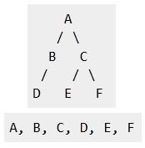
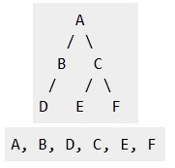
BFS vs. DFS (Example)
BFS | DFS

Slide 133
Differences between DFS and BFS
Comparing BFS and DFS, the big advantage of DFS is that it has much lower memory requirements than BFS, because it’s not necessary to store all of the child pointers at each level.
Depending on the data and what you are looking for, either DFS or BFS could be advantageous.

Slide 134
Differences between DFS and BFS
For example, given a family tree if one were looking for someone on the tree who’s still alive, then it would be safe to assume that person would be on the bottom of the tree.
This means that a BFS would take a very long time to reach that last level.
A DFS, however, would find the goal faster.
But, if one were looking for a family member who died a very long time ago, then that person would be closer to the top of the tree.
Then, a BFS would usually be faster than a DFS.
So, the advantages of either vary depending on the data and what you’re looking for.

