Slide 1
Data Structure Heap

Slide 2
Priority Queue(Heap)
Collection of elements.
Each element has a priority or key.
Different implementations of a priority queue is possible. We will use HEAP data structure to implement the priority queue.
Two kinds of priority queues:
Min priority queue (min heap): elements with minimum key value gets the highest priority.
Max priority queue (max heap): elements with maximum key value gets the highest priority.

Slide 3
Priority Queue Operations (Heap)
Following are the operations available for a priority queue:
Create a heap with a given set of values.
Insert an element into the heap.
Delete min/max element from the min/max heap (respectively).
Sort the element in ascending/descending order for max/min heap (respectively).
Modifying value of a particular element.

Slide 4
Real world example
Suppose you have a hospital in which patients are attended based on their ages. The oldest are always attended first, no matter when he/she got in the queue.
You can't just keep track of the oldest one because if you pull he/she out, you don't know the next oldest one.
In order to solve this hospital problem, you implement a max heap. This heap is, by definition, partially ordered. This means you cannot sort the patients by their age, but you know that the oldest ones are always in the top, so you can pull a patient out in constant time O(1) and re-balance the heap in log time O(log N).

Slide 5
But Why we need Heap for this?
Heaps are structures meant to allow quick access to the min or the max.
But why would you want that? You could just check every entry on add to see if it's the smallest or the biggest. This way you always have the smallest or the biggest in constant time O(1).
The answer is because heaps allow you to pull the smallest or the biggest and quickly know the NEXT smallest or biggest. That's why it's called a Priority Queue.

Slide 6
Heap-->Data Structure
In data structures, a heap is a collection that allows elements to be inserted continuously and the smallest/highest element to be found and/or removed.
A heap is a partially sorted binary tree. Although a heap is not completely in order, it conforms to a sorting principle:
every node has a value less/greater than either of its children.

Slide 7
When do we need Heap?
Use it whenever you need quick access to the largest (or smallest) item, because that item will always be the first element in the array or at the root of the tree.
However, the remainder of the array is kept partially unsorted. Thus, instant access is only possible to the largest (smallest) item. Insertions are fast, so it's a good way to deal with incoming events or data and always have access to the lowest/biggest.
Best if insertions are frequent.

Slide 8
Advantages of Heap
The characteristic of a heap is that it is a structure that maintains data
semi- ordered.
Thus, it is a good tradeoff between the cost of maintaining a complete order and the cost of searching through random chaos.
Sorting an array has a very high time complexity; heap operations are so cheap that they are actually used for a decent sorting implementation.
Using a heap to find the smallest element is definitely a lot faster than sorting an array.
Anytime when you sort a temporary list, you should consider heaps.

Slide 9
Types of Heap…
A heap is a complete binary tree which satisfies the heap ordering property. The ordering can be one of two types:
The min-heap property: the value of each node is less than or equal to either of its children, with the minimum-value element at the root.
So basically, The key value of the parent is lower than its children.
The max-heap property: the value of each node is greater than or equal to either of its children, with the maximum-value element at the root.
So basically, The key value of the parent is greater than its children.

Slide 10
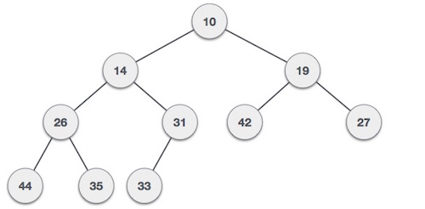
Types of heap
Min-Heap − Where the value of the root node is less than or equal to either of its children.

Slide 11
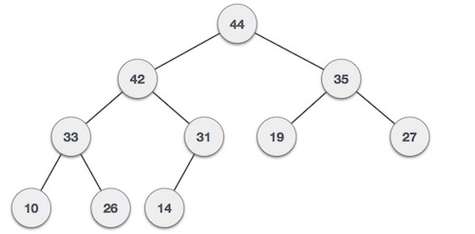
Types of heap
Max-Heap − Where the value of the root node is greater than or equal to either of its children.

Slide 12
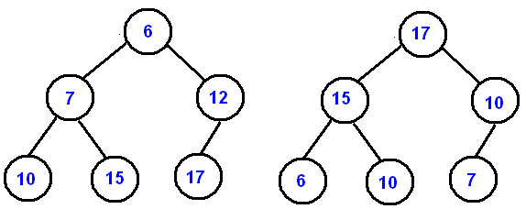
Types of heap
(min heap)
(max heap)

Slide 13
Example
a heap
not a heap
not a heap
Note: Heap’s elements are ordered top down (along any path down from its root), but they are not ordered from left to right

Slide 14
Operations on Heaps
Maintain the max-heap/min-heap property
MAX-HEAPIFY/MIN-HEAPIFY
Create a max-heap/min-heap from an unordered array
BUILD-MAX-HEAP/ BUILD-MIN-HEAP
Sort an heap array
HEAPSORT

Slide 15
Properties of a Heap
1
2
3
4
5
6
7
8
9
10
11
12
5
10
15
20
35
30
45
25
32
38
40
43
Heap is a complete binary tree.
Min Heap: The key value of the parent is lower than its children.
Max Heap: The key value of the parent is higher than its children.
Heap is implemented using an array starting from index 1 (not 0).
Index 1 contains the root.
Left child of any node at index p is stored at index (p*2).
Right child of any node at index p is stored at index (p*2+1).
So, the parent node of any child at index c is found at index ⎣c/2⎦.
If there are n elements in a heap:
There are ⎣n/2⎦ parents indexed from 1 to ⎣ n/2⎦.
Leaf nodes are indexed from ⎣n/2⎦ +1 to n.
2
3
4
5
6
4
6
8
10
12
⎣4
⎣6
⎣8
⎣10
Left Child:
1
× 2 =
2
⎣12
Parent
⎣2
/2⎦ =
1
2
3
4
5
6
⎣3
/2⎦ =
⎣5
⎣7
⎣9
⎣11
2
3
4
5
Right Child:
1
× 2 + 1 =
3
1
2
3
4
5
5
7
9
11
5
10
15
20
35
30
45
25
32
38
40
43

Slide 16
Complete Binary Tree Representations
If a complete binary tree with n nodes is represented sequentially, then for any node with index i,
1<=i<=n, we have:
parent(i) is at ⎣i/2⎦ .
leftChild(i) is at 2i if 2i<=n.
If 2i>n, then i has no left child.
rightChild(i) is at 2i+1 if 2i+1 <=n.
If 2i +1>n, then i has no right child.

Slide 17
Creating a Heap – Heapify( )
p = --i = 4
p = --i = 3
p = --i = 5
p = --i = 2
p = --i = 1
i = p = ⎣n/2⎦ = ⎣12/2⎦ = 6
1
9
3
11
Parent:
4
6
2
12
5
7
There are n elements in an array.
Start with the last parent at index i=p=⎣n/2⎦.
Compare the smallest of the two children (left child if one child) with the parent at p.
If parent is bigger, swap. So, p=p*2 or p*2+1. else go to Step-6.
Continue comparing (step 3) and swapping until parent is bigger or no more child to compare.
Choose the previous parent (p=--i) and continue step 3 until i>0.
10
4
12
2
6
5
8
4
3
2
Left Child:
1
× 2 =
6
10
3
5
9
11
Right Child:
6
× 2 + 1 =
13
5
4
3
2
1
7
45
5
38
30
10
5
45
15
40
15
10
38
35
45
32
25
5
20
30
1
2
3
4
5
6
7
8
9
10
11
12
32
40
38
43
20
10
35
25
45
35
45
45
38
30
32
10
5
10
5
20
40
15
5
43
20
10
35
25
45
15
38
25
30
32
40
38
45

Slide 18
Inserting into a Heap
Increase the total element; n++.
Add the new element at the end; index n.
Child index c = n;
Parent index p = ⎣c/2⎦;
If Child at c is smaller than Parent at p then, Swap and Child index c = p; else go to step 7.
Continue step 4 until c > 1;
End.
Total Element n :
10
11
12
Child c :
12
Parent p :
⎣12
/2⎦ =
1
3
6
11
2
5
⎣6
⎣3
⎣5
⎣11
⎣2
3
1
2
5
1
6
7
5
10
15
8
5
7
35
30
8
10
5
20
15
45
1
2
3
4
5
6
7
8
9
10
11
12
25
32
38
8
5
5
8
5
35
30
7
8
10
5
15
35
5
7
10
15
20
35
30
45
25
32
38
8
30

Slide 19
Delete Root of a Heap
Sorting from a Heap
Total Element n :
9
12
11
10
8
Delete the root from the heap;
Continue step 1 until there are no more root to delete.
End.
Continuing the process will give us a sorted array.
Min Heap Gives us Descending order.
Max Heap Gives us Ascending order.
Swap the root with the last element;
Decrease the total element; n--;
Parent index p = 1;
Smaller Child index c = p × 2 or p × 2 + 1 (if right child exists);
If Child at c smaller than Parent at p then, Swap and p = c; else go to step 7.
Continue step 4 until p <= ⎣n/2⎦;
End.
2
8
4
3
Parent p :
6
1
Left Child:
× 2 =
Child c :
4
2
3
4
8
1
6
2
2
4
8
3
6
Right Child:
× 2 + 1 =
3
1
2
4
3
5
9
7
25
5
43
10
40
15
20
25
10
15
43
20
40
32
30
32
35
30
38
20
45
43
25
40
1
2
3
4
5
6
7
8
9
10
11
12
43
25
32
38
15
10
40
5
38
43
43
20
10
40
15
20
43
20
32
40
30
43
25
5
10
15
32
40
43
38
15
10
5
25
25
20
35
30
45
25
32
38
40
43
38
20

Slide 20
Modifying a Value
Changing a value of an element in a heap might destroy the properties of the heap.
Change the value of the element;
First check with the parent value; If Parent value is higher then swap; Continue the process with the new Parent Until Parent value is lower.
Otherwise, check with the lower of the two children; If chosen Child value is lower then swap; Continue the process with the new Children Until Children value is higher.
Changing value 10 to 42
Changing value 43 to 7
5
42
10
20
15
7
25
42
35
30
20
7
45
15
25
32
38
42
40
43
7
30

Slide 21
Heapsort Complexity[O(NlogN)]
Add all items into a heap. Pop the smallest/largest item from the heap and insert it at the end (final position). Repeat for all items.
Heapsort is just like selection sort, but with a better way to get the largest element. Instead of scanning all the items to find the max, it pulls it from a heap. Heaps have properties that allow heapsort to work in-place, without additional memory.
Creating the heap is O(N lg N). Popping items is O(1), and fixing the heap after the pop is lgN. There are N pops, so there is another O(N lgN) factor, which is O(N lg N) overall.

