Slide 1
Data Structure Tree

Slide 2
Data Structure - Tree
President
Vice President
Vice President
Vice President
Executive
Executive
Executive
Executive
Executive
Many applications are hierarchical in nature.
Linear data structures are not appropriate for these type of applications.
Hierarchical structure of a company
Mashrafi Khan
Fahim Khan
Mairufa Khan
Faizul Khan
Ashfar Khan
Junayed Ahmed
Masrufa Ahmed
Mahboob Khan
Mashraba Khan
Imran Khan
Moin Khan
Mashrufa Khan
Bushra Khan
Genealogy tree of a family

Slide 3
Why Tree?
There are many basic data structures that can be used to solve application problems.
Array is a good static data structure that can be accessed randomly and is fairly easy to implement.
Linked Lists on the other hand is dynamic and is ideal for application that requires frequent operations such as add, delete, and update. One drawback of linked list is that data access is sequential.
Then there are other specialized data structures like, stacks and queues that allows us to solve complicated problems (eg: Maze traversal) using these restricted data structures.

Slide 4
Why Tree?
Unlike Array and Linked List, which are linear data structures, tree is hierarchical (or non-linear) data structure.
Saying that the structure of a tree is hierarchical means that things are ordered above or below other things.
For example, the army is hierarchical, with generals above colonels, and colonels above lieutenants, etc.

Slide 5
Why Tree?
One reason to use trees might be because you want to store information that naturally forms a hierarchy.
For example, the file system on a computer:

Slide 6
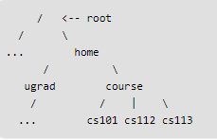
Why Tree?
One reason to use trees might be because you want to store information that naturally forms a hierarchy.
For example, the file system on a computer:

Slide 7
Why Tree?
If we organize keys in form of a tree (with some ordering e.g., BST), we can search for a given key in moderate time
(quicker than Linked List and slower than arrays).

Slide 8
Common Use of Tree as a Data Structure
Representing hierarchical data
Storing data in a way that makes it easily searchable
Representing sorted lists of data
As a workflow for compositing digital images for visual effects
Routing algorithms

Slide 9
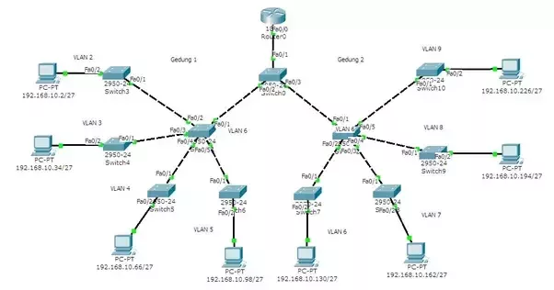
Routing algorithms

Slide 10
Tree - Definition
ROOT
As a data structure, a tree consists of one or more nodes, where each node has a value and a list of references to other (its children) nodes with the constraints that no reference is duplicated, and none points to the root.
A tree must have a node designated as root. If a tree has only one node, that node is the root node. Root is never referenced by any other node.
Having more than one node indicates that the root have some (at least one) references to its children nodes and the children nodes (might) have references to their children nodes and so on.
VALUE
A
CHILD
CHILD
B
C
D
E
F
G
H
I
J
K
L
M
N
O

Slide 11
Tree--Recursive Data Structure
A tree can be viewed as a recursive data structure.
Why?
Remember that recursive means that something is defined in terms of itself.
Here, this means that trees are made up of subtrees.
A
B
C
D
E
F
G
H
I

Slide 12
Tree - Definition
Generally it is considered that in a tree, there is only one path going from one node to another node.
There cannot be any cycle or loop.
The link from a node to other node is called an edge.
An arrowed edge indicates flow from P to Q.
An straight line edge indicates flow from P to Q and Q to P.
A
B
C
D
E
F
G
H
I
J
P
Q
K
L
M
N
O
P
Q
If node F is reached through node B, than the link from node K to node F will not be considered.
A straight line is generally used to represent the links between the nodes of a tree.
If link from node L to node C is considered, than there will be a cycle among nodes C, G, and L.

Slide 13
Not a Tree
Structures that are not trees.
A
B
C
D
E
F
G
H
I

Slide 14
Not a Tree
Structures that are not trees.
A
B
C
D
E
F
G
H
I

Slide 15
Not a Tree
Structures that are not trees.
A
B
C
D
E
F
G
H
I

Slide 16
Tree - Definition
Nodes
Parent Nodes & Child Nodes
Leaf Nodes: nodes with no child
Root Node: node with no parent
Sub Tree: the tree rooted by a child
Level of a tree:
Root at level 0;
Each children have the level one more than its parent.
Height/depth of the tree: Total number of Levels
Height of a node: Total number of levels from bottom [Tree height – node level].
LEVEL
0
A
1
B
C
D
2
E
F
G
H
I
J
3
K
L
M
N
O
Height of root A is 4;
Height of nodes B, C, D is 3;
Height of E, F, G, H, I, J is 2;
Height of nodes K, L , M, N, O is 1.
Height of this tree is 4, as there are four levels (0…3).

Slide 17
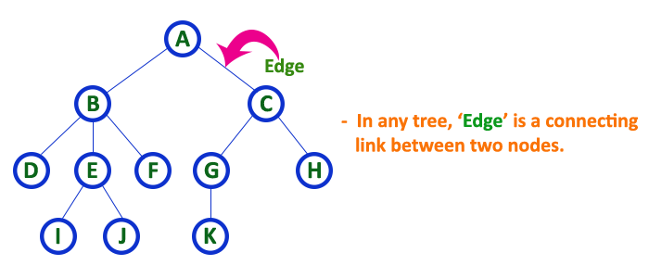
Edge
In a tree data structure, the connecting link between any two nodes is called as EDGE. In a tree with 'N' number of nodes there will be a maximum of 'N-1' number of edges.

Slide 18
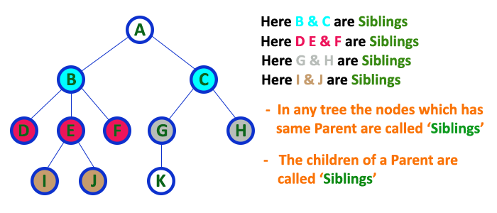
Siblings
In a tree data structure, nodes which belong to same Parent are called as SIBLINGS. In simple words, the nodes with same parent are called as Sibling nodes.

Slide 19
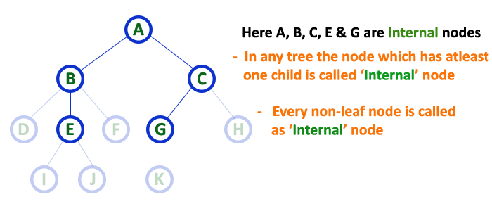
Internal Nodes
In a tree data structure, the node which has atleast one child is called as INTERNAL Node. In simple words, an internal node is a node with atleast one child.
In a tree data structure, nodes other than leaf nodes are called as Internal Nodes. The root node is also said to be Internal Node if the tree has more than one node. Internal nodes are also called as 'Non-Terminal' nodes.

Slide 20
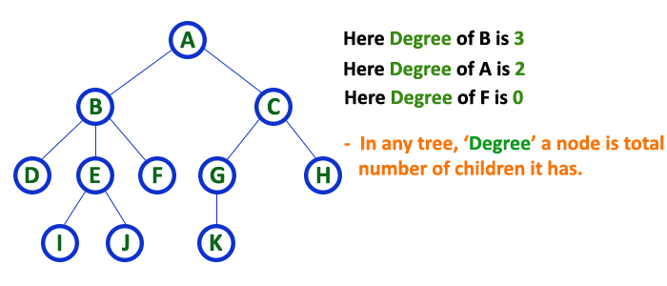
Degree
In a tree data structure, the total number of children of a node is called as DEGREE of that Node. In simple words, the Degree of a node is total number of children it has. The highest degree of a node among all the nodes in a tree is called as 'Degree of Tree'

Slide 21
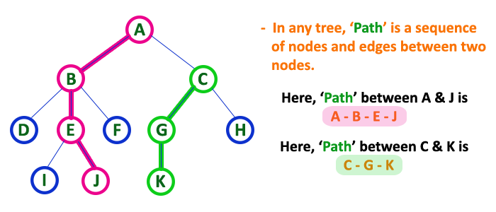
Path
In a tree data structure, the sequence of Nodes and Edges from one node to another node is called as PATH between that two Nodes.
Length of a Path is total number of nodes in that path. In below example the path A - B - E - J has length 4.

Slide 22
m-ary Tree
A Tree is an m-ary Tree when each of its node has no more than m children.
A
A
B
D
B
C
D
E
F
H
I
E
F
G
H
I
J
K
G
N
O
K
L
M
N
O
2-ary tree
L
M
3-ary tree
Two-array tree
(m=2)
Three-array tree
(m=3)

Slide 23
Binary Tree (BT)
Each node of a binary Tree has at most 2 children.
A
B
D
E
F
H
I
K
G
N
O
L
M
Binary tree

Slide 24
Binary Tree
Binary tree with 9 nodes.
A
B
C
D
E
F
G
H
I

Slide 25
Binary Tree
root
A
B
C
D
E
F
G
H
I
Left subtree
Right subtree

Slide 26
Binary Tree
Recursive definition
A
root
B
C
D
E
F
Left subtree
G
H
I
Right subtree

Slide 27
Binary Tree
Recursive definition
A
B
C
root
D
E
F
G
H
I
Left subtree

Slide 28
Binary Tree
Recursive definition
A
B
C
D
E
F
root
G
H
I

Slide 29
Binary Tree
Recursive definition
A
root
B
C
D
E
F
G
H
I
Right subtree

Slide 30
Binary Tree
Recursive definition
A
B
C
root
D
E
F
G
H
I
Left subtree
Right subtree

Slide 31
Level & Depth of a Binary Tree
The level of a node in a binary tree is defined as follows:
Root has level 0,
Level of any other node is one more than the level its parent (father).
The depth of a tree means how many levels is in the tree i.e. the Total number of level in the tree.

Slide 32
Level of a Binary Tree Node
A
0
Level 0
B
1
C
1
Level 1
D
E
F
2
Level 2
2
2
G
H
3
I
3
Level 3
3

Slide 33
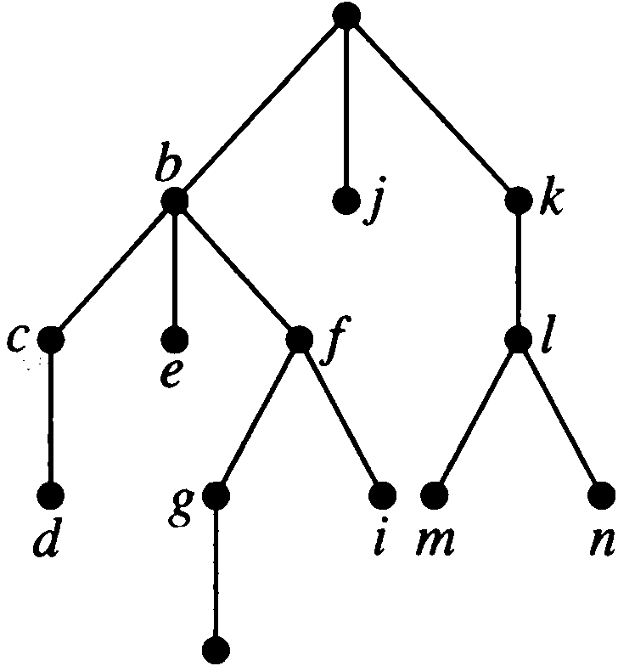
Find the level of each node in the tree shown in Figure. What is the height/depth of this tree?
a
The root a is at level O.
Nodes b, j, and k are at level 1 .
Nodes c, e, f, and I are at level 2.
Nodes d, g, i , m , and n are at level 3 .
Finally, Node h is at level 4.
The height/depth of this tree is 5.
The height of node h is 1.
The height of node b is 4.
The depth of node m is 2.
h

Slide 34
Complete Binary Tree
A complete binary tree is a binary tree, which is completely filled, with the possible exception of the bottom level, which is filled from left to right.
A
0
B
1
C
2
D
3
E
4
F
5
G
6
H
I
J
K
L
8
9
10
11
12
Top to bottom,
From left to right number

Slide 35
Full Binary Tree
A full binary tree of depth k is a binary tree of depth k having 2^{k} -1 nodes, k>=0.
A
Level 0: 2⁰ = 1 nodes
B
C
Level 1: 2¹ = 2 nodes
D
E
F
G
Level 2: 2² = 4 nodes
H
I
J
K
L
M
N
O
Level 3: 2³ = 8 nodes
Here depth is k = 4 and Total nodes (2⁴ -1) = 15

Slide 36
Full BT VS Complete BT
k
A full binary tree of depth k is a binary tree of depth k having 2 -1 nodes, k>=0.
A binary tree with n nodes and depth k is complete iff its nodes correspond to the nodes numbered from 0 to n-1 in the full binary tree of depth k..
Top to bottom,
From left to right number
A
A
B
C
B
C
D
E
F
G
D
E
F
G
H
H
I
J
K
L
M
N
O
Complete binary tree
Full binary tree of depth 4

Slide 37
Complete and Full Binary Tree
A complete/full binary tree is a binary tree, which is completely filled with nodes from top to bottom and left to right.
The tree starts from the root (top), goes to the next level with first the left child and then the right child (left to right). The process repeats for each next level with each node till the last (bottom) level.
In complete binary tree some of the nodes only for the bottom level might be absent (here nodes after N).
In Full binary tree the last/bottom level must also be filled up.
A
B
D
E
F
H
I
K
L
G
M
N
C
J
P

Slide 38
Complete and Full Binary Tree
A full binary tree of depth n is a binary tree of depth n with 2^{n} - 1 nodes, n >=0.
A binary tree with k nodes and depth n is a complete binary tree if and only if its nodes correspond to the nodes numbered from 0 to k-1 in the full binary tree of depth n.
Level=0,
# of nodes=2⁰=1
A
Total Number of Nodes:
2⁰+ 2¹+ 2²+ 2³ = 2⁴ - 1 = 15
Height of the tree: ⎡Log₂15⎤ = 4
If total number of nodes are n,
Nodes at each level L = 2^{L}
Bottom Level = BL
Height h = BL+1 = ⎡Log₂n⎤
Total nodes = 2^{h} – 1 = n
Level=1,
# of nodes=2¹=2
B
D
Level=2,
# of nodes=2²=4
E
F
H
I
Level=3,
# of nodes=2³=8
K
L
G
M
N
C
J
P

Slide 39
Traversal
Systematic way of visiting all the nodes.
Methods:
Inorder
Postorder
Preorder
They all traverse the left subtree before the right subtree.
The name of the traversal method depends on when the node is visited.

Slide 40
Inorder Traversal (Left_Node_Right)
Traverse the left subtree.
Visit the node.
Traverse the right subtree.
a
b
c
b
a
c

Slide 41
Inorder Example
a
b
c
f
d
e
g
j
h
i
g
d
h
b
e
i
a
f
j
c

Slide 42
Postorder Traversal (Left_Right_Node)
Traverse the left subtree.
Traverse the right subtree.
Visit the node.
a
b
c
b
c
a

Slide 43
Postorder Example
a
b
c
f
d
e
g
j
h
i
g
h
d
i
e
b
j
f
c
a

Slide 44
Preorder Traversal (Node_Left_Right)
Visit the node.
Traverse the left subtree.
Traverse the right subtree.
a
b
c
a
b
c

Slide 45
Preorder Example
a
b
c
f
d
e
g
j
h
i
a
b
d
g
h
e
i
c
f
j
Notes:
During the traversal, t starts at the root, moves to the left child b of the root, then to the left child d of b. When the traversal of the left subtree of b is complete, t, once again, points to the node b. The t moves into the right subtree of b. When the traversal of this right subtree is complete, t again points to b. Following this, t points to a. We see that t points to every node in the binary tree three times – once when you get to the node from its parent (or in the case of the root, t is initially at the root), once when you return from the left subtree of the node, and once when you return from the node’s right subtree. Of these three times that t points to a node, the node is visited the first time.

Slide 46
Example: Inorder
43
31
64
20
40
56
89
28
33
47
59
20
28
31
33
40
43
47
56
59
64
89

Slide 47
Example: Postorder
43
31
64
20
40
56
89
28
33
47
59
28
20
33
40
31
47
59
56
89
64
43

Slide 48
Example: Preorder
43
31
64
20
40
56
89
28
33
47
59
43
31
20
28
40
33
64
56
47
59
89

Slide 49
Some Examples
preorder = ab
a
a
b
b
inorder
= ab
b
a
a
b
postorder = ab
b
b
a
a

Slide 50
Exercise: Find the sequences for Preorder, Inorder and Postorder Traversal
a
d
b
c
e
i
g
f
h
j
k
l
m
n
o
p

Slide 51
Answer:
Preorder: a b e j k n o p f c d g l m h i
Inorder: j e n k o p b f a c l g m d h i
Postorder: j n o p k e f b c l m g h i d a

Slide 52
Inorder Traversal – Left_ParentNode_Right
Traverse the left subtree
Visit the parent node
Traverse the right subtree
A
B
D
E
F
H
K
E
L
B
F
M
A
H
C
D
K
L
M
C

Slide 53
Postorder Traversal – Left_Right_ParentNode
Traverse the left subtree
Traverse the right subtree
Visit the parent node
A
B
D
E
F
H
K
L
E
M
F
B
C
H
D
A
K
L
M
C

Slide 54
Preorder Traversal – ParentNode_Left_Right
Visit the parent node
Traverse the left subtree
Traverse the right subtree
A
B
D
E
F
H
A
B
E
K
L
F
M
D
H
C
K
L
M
C

