Slide 1


WELCOME TO ANOTHER EDITION OF HISF WEBINAR
Unlocking Fully Funded Scholarships: Navigating Opportunities in Humanities and Social Sciences ✈

Slide 2
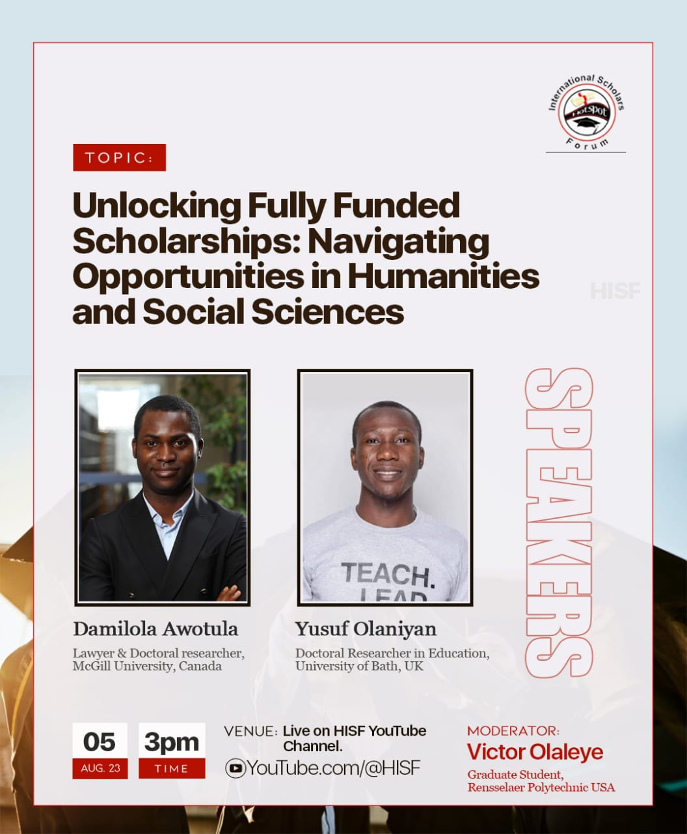
Navigating Opportunities in Humanities and Social Sciences

Slide 3

Webinar Agenda
Introduction of Guest Speakers
Speaker 1 Lecture: Damilola Awotula
Speaker 2 Lecture: Yusuf Olaniyan
Q&A

Slide 4
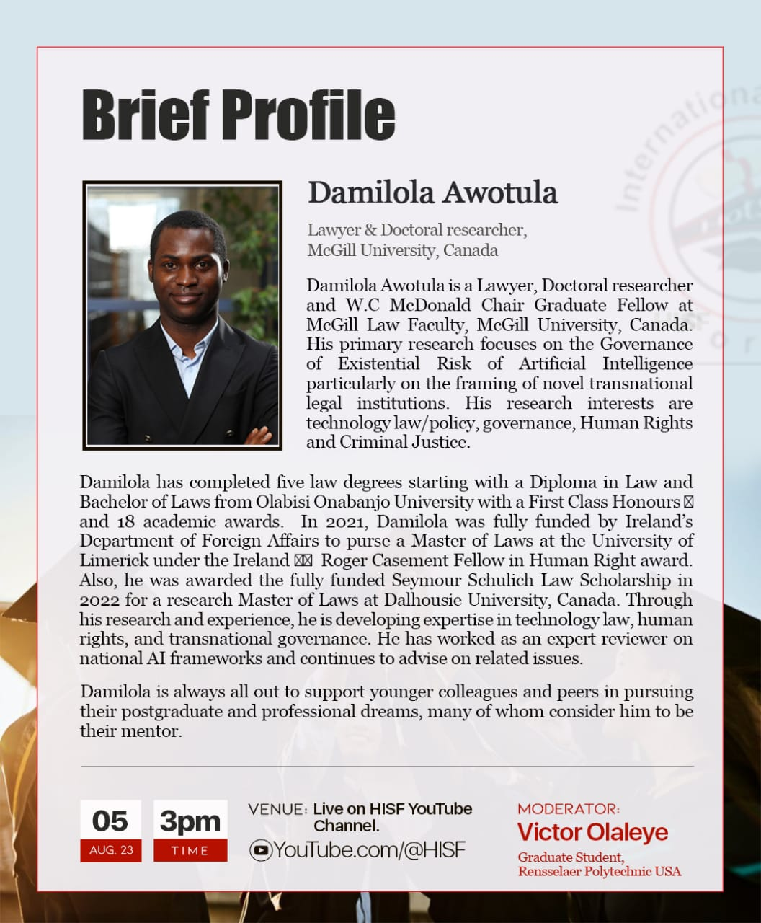
Guest Speaker 1
Damilola Awotula

Slide 5
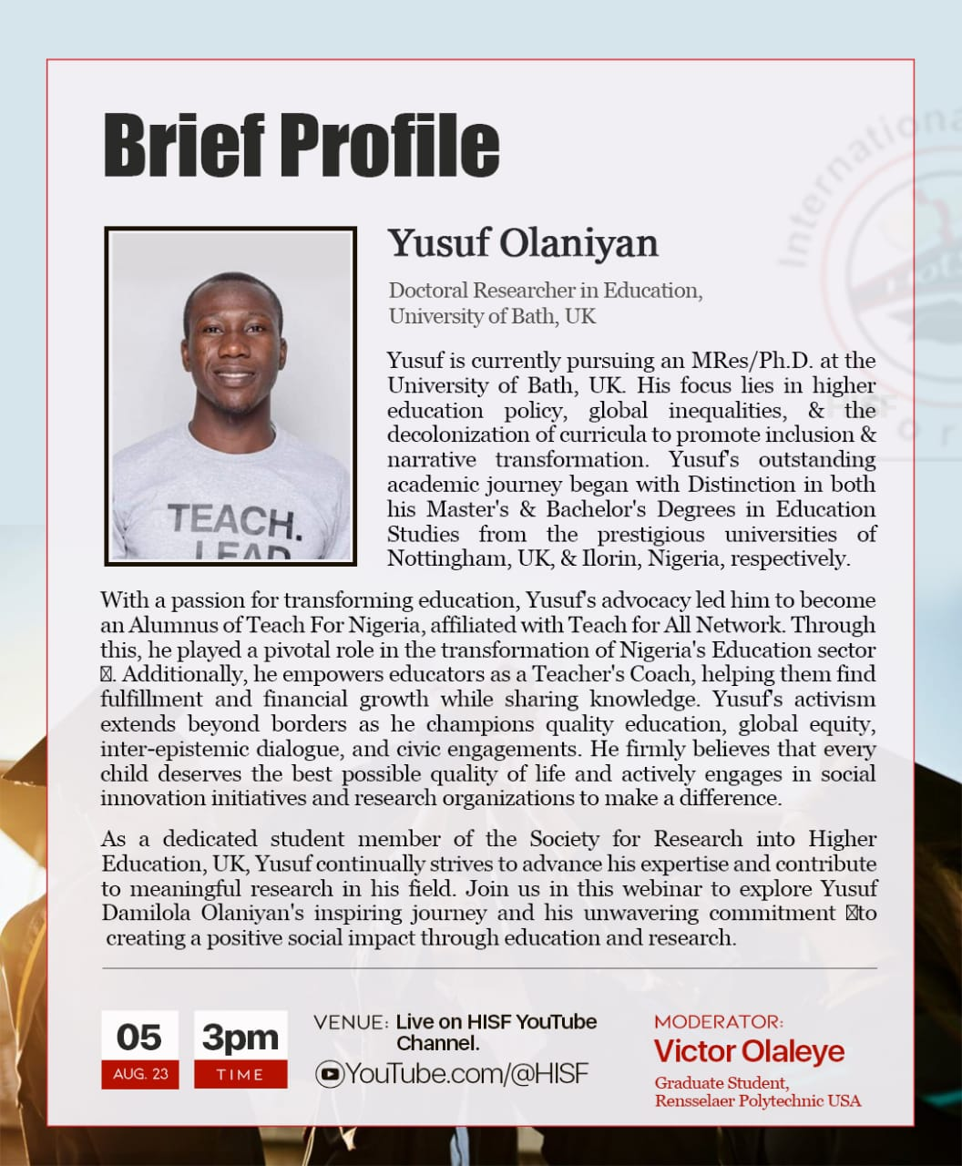
Guest Speaker 2
Yusuf Olaniyan

Slide 6

YouTube.com/@HISF

Slide 7

Speaker 1 Lecture
Understanding the landscape of fully funded scholarships in humanities and social sciences.
Strategies for crafting compelling scholarship applications - Motivation letter, CV, research proposal etc.
Exploring niche scholarships and lesser-known opportunities.
Humanities and Social science opportunities in North America Universities.
General advice to applicants.
Damilola Awotula

Slide 8
Speaker 2 Lecture
Tell us briefly about your scholarship journey in the Social science field.
Tips on showcasing strengths and unique qualities as an applicant.
Humanities and Social science opportunities in African, European, and Asian Universities.
Yusuf Olaniyan

Slide 9

Q&A

Slide 10
Question 1/10
What is the process to get a fully funded scholarship in Education or Law?

Slide 11
Question 2/10
How truly can someone gets scholarship studying history and international studies as degree in Germany?

Slide 12
Question 3/10
I observed it is good to message the program coordinator just like other science students message prospective supervisors. What should be included in the email and can you still turn in your application even if no response is forthcoming?

Slide 13
Question 4/10
It has been really difficult, How can one get mentors in this scholarship journey?

Slide 14
Question 5/10
Which regions of the world should I focus more to get fully funded scholarship as a graduate of gender studies?

Slide 15
Question 6/10
I am a graduate of Humanities. Which courses can I apply for under the Erasmus mundus scholarship?

Slide 16
Question 7/10
Both guest speakers have impressive academic journeys. Could they share their personal experiences and strategies for crafting compelling scholarship applications that stood out to selection committees?

Slide 17
Question 8/10
What are some key resources or platforms where scholars interested in humanities and social sciences can find fully funded scholarship opportunities, especially those that might be lesser-known but highly valuable?

Slide 18
Question 9/10
For students coming from different cultural backgrounds and education systems, how can they effectively showcase their strengths and unique qualities as applicants, ensuring their applications resonate with international scholarship providers?

Slide 19
Question 10/10
What advice do the guest speakers have for scholars who have secured fully funded scholarships, especially when it comes to navigating academic life abroad, managing work-life balance, and maximizing the impact of their research on the global stage?

Slide 20
Don‘t forget to subscribe and share with family and friends.
YouTube.com/@HISF

Slide 21

THANK YOU ALL FOR JOINING THE SESSION
Contacts:
hotspotisf@gmail.com
admin@hotspotisf.com

