Slide 1


PROJECT TITLE
Melanoma Skin Cancer Detection
Supervised By
DR. MD. ASRAF ALI
Group Members
AZMINUR RAHMAN (22-46588-1)
PRITHOY CHANDRA ROY (22-46424-1)

Slide 2
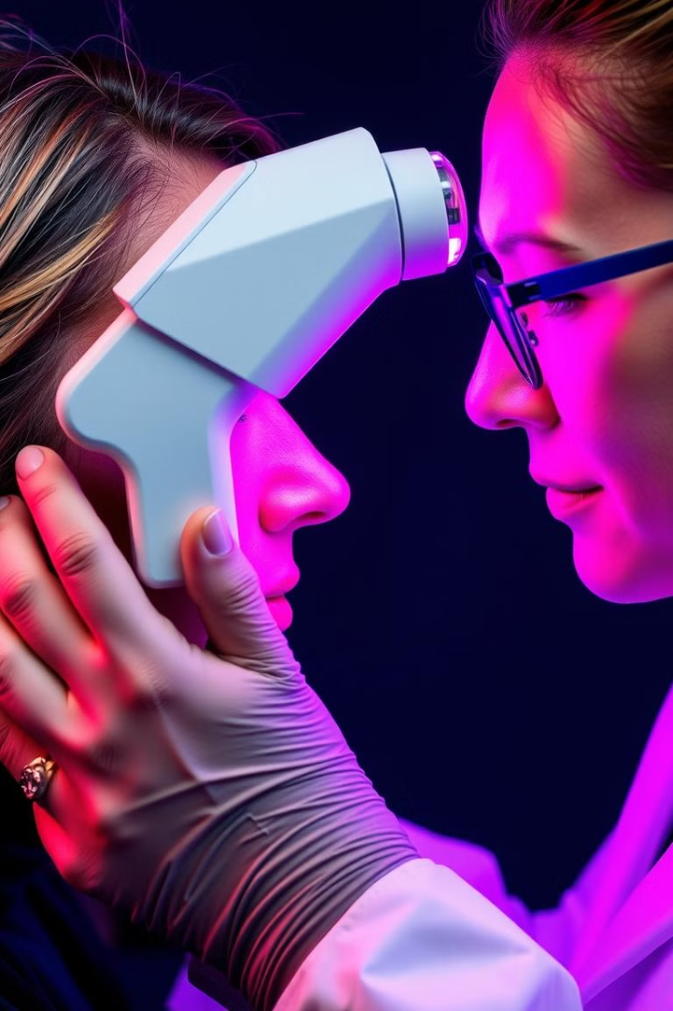
Introduction
This presentation explores a deep learning approach to melanoma detection using a labeled dataset of skin lesion images. The project aims to develop a robust model for early detection of melanoma, potentially improving patient outcomes and supporting healthcare providers in timely diagnosis.

Slide 3
Project Overview
Objective
Methodology
To develop a machine learning model for accurate and timely melanoma detection using dermoscopic images.
The project utilizes a Convolutional Neural Network (CNN) model trained on a dataset of 10,000 dermoscopic images.

Slide 4

Data Collection and Validation
Dataset Source
Data Validation
The melanoma skin cancer dataset was obtained from the Kaggle repository, containing 10,000 high-resolution dermoscopic images.
The dataset underwent thorough checks to ensure reliability, including verifying completeness, consistency, and accuracy.

Slide 5

Data Preprocessing and Feature Extraction
1
Image Resizing
2
Normalization
Images were resized to a uniform size of 128x128 pixels.
Pixel values were normalized to range between 0 and 1.
3
Feature Extraction
The CNN model automatically learned and extracted relevant features from the images, capturing patterns and characteristics at various levels of abstraction.

Slide 6
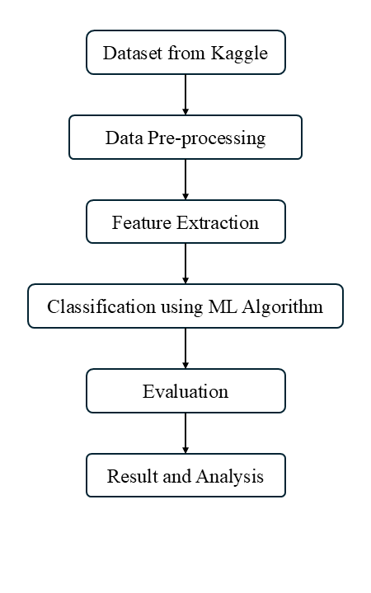
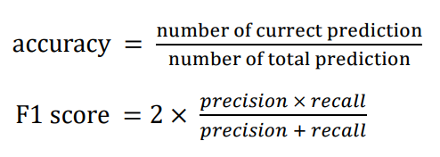
Model Training and Evaluation
Model Architecture
The CNN model consisted of multiple convolutional layers, maxpooling layers, and fully connected dense layers.
Evaluation Metrics
The model's performance was evaluated using accuracy, loss, precision, recall, and F1-score.

Slide 7
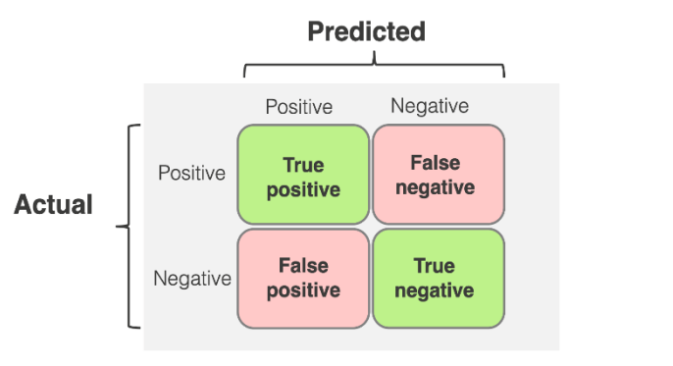




Confusion Matrix Analysis
True Positives
True Negatives
The model correctly identified melanoma cases.
The model correctly identified non-melanoma cases.
False Positives
False Negatives
The model incorrectly identified non-melanoma cases as melanoma.
The model incorrectly identified melanoma cases as non-melanoma.

Slide 8
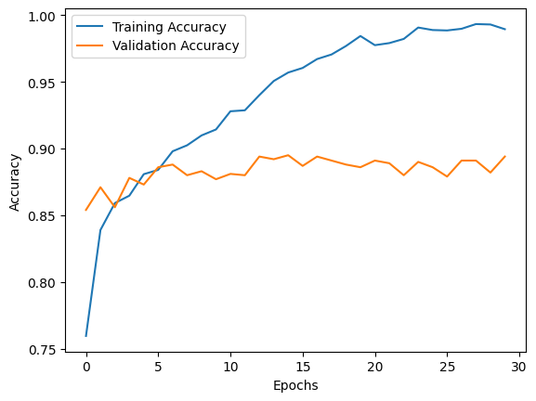
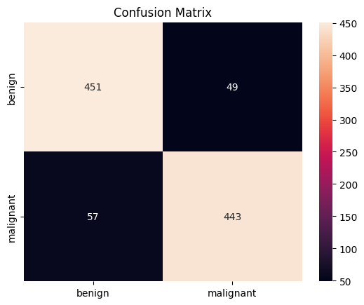
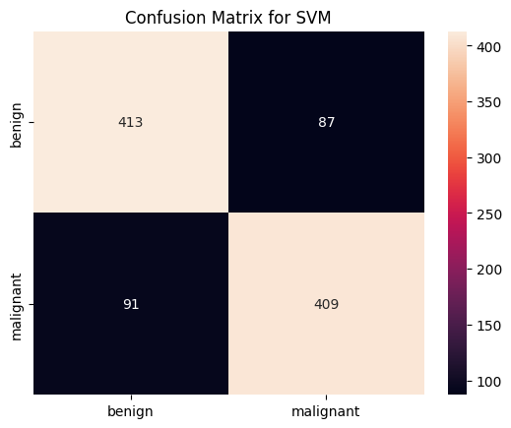
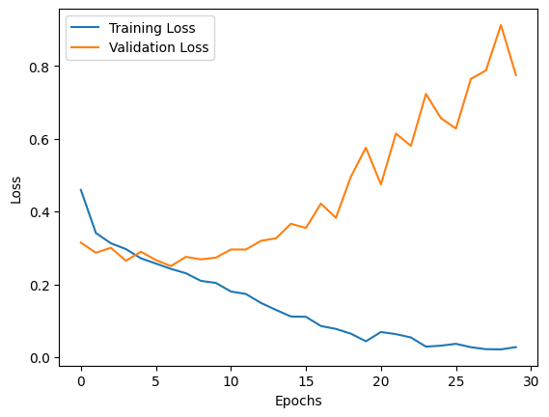
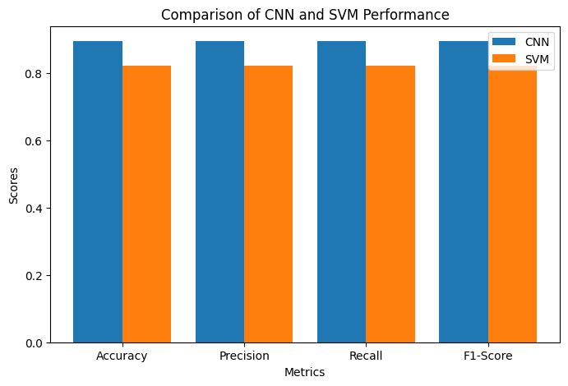
Results and Discussion
89%
82%
CNN Accuracy
SVM Accuracy
The CNN model achieved an accuracy of 89%.
The SVM model achieved an accuracy of 82%.
Accuracy graph CNN
Loss graph CNN

Slide 9
Conclusion and Future Recommendations
Key Findings
1
The CNN model demonstrated superior performance in classifying melanoma skin lesions compared to the SVM model.
Future Directions
2
Future work could focus on diversifying the dataset, employing transfer learning, and incorporating domain-specific knowledge.
Impact
3
These advancements could significantly improve the robustness of melanoma detection models and pave the way for their integration into real-world healthcare systems.

