Slide 1


Slide 2

AMERICAN INTERNATIONAL UNIVERSITY–BANGLADESH (AIUB)
FACULTY OF SCIENCE & TECHNOLOGY
DEPARTMENT OF PHYSICS
PHYSICS 2 LAB
Summer 2021-2022
Group: 01
LAB REPORT ON
To verify the laws of transverse vibration of strings and to determine the frequency of a tuning fork by Meld’s experiment.
Supervised By
DR. MD. MOZAHAR ALI

Slide 3
Submitted By:
Name | ID | Contribution
1. RABIUL ISLAM BIPUL | 21-45121-2 | Theory & Apparatus
2. MD. SHAHRIAR SHAON | 21-45024-2 | Procedure
3. MD. Al FAIAZ RAHMAN FAHIM | 21-45080-2 | Experimental Data and Calculation
4. SHATABDI SARKER | 21-45031-2 | Experimental Data and Calculation
5. TRIDIB SARKAR | 22-46444-1 | Result, Discussion & References

Slide 4
TABLE OF CONTENTS
TOPICS | Page no.
I. Title Page | 2
II. Table of Content | 4
1. Theory | 5
2. Apparatus | 8
3. Procedure | 8-9
4. Experimental Data & Calculation | 10-11
6. Result | 12
7. Discussion | 12
8. References | 12

Slide 5
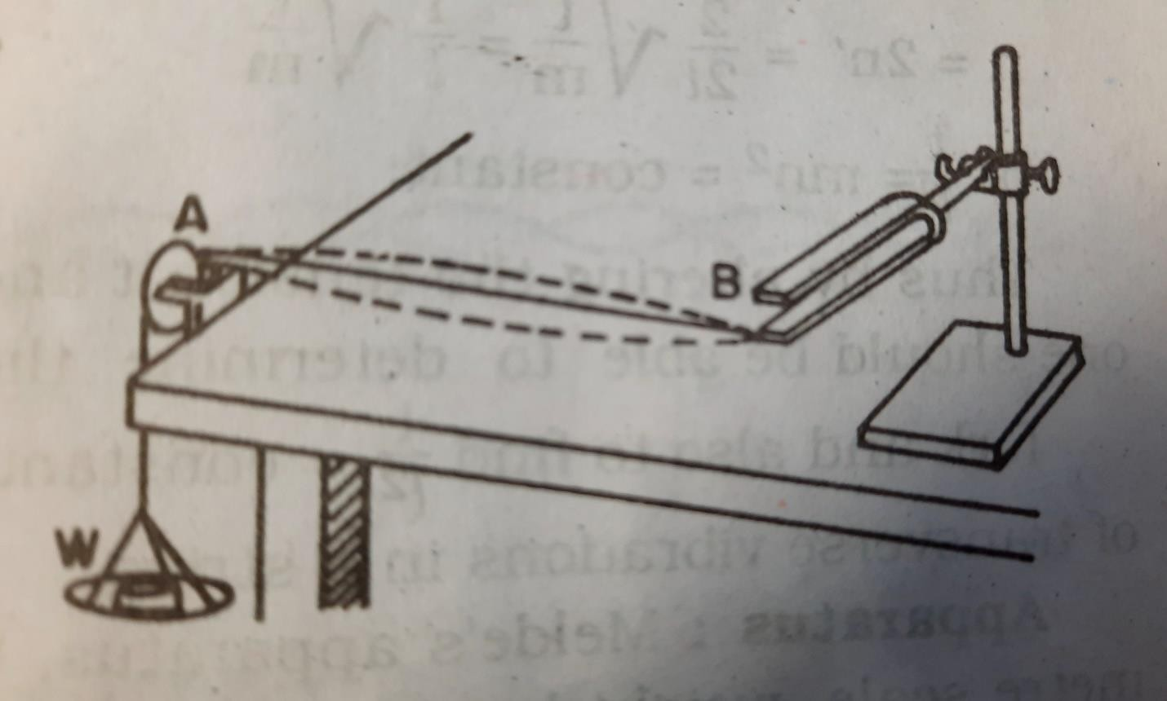
Theory
Let one end of B of the string be attached to one prong of the fork F. The other end A passes over a small pulley and is attached to a scale pan – (Figure -1).
Figure -1: Arranging the Melda’s apparatus
The string will be set into vibration by setting the tuning fork into vibration. As a result, waves will proceed along the length of the string and will be reflected on reaching the fixed end of the string. The superposition of the direct and reflected waves will form stationary waves, in which the extreme fixed ends of the string will always be nodes and in between them there may be one or more antinodes depending on the tension to which the string is subjected or the length of the string.

Slide 6
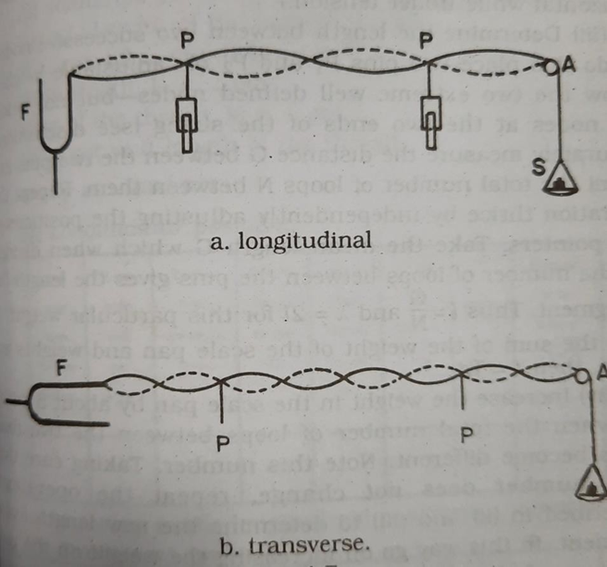
Where 𝜇 is the mass per unit length of the vibrating string in grams and 𝑟 is the tension applied to the string and is expressed in absolute units, i.e., dynes or pounds.
Now the motion of the prongs of the fork, which sets the string in resonant vibration, can be in two different directions-
In a direction perpendicular to the length of the string i.e., transverse position (Figure – 2)
In a direction along (parallel) the length of the string i.e., longitudinal position (Figure – 2)
Figure-2: Longitudinal and Transverse mode of vibration

Slide 7
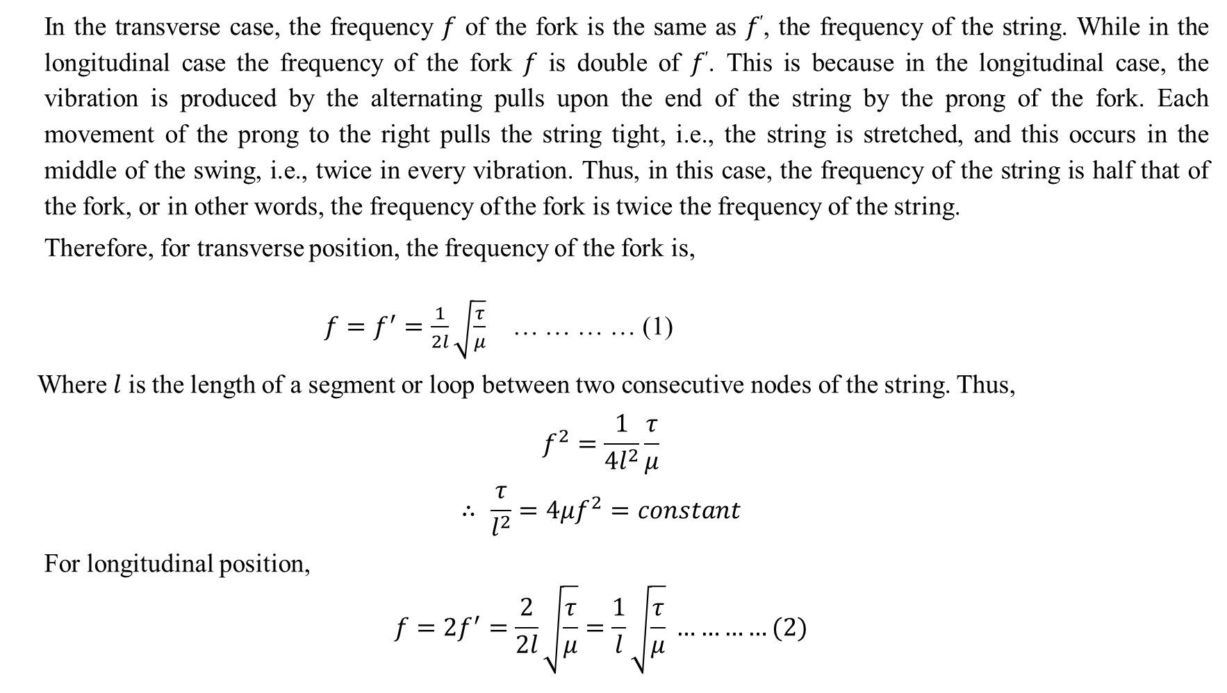
In the transverse case, the frequency 𝑓 of the fork is the same as 𝑓′, the frequency of the string. While in the longitudinal case the frequency of the fork 𝑓 is double of 𝑓′. This is because in the longitudinal case, the vibration is produced by the alternating pulls upon the end of the string by the prong of the fork. Each movement of the prong to the right pulls the string tight, i.e., the string is stretched, and this occurs in the middle of the swing, i.e., twice in every vibration. Thus, in this case, the frequency of the string is half that of the fork, or in other words, the frequency of the fork is twice the frequency of the string.
Therefore, for transverse position, the frequency of the fork is,
$f=f^{′}=\frac{1}{2l}\sqrt{\frac{τ}{μ}}$ … … … … (1)
Where 𝑙 is the length of a segment or loop between two consecutive nodes of the string. Thus,
$$f^{2}=\frac{1}{4l^{2}}\frac{τ}{μ}$$
$$∴ \frac{τ}{l^{2}}=4μf^{2}=constant$$
For longitudinal position,
$$f=2f^{′}=\frac{2}{2l}\sqrt{\frac{τ}{μ}}=\frac{1}{l}\sqrt{\frac{τ}{μ}} …………(2)$$

Slide 8
Apparatus
Procedure
At first, we weighed the scale pan. Then, we clamped the tuning fork in a longitudinal position at the edge of the table. We fixed a pulley which was fixed over a clamp and screwed to the other edge of the table. A thread was fastened to the tip of the prong and pass the other end over the pulley. We hung the scale pan at this end and put some small weights on it so that the string is lightly stretched.
Then we rotated the screw to maintain an electrically tuning fork (i.s., the tuning has exited). As a result, the vibration in the tuning fork gets started and several nodes and loops can possibly be seen.
We increased the weight until the loops are maximum, the nodal points are fixed in position and the loops are of equal length. This happened when resonance occurred between the fork and the particular mode of vibration of the string. We defined the loops by adjusting the length of the string while keeping the weight on the pan fixed.
Meld’s apparatus.
String.
Meter scale.
Weight box.

Slide 9
After That, we determined the length between two successive nodes, placing two pins P1 and P2 of adjustable height below the two extreme well-defined nodes. Then, we measured the distance between the two pins and the total number of loops between them counted. The operation was repeated three times by independently adjusting the positions of the pointers. From these observations, we calculated the length l of a segment.
Again That, we increased the weight in the scale pan when the total number of loops between the two fixed ends became different. The operations were repeated as described in 2, 3 and 4 to determine the new length of a segment. In that way, the weight was being increased on the pan. The number of loops decreases as the weights increased. The total number of loops for each new weight was measured and the corresponding l in the manner described in 2, 3 and 4 was determined.
We repeated the whole process with another mode of vibration of the fork, by turning the fork through 90̊.
At the end of the experiment, we determined the weight and length of the string. And we determined the mass per unit length of the thread was determined. Also, we determined the mass of the scale pan.
We calculated the frequency of the given fork with the help of equation (1) and (2).

Slide 10
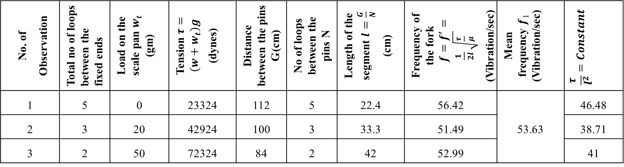

Experimental Data
Data table
(A) Mass of the scale pan, w = 23.8 gm
(B) Length of the string, L = 192 cm.
Mass of the string, M = 0.7 gm
So, the mass per unit length, $μ=\frac{M}{L}=\frac{0.7}{192}$
$$∴μ=3.65×{10}^{−3}gm/cm$$
Table - 1: Table for transverse position
No. of Observation | Total no of loops between the fixed ends | Load on the scale pan 𝒘_{𝒕} (gm) | Tension $τ=(w+w_{t})g$ (dynes) | Distance between the pins G (cm) | No of loops between the pins N | Length of the segment $l=\frac{G}{N}$ (cm) | Frequency of the fork $f=f^{′}=\frac{1}{2l}\sqrt{\frac{τ}{μ} }$ (Vibration/sec) | Mean frequency 𝒇₁ (Vibration/sec) | $$\frac{τ}{l^{2}}=Constant$$
1 | 5 | 0 | 23324 | 112 | 5 | 22.4 | 56.42 |  | 46.48
2 | 3 | 20 | 42924 | 100 | 3 | 33.3 | 51.49 | 53.63 | 38.71
3 | 2 | 50 | 72324 | 84 | 2 | 42 | 52.99 |  | 41

Slide 11
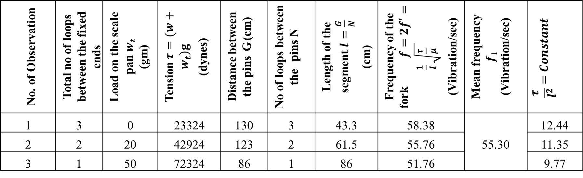

Table - 2: Table for Longitudinal position
Mean frequency of the fork, $f=\frac{f_{1}+f_{2}}{2}=\frac{53.63+55.30}{2}, ∴f=54.46 vibration/sec$
No. of Observation | Total no of loops between the fixed ends | Load on the scale pan 𝒘_{𝒕} (gm) | Tension $τ=(w+w_{t})g$ (dynes) | Distance between the pins G (cm) | No of loops between the pins N | Length of the segment $l=\frac{G}{N}$ (cm) | Frequency of the fork $f=2f^{′}=\frac{1}{l}\sqrt{\frac{τ}{μ} }$ (Vibration/sec) | Mean frequency 𝒇₁ (Vibration/sec) | $$\frac{τ}{l^{2}}=Constant$$
1 | 3 | 0 | 23324 | 130 | 3 | 43.3 | 58.38 |  | 12.44
2 | 2 | 20 | 42924 | 123 | 2 | 61.5 | 55.76 | 55.30 | 11.35
3 | 1 | 50 | 72324 | 86 | 1 | 86 | 51.76 |  | 9.77

Slide 12
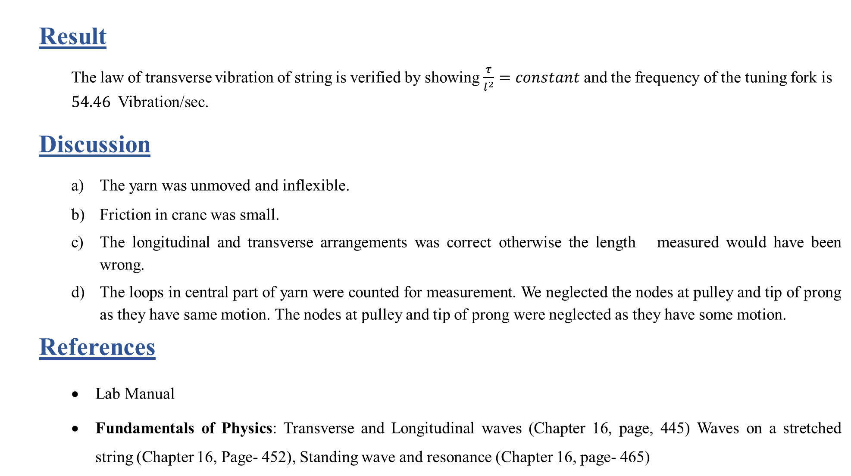
Result
The law of transverse vibration of string is verified by showing $\frac{τ}{l^{2}}=constant$ and the frequency of the tuning fork is $54.46$Vibration/sec.
Discussion
The yarn was unmoved and inflexible.
Friction in crane was small.
The longitudinal and transverse arrangements was correct otherwise the length measured would have been wrong.
The loops in central part of yarn were counted for measurement. We neglected the nodes at pulley and tip of prong as they have same motion. The nodes at pulley and tip of prong were neglected as they have some motion.
References
Lab Manual
Fundamentals of Physics: Transverse and Longitudinal waves (Chapter 16, page, 445) Waves on a stretched string (Chapter 16, Page- 452), Standing wave and resonance (Chapter 16, page- 465)

Slide 13
Thank You For Staying With Us

