Slide 1
Computability Theory
CSC3113: Theory of Computation
13
8
Spring 2022-2023
Sharfuddin Mahmood, Assistant Professor,
Department of Computer Science, Faculty of Science & Technology.
smahmood@aiub.edu

Slide 2
Computability & Turing Machine
Following FA, PDA, Regular & Context-free language towards Computability & Turing Machine (TM).
Computability Theory, History.
Turing Machine
Informal Description
Input/output convention
Abstraction
Implementation level description
Low level description
Formal Definition
State Diagram

Slide 3
Difference among FA, PDA, and TM
Understand Computability Theory through Turing Machine model.
Description of Turing Machine

Slide 4
All outcome are represented with examples
Understand why we need TM through understanding the difference among FA, PDA, Regular & Context-free languages with Computability and Turing machine.
Basic concept of Computability Theory and its history.
Description of Turing Machine –
Informal
Implementation level
Low level
Formal
State Diagram

Slide 5
We have Learned so far…
Context Free Languages
Regular Languages
Push Down Automaton (PDA) Computational Model with additional stack memory can be used to compute these languages.
Regular language is member of CFL.
Can be generated by CFG.
Can be recognized by PDA.
CFG can be decided by PDA.
Finite Automaton (FA) Computational Model with limited memory can be used to compute these languages.
Can be decided by a DFA.
Can be decided by an NFA.
Can be expressed by a regular expression.
Regular language is closed under regular operations.
Pushdown automata is used in programming languages, AI tools, Natural Language processing, parsing (math expressions), etc.
Finite automata is used in text processing, pattern matching, parity checking, compilers, and hardware design, etc.

Slide 6
Next: We will Learn
Computable
Can be decided by a Turing Machine (TM).
A model of computation that is –
General purpose: Captures all algorithms that can be implemented in any programming language.
Mathematically simple: We can hope to prove that things are not computable in this model.
Turing Machine is deterministic
Must reach Accept/Reject state
Halts once it reaches Accept/Reject state
Might loop forever
Context Free Languages
Regular Languages

Slide 7
Computability Theory
A mathematical problem is computable if it can be solved in principle by a computing device.
In the 1930’s, well before there were computers, Gödel, Turing, and Church showed that not all mathematical problems are computable in a computing device.
There is an extensive study and classification of
Which mathematical problems are computable, and which are not.
Computable problems into computational complexity classes according to how much computation is needed to answer that instance, as a function of the size of the problem instance.
Some common synonyms for “computable” are “solvable”, “decidable”, and “recursive”.

Slide 8
Computability History
David Hilbert’s Tenth Problem in 1900 states that a given Diophantine equation (polynomial equation with integral coefficients) is solvable in rational integers using a finite number of operations.
Hilbert came up with the term “entscheidungsproblem” (decision problems) which is the pre-version to the NP-problem that we currently know as SAT (satisfiability problem) in computing science, in 1928.
In 1930s, various mathematicians – Alonzo Church, Kurt Gödel, Stephen Kleene, Markov, Emil Post, and Alan Turing, independently defined what it means to be computable.
They defined Lambda calculus, Recursive functions, Formal systems, Markov algorithms, Post (abstract) machine, and Turing (abstract) machine models, which are equivalent to each other.
In 1930 & 1931, Mr. Gödel gave his Completeness and Incompleteness theorem. A few years later, Church and Turing independently proved that the entscheidungsproblem is unsolvable.

Slide 9
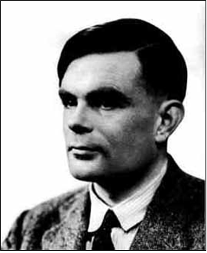
Turing Machines
In 1936, Turing introduced his abstract model for computation in his article “On Computable Numbers, with an application to the Entscheidungsproblem”.
Turing machine model was used to prove the unsolvable assuming that the intuitive notion of "effectively calculable“ (computability) is captured by the functions computable by a Turing machine.
Equivalently, Church also proved the same assumption by those expressible in the lambda calculus.
This assumption is now known as the Church–Turing thesis.
TM is similar to a finite automaton but with an unlimited and unrestricted memory, a Turing machine is a much more accurate model of a general purpose computer. A Turing machine model can model everything that a real computer can do.
Turing additionally proved many interesting theorems with his machine model which has become the standard model in theoretical computer science.
Alan M. Turing (1912–1954)

Slide 10
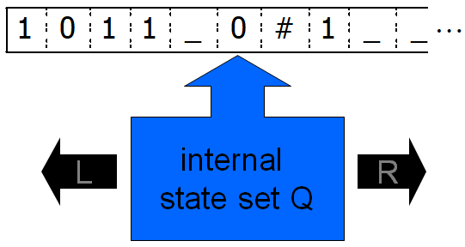
Informal Description
Turing Machine (TM)
At every step, the head of the Turing Machine named M reads a letter x_{i} from the one-way infinite tape.
Depending on its current state and the letter x_{i} being pointed by the head of the TM –
reads/writes a letter from/on the tape,
moves its read/write head left or right, and
jumps to a new state.

Slide 11
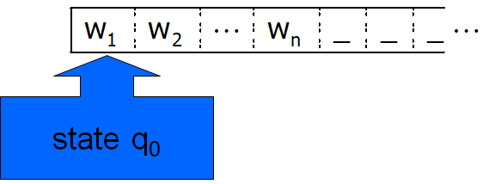
Input Convention
Turing Machine (TM)
Initially, the tape contains the input w∈Σ*, padded with blanks “_”, and the TM is in start state q₀.
During the computation –
the head moves left and right (but not beyond the leftmost point),
the internal state of the machine changes, and
the content of the tape is rewritten.

Slide 12
Input Convention: Simulation
Instruction:
Write A, Move right
Read N, Move right
Write N, Move left
q₁
q₀
q₂
Finite State Control
q₃
Head
 |  |  |  |  |  |  |  |  |  |  |  |  | …
I | N | P | U | T |  |  |  |  |  |  |  |  | …
A | N | P | U | T |  |  |  |  |  |  |  |  | …
A | N | N | U | T |  |  |  |  |  |  |  |  | …
Infinite Tape

Slide 13
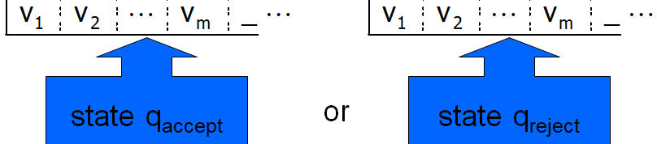
Output convention
Turing Machine (TM)
The computation completes/ends when the machines reaches one of the two halting states –
Accept State
Reject State
There is also a possibility for the machine not to complete/end the computation.
The computation can proceed indefinitely

Slide 14
Three Levels of Abstraction
High‐Level Description: An algorithm (already covered)
Implementation‐Level Description:
Describe (in English) the instructions for a TM, example:
How to move the head
What to write on the tape
A version of it is covered as pseudo code in programming language courses, assembly language in “Computer Organization & Architecture”. We will briefly cover here in terms of Turing machine.
Low‐Level Description:
State diagram
Formal Specification
Next, we will look into an example for Implementation level description by testing membership of a string for a given language.

Slide 15
TM Design Idea, B = { w#w | w ∈ {0,1}* }
The language here contains strings which has the following properties,
w is a binary string that contains only 0’s and/or 1’s.
Each string has a ‘#’ symbol in the middle
Both left and right side of the ‘#’ contains same string.
Example: 101#101
Testing the language B in TM,
Put (blank ‘⌴’) marker on both (left & right) side of the input string
Scan, Store and Mark (‘X’) the 1st (0 or 1) symbol right to the left marker of the string.
If no (0 or 1) symbol found before ‘#’ then
If no (0 or 1) symbol found after ‘#’ and before right marker then ACCEPT, otherwise REJECT.
Move right to the ‘#’ symbol.
Scan and Mark (‘X’) the 1st (0 or 1) symbol right to the ‘#’ of the string only of it matches with stored symbol in step 2.
Move right to the left marker, continue from step 2.
⌴ | 1 | 0 | 1 | # | 1 | 0 | 1 | ⌴
⌴ | 1 | 0 | 1 | # | 1 | 0 | 1 | ⌴
⌴ | X | 0 | 1 | # | X | 0 | 1 | ⌴
⌴ | X | 0 | 1 | # | X | 0 | 1 | ⌴
⌴ | X | X | 1 | # | X | X | 1 | ⌴
⌴ | X | X | 1 | # | X | X | 1 | ⌴
⌴ | X | X | X | # | X | X | X | ⌴
⌴ | X | X | X | # | X | X | X | ⌴

Slide 16
Testing membership in B = { w#w | w ∈ {0,1}* }
Putting marker on both end of input
Input example: 011#011
Implementation level description: Common steps
Shift the input one space right, Put ⌴ at both left and right side of input in following steps
READ (store) 1st alphabet, WRITE ⌴, MOVE right
READ current alphabet, WRITE stored alphabet, store current alphabet, MOVE right
Continue step 2 until it WRITE ⌴, then MOVE to the ⌴ on the left, MOVE right to the 1st alphabet
We will always consider that the given input already has a blank symbol ⌴ at both left and right of input. So, we will ignore these steps for our computation.
The input always ends with a blank symbol ⌴
The head initially points at the first input alphabet
MOVE right to 1st alphabet
READ 0, WRITE ⌴, MOVE right
READ 1, WRITE 0, MOVE right
READ 1, WRITE 1, MOVE right
READ #, WRITE 1, MOVE right
READ 0, WRITE #, MOVE right
READ 1, WRITE 0, MOVE right
READ 1, WRITE 1, MOVE right
READ ⌴, WRITE ⌴, MOVE left to ⌴
READ ⌴, WRITE 1, MOVE right
0 | 1 | 1 | # | 0 | 1 | 1 | ⌴
⌴ | 1 | 1 | # | 0 | 1 | 1 | ⌴
⌴ | 0 | 1 | # | 0 | 1 | 1 | ⌴
⌴ | 0 | 1 | # | 0 | 1 | 1 | ⌴
⌴ | 0 | 1 | 1 | 0 | 1 | 1 | ⌴
⌴ | 0 | 1 | 1 | # | 1 | 1 | ⌴
⌴ | 0 | 1 | 1 | # | 0 | 1 | ⌴
⌴ | 0 | 1 | 1 | # | 0 | 1 | ⌴
⌴ | 0 | 1 | 1 | # | 0 | 1 | 1
⌴ | 0 | 1 | 1 | # | 0 | 1 | 1 | ⌴
⌴ | 0 | 1 | 1 | # | 0 | 1 | 1 | ⌴

Slide 17
Testing membership in B = { w#w | w ∈ {0,1}* }
Example: 011#011
Computing steps
READ (store) 1st alphabet, WRITE X,
(find #) MOVE right until READ #, If ⌴ found REJECT
(skip X) MOVE right while READ X
if current alphabet = stored alphabet, WRITE X, MOVE left to ⌴, else REJECT
(skip X) MOVE right while READ X
READ (store) current alphabet, if alphabet is not #, then continue step 2
If alphabet is #, (skip X) MOVE right while READ X,
If current alphabet ⌴ then ACCEPT otherwise REJECT
The input always starts and ends with a blank symbol ⌴
The head initially points at the first input alphabet
MOVE while ×
MOVE right while ×
MOVE right while READ ×
READ 1 (store), WRITE × MOVE right to #
READ 1(store), WRITE × MOVE Until #
MOVE right while ×
MOVE right while READ ×
MOVE while ×
READ 0 (match), WRITE ×, MOVE left to ⌴
READ 1 (match),WRITE × MOVE left to ⌴
READ 0, WRITE ×, MOVE right until READ #
READ #, MOVE right while ×
READ 1(match), WRITE ×, MOVE left to ⌴
READ ⌴
ACCEPTED
⌴ | × | 1 | 1 | # | × | 1 | 1 | ⌴
⌴ | × | × | 1 | # | × | 1 | 1 | ⌴
⌴ | × | × | 1 | # | × | × | 1 | ⌴
⌴ | × | × | × | # | × | × | 1 | ⌴
⌴ | × | × | × | # | × | × | 1 | ⌴
⌴ | × | × | × | # | × | × | × | ⌴
⌴ | × | × | × | # | × | × | × | ⌴
⌴ | 0 | 1 | 1 | # | 0 | 1 | 1 | ⌴
⌴ | × | 1 | 1 | # | 0 | 1 | 1 | ⌴

Slide 18
Formal Definition: Turing Machine (TM)
A Turing machine M is defined by a 7-tuple (Q, Σ, Γ, δ, q₀, q_{accept}, q_{reject})
Q finite set of states
Σ finite input alphabet (without blank symbol “⌴”)
Γ finite tape alphabet with {⌴} ∪ Σ ⊆ Γ
δ the transition function δ: Q\{q_{accept}, q_{reject}} × Γ → Q × Γ × {L,R}
q₀ start state ∈ Q
q_{accept} accept state ∈ Q
q_{reject} reject state ∈ Q
q_{accept} ≠ q_{reject}

Slide 19
Sipser-Introduction to the Theory of Computation 3E, Computability.
Lewis, Papadimitriou-Elements of Theory of Computation, 2ed, Turing Machine.
Hopcroft, Motwani, Ullman-Introduction to Automata Theory, Languages, and Computations, Turing Machine.

