Slide 1
Context-Free Languages (CFL) Pushdown Automata (PDA)
CSC3113: Theory of Computation
12
8
Spring 2023-2024
Dr. Afroza Nahar, Professor
Department of Computer Science, Faculty of Science & Technology.
afroza@aiub.edu

Slide 2
Recognizing CFL
PDA – Schematic, Formal Definition
PDA – Example with State Diagram

Slide 3
Understanding the concept of PDA in terms of recognizing non-regular languages.
PDA construction
Equivalence of CFG with PDA.

Slide 4
All outcome are represented with examples
Understanding the concept of PDA
Relationship among CFL, CFG, PDA, and non-regular languages
Able to construct PDAs for given CFL

Slide 5
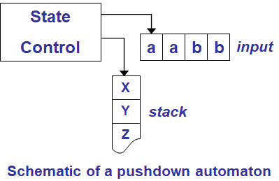
Pushdown Automata
Non-regular Languages
Have an extra component called stack.
Stack provides additional memory beyond the finite amount available in the control.
Schematic of a pushdown automaton
Control represents the states and transition function
The arrow on the tape, containing the input string, represents the input head, pointing at the next input symbol to be read.
The arrow on the stack points the top element.
Writing symbol on the stack is referred to as pushing down the symbols.
Removing a symbol is referred to as popping up.
The top symbol of the stack can be read and removed at any time.

Slide 6
Formal Definition
A pushdown automaton is a 6-touple (Q, Σ, Γ, δ, q₀, F), where Q, Σ, Γ, and F are all finite sets and
Q is the set of states,
Σ is the set of alphabet,
Σ_{ε}= Σ ∪ {ε}
Γ is the stack alphabet,
Γ_{ε}= Γ ∪ {ε}
δ : Q × Σ_{ε} × Γ_{ε} → P(Q × Γ_{ε})
Domain of the transition function is the current state, next input symbol read, and top symbol of the stack.
Because of the nondeterminism, i.e. several legal next moves, δ returns a set of members, each containing the next state and the next stack symbol.
q₀∈Q is the start state, and
F ⊆ Q is the set of accept states

Slide 7
Design Using PDA
Label description:
x, y → z
x: input alphabet from ∑; ε if no input is read; ∅ if end of input.
y: stack top symbol from Γ to be popped; ε if no pop;
z: symbol from Γ to be pushed; ε if no push;
Operations:
No pop/push : x, ε → ε
Pop if y on top (push nothing): x, y → ε
if y on top, pop y and push z: x, y → z
Push z (pop nothing): x, ε → z

Slide 8
L = {w | w = a^{m}b^{n} and m ≤ 2n}
a, ε → a
b, ε → ε
ε, $ → ε
q2
a, ε → a
q3
b, a → ε
q4
∅, $ → ε
q6
ε, ε → $
ε, a → ε
ε, $ → ε
b, a → ε
∅, $ → ε
q1
q5
For 1 a, there must be minimum 1 b or more.
For 2 a’s, there must be minimum 1 b or more.
For 3/4 a’s, there must be minimum 2 b’s or more.
For 5/6 a’s, there must be minimum 3 b’s or more.
So, for 2k/2k-1 number of a’s we must match at least k number of b’s.
Solution:
Push all a’s of the input into the stack.
For each b we pop two a’s
If the number of a’s are odd, only one a will be popped for the last b.
Empty the stack.
Read/scan rest of the b’s, if remains.

Slide 9
L = {w | w = a^{m}b^{n} and m ≤ 2n}
a, ε → a
b, ε → ε
ε, $ → ε
q2
a, ε → a
q3
b, a → ε
q4
∅, $ → ε
q6
ε, ε → $
ε, a → ε
ε, $ → ε
b, a → ε
∅, $ → ε
q1
q5
Input
Stack
aaaaaabbb
aaaaaabbb
aaaaaabbb
aaaaaabbb
aaaaaabbb
aaaaaabbb
aaaaaabbb
aaaaaabbb
aaaaaabbb
aaaaaabbb∅
aaaaaabbb
$
$a
$aa
$aaa
$aaaa
$aaaaa
$aaaaaa

Slide 10
a, ε → a
b, ε → ε
ε, $ → ε
q2
a, ε → a
q3
b, a → ε
q4
∅, $ → ε
q6
ε, ε → $
ε, a → ε
ε, $ → ε
b, a → ε
∅, $ → ε
q1
q5

Slide 11
L = {w | w = a^{m}b^{n} and m ≤ 2n}
a, ε → a
b, ε → ε
ε, $ → ε
q2
a, ε → a
q3
b, a → ε
q4
∅, $ → ε
q6
ε, ε → $
ε, a → ε
ε, $ → ε
b, a → ε
∅, $ → ε
q1
q5
Input
Stack
aaaaabbb
aaaaabbb
aaaaabbb
aaaaabbb
aaaaabbb
aaaaabbb
aaaaabbb
aaaaabbb
aaaaabbb
aaaaabbb∅
$
$a
$aa
$aaa
$aaaa
$aaaaa

Slide 12
L = {w | w = a^{m}b^{n} and m ≤ 2n}
a, ε → a
b, ε → ε
ε, $ → ε
q2
a, ε → a
q3
b, a → ε
q4
∅, $ → ε
q6
ε, ε → $
ε, a → ε
ε, $ → ε
b, a → ε
∅, $ → ε
q1
q5
Input
Stack
aaabbbb
aaabbbb
aaabbbb
aaabbbb
aaabbbb
aaabbbb
aaabbbb
aaabbbb
aaabbbb∅
$
$a
$aa
$aaa

Slide 13
L = {w | w = a^{m}b^{n} and m = 2n}
a, ε → a
q2
a, ε → a
q3
b, a → ε
q4
q6
ε, ε → $
ε, a → ε
b, a → ε
∅, $ → ε
q1
q5

Slide 14
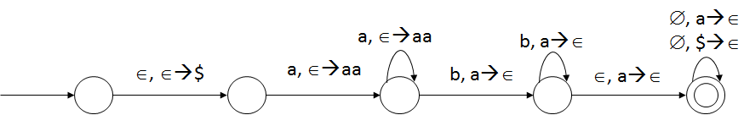
A={a^{n}b^{m} | where n < m < 2n}

Slide 15
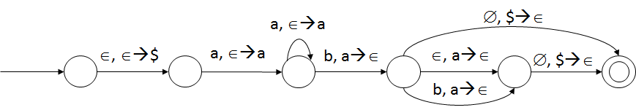
A={a^{m}b^{n} | where n < m ≤ 2n}

Slide 16
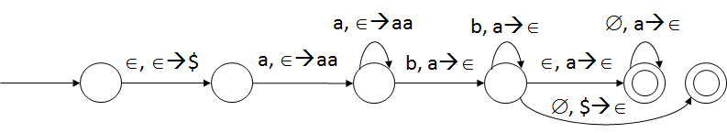
A={a^{n}b^{m} | where m ≤ 2n}

Slide 17
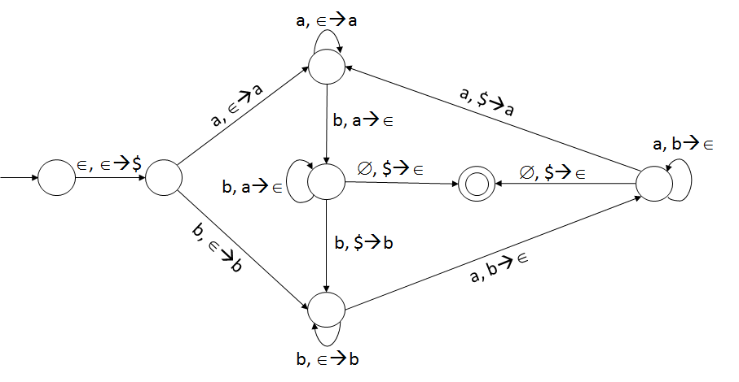
A={w | w = {a, b}* and number of a’s and b’s are equal}

Slide 18
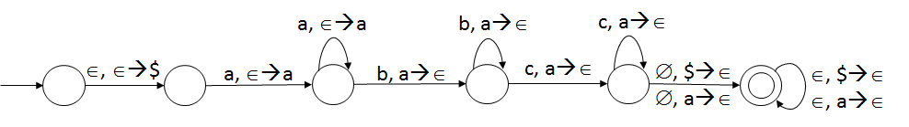
A={a^{i}b^{j}c^{k} | where i ≥ j + k and i, j, k ≥ 1}

Slide 19
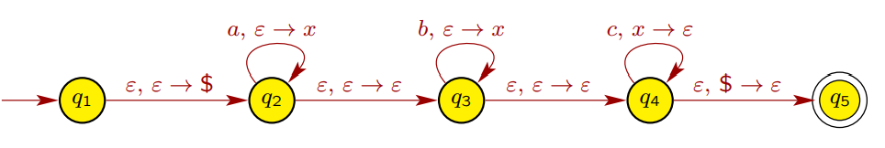
A={a^{i}b^{j}c^{k} | where i+ j = k and i, j, k ≥ 1}

Slide 20
Non-Context Free Language
Consider the language, L = {a^{n}b^{n}c^{n} | n ≥ 0} for ∑={a, b, c}.
Neither a CFG nor a PDA can be constructed for this language L.
Such language cannot be represented using CFL.
A pumping lemma (Theorem 2.34) for CFL can be used to prove if a given language is context free.

Slide 21
Pushdown Automata
Introduction to Theory of Computation, Sipser, (3rd ed), CFL-2; All Exercises.
Elements of the Theory of Computation, Papadimitriou (2nd ed), CFL-2.

