Slide 1
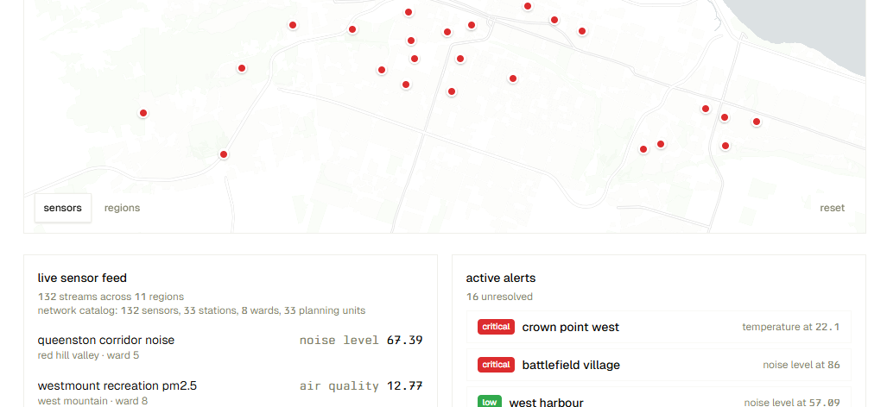
SCEMAS Platform
Tutorial 2 Group 5
Aaron, Arsia, Han, Mithu, Tridib
April 7th, 2026
Notes:
Present the requirements of the system and then your design using system architecture, ACD, and how it fulfils the requirements given.

Slide 2
Key Problems our Platform Addresses
Problem | Consequence
Disconnected, manual monitoring | Delayed response to environmental hazards
No real-time threshold detection | Operators inspect raw data manually
No public data access | Citizens unaware of hazards
Notes:
from the project description we have derived the primary problems which our scemas platform aims to address, starting off we have the fact that currently many citiies rely on sparse, manual or silled environmental monitoring which has the consequence of delaying repsonses ti environmental hazards, by implementing our platform which is a scalable software thatc ollects, processes and acts upon environmental data over a sensor network, it will support smarter cities which makes infastructure more sustainable. following that another problem is the fact that there is no real time threshold detection which would force city operators to inspect raw data manually, which scemas would counteract by making the data into actionable intelligence which is much easier to work with. Finally we realized that the general public are typically unaware of such hazards since there is no general site for such data that they can access, which will now be provided to them through our platform

Slide 3

Viewpoints
City Operator
System Admin
Public
Third-Party Developer
Security

Slide 4
Key Requirements
Functional Requirements
ID | Business Event | Who Benefits?
BE1 | Signup and Login | All users
BE2 | Request and Interpret Environmental Data | Public users & third-party developers
BE3 | Define Alert Rules | System administrators
BE4 | Acknowledge a Critical Environmental Alert | City operators
BE5 | Manage Personalized Alert Subscriptions | City operators

Slide 5
BE5
corresponds to
our Innovative
Feature:
City Operators can manage personalized alert subscriptions
Notes:
Demonstrate later in demo

Slide 6
Key Requirements
Non-Functional Requirements (NFR)
NFR Class | NFR | Value | Architectural Impact
Speed and latency | Alert generation latency | ≤ 5 sec | Blackboard: parallel rule evaluation
Speed and latency | Public API response time | ≤ 500ms (p95) | Public REST API layer
Usability | Alert acknowledgement time | ≤ 30 sec | PAC: isolated operator view
Privacy | No Personally Identifiable Information collected | - | Data aggregated by zone only
Notes:
Alert generation latency must be less than 5 sec. This is achievable because of the Blackboard architecture — rule evaluators for air quality, temperature, humidity, and noise all run independently and non-deterministically, rather than waiting for each other sequentially.
Public API response time must be less than 500 milliseconds. Here, p95 means 95% of API requests are completed within this time or faster. Due to the necessity of using API, we need a REST API layer. The project outline explicitly requires a REST API, and 500ms aligns with industry expectations for public-facing APIs consumed by digital signage and third-party developers.
Usability: If we didn’t pick PAC and we didn’t have a view specific to city operators, they would see a cluttered view. So, it would take longer for them to navigate through and acknowledge an alert.
The system must never collect, store, or expose Personally Identifiable Information. This is enforced architecturally by aggregating all environmental data by geographical zone only — no precise locations, no user-identifiable readings are ever stored or served through the public API.

Slide 7

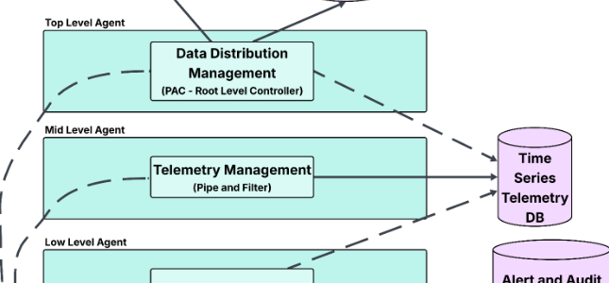

System Architecture

Slide 8
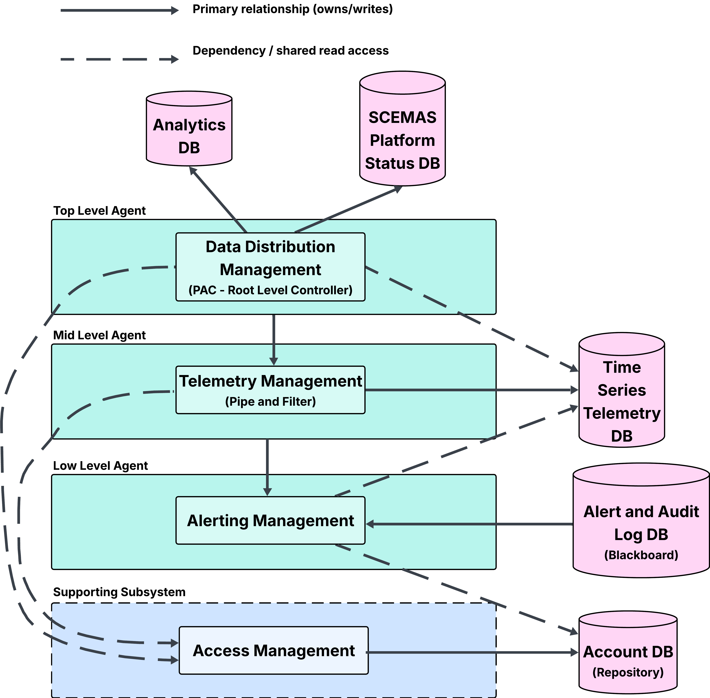
System Architecture Diagram

Slide 9
Rationale for Architecture Choices
What? | Architecture Style | Why?
Overall | PAC | Operator, Admin, Public each needs isolated views Each agent owns its own data PAC prevents shared model coupling
City Operator
Alerts & maps
Views
Sys Admin
Audit logs & rules
Views
Public
Environmental data only
Views

Slide 10
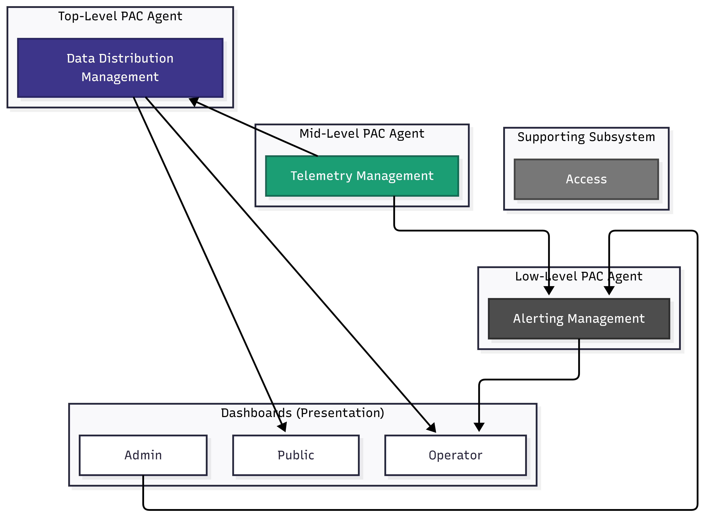
Rationale for Architecture Choices
Notes:
We classified our backend services as PAC agents. However, traditionally, UI components are considered PAC agents, since PAC is responsible for visualization and making a complex UI easy to manage by assigning different UI components to different PAC agents. So, we mapped our 3 backend services to user dashboards. Admin defines alert rules from Admin dashboard and that is processed by Alerting Management. If an alert is triggered, Operator views them in Operator dashboard.
Data Distribution combines processed information and distributes it to the dashboards.
After IoT sensors (physical devices) collect data, Telemetry Management receives it (raw sensor data). After processing the received sensor data, Telemetry Management sends processed sensor data to Alerting Management for alert triggering. It also sends processed sensor data to Data Distribution Management to update visualization charts in public and operator dashboard.

Slide 11
Rationale for Architecture Choices
What? | Architecture Style | Why?
Telemetry Management | Pipe and Filter | Raw sensor reading validated for missing fields, out-of-range values, and timestamp drift before persisting Each filter is stateless and independent
HTTP
JSON
(Data Source)
Schema
filter 1
Range
filter 2
Timestamp
filter 3
Persist
(Data Sink)
pipe
pipe
pipe
pipe
any filter failure → reading rejected, not persisted
Notes:
All 3 filters are ‘validators’.
Schema filter checks whether the JSON matches the expected schema
Range filter checks whether numeric values fall within acceptable bounds
Timestamp filter checks whether the timestamp is valid
Filters can be of many types: validators, transformers, routers, aggregators. But our 3 filters here are all validators

Slide 12
Rationale for Architecture Choices
What? | Architecture Style | Why?
Access Management | Repository | Signup, IoT authorization, and security permissions all read and write to a shared repository deterministically
Bootstrap
(server startup)
Signup and Login
(user authentication)
Authorize IoT Devices
Manage Security Permissions
Account DB + active session token + device identity registry (repository)
Notes:
Taken from Data Centered arch lecture slide 10

Slide 13
Rationale for Architecture Choices
What? | Architecture Style | Why?
Alerting Management | Blackboard | Air quality, temperature, humidity, and noise rule evaluators non-deterministically read and write to a shared blackboard Alert moves through triggered → acknowledged → resolved
Define Threshold Rules
Handle Active Alerts
Dispatch Alert Notifications
Alert & Audit Log DB + Threshold Rulebook (blackboard)
Notes:
Taken from Data Centered arch lecture slide 13

Slide 14
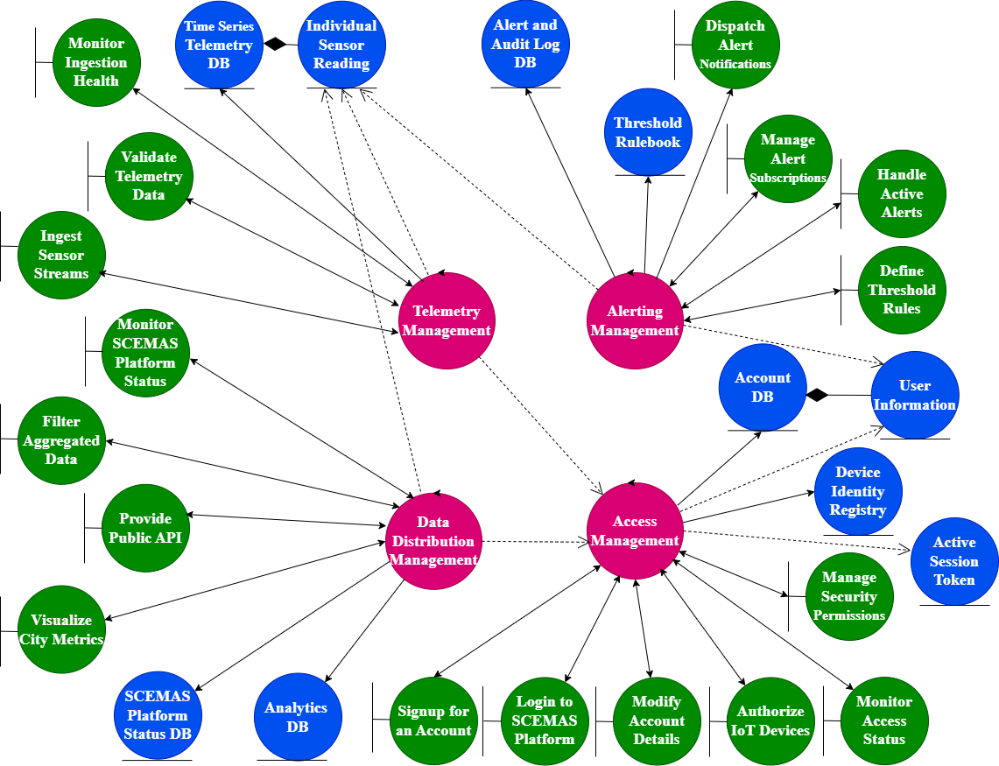
Analysis Class Diagram

Slide 15

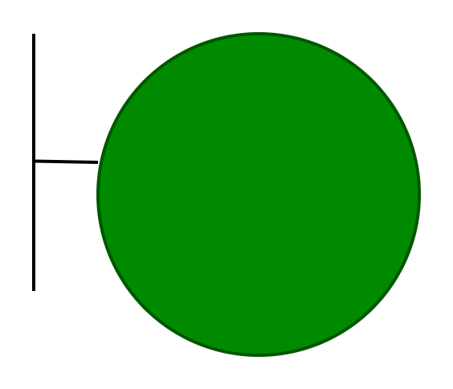

Controller Class
Boundary Class
Entity Class

Slide 16
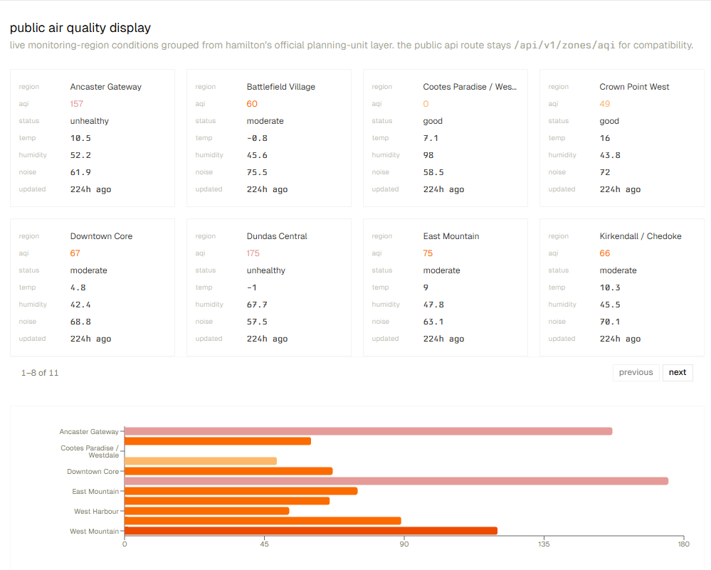
Moving onto the live demo
During the demo, we will show how our design meets requirements

