Slide 1

Agents' Retail Stores POS System - Presentation- Individual (20%)
Requirements Analysis & Design (RAD)
By Students:
521k0035 : Nguyễn Minh Triết

Slide 2
Customer Management
Customer Management is tailored for efficient interaction with customers. Sales Staff can seamlessly create new customer profiles, while Admins and Managers have access to comprehensive customer information.
Objective:
Customer Management is designed to streamline the process of creating and accessing customer information within the POS system.
Sales Staff play a key role in managing customer interactions.
New Customer Creation:
Sales Staff can create new customer profiles via the Sales interface during the first-time purchase.
Ensure a seamless and quick process for capturing essential customer details.
Customer Information Access:
Admins, Managers, and Sales Staff can view customers' personal information, including name, phone number, address.
Access to customer purchase history for personalized service.
Sales Staff Efficiency:
Empower Sales Staff to create new customer profiles effortlessly.
Provide a centralized location for customer information to enhance service.
Expected Outcome:
Quick and efficient customer data entry for Sales Staff.
Comprehensive customer profiles accessible to Admins and Managers for better customer relationship management.

Slide 3
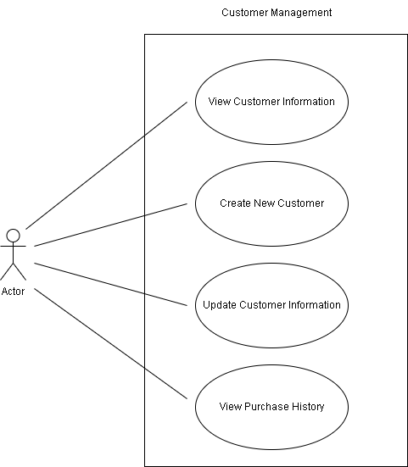
Analysis Model: Use Case Diagram

Slide 4
Analysis Model: Use Case Description
Use Case Name: | Manage Customer Information
Scenario: | Customer information needs to be created, updated, and viewed within the system.
Trigger Event: | The Sales Staff or Admin initiates a request to manage customer information.
Brief Description: | This use case involves creating new customer profiles, updating existing customer information, and viewing the purchase history of customers.
Actors: | Admin Sales Staff
Related use case: | View Purchase History
Stakeholders: | Sales, Customers
Preconditions: | The system is operational. The actor is logged in with the necessary permissions.
Postconditions: | Customer information is accurately managed, including the creation of new profiles, updates, and viewing purchase history.
Flow of activities | Actor | System
 | 1. Actor selects the option to create a new customer profile. 2. Actor selects a specific customer from the list to updates relevant customer information. 3. Actor selects a customer to view purchased history. | 1. System prompts actor to enter essential customer information. 2.1 System displays the customer's details. 2.2 System validates and updates the customer's profile. 3. System displays the customer's purchase history
Exception conditions: | If the system encounters an error during data validation, it notifies the actor and prompts for correction.

Slide 5
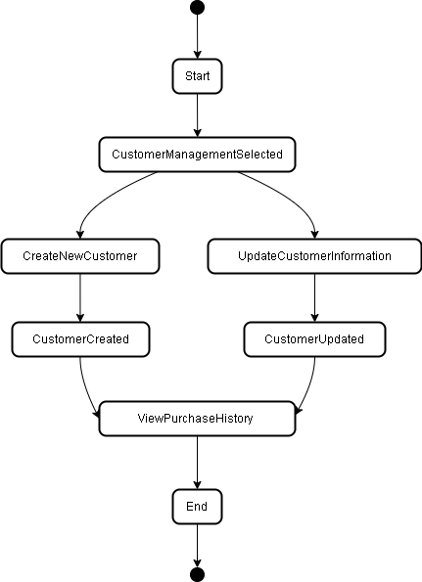
Analysis Model: State Diagram

Slide 6
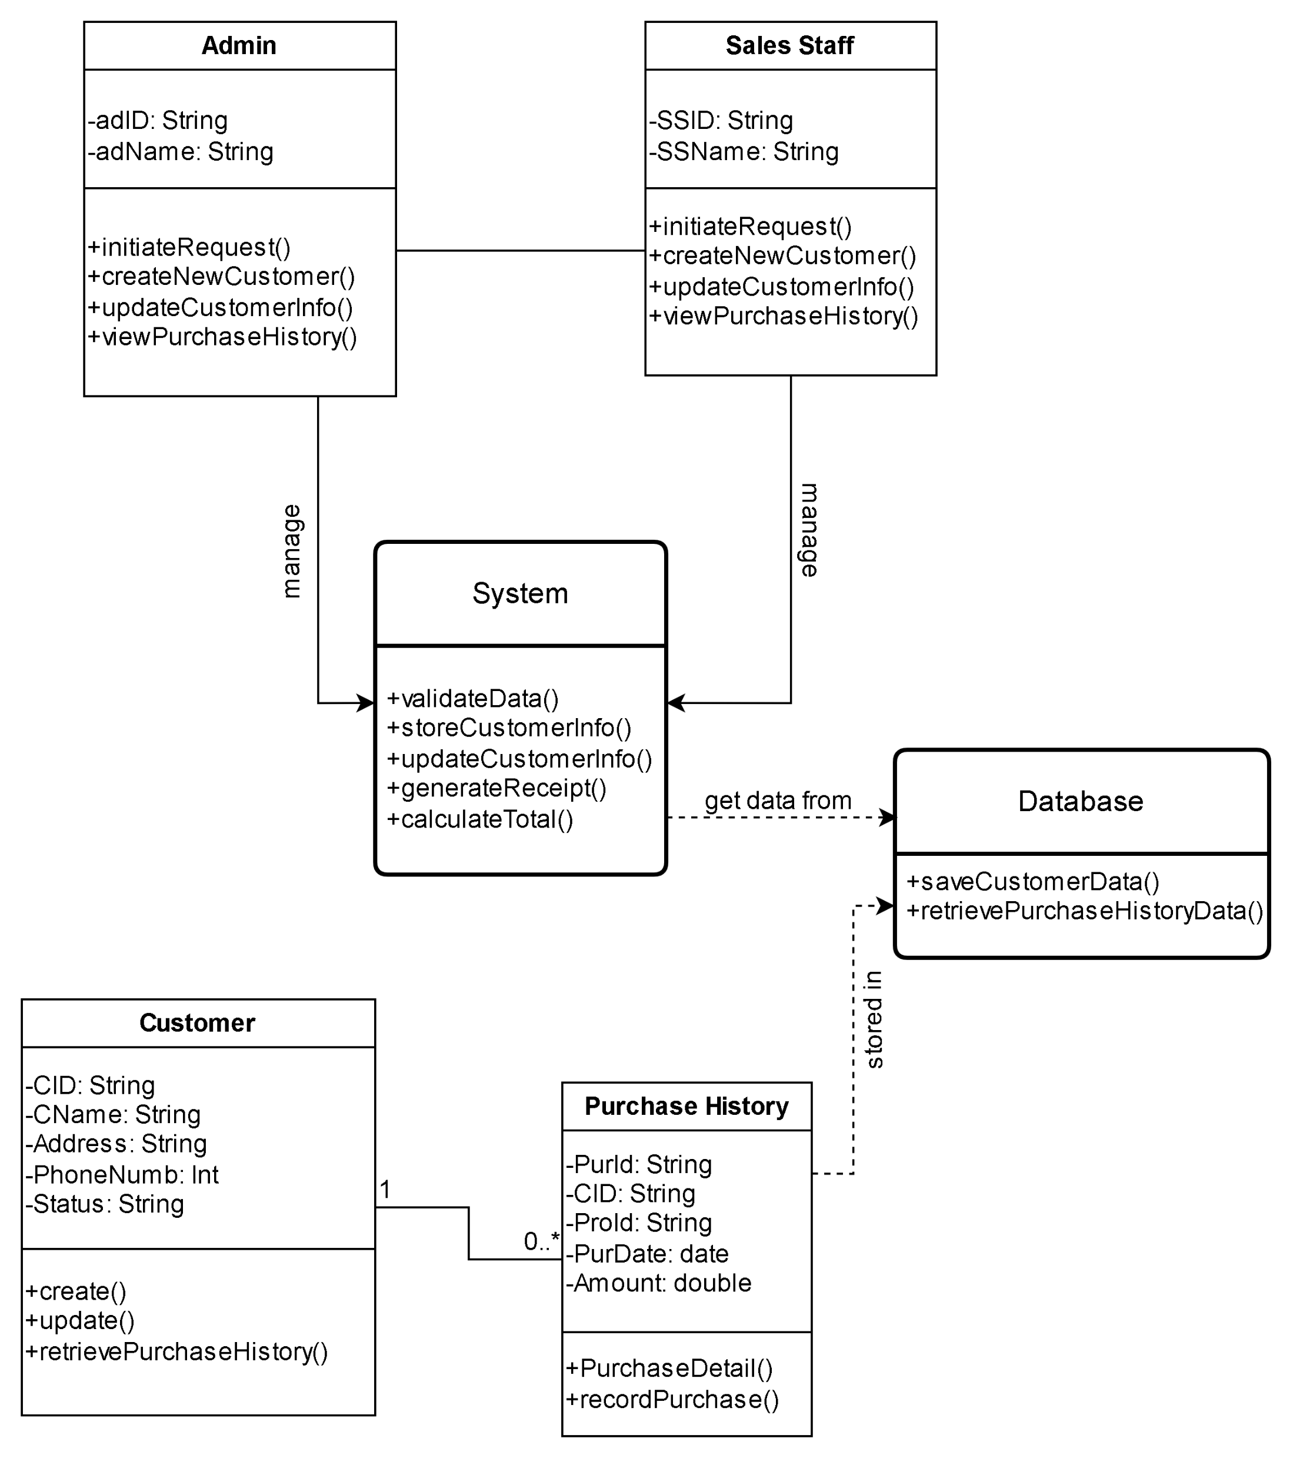
Analysis Model: Domain Class Diagram

Slide 7
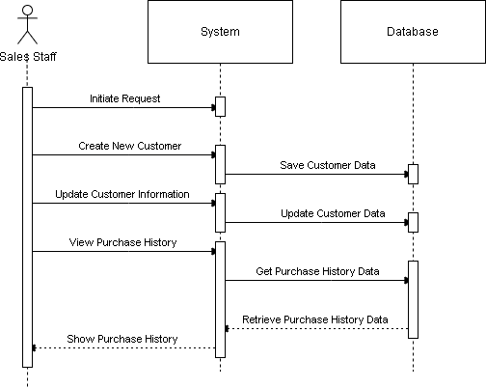
Design Model: Sequence Diagram

Slide 8
Test Case
TC Summary | Pre-Condition | Steps | Expected Result
Manage Sales Transaction
Verify that sales staff can add product to transaction | The actor (Admin or Sales Staff) is logged in with the necessary permissions. | 1. Log in as a Sales Staff. 2. Navigate to the “Product” section. 3. Click the button “add product to cart”. | The new product is add to transaction successfully
Verify that system can generate receipt after a transaction is success. |  | 1. Log in as a Sales Staff. 2. Navigate to the “Product” section. 3. Click the button “add product to cart”. 4. Go to “check out” page and click on “Proceed to checkout” button. 5. Input all required field and “click Check out” button. | The receipt is generated after a success transaction
Verify that after a success transaction, the system update customer purchase history |  | 1. Log in as a Sales Staff. 2. Navigate to the “Product” section. 3. Click the button “add product to cart”. 4. Go to “check out” page and click on “Proceed to checkout” button. 5. Input all required field and “click Check out” button. 6. Navigate to the “Customer Management” section. 7. Select a customer and view their purchase history. | The selected customer’s purchase history is updated correctly.

Slide 9
Programming Model: Customer and SalesStaff Class
public class SalesStaff {
private String id;
private String name;
private String role;
public void initiateRequest() {
// Implementation for initiating a request
}
public void createNewCustomer(Customer customer) {
customer.create();
}
public void updateCustomerInfo(Customer customer) {
customer.update();
}
public void viewPurchaseHistory(Customer customer) {
customer.retrievePurchaseHistory();
}
}
public class Customer {
private String id;
private String name;
private String phoneNumber;
private String address;
private String status;
public void create() {
//
}
public void update() {
//
}
public void retrievePurchaseHistory() {
}
}

Slide 10
Programming Model: System Class
public class System {
public void validateData() {
// Implementation for data validation
}
public void storeCustomerInfo(Customer customer) {
// Implementation for storing customer information
}
public void updateCustomerInfo(Customer customer) {
// Implementation for updating customer information
}
public void generateReceipt() {
// Implementation for generating a receipt
}
public void calculateTotal() {
// Implementation for calculating total amount
}
}

Slide 11
Programming Model: Database and PurchaseHistory Class
public class Database {
public void saveCustomerData(Customer customer) {
// Implementation for saving customer data
} public void retrievePurchaseHistoryData(Customer customer) {
// Implementation for retrieving purchase history data
}
} public class PurchaseHistory {
private String purchaseID;
private String customerID;
private String productID;
private String purchaseDate;
private double Amount;
public void recordPurchase() {
// Implementation for recording a purchase
}
}

Slide 12

THANK YOU FOR LISTENING

