Slide 1
Introduction to
Natural Language Processing (600.465)
Parsing: Introduction

Slide 2
Context-free Grammars
Chomsky hierarchy
  Type 0 Grammars/Languages
    rewrite rules α → β; α,β are any string of terminals and nonterminals
  Context-sensitive Grammars/Languages
    rewrite rules: αXβ → αγβ, where X is nonterminal, α,β,γ any string of terminals and nonterminals (γ must not be empty)
  Context-free Grammars/Lanuages
    rewrite rules: X → γ, where X is nonterminal, γ any string of terminals and nonterminals
  Regular Grammars/Languages
    rewrite rules: X → α Y where X,Y are nonterminals, α string of terminal symbols; Y might be missing

Slide 3
Parsing Regular Grammars
Finite state automata
  Grammar ↔ regular expression ↔ finite state automaton
Space needed:
  constant
Time needed to parse:
  linear (~ length of input string)
Cannot do e.g. a^{n}b^{n} , embedded recursion (context-free grammars can)

Slide 4
Parsing Context Free Grammars
Widely used for surface syntax description (or better to say, for correct word-order specification) of natural languages
Space needed:
  stack (sometimes stack of stacks)
    in general: items ~ levels of actual (i.e. in data) recursions
Time: in general, O(n³)
Cannot do: e.g. a^{n}b^{n}c^{n} (Context-sensitive grammars can)

Slide 5
Example Toy NL Grammar
S
#1 S → NP
#2 S → NP VP
#3 VP → V NP
#4 NP → N
#5 N → flies
#6 N → saw
#7 V → flies
#8 V → saw
VP
NP NP
N V N
flies saw saw

Slide 6
Probabilistic Parsing and PCFGs
CS 224n / Lx 237
Monday, May 3
2004

Slide 7
Modern Probabilistic Parsers
A greatly increased ability to do accurate, robust, broad coverage parsers (Charniak 1997, Collins 1997, Ratnaparkhi 1997, Charniak 2000)
Converts parsing into a classification task using statistical / machine learning methods
Statistical methods (fairly) accurately resolve structural and real world ambiguities
Much faster – often in linear time (by using beam search)
Provide probabilistic language models that can be integrated with speech recognition systems

Slide 8
Supervised parsing
Crucial resources have been treebanks such as the Penn Treebank (Marcus et al. 1993)
From these you can train classifiers.
  Probabilistic models
  Decision trees
  Decision lists / transformation-based learning
Possible only when there are extensive resources
Uninteresting from a Cog Sci point of view

Slide 9
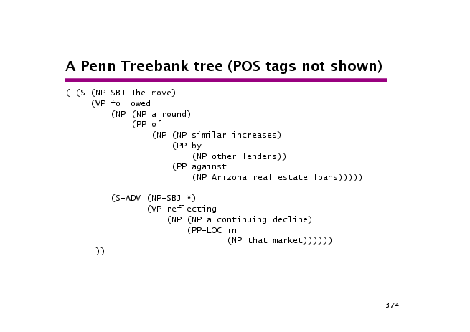

Slide 10
Probabilistic Models for Parsing
Conditional / Parsing Model/ discriminative:
  We estimate directly the probability of a parse tree
  ˆt = argmax_{t} P(t|s, G) where Σ_{t} P(t|s, G) = 1
  Odd in that the probabilities are conditioned on a particular sentence.
  We don’t learn from the distribution of specific sentences we see (nor do we assume some specific distribution for them) ➔ need more general classes of data

Slide 11
Probabilistic Models for Parsing
Generative / Joint / Language Model:
  Assigns probability to all trees generated by the grammar. Probabilities, then, are for the entire language L:
  Σ_{{t:yield(t) ∈ L}} P(t) = 1 – language model for all trees (all sentences)
  We then turn the language model into a parsing model by dividing the probability of a tree (p(t)) in the language model by the probability of the sentence (p(s)). This becomes the joint probability P(t, s| G)
  ˆt = argmax_{t} P(t|s)[parsing model] = argmax_{t} P(t,s) / P(s) = argmax_{t} P(t,s)[generative model] = argmax_{t} P (t)
  Language model (for specific sentence) can be used as a parsing model to choose between alternative parses
  P(s) = Σ_{t} p(s, t) = Σ _{{t: yield(t)=s}} P(t)

Slide 12
Syntax
One big problem with HMMs and n-gram models is that they don’t account for the hierarchical structure of language
They perform poorly on sentences such as
  The velocity of the seismic waves rises to …
  Doesn’t expect a singular verb (rises) after a plural noun (waves)
  The noun waves gets reanalyzed as a verb
Need recursive phrase structure

Slide 13
Syntax – recursive phrase structure
S
NP_{sg} VP_{sg}
DT NN PP rises to …
the velocity IN NP_{pl}
of the seismic waves

Slide 14
PCFGs
The simplest method for recursive embedding is a Probabilistic Context Free Grammar (PCFG)
A PCFG is basically just a weighted CFG.
S NP VP 1.0 VP V NP 0.7 VP VP PP 0.3 PP P NP 1.0 P with 1.0 V saw 1.0 | NP NP PP 0.4 NP astronomers 0.1 NP ears 0.18 NP saw 0.04 NP stars 0.18 NP telescope 0.1

Slide 15
PCFGs
A PCFG G consists of :
  A set of terminals, {w^{k}}, k=1,…,V
  A set of nonterminals, {N^{i}}, i=1,…,n
  A designated start symbol, N¹
  A set of rules, {N^{i} ζ^{j}}, where ζ^{j} is a sequence of terminals and nonterminals
  A set of probabilities on rules such that for all i:
  Σ_{j} P(N^{i} ζ^{j} | N^{i} ) = 1
A convention: we’ll write P(N^{i} ζ^{j}) to mean
P(N^{i} ζ^{j} | N^{i} )

Slide 16
PCFGs - Notation
w_{1n} = w₁ … w_{n} = the sequence from 1 to n (sentence of length n)
w_{ab} = the subsequence w_{a} … w_{b}
N^{j}_{ab} = the nonterminal N^{j} dominating w_{a} … w_{b}
N^{j}
w_{a} … w_{b}

Slide 17
Finding most likely string
P(t) -- The probability of tree is the product of the probabilities of the rules used to generate it.
P(w_{1n}) -- The probability of the string is the sum of the probabilities of the trees which have that string as their yield
  P(w_{1n}) = Σ_{j} P(w_{1n}, tj) where tj is a parse of w_{1n}
= Σ_{j} P(tj)

Slide 18
A Simple PCFG (in CNF)
S NP VP 1.0 VP V NP 0.7 VP VP PP 0.3 PP P NP 1.0 P with 1.0 V saw 1.0 | NP NP PP 0.4 NP astronomers 0.1 NP ears 0.18 NP saw 0.04 NP stars 0.18 NP telescope 0.1

Slide 19
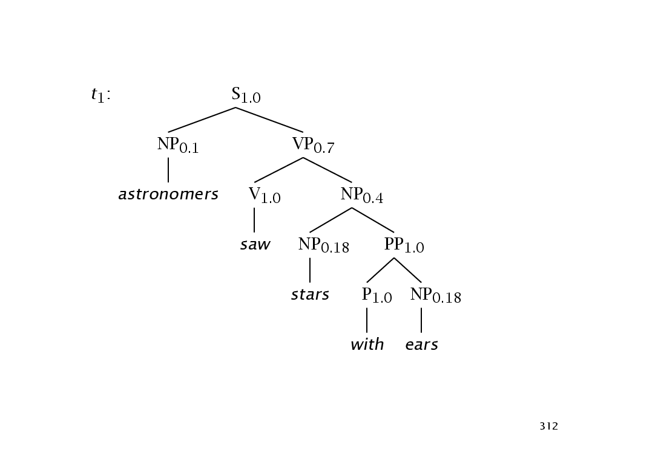

Slide 20
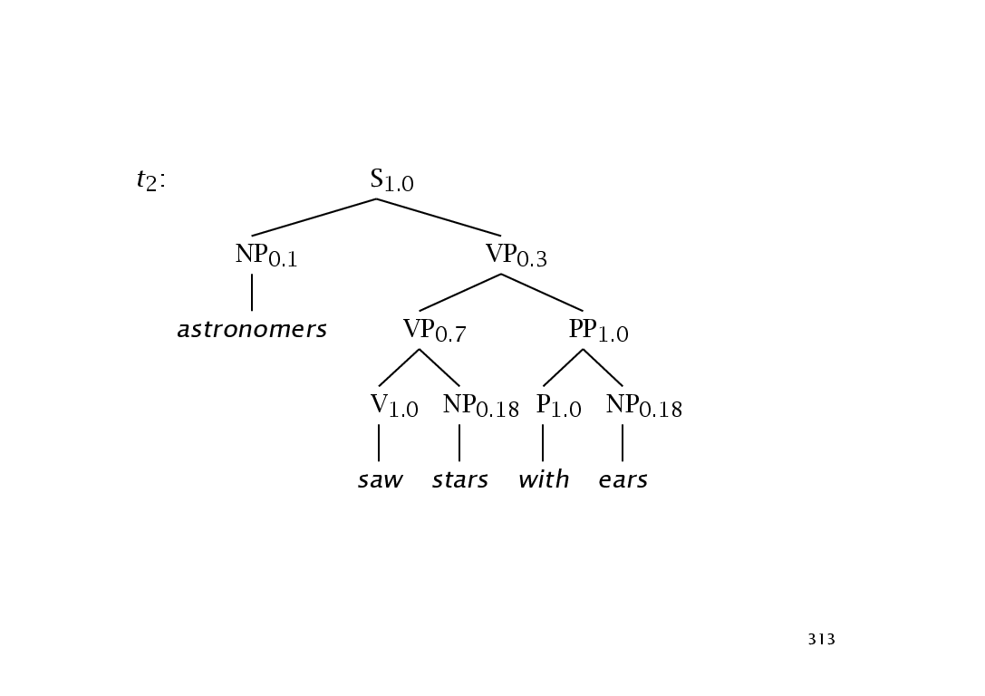

Slide 21
Tree and String Probabilities
w₁₅ = string ‘astronomers saw stars with ears’
P(t₁) = 1.0 * 0.1 * 0.7 * 1.0 * 0.4 * 0.18
* 1.0 * 1.0 * 0.18
= 0.0009072
P(t₂) = 1.0 * 0.1 * 0.3 * 0.7 * 1.0 * 0.18
* 1.0 * 1.0 * 0.18
= 0.0006804
P(w₁₅) = P(t₁) + P(t₂)
= 0.0009072 + 0.0006804
= 0.0015876

Slide 22
Assumptions of PCFGs
Place invariance (like time invariance in HMMs):
  The probability of a subtree does not depend on where in the string the words it dominates are
Context-free:
  The probability of a subtree does not depend on words not dominated by the subtree
Ancestor-free:
  The probability of a subtree does not depend on nodes in the derivation outside the subtree

Slide 23
Some Features of PCFGs
Partial solution for grammar ambiguity: a PCFG gives some idea of the plausibility of a sentence
But not so good as independence assumptions are too strong
Robustness (admit everything, but low probability)
Gives a probabilistic language model
But in a simple case it performs worse than a trigram model
Better for grammar induction (Gold 1967 v Horning 1969)

Slide 24
Some Features of PCFGs
Encodes certain biases (shorter sentences normally have higher probability)
Could combine PCFGs with trigram models
Could lessen the independence assumptions
  Structure sensitivity
  Lexicalization

Slide 25
Structure sensitivity
Manning and Carpenter 1997, Johnson 1998
Expansion of nodes depends a lot on their position in the tree (independent of lexical content)
Pronoun Lexical
  Subject 91% 9%
  Object 34% 66%
We can encode more information into the nonterminal space by enriching nodes to also record information about their parents
  ^{S}NP is different than ^{VP}NP

Slide 26
Structure sensitivity
Another example: the dispreference for pronouns to be second object NPs of ditransitive verb
  I gave Charlie the book
  I gave the book to Charlie
  I gave you the book
  ? I gave the book to you

Slide 27
(Head) Lexicalization
The head word of a phrase gives a good representation of the phrase’s structure and meaning
  Attachment ambiguities
The astronomer saw the moon with the telescope
  Coordination
  the dogs in the house and the cats
  Subcategorization frames
put versus like

Slide 28
(Head) Lexicalization
put takes both an NP and a VP
  Sue put [ the book ]_{NP} [ on the table ]_{PP}
  * Sue put [ the book ]_{NP}
  * Sue put [ on the table ]_{PP}
like usually takes an NP and not a PP
  Sue likes [ the book ]_{NP}
  * Sue likes [ on the table ]_{PP}

Slide 29
(Head) Lexicalization
Collins 1997, Charniak 1997
Puts the properties of the word back in the PCFG
S_{walked}
NP_{Sue} VP_{walked}
Sue V_{walked} PP_{into}
walked P_{into} NP_{store}
into DT_{the} NP_{store}
the store

Slide 30
Using a PCFG
As with HMMs, there are 3 basic questions we want to answer
  The probability of the string (Language Modeling):
  P(w_{1n} | G)
  The most likely structure for the string (Parsing):
  argmax_{t} P(t | w_{1n} ,G)
  Estimates of the parameters of a known PCFG from training data (Learning algorithm):
  Find G such that P(w_{1n} | G) is maximized
We’ll assume that our PCFG is in CNF

Slide 31
HMMs and PCFGs
HMMs
  Probability distribution over strings of a certain length
  For all n: Σ_{W1n} P(w_{1n} ) = 1
Forward/Backward
  Forward
  α_{i}(t) = P(w_{1(t-1)}, X_{t}=i)
  Backward
  β_{i}(t) = P(w_{tT}|X_{t}=i)
PCFGs
  Probability distribution over the set of strings that are in the language L
  Σ_{ω∈ L} P(ω ) = 1
Inside/Outside
  Outside
  α_{j}(p,q) = P(w_{1(p-1)}, N^{j}_{pq},
  w_{(q+1)m} | G)
  Inside
  β_{j}(p,q) = P(w_{pq} | N^{j}_{pq}, G)

Slide 32
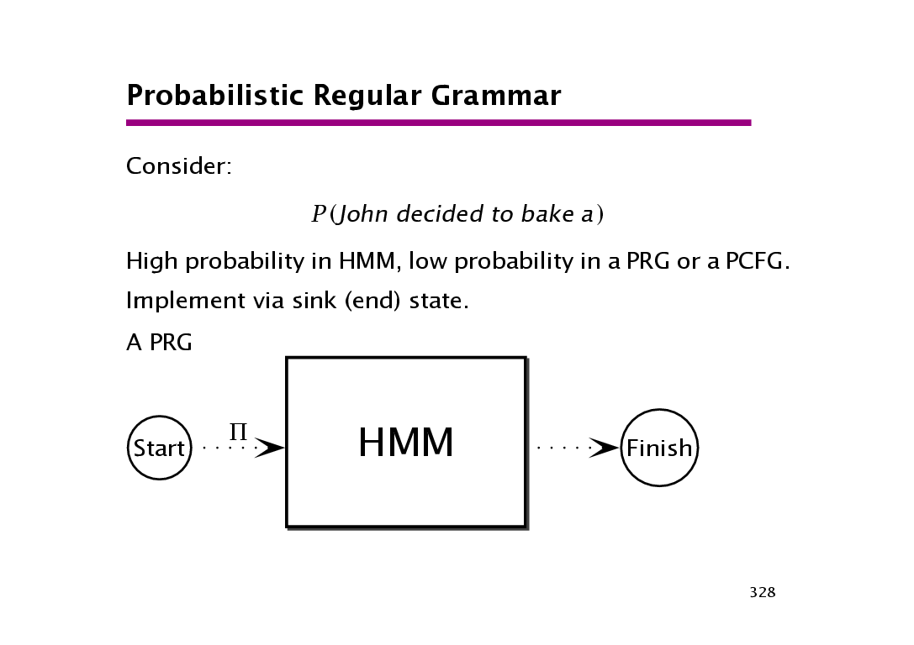

Slide 33
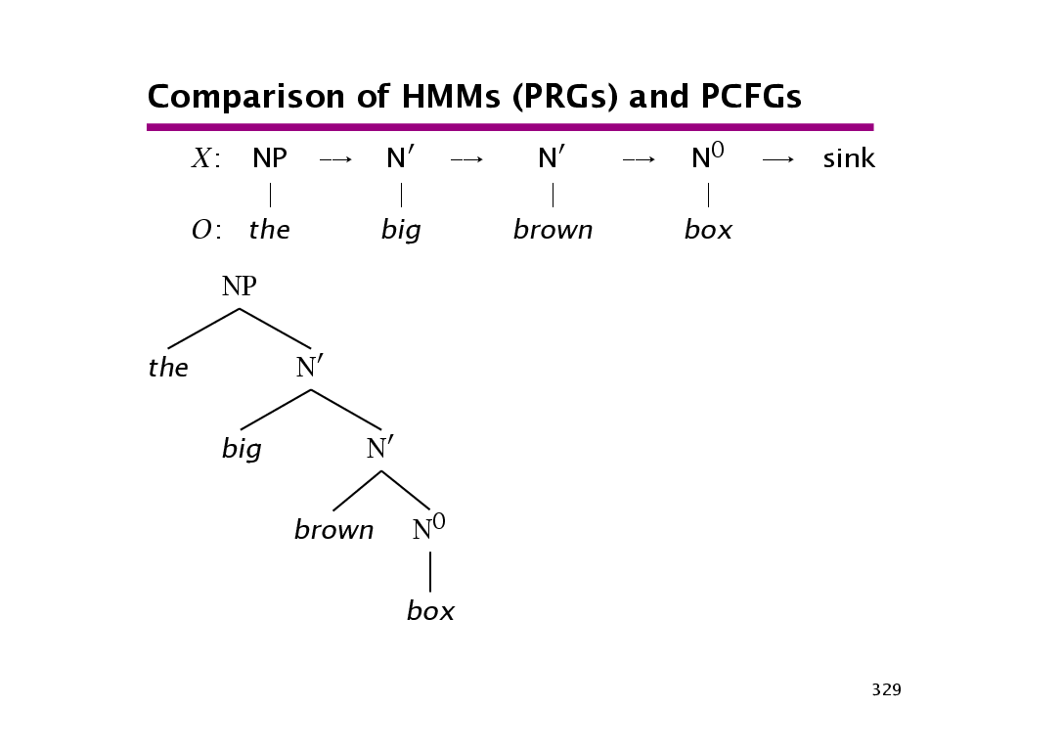

Slide 34
PCFGs –hands on
CS 224n / Lx 237 section
Tuesday, May 4
2004

Slide 35
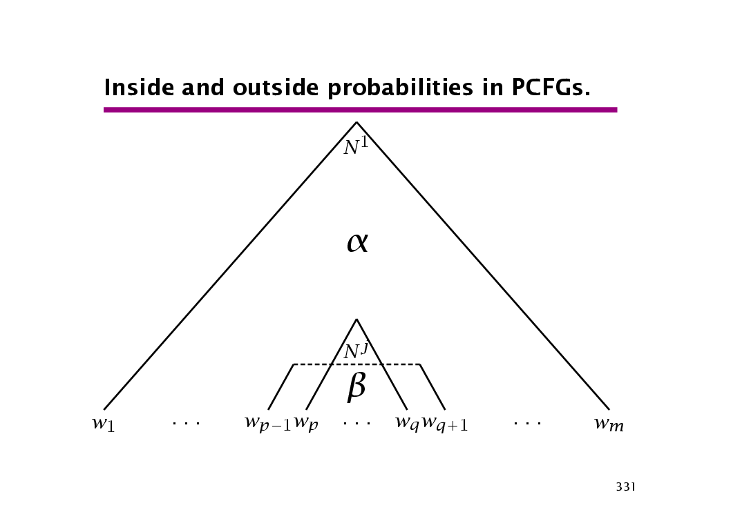

Slide 36
Inside Algorithm
We’re calculating the total probability of generating words w_{p} … w_{q} given that one is starting with the nonterminal N^{j}
N^{j}
N^{r} N^{s}
w_{p} w_{d} w_{d+1} w_{q}

Slide 37
Inside Algorithm - Base
Base case, for rules of the form N^{j} → w^{k} :
β_{j}(k,k) = P(w^{k}|N^{j}_{kk},G)
= P(N^{i} → w^{k}|G)
This deals with the lexical rules

Slide 38
Inside Algorithm - Inductive
Inductive case, for rules of the form : N^{j} → N^{r} N^{s}
β_{j}(p,q) = P(w_{pq}|N^{j}_{pq},G)
= Σ_{r,s}Σ^{q-1}_{d=p} P(N^{r}_{pd},N^{s}_{(d+1)q}|N^{j}_{pq},G) *
P(w_{pd}|N^{r}_{pd},G) * P(w_{(d+1)q}|N^{s}_{(d+1)q},G)
= Σ_{r,s}Σ_{d} P(N^{j} → N^{r} N^{s}) β_{r}(p,d) β_{s}((d+1),q)
N^{j}
N^{r} N^{s}
w_{p} w_{d} w_{d+1} w_{q}

Slide 39
Inside Algorithm - Inductive
Inductive case, for rules of the form : N^{j} → N^{r} N^{s}
β_{j}(p,q) = P(w_{pq}|N^{j}_{pq},G)
= Σ_{r,s}Σ^{q-1}_{d=p} P(N^{r}_{pd},N^{s}_{(d+1)q}|N^{j}_{pq},G) *
P(w_{pd}|N^{r}_{pd},G) * P(w_{(d+1)q}|N^{s}_{(d+1)q},G)
= Σ_{r,s}Σ_{d} P(N^{j} → N^{r} N^{s}) β_{r}(p,d) β_{s}((d+1),q)
N^{j}
N^{r} N^{s}
w_{p} w_{d} w_{d+1} w_{q}

Slide 40
Inside Algorithm - Inductive
Inductive case, for rules of the form : N^{j} → N^{r} N^{s}
β_{j}(p,q) = P(w_{pq}|N^{j}_{pq},G)
= Σ_{r,s}Σ^{q-1}_{d=p} P(N^{r}_{pd},N^{s}_{(d+1)q}|N^{j}_{pq},G) *
P(w_{pd}|N^{r}_{pd},G) * P(w_{(d+1)q}|N^{s}_{(d+1)q},G)
= Σ_{r,s}Σ_{d} P(N^{j} → N^{r} N^{s}) β_{r}(p,d) β_{s}((d+1),q)
N^{j}
N^{r} N^{s}
w_{p} w_{d} w_{d+1} w_{q}

Slide 41
Inside Algorithm - Inductive
Inductive case, for rules of the form : N^{j} → N^{r} N^{s}
β_{j}(p,q) = P(w_{pq}|N^{j}_{pq},G)
= Σ_{r,s}Σ^{q-1}_{d=p} P(N^{r}_{pd},N^{s}_{(d+1)q}|N^{j}_{pq},G) *
P(w_{pd}|N^{r}_{pd},G) * P(w_{(d+1)q}|N^{s}_{(d+1)q},G)
= Σ_{r,s}Σ_{d} P(N^{j} → N^{r} N^{s}) β_{r}(p,d) β_{s}((d+1),q)
N^{j}
N^{r} N^{s}
w_{p} w_{d} w_{d+1} w_{q}

Slide 42
Inside Algorithm - Inductive
Inductive case, for rules of the form : N^{j} → N^{r} N^{s}
β_{j}(p,q) = P(w_{pq}|N^{j}_{pq},G)
= Σ_{r,s}Σ^{q-1}_{d=p} P(N^{r}_{pd},N^{s}_{(d+1)q}|N^{j}_{pq},G) *
P(w_{pd}|N^{r}_{pd},G) * P(w_{(d+1)q}|N^{s}_{(d+1)q},G)
= Σ_{r,s}Σ_{d} P(N^{j} → N^{r} N^{s}) β_{r}(p,d) β_{s}((d+1),q)
N^{j}
N^{r} N^{s}
w_{p} w_{d} w_{d+1} w_{q}

Slide 43
Inside Algorithm - Inductive
Inductive case, for rules of the form : N^{j} → N^{r} N^{s}
β_{j}(p,q) = P(w_{pq}|N^{j}_{pq},G)
= Σ_{r,s}Σ^{q-1}_{d=p} P(N^{r}_{pd},N^{s}_{(d+1)q}|N^{j}_{pq},G) *
P(w_{pd}|N^{r}_{pd},G) * P(w_{(d+1)q}|N^{s}_{(d+1)q},G)
= Σ_{r,s}Σ_{d} P(N^{j} → N^{r} N^{s}) β_{r}(p,d) β_{s}((d+1),q)
N^{j}
N^{r} N^{s}
w_{p} w_{d} w_{d+1} w_{q}

Slide 44
Inside Algorithm - Inductive
Inductive case, for rules of the form : N^{j} → N^{r} N^{s}
β_{j}(p,q) = P(w_{pq}|N^{j}_{pq},G)
= Σ_{r,s}Σ^{q-1}_{d=p} P(N^{r}_{pd},N^{s}_{(d+1)q}|N^{j}_{pq},G) *
P(w_{pd}|N^{r}_{pd},G) * P(w_{(d+1)q}|N^{s}_{(d+1)q},G)
= Σ_{r,s}Σ_{d} P(N^{j} → N^{r} N^{s}) β_{r}(p,d) β_{s}((d+1),q)
N^{j}
N^{r} N^{s}
w_{p} w_{d} w_{d+1} w_{q}

Slide 45
Inside Algorithm - Inductive
Inductive case, for rules of the form : N^{j} → N^{r} N^{s}
β_{j}(p,q) = P(w_{pq}|N^{j}_{pq},G)
= Σ_{r,s}Σ^{q-1}_{d=p} P(N^{r}_{pd},N^{s}_{(d+1)q}|N^{j}_{pq},G) *
P(w_{pd}|N^{r}_{pd},G) * P(w_{(d+1)q}|N^{s}_{(d+1)q},G)
= Σ_{r,s}Σ_{d} P(N^{j} → N^{r} N^{s}) β_{r}(p,d) β_{s}((d+1),q)
N^{j}
N^{r} N^{s}
w_{p} w_{d} w_{d+1} w_{q}

Slide 46
Inside Algorithm - Inductive
Inductive case, for rules of the form : N^{j} → N^{r} N^{s}
β_{j}(p,q) = P(w_{pq}|N^{j}_{pq},G)
= Σ_{r,s}Σ^{q-1}_{d=p} P(N^{r}_{pd},N^{s}_{(d+1)q}|N^{j}_{pq},G) *
P(w_{pd}|N^{r}_{pd},G) * P(w_{(d+1)q}|N^{s}_{(d+1)q},G)
= Σ_{r,s}Σ_{d} P(N^{j} → N^{r} N^{s}) β_{r}(p,d) β_{s}((d+1),q)
N^{j}
N^{r} N^{s}
w_{p} w_{d} w_{d+1} w_{q}

Slide 47
Inside Algorithm - Inductive
Inductive case, for rules of the form : N^{j} → N^{r} N^{s}
β_{j}(p,q) = P(w_{pq}|N^{j}_{pq},G)
= Σ_{r,s}Σ^{q-1}_{d=p} P(N^{r}_{pd},N^{s}_{(d+1)q}|N^{j}_{pq},G) *
P(w_{pd}|N^{r}_{pd},G) * P(w_{(d+1)q}|N^{s}_{(d+1)q},G)
= Σ_{r,s}Σ_{d} P(N^{j} → N^{r} N^{s}) β_{r}(p,d) β_{s}((d+1),q)
N^{j}
N^{r} N^{s}
w_{p} w_{d} w_{d+1} w_{q}

Slide 48
Inside Algorithm - Inductive
Inductive case, for rules of the form : N^{j} → N^{r} N^{s}
β_{j}(p,q) = P(w_{pq}|N^{j}_{pq},G)
= Σ_{r,s}Σ^{q-1}_{d=p} P(N^{r}_{pd},N^{s}_{(d+1)q}|N^{j}_{pq},G) *
P(w_{pd}|N^{r}_{pd},G) * P(w_{(d+1)q}|N^{s}_{(d+1)q},G)
= Σ_{r,s}Σ_{d} P(N^{j} → N^{r} N^{s}) β_{r}(p,d) β_{s}((d+1),q)
N^{j}
N^{r} N^{s}
w_{p} w_{d} w_{d+1} w_{q}

Slide 49
Inside Algorithm - Inductive
Inductive case, for rules of the form : N^{j} → N^{r} N^{s}
β_{j}(p,q) = P(w_{pq}|N^{j}_{pq},G)
= Σ_{r,s}Σ^{q-1}_{d=p} P(N^{r}_{pd},N^{s}_{(d+1)q}|N^{j}_{pq},G) *
P(w_{pd}|N^{r}_{pd},G) * P(w_{(d+1)q}|N^{s}_{(d+1)q},G)
= Σ_{r,s}Σ_{d} P(N^{j} → N^{r} N^{s}) β_{r}(p,d) β_{s}((d+1),q)
N^{j}
N^{r} N^{s}
w_{p} w_{d} w_{d+1} w_{q}

Slide 50
Calculating inside probabilities with CKY the base case
NP → astronomers 0.1 NP → saw 0.04 V → saw 1.0 | NP → stars 0.18 P → with 1.0 NP → ears 0.18
 | 1 | 2 | 3 | 4 | 5
1 | β_{NP} = 0.1
2 |  | β_{NP} = 0.04 β_{V} = 1.0
3 |  |  | β_{NP} = 0.18
4 |  |  |  | β_{P} = 1.0
5 |  |  |  |  | β_{NP} = 0.18
 | astronomers | saw | stars | with | ears

Slide 51
Calculating inside probabilities with CKY inductive case
VP → V NP 0.7 β_{NP} 0.18 β_{V} 1.0 | β_{VP} = P(VP → V NP) * β_{V} * β_{NP} β_{VP} = 0.7 * 1.0 * 0.18 β_{VP} = 0.126
 | 1 | 2 | 3 | 4 | 5
1 | β_{NP} = 0.1
2 |  | β_{NP} = 0.04 β_{V} = 1.0 | β_{VP} = 0.126
3 |  |  | β_{NP} = 0.18
4 |  |  |  | β_{P} = 1.0
5 |  |  |  |  | β_{NP} = 0.18
 | astronomers | saw | stars | with | ears

Slide 52
Calculating inside probabilities with CKY inductive case
PP → P NP 1.0 β_{P} 1.0 β_{NP} 0.18 | β_{PP} = P(PP → P NP) * β_{V} * β_{NP} β_{PP} = 1.0 * 1.0 * 0.18 β_{PP} = 0.18
 | 1 | 2 | 3 | 4 | 5
1 | β_{NP} = 0.1
2 |  | β_{NP} = 0.04 β_{V} = 1.0 | β_{VP} = 0.126
3 |  |  | β_{NP} = 0.18
4 |  |  |  | β_{P} = 1.0 | β_{PP} = 0.18
5 |  |  |  |  | β_{NP} = 0.18
 | astronomers | saw | stars | with | ears

Slide 53
Calculating inside probabilities with CKY
β_{VP} = P(VP → V NP) * β_{V} * β_{NP} + P(VP → VP PP) * β_{VP} * β_{PP} = 0.7 * 1.0 * 0.1296 + 0.3 * 0.126 * 0.18 = 0.09072 + 0.006804 = 0.097524
 | 1 | 2 | 3 | 4 | 5
1 | β_{NP} = 0.1 |  | β_{S} = 0.0126 |  | β_{S} = 0.0097524
2 |  | β_{NP} = 0.04 β_{V} = 1.0 | β_{VP} = 0.126 |  | β_{VP} = 0.097524
3 |  |  | β_{NP} = 0.18 |  | β_{NP} = 0.1296
4 |  |  |  | β_{P} = 1.0 | β_{PP} = 0.18
5 |  |  |  |  | β_{NP} = 0.18
 | astronomers | saw | stars | with | ears

Slide 54
Outside algorithm
Outside algorithm reflects top-down processing (whereas the inside algorithm reflects bottom-up processing)
With the outside algorithm we’re calculating the total probability of beginning with a symbol N^{j} and generating the nonterminal N^{j}_{pq} and all words outside w_{p} … w_{q}

Slide 55
Outside Algorithm
N¹_{1m}
N^{f}_{pe}
N^{j}_{pq} N^{g}_{(q+1)e}
w₁ w_{p-1} w_{p} w_{q} w_{q+1} w_{e} w_{e+1} w_{m}

Slide 56
Outside Algorithm
Base case, for the start symbol:
α_{j}(1,m) = 1 j = 1
0 otherwise
Inductive case (either left or right branch):
α_{j}(p,q) = Σ_{f,g}Σ^{m}_{e=q+1} P(w_{1(p-1)}, w_{(q+1)m},N^{f}_{pe},N^{j}_{pq},N^{g}_{(q+1)e} ) +
Σ_{f,g}Σ^{p-1}_{e=1} P(w_{1(p-1)} ,w_{(q+1)m},N^{f}_{eq},N^{g}_{e(p-1)},N^{j}_{pq} )
.
= Σ_{f,g}Σ^{m}_{e=q+1} α_{f}(p,e) P(N^{f} → N^{j} N^{g}) β_{g}(q+1,e) +
.
Σ_{f,g}Σ^{p-1}_{e=1} α_{f}(e,q) P(N^{f} → N^{g} N^{j}) β_{g}(e, p-1)

Slide 57
Outside Algorithm – left branching
N¹_{1m}
N^{f}_{pe}
N^{j}_{pq} N^{g}_{(q+1)e}
w₁ w_{p-1} w_{p} w_{q} w_{q+1} w_{e} w_{e+1} w_{m}

Slide 58
Outside Algorithm – right branching
N¹_{1m}
N^{f}_{eq}
N^{g}_{e(p-1)} N^{j}_{pq}
w₁ w_{e-1} w_{e} w_{p-1} w_{p} w_{q} w_{q+1} w_{m}
N^{f}_{pe}
N^{j}_{pq} N^{g}_{(q+1)e}
w₁ w_{p-1} w_{p} w_{q} w_{q+1} w_{e} w_{e+1} w_{m}

Slide 59
Overall probability of a node
Similar to HMMs (with forward/backward algorithms), the overall probability of the node is formed by taking the product of the inside and outside probabilities
α_{j}(p,q)β_{j}(p,q) = P(w_{1(p-1),} N^{j}_{pq,}w_{(q+1)m} |G)P(w_{pq} |N^{j}_{pq} ,G)
= P (w_{1m} ,N^{j}_{pq} |G)
Therefore
P (w_{1m} ,N_{pq} |G) = Σ_{j} α_{j}(p,q)β_{j}(p,q)
In the case of the root node and terminals, we know there will be some such constituent

Slide 60
Viterbi Algorithm and PCFGs
This is like the inside algorithm but we find the maximum instead of the sum and then record it
δ_{i}(p,q) = highest probability parse of a subtree N^{i}_{pq}
Initialization: δ_{i}(p,p) = P(N^{i} → w_{p})
Induction:
  δ_{i}(p,q) = max P(N^{i} → N^{j} N^{k} ) δ_{j}(p,r) δ_{k}(r+1,q)
Store backtrace:
  Ψ_{i}(p,q) = argmax P(N^{i} → N^{j} N^{k} ) δ_{j}(p,r) δ_{k}(r+1,q)
From start symbol N¹, most likely parse t is:
P(t) = δ₁(1,m)

Slide 61
Calculating Viterbi with CKY
Initialization
NP → astronomers 0.1 NP → saw 0.04 V → saw 1.0 | NP → stars 0.18 P → with 1.0 NP → ears 0.18
 | 1 | 2 | 3 | 4 | 5
1 | δ_{NP} = 0.1
2 |  | δ_{NP} = 0.04 δ_{V} = 1.0
3 |  |  | δ_{NP} = 0.18
4 |  |  |  | δ_{P} = 1.0
5 |  |  |  |  | δ_{NP} = 0.18
 | astronomers | saw | stars | with | ears

Slide 62
Calculating Viterbi with CKY
Induction
So far this is the same as calculating the inside probabilities
 | 1 | 2 | 3 | 4 | 5
1 | δ_{NP} = 0.1 |  | δ_{S} = 0.0126
2 |  | δ_{NP} = 0.04 δ_{V} = 1.0 | δ_{VP} = 0.126
3 |  |  | δ_{NP} = 0.18 |  | δ_{NP} = 0.1296
4 |  |  |  | δ_{P} = 1.0 | δ_{PP} = 0.18
5 |  |  |  |  | δ_{NP} = 0.18
 | astronomers | saw | stars | with | ears

Slide 63
Calculating Viterbi with CKY
Backpointers
δ_{VP} = max ( P(VP → V NP) * β_{V} * β_{NP} , P(VP → VP PP) * β_{VP} * β_{PP} ) = max (0.09072 , 0.006804) = 0.09072
 | 1 | 2 | 3 | 4 | 5
1 | δ_{NP} = 0.1 |  | δ_{S} = 0.0126 |  | δ_{S} = 0.009072
2 |  | δ_{NP} = 0.04 δ_{V} = 1.0 | δ_{VP} = 0.126 |  | δ_{VP} = 0.09072
3 |  |  | δ_{NP} = 0.18 |  | δ_{NP} = 0.1296
4 |  |  |  | δ_{P} = 1.0 | δ_{PP} = 0.18
5 |  |  |  |  | δ_{NP} = 0.18
 | astronomers | saw | stars | with | ears

Slide 64
Learning PCFGs – only supervised
Imagine we have a training corpus that contains the treebank given below
(1)S (2)S (3)S
A A B B A A
a a a a f g
(4)S (5)S
A A A A
f a g f

Slide 65
Learning PCFGs
Let’s say that (1) occurs 40 times, (2) occurs 10 times, (3) occurs 5 times, (4) occurs 5 times, and (5) occurs one time.
We want to make a PCFG that reflects this grammar.
What are the parameters that maximizes the joint likelihood of the data?
  Σ_{j} P(N^{i} → ζ^{j} | N^{i} ) = 1

Slide 66
Learning PCFGs
Rules
  S → A A : 40 + 5 + 5 + 1 = 51
  S → B B : 10
  A → a : 40 + 40 + 5 = 85
  A → f : 5 + 5 + 1 = 11
  A → g : 5 + 1 = 6
  B → a : 10

Slide 67
Learning PCFGs
Parameters that maximize the joint likelihood:
G S → A A S → B B A → a A → f A → g B → a | Count 51 10 85 11 6 10 | Total 61 61 102 102 102 10 | Probability 0.836 0.164 0.833 0.108 0.059 1.0

Slide 68
Learning PCFGs
Given these parameters, what is the most likely parse of the string ‘a a’?
(1)S (2)S
A A B B
a a a a
P(1) = P(S → A A) * P(A → a) * P(A → a)
= 0.836 * 0.833 * 0.833 = 0.580
P(2) = P(S → B B) * P(B → a) * P(B → a)
= 0.164 * 1.0 * 1.0 = 0.164

Slide 69
Probabilistic Parsing-advanced
CS 224n / Lx 237
Wednesday, May 5
2004

Slide 70
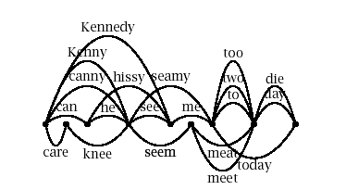
Parsing for Disambiguation
Probabilities for determining the sentence.
  Now we have a language model
    Can be used in speech recognition, etc.

Slide 71
Parsing for Disambiguation (2)
Speedier Parsing
  As searching, prune out highly unprobable parses
  Goal: parse as fast as possible, but don’t prune out actual good parses.
  Beam Search: Keep only the top n parses while searching.
Probabilities for choosing between parses
  Choose the best parse from among many.

Slide 72
Parsing for Disambiguation (3)
One might think that all this talk about ambiguities is contrived.
  Who really talks about a man with a telescope?
  Reality: sentences are lengthy, and full of ambiguities.
Many parses don’t make much sense. So go tell the linguist: “Don’t allow this!” – restrict grammar!
  Loses robustness – now it can’t parse other proper sentences.
Statistical parsers allow us to keep our robustness while picking out the few parses of interest.

Slide 73
Pruning for Speed
Heuristically throw out parses that won’t matter.
Best-First Parsing
  Explore best options first
    Get a good parse early, and just take it.
  Prioritize our constituents.
    When we build something, give it a priority
    If the priority is well defined, can be an A* algorithm
    Use with a priority queue, and pop the highest priority first.

Slide 74
Weakening PCFG independence assumptions
Prior context
  Priming – context before reading the sentence.
Lack of Lexicalization
  Probability of expanding a VP is the same regardless of the word. But this is ridiculous.
  N-grams are much better at capturing these lexical dependencies.

Slide 75
Lexicalization
Local Tree | Come | Take | Think | Want
VP-> V | 9.5% | 2.6% | 4.6% | 5.7%
VP-> V NP | 1.1% | 32.1% | 0.2% | 13.9%
VP-> V PP | 34.5% | 3.1% | 7.1% | 0.3%
VP- V SBAR | 6.6% | 0.3% | 73.0% | 0.2%
VP-> V S | 2.2% | 1.3% | 4.8% | 70.8%
VP->V NP S | 0.1% | 5.7% | 0.0% | 0.3%
VP->V PRT NP | 0.3% | 5.8% | 0.0% | 0.0%
VP->V PRT PP | 6.1% | 1.5% | 0.2% | 0.0%

Slide 76
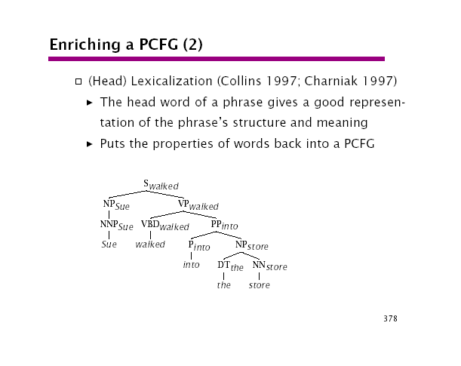

Slide 77
Problems with Head Lexicalization.
There are dependencies between non-heads
  I got [NP the easier problem [of the two] [to solve]]
    [of the two] and [to solve] are dependent on the pre-head modifier easier.

Slide 78
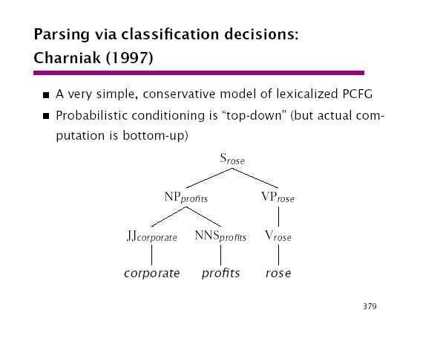

Slide 79
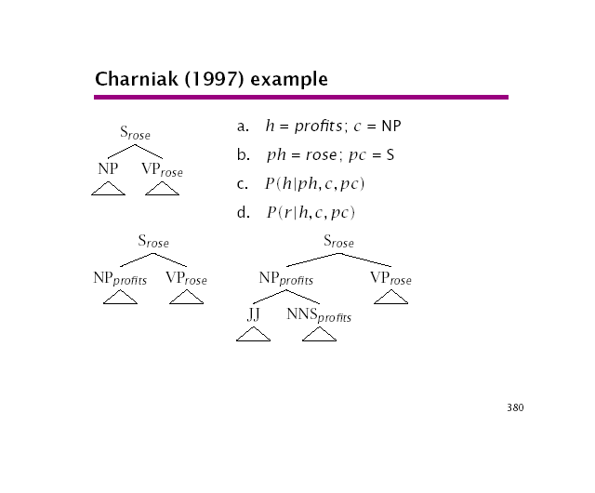

Slide 80
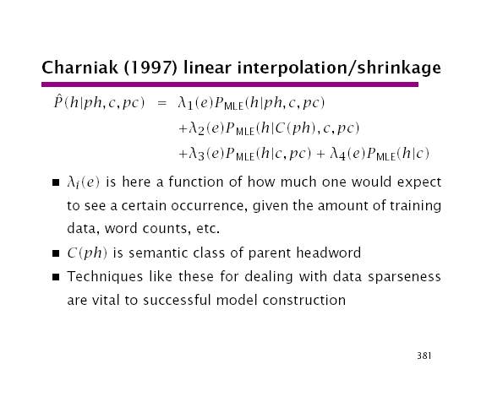

Slide 81
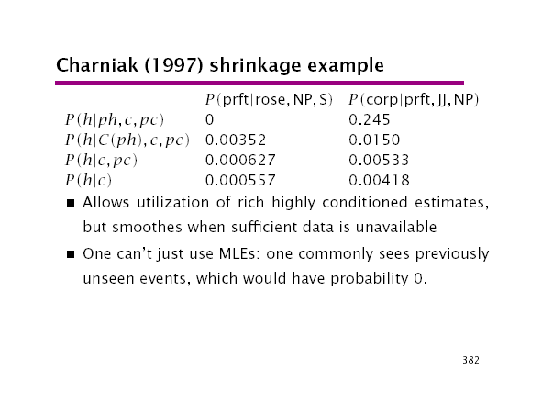

Slide 82
Other PCFG problems
Context-Free
  An NP shouldn’t have the same probability of being expanded if it’s a subject or an object.
  Expansion of nodes depends a lot on their position in the tree (independent of lexical content)
Pronoun Lexical
  Subject 91% 9%
  Object 34% 66%
  There are even more significant differences between much more highly specific phenomena (e.g. whether an NP is the 1st object or 2nd object)

Slide 83
There’s more than one way
The PCFG framework seems to be a nice intuitive method and maybe only way of probabilistic parsing
In normal categorical parsing, different ways of doing things generally lead to equivalent results.
However, with probabilistic grammars, different ways of doing things normally lead to different probabilistic grammars.
  What is conditioned on?
  What independence assumptions are made?

Slide 84
Other Methods
Dependency Grammars
  The old man ate the rice slowly
  Disambiguation made on dependencies between words, not on higher up superstructures
  Different way of estimating probabilities. If a set of relationships hasn’t been seen before, it can decompose each relationship separately. Whereas, a PCFG is stuck into a single unseen tree classification.

Slide 85
Evaluation
Objective Criterion
  1 point if parser is entirely correct, 0 otherwise
    Reasonable – A bad parse is a bad parse. We don’t want any somewhat right parse.
  But students always want partial credit. So maybe we should give parsers some too.
    Partially correct parses may have uses
    PARSEVAL measures
      Measure the component pieces of a parse
      But are specific to only a few issues. Ignored node labels, and unary branching nodes.
      Not very discriminating. Take advantage of this.

Slide 86
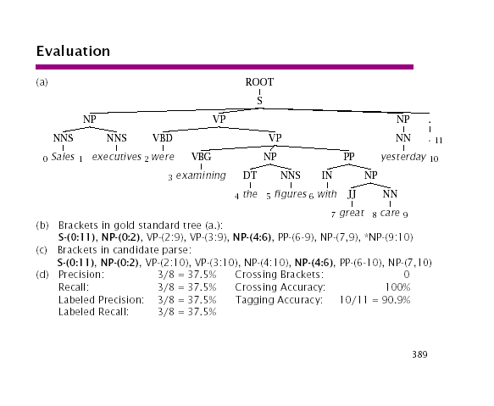

Slide 87
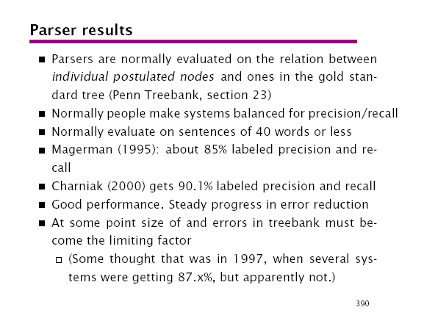

Slide 88
Equivalent Models
Grandparents (Johnson (1998))
  Utility of using the grandparent node.
    P(NP -> α | Parent = NP, Grandparent = S)
    Can capture subject/object distinctions
    But fail on 1st Object/2nd Object Distinctions
    Outperforms a Prob. Left Corner Model
    Best enrichment of PCFG short of lexicalization.
  But this can thought of in 3 ways:
    Using more of derivational history
    Using more of parse tree context (but only in the upwards direction)
    Enriching the category labels.
  All 3 methods can be considered equivalent

Slide 89
Search Methods
Table
  Stores steps in a parse derivation in bottom-up
  A form of dynamic programming
  May discard lower probability parses (viterbi algorithm) – Only interested in the most probable parse.
Stack decoding (Jelinek 1969)
  Tree-structured search space
    Uniform-cost search (least-cost leaf node first)
Beam Search
  May be fixed sized, or within a factor of the best item.
A* search
  Uniform –cost is inefficient.
  Best-first search using a optimistic estimate
  Complete & Optimal ( and optimally efficient)

Slide 90
Introduction to
Natural Language Processing (600.465)
Treebanks, Treebanking and Evaluation
Dr. Jan Hajiè
CS Dept., Johns Hopkins Univ.
hajic@cs.jhu.edu
www.cs.jhu.edu/~hajic

Slide 91
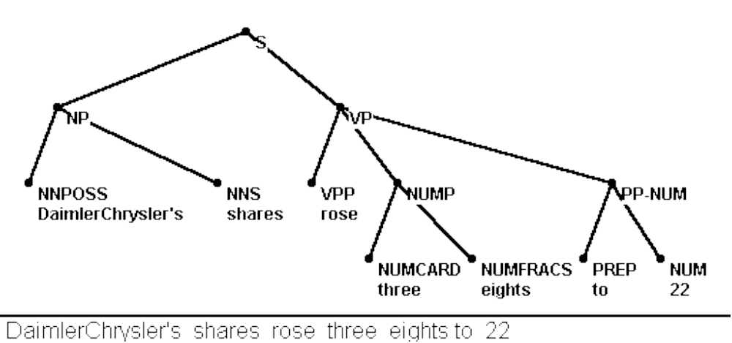
Phrase Structure Tree
Example:
((DaimlerChrysler’s shares)_{NP} (rose (three eights)_{NUMP} (to 22)_{PP-NUM} )_{VP} )_{S}

Slide 92
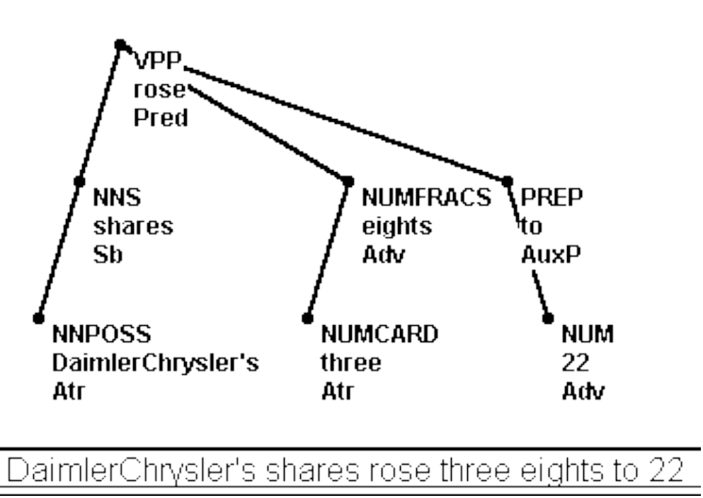
Dependency Tree
Example:
rose_{Pred}(shares_{Sb}(DaimlerChrysler’s_{Atr}),eights_{Adv}(three_{Atr}),to_{AuxP}(22_{Adv}))

Slide 93
Data Selection and Size
Type of data
  Task dependent (Newspaper, Journals, Novels, Technical Manuals, Dialogs, ...)
Size
  The more the better! (Resource-limited)
Data structure:
  Eventually; training + development test + eval test sets
    more test sets needed for the long term (development, evaluation)
  Multilevel annotation:
      training level 1, test level 1; separate training level 2, test level 2, ...

Slide 94
Parse Representation
Core of the Treebank Design
Parse representation
  Dependency vs. Parse tree
    Task-dependent
    (1 : n) mapping from dependency to parse tree (in general)
  Attributes
    What to encode: words, morphological, syntactic, ... information
    At tree nodes vs. arcs
      e.g. Word, Lemma, POSTag, Function, Phrase-name, Dep-type, ...
    Different for leaves? (Yes - parse trees, No - dependency trees)
  Reference & Bookkeeping Attributes
    bibliograph. ref., date, time, who did what

Slide 95
Low-level Representation
Linear representation:
  SGML/XML (Standard Generalized Markup Language)
  www.oasis-open.org/cover/sgml-xml.html
  TEI, TEILite, CES: Text Encoding Initiative
  www.uic.edu/orgs/tei
  www.lpl.univ-aix.fr/projects/multext/CES/CES1.html
  Extension / your own
    Ex.: Workshop’98 (Dependency representation encoding):
www.clsp.jhu.edu/ws98/projects/nlp/doc/data/a0022.dtd

Slide 96
Organization Issues
The Team
Approx. need for
1 mil. word size:
  Team leader; bookkeeping/hiring person 1
  Guidelines person(s) (editing) 1
  Linguistic issues person 1
  Annotators 3-5 (x2)^{x}
  Technical staff/programming 1-2
  Checking person(s) 2
^{x}Double-annotation if possible

Slide 97
Annotation
Text vs. Graphics
  text: easy to implement, directly stored in low-level format
    e.g. use Emacs macros; Word macros; special SW
  graphics: more intuitive (at least for linguists)
    special tools needed
      annotation
      bookkeeping
      “undo”
      batch processing capability

Slide 98
Treebanking Plan
The main points (apart from securing financing...):
  Planning
  Basic Guidelines Development
  Annotation & Guidelines Refinement
  Consistency Checking, Guidelines Finalization
  Packaging and Distribution (Data, Guidelines, Viewer)
Time needed:
  in the order of 2 years per 1 mil. words
  only about 1/3 of the total effort is annotation

Slide 99
Parser Development
Use training data for learning phase
  segment as needed (e.g., for heldout)
  use all for
    manually written rules (seldom today)
    automatically learned rules/statistics
Occasionally, test progress on Development Test Set
  (simulates real-world data)
When done, test on Evaluation Test Set
Unbreakable Rule #1: Never look at Evaluation Test Data (not even indirectly, e.g. performance numbers)

Slide 100
Evaluation
Evaluation of parsers (regardless of whether manual-rule-based or automatically learned)
Repeat: Test against Evaluation Test Data
Measures:
  Dependency trees:
    Dependency Accuracy, Precision, Recall
  Parse trees:
    Crossing brackets
    Labeled precision, recall [F-measure]

Slide 101
Dependency Parser Evaluation
Dependency Recall:
  R_{D} = Correct(D) / |S|
    Correct(D): number of correct dependencies
      correct: word attached to its true head
      Tree root is correct if marked as root
    |S| - size of test data in words (since |dependencies| = |words|)
Dependency precision (if output not a tree, partial):
  P_{D} = Correct(D) / Generated(D)
    Generated(D) is the number of dependencies output
      some words without a link to their head
      some words with several links to (several different) heads

Slide 102
Phrase Structure (Parse Tree) Evaluation
Crossing Brackets measure
  Example “truth” (evaluation test set):
    ((the ((New York) - based company)) (announced (yesterday)))
  Parser output - 0 crossing brackets:
    ((the New York - based company) (announced yesterday))
  Parser output - 2 crossing brackets:
    (((the New York) - based) (company (announced (yesterday))))
Labeled Precision/Recall:
  Usual computation using bracket labels (phrase markers)
    T: ((Computers)_{NP} (are down)_{VP})_{S} ↔ P: ((Computers)_{NP} (are (down)_{NP})_{VP})_{S}
    Recall = 100%, Precision = 75%

