Slide 1
Inside-outside algorithm
LING 572
Fei Xia
02/28/06

Slide 2
Outline
HMM, PFSA, and PCFG
Inside and outside probability
Expected counts and update formulae
Relation to EM
Relation between inside-outside and forward-backward algorithms

Slide 3
HMM, PFSA, and PCFG

Slide 4
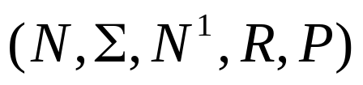



PCFG
A PCFG is a tuple:
  N is a set of non-terminals:
  is a set of terminals
  N¹ is the start symbol
  R is a set of rules
  P is the set of probabilities on rules
We assume PCFG is in Chomsky Norm Form
Parsing algorithms:
  Earley (top-down)
  CYK (bottom-up)
  …

Slide 5
PFSA vs. PCFG
PFSA can be seen as a special case of PCFG
  State ➔ non-terminal
  Output symbol ➔ terminal
  Arc ➔ context-free rule
  Path ➔ Parse tree (only right-branch binary tree)
S1
a
b
a
S2
S1
S2
S3
b
S3
ε

Slide 6

PFSA and HMM
Start
HMM
Finish
Add a “Start” state and a transition from “Start” to any state in HMM.
Add a “Finish” state and a transition from any state in HMM to “Finish”.

Slide 7
The connection between two algorithms
HMM can (almost) be converted to a PFSA.
PFSA is a special case of PCFG.
Inside-outside is an algorithm for PCFG.
Inside-outside algorithm will work for HMM.
Forward-backward is an algorithm for HMM.
In fact, Inside-outside algorithm is the same as forward-backward when the PCFG is a PFSA.

Slide 8
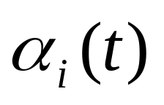
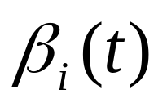
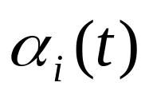

Forward and backward probabilities
o₁
o_{n}
O_{t-1}
X_{n+1}
X₁
…
X_{t}
…
X_{n}
X₁
…
O₁
X_{t-1}
O_{t-1}
X_{t}
O_{t}
…
X_{n}
O_{n}
X_{n+1}

Slide 9
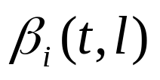
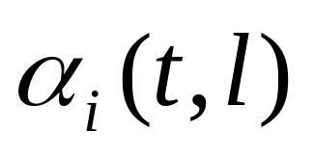
Backward/forward prob vs.
Inside/outside prob
PCFG:
X₁
PFSA:
X₁
Outside
Inside
Forward
Backward
X_{t}=N^{i}
X_{t}=N^{i}
O₁
O_{t-1}
O_{t}
O_{l}
O_{n}
O₁
O_{t-1}
O_{t}
O_{n}

Slide 10
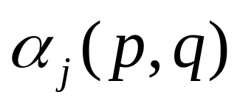

Notation
N¹
N^{j}
w₁
w_{p-1}
w_{p}
w_{q}
W_{q+1}
w_{m}

Slide 11
Inside and outside probabilities

Slide 12
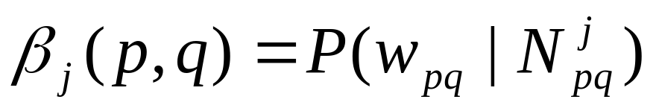

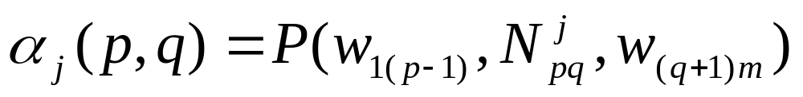

Definitions
Inside probability: total prob of generating words w_{p}…w_{q} from non-terminal N^{j}.
Outside probability: total prob of beginning with the start symbol N¹ and generating and all the words outside w_{p}…w_{q}
When p>q,

Slide 13
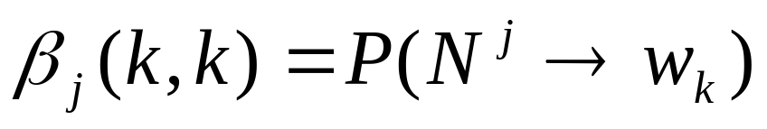
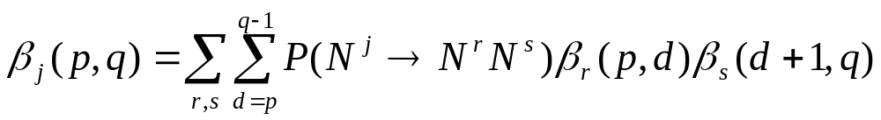
Calculating inside probability
(CYK algorithm)
N^{j}
N^{r}
N^{s}
w_{p}
w_{d}
W_{d+1}
w_{q}

Slide 14
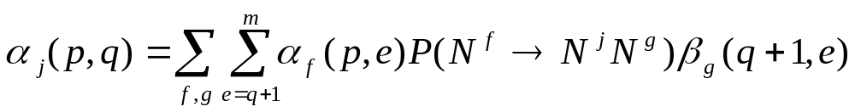
Calculating outside probability (case 1)
N¹
N^{f}
N^{j}
N^{g}
w₁
w_{p}
w_{q}
W_{q+1}
w_{e}
w_{m}

Slide 15
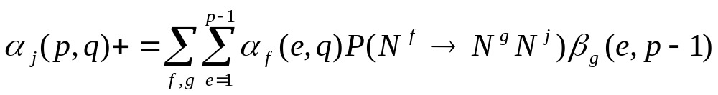
Calculating outside probability (case 2)
N¹
N^{f}
N^{g}
N^{j}
w₁
w_{e}
W_{p-1}
W_{p}
w_{q}
w_{m}

Slide 16
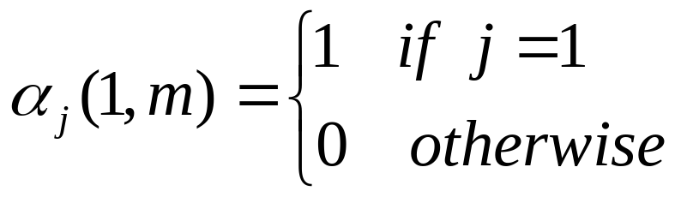
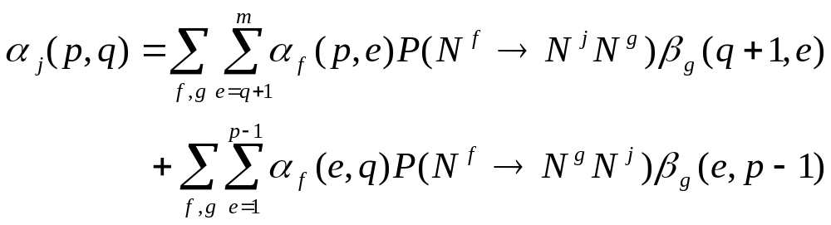
Outside probability

Slide 17
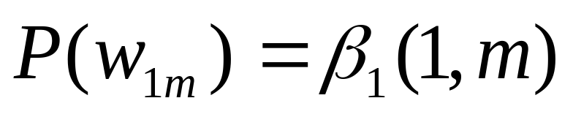
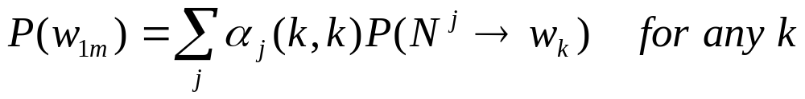
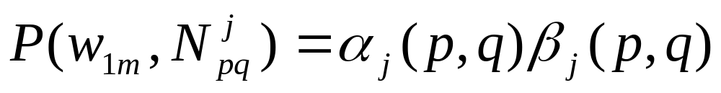
Probability of a sentence

Slide 18
Recap so far
Inside probability: bottom-up
Outside probability: top-down using the same chart.
Probability of a sentence can be calculated in many ways.

Slide 19
Expected counts and update formulae

Slide 20
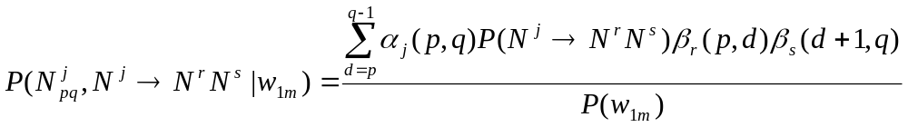
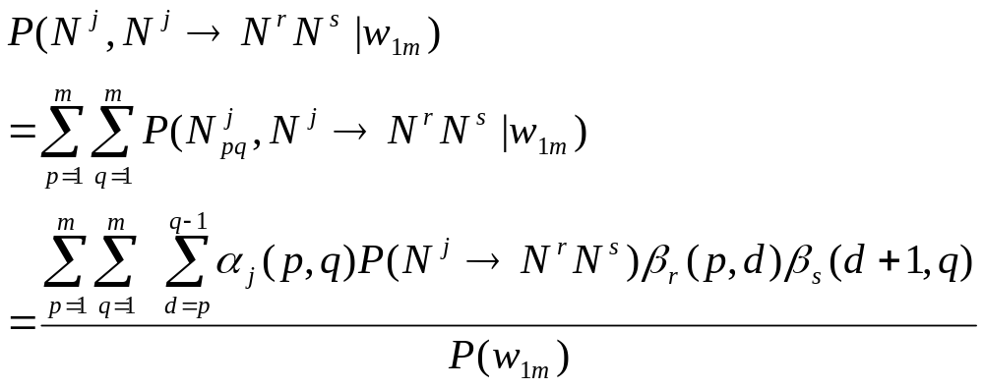
The probability of a binary rule is used
(1)

Slide 21
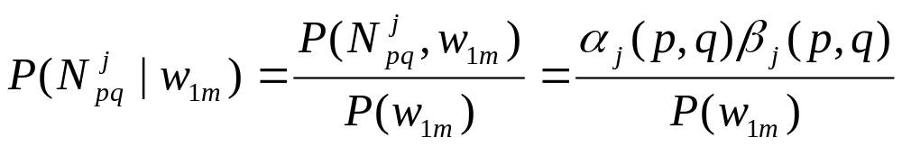
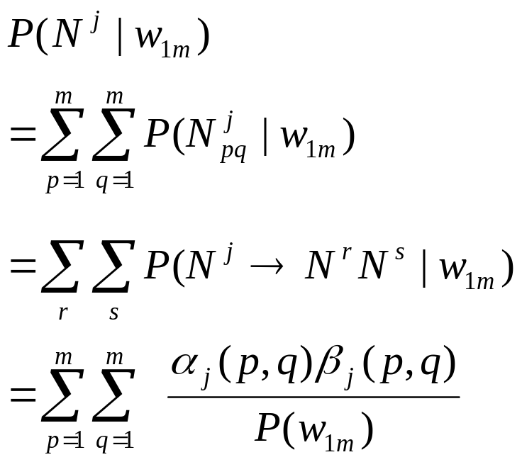
The probability of N^{j} is used
(2)

Slide 22
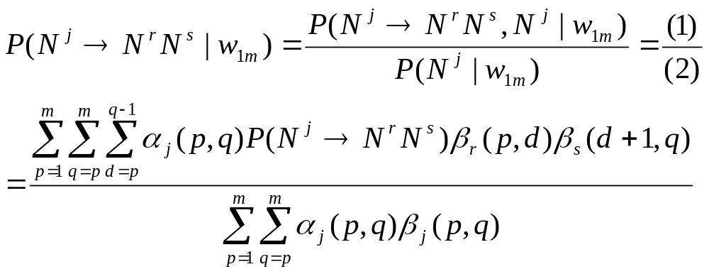

Slide 23
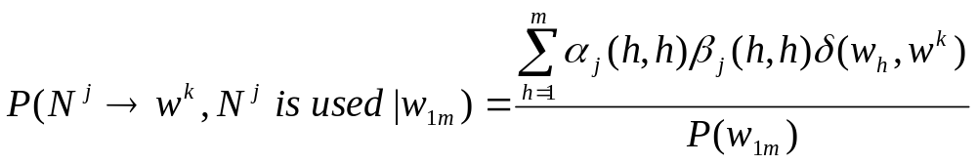
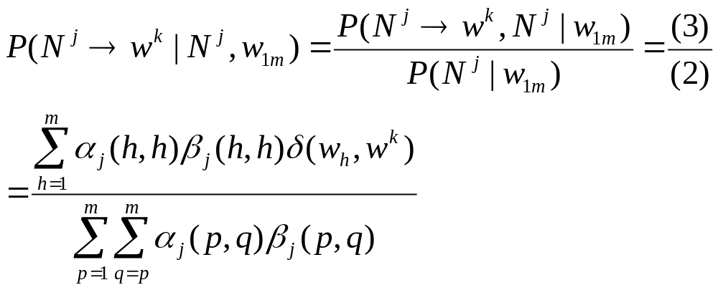
The probability of a unary rule is used
(3)

Slide 24
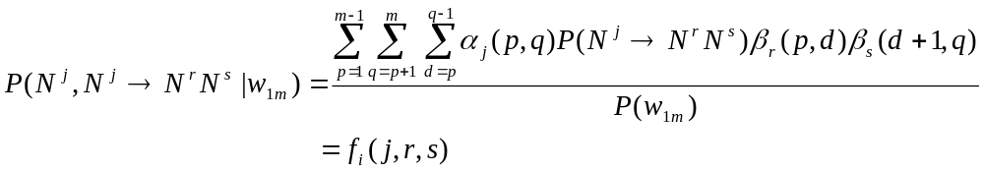
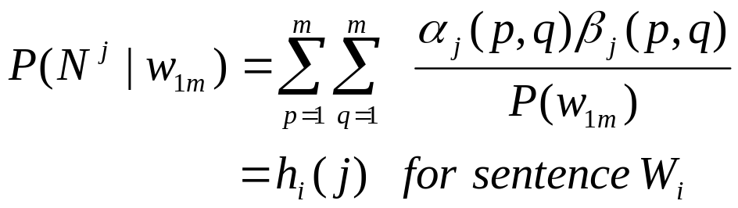
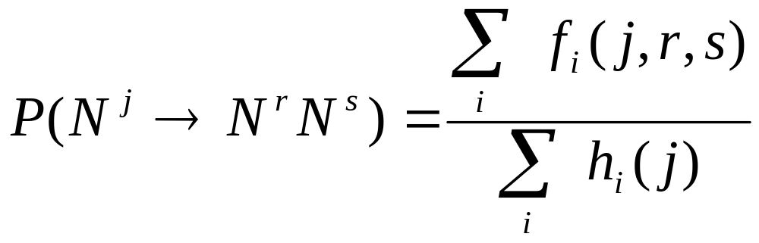
Multiple training sentences
(1)
(2)

Slide 25

Inner loop of the
Inside-outside algorithm
Given an input sequence and
Calculate inside probability:
  Base case
  Recursive case:
Calculate outside probability:
  Base case:
  Recursive case:

Slide 26
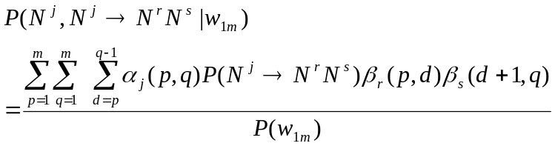
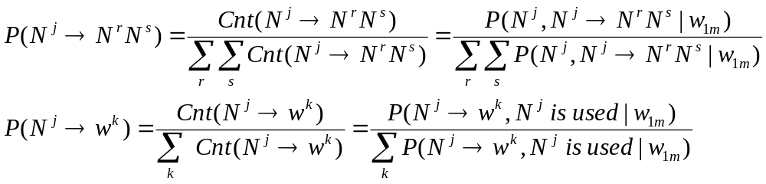
Inside-outside algorithm (cont)
3. Collect the counts
4. Normalize and update the parameters

Slide 27
Relation to EM

Slide 28
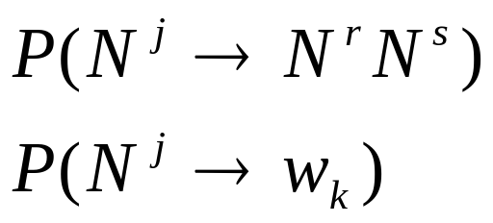
Relation to EM
PCFG is a PM (Product of Multi-nominal) Model
Inside-outside algorithm is a special case of the EM algorithm for PM Models.
X (observed data): each data point is a sentence w_{1m}.
Y (hidden data): parse tree Tr.
Θ (parameters):

Slide 29
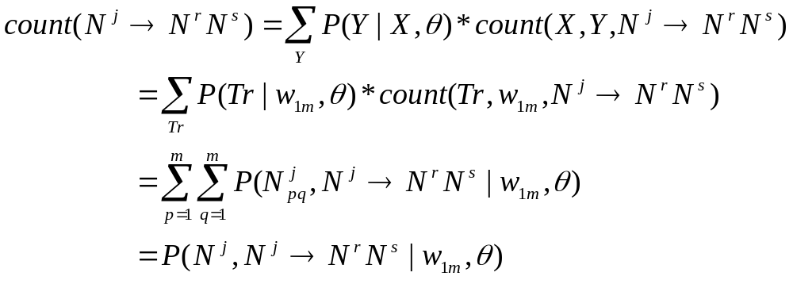
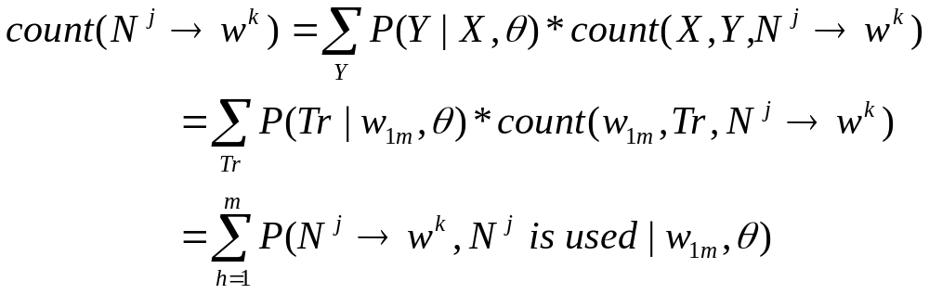
Relation to EM (cont)

Slide 30
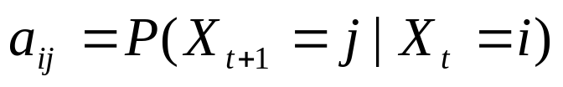


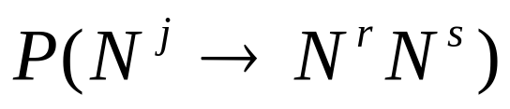

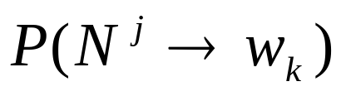

Summary
O_{t}
X_{t}
X_{t+1}
N¹
N^{j}
N^{r}
N^{s}
w_{p}
w_{d}
W_{d+1}
w_{q}

Slide 31
Summary (cont)
Topology is known:
  (states, arcs, output symbols) in HMM
  (non-terminals, rules, terminals) in PCFG
Probabilities of arcs/rules are unknown.
Estimating probs using EM (introducing hidden data Y)

Slide 32
Additional slides

Slide 33
Relation between forward-back and inside-outside algorithms

Slide 34


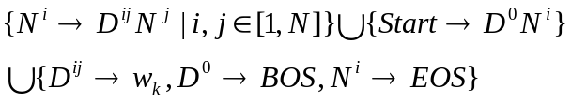
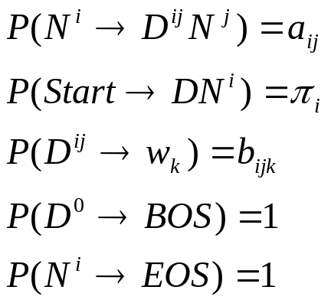
Converting HMM to PCFG
Given an HMM=(S, Σ, π, A, B), create a PCFG=(S1, Σ1,S0, R, P) as follows:
  S1=
  Σ1=
  S0=Start
  R=
  P:

Slide 35
Path ➔ Parse tree
o₁
o_{T}
o₂
…
X_{T}
X_{T+1}
X₁
X₂
Start
D₀
X₁
BOS
D₁₂
X₂
…
o₁
X_{T}
D_{T,T+1}
X_{T+1}
o_{t}
EOS

Slide 36
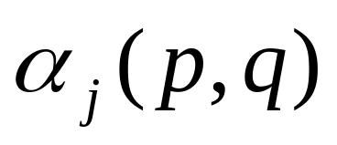
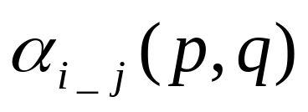
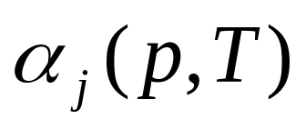
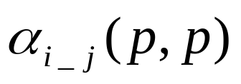
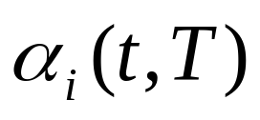
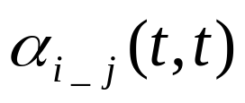
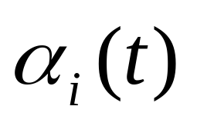
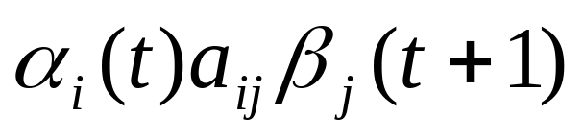
Outside probability
Outside prob for N^{j}
Outside prob for D^{ij}
q=T
q=p
(j,i),(p,t)
(p,t)

Slide 37
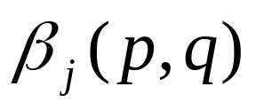
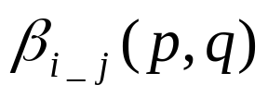
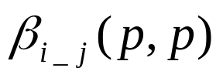
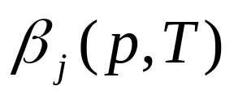




Inside probability
Inside prob for N^{j}
Inside prob for D^{ij}
q=p
q=T
(p,t)
(j,i),(p,t)

Slide 38





Estimating
Renaming: (j,i), (s,j),(p,t),(m,T)

Slide 39




Estimating
Renaming: (j,i), (s,j),(p,t),(m,T)

Slide 40




Estimating
Renaming: (j,i), (s,j),(p,t),(m,T)

Slide 41



Calculating
Renaming: (j,i), (s,j),(w,o),(m,T)

Slide 42





Calculating
Renaming (j,i_j), (s,j),(p,t),(h,t),
(m,T),(w,O), (N,D)

