Slide 1
Parsing

Slide 2
What is Parsing?
S → NP VP
NP → Det N
NP → NP PP
VP → V NP
VP → VP PP
PP → P NP
NP → Papa
N → caviar
N → spoon
V → spoon
V → ate
P → with
Det → the
Det → a
S
NP
VP
VP
PP
V
NP
P
NP
Det
N
Det
N
Papa
ate
the
caviar
with
a
spoon

Slide 3
What is Parsing?
S → NP VP
NP → Det N
NP → NP PP
VP → V NP
VP → VP PP
PP → P NP
NP → Papa
N → caviar
N → spoon
V → spoon
V → ate
P → with
Det → the
Det → a
S
NP
VP
Papa
VP
PP
V
NP
P
NP
ate
Det
N
with
Det
N
the
caviar
a
spoon

Slide 4
Programming languages
printf ("/charset [%s",
(re_opcode_t) *(p - 1) == charset_not ? "^" : "");
assert (p + *p < pend);
for (c = 0; c < 256; c++)
if (c / 8 < *p && (p[1 + (c/8)] & (1 << (c % 8)))) {
/* Are we starting a range? */
if (last + 1 == c && ! inrange) {
putchar ('-');
inrange = 1;
}
/* Have we broken a range? */
else if (last + 1 != c && inrange) {
putchar (last);
inrange = 0;
}
if (! inrange)
putchar (c);
last = c;
}
Easy to parse.
Designed that way!
Notes:
Let me start with a few words on parsing.
This is random code from Emacs, so if you see anything you like, it’s yours.
It’s written in an artificial language, designed to be easy to parse. Not completely trivial - we can’t tell whether (re_opcode_t) * (p-1) is a pointer cast or a mulitiplication, without some more context. But the scope of the ifs and fors is clearly marked. So is order of operations.

Slide 5
Natural languages
printf "/charset %s", re_opcode_t *p - 1 == charset_not ? "^" : ""; assert p + *p < pend; for c = 0; c < 256; c++ if c / 8 < *p && p1 + c/8 & 1 << c % 8 Are we starting a range? if last + 1 == c && ! inrange putchar '-'; inrange = 1; Have we broken a range? else if last + 1 != c && inrange putchar last; inrange = 0; if ! inrange putchar c; last = c;
No {} () [] to indicate scope & precedence
Lots of overloading (arity varies)
Grammar isn’t known in advance!
Context-free grammar not best formalism
Notes:
To get some flavor for why natural language is harder , think about parsing
this. Same code, but now we have no parentheses or indentation. Without that information, this is wildly ambiguous.
There are many other reasons why natural languages are subtle and difficult, but maybe the biggest - and most important for today - is function overloading. The English verb “bet”, B-E-T, can be either a noun or a verb, and as a verb it can take from 1 to 4 arguments: “I, would bet, you, five dollars, that it’s got four arguments.” But you can also say “you bet!”
Finally, you didn’t design the language, so you don’t know the grammar in advance. In fact, there’s a long-standing question as to what class of grammars is even appropriate for natural languages.

Slide 6
Ambiguity
S → NP VP
NP → Det N
NP → NP PP
VP → V NP
VP → VP PP
PP → P NP
S
NP → Papa
N → caviar
N → spoon
V → spoon
V → ate
P → with
Det → the
Det → a
NP
VP
Papa
VP
PP
V
NP
P
NP
ate
Det
N
with
Det
N
the
caviar
a
spoon

Slide 7
Ambiguity
S → NP VP
NP → Det N
NP → NP PP
VP → V NP
VP → VP PP
PP → P NP
S
NP → Papa
N → caviar
N → spoon
V → spoon
V → ate
P → with
Det → the
Det → a
NP
VP
Papa
V
NP
ate
NP
PP
Det
N
P
NP
the
caviar
with
Det
N
a
spoon

Slide 8
The parsing problem
correct test trees
P
A
R
S
E
R
s
c
o
r
e
r
accuracy
test
sentences
Recent parsers quite accurate
… good enough
to help NLP tasks!
Grammar
Notes:
That’s why parsing is hard; here’s what a parser does. We feed it some sentences. For each sentence, it consults its grammar, and produces a tree whose leaves are the sentence’s words, and whose structure is intended to be helpful.
If you want to see how good the parser is, feed it some test sentences, and using your favorite scoring method, compare the output trees to an answer key of trees produced by a human. Suffice it to say that the recent crop of parsers is quite accurate. Most sentences are parsed correctly, or with one error.
Eisner is me, and while today’s talk isn’t really about parsing ...

Slide 9
Applications of parsing (1/2)
Warning: these slides are out of date
Machine translation (Alshawi 1996, Wu 1997, ...)
tree
operations
English
Chinese
Speech synthesis from parses (Prevost 1996)
  The government plans to raise income tax.
  The government plans to raise income tax the imagination.
Speech recognition using parsing (Chelba et al 1998)
  Put the file in the folder.
  Put the file and the folder.
Notes:
So why is accurate parsing a good thing? Many hard natural language problems become somewhat easier once you can parse the input.
(MT) If you want to translate sentences, it helps to parse them first, because the manipulations that turn English into Chinese are more easily defined or learned over trees than over sentences.
(SS) If you want your machine to read your email to you over the phone, let’s say in Rex Harrison’s voice with perfect elocution, then it had better be careful with the following apparently similar strings: (read). These similar strings have very different intonation because they have very different parses. So again, computing intonation from the parse is much easier.
(SR) It’s recently been demonstrated that parsing helps in speech recognition. Commercial speech recognizers will mix up these sentences, because they sound the same and each is locally well-formed within a three-word window. But the first transcription is much more likely for syntactic reasons. A recognizer that parses as it goes will prefer the first transcription.

Slide 10
Applications of parsing (2/2)
Warning: these slides are out of date
Grammar checking (Microsoft)
Indexing for information retrieval (Woods 1997)
  ... washing a car with a hose ... vehicle maintenance
Information extraction (Hobbs 1996)
NY Times
archive
Database
query
Notes:
(GC) Microsoft is doing a lot of work on parsing, in part to improve the grammar checker in MS Word.
(IR) Bill Woods at Sun has an Information Retrieval system that uses light parsing to get really great results in user tests. If your document says “washing a car with a hose,” Bill will pick out this phrase and construct up a bunch of ways to index it, including “vehicle maintenance.”
(IE) Finally, there’s so much information out there on the web. If we parse it, we should be able to read all kinds of useful information off the parse trees, both in general and for specific queries. Informative queries are easier to write over parse trees than over strings.

Slide 11
Parsing for the Turing Test
Most linguistic properties are defined over trees.
One needs to parse to see subtle distinctions. E.g.:
Sara dislikes criticism of her. (her ≠ Sara)
Sara dislikes criticism of her by anyone. (her ≠ Sara)
Sara dislikes anyone’s criticism of her. (her = Sara or her ≠ Sara)
Notes:
Finally, if you want to really understand language, deeply, you gotta parse. Almost everything linguists care about is in the trees, not the words. People make subtle distinction in languages, and eventually machines must too.
What do I mean by subtle distinctions? Well, look at this sentence ...
(stress HER when reading it, to make it easier for audience)
“her” might refer to Sara’s mom, or Sara’s favorite student, but it can’t refer to Sara - we’d have to say “herself.”

Slide 12
In rest of lecture (and following two lectures), we’ll develop some parsing algorithms on the blackboard.

Slide 13
“Papa ate the caviar with a spoon”
0
1
2
3
4
5
6
7
S → NP VP
NP → Det N
NP → NP PP
VP → V NP
VP → VP PP
PP → P NP
NP → Papa
N → caviar
N → spoon
V → spoon
V → ate
P → with
Det → the
Det → a

Slide 14
First try … does it work?
“Papa ate the caviar with a spoon”
0
1
2
3
4
5
6
7
for each constituent on the LIST (Y i j)
  scan the LIST for an adjacent constituent (Z j k)
  if grammar has a rule to combine them (X → Y Z)
    then add the result to the LIST (X i k)

Slide 15
Second try …
“Papa ate the caviar with a spoon”
0
1
2
3
4
5
6
7
initialize the list using words (T i i+1)
where T is a preterminal tag like Noun
for each constituent on the LIST (Y i j)
  scan the LIST for an adjacent constituent (Z j k)
  if grammar has a rule to combine them (X → Y Z)
    then add the result to the LIST (X i k)
if the above loop added anything, do it again!
(so that X i k gets a chance to combine or be combined with)

Slide 16
Third try …
“Papa ate the caviar with a spoon”
0
1
2
3
4
5
6
7
initialize the list using words (T i i+1)
where T is a preterminal tag like Noun
for each constituent on the LIST (Y i j)
  for each adjacent constituent on the list (Z j k)
    for each rule to combine them (X → Y Z)
      add the result to the LIST (X i k)
      if it’s not already there
if the above loop added anything, do it again!
(so that X i k gets a chance to combine or be combined with)

Slide 17
Third try …
“Papa ate the caviar with a spoon”
0
1
2
3
4
5
6
7
NP 0 1
V 1 2
Det 2 3
N 3 4
P 4 5
Det 5 6
N 6 7
V 6 7
NP 2 4
NP 5 7
VP 1 4
PP 4 7
…

Slide 18
Still, that was inefficient when we tried it on the board …
We kept checking the same pairs that already had failed

Slide 19
CKY algorithm, recognizer version
Input: string of n words
Output: yes/no (since it’s only a recognizer)
Data structure: n × n table
  rows labeled 0 to n-1
  columns labeled 1 to n
  cell [i,j] lists constituents found between i and j

Slide 20
CKY algorithm, recognizer version
for i := 1 to n
  Add to [i-1,i] all categories for the i^{th} word
for width := 2 to n
    for start := 0 to n-width
      Define end := start + width
      for mid := start+1 to end-1
        for every nonterminal Y in [start,mid]
        for every nonterminal Z in [mid,end]
        for all nonterminals X
        if X → Y Z is in the grammar
        then add X to [start,end]

Slide 21
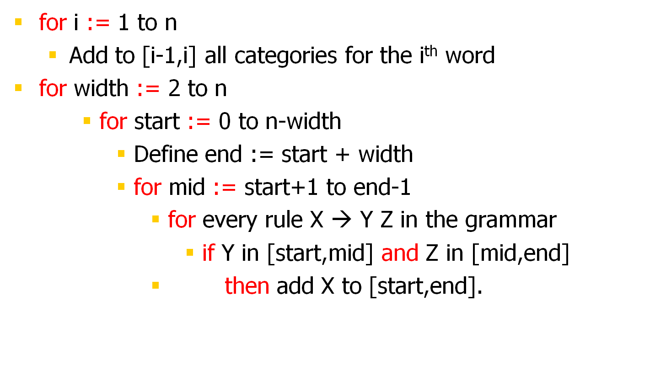
Alternative version of inner loops

