Slide 1
Retoolkit scripting-based reverse engineering toolkit
James Leskovar
16 february 2010

Slide 2
Outline
Reverse engineering
Hooks and DLL Injection
Retoolkit Motivation
Architecture
Scripting for Agility
Sample

Slide 3
Reverse engineering
Types of reverse engineering.
  Passive: Discerning the behaviour of a program in the absence of source code.
  Active: Observing and potentially modifying the behaviour of a running process.

Slide 4
Hooks and DLL Injection
What is a Dll?
  Dynamic-link library (shared library).
  Binary containing position-independent code
  Can be loaded by processes at runtime, or linked to a program as a dependency at compile-time.
  Exports functions which can be referenced and called by name.

Slide 5
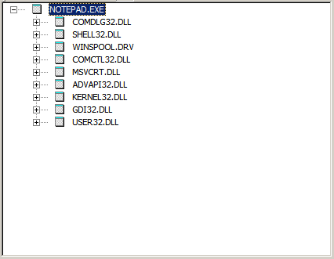
DLL
DLL dependencies of notepad.exe

Slide 6
DLL Injection
Forcing a running process to load a DLL we’ve written.
Why would we want to do this?
  Our DLL lives within the address space of the host process
  Can directly read and write process memory.
  Can directly call code within the process
  Ability to hook the host process’s code

Slide 7
Hooks
What is a hook?
  Modifying the host process’s code in such a way so that it executes our own.
  E.g. hooking the “send” function from the winsock library in order to be notified when any code sends data over sockets.

Slide 8
Motivation for Retoolkit
Reverse engineering typically not agile:
Find source code for injector
Write injector
Find source code for function hooking
Start a new dll project in IDE of choice
Paste source code, hope it works
Find addresses you want to hook
Write code to install hooks, do something interesting with information
Repeat steps 4-7 for each new process you want to look at

Slide 9
Motivation for Retoolkit
Enter, Retoolkit
  Framework for simplifying a lot of the cruft involved in RE work.

Slide 10
Retoolkit Architecture
Reverse engineering toolkit for Windows
  Comes in two parts:
  1) native injector program
  2) .NET retoolkit scripting IDE,

