Slide 1
USB

Slide 2
Host controller
Device type
  Hub
  xxx

Slide 3
数据流类型
通信方向
  Downstream / OUT transfer : host -> device
  Upstream / IN transfer : device -> host
Transfer type（内核使用URB传输）
  Control transfer
  Bulk transfer
  Interrupt transfer
    自动重传
  Isochronous transfer :
    实时方面
    音、视频设备
Notes:
控制传输类型的标准命令：
GET STATUS
CLEAR FEATURE
SET FEATURE
SET ADDRESS
GET DESCRIPTOR
SET DESCRIPTOR
GET CONFIGURATION
SET CONFIGURATION
GET INTERFACE
SET INTERFACE
SYNCH FRAME

Slide 4
标准描述符
Device Descriptor
  Usb 设备仅有一个设备描述符
Configuration Descriptor
Interface Descriptor
  0或多个EP (endpoint)
  Alternate setting
Endpoint Descriptor
String Descriptor
Notes:
What is Alternate setting?

Slide 5
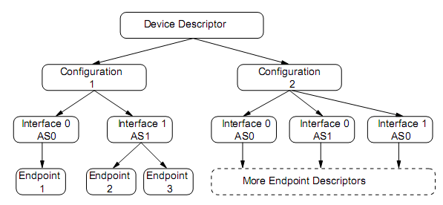
设备描述符
Notes:
当USB设备插上，linux中USB子系统枚举该设备，与该设备交互其设备描述符（device descriptor）
0 <= configuration < dev->desc.bNumConfigurations
0 <= interface < dev->actconfig->bNumInterfaces
0 <= alternate < dev->actconfig->interface[intfc].num_altsetting

Slide 6
Device class

Slide 7
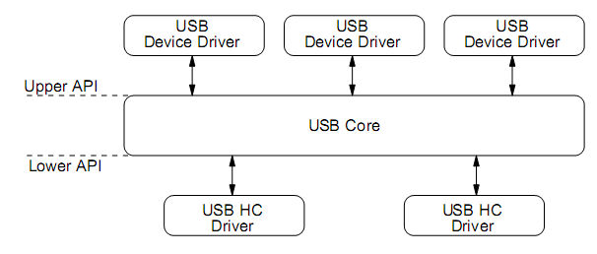
Device Driver
Device 或 interface都可以有相应驱动
Notes:
Linux usb core API layer

