Slide 1
Helikaon Linux Debugger:
A Stealthy Custom Debugger
For Linux
Jason Raber, Team Lead - Reverse Engineer

Slide 2
Overview
The Problem: Anti-debugging
Helikaon: How it works
Demo
Nuts and Bolts
Debugger Output
This and That
Future Work
Summary

Slide 3
The Problem: Anti-debugging
Linux OS is not immune to malware and viruses
Protect their IP
Why custom debugger?
  COTS debuggers, such as GDB and IDA Pro, are detected in Linux utilizing a variety of anti-debugging techniques
  Often interesting to break protections, why reproduce every time

Slide 4
The Problem: Anti-debugging
Traditional Ring-3 debuggers (GDB and IDA Pro) need to register with the OS to begin debugging a user application
They need to handle signals such as a SIGTRAP to handle an INT 3, and are easily detectable due to Linux debuggers needing to use ‘ptrace’ to debug a binary
Using the Helikaon debugger, registration with the OS is not required
Checks for ptrace, signal, INT 3’s, and hardware debug register use are circumvented

Slide 5
Helikaon
“Helikaon” — a stealthy Linux-driver-based debugger that will aid the engineer in debugging a running executable

Slide 6
Feature Comparison Chart
 | User Debuggers (gdb, IDA Pro) | Helikaon Debugger
Caught by Registration-based Debugger Checks (e.g. Ptrace(), signal()) | Yes | No
Uses INT 3's and Debug Registers for Breakpoints | Yes | No
Caught by Single-stepping Checks | Yes | No
Caught by IDT Checks | Yes | No
Reading /proc/self/stat | Yes | No
Caught by Exception Handlers | Yes | No
Parent-child Debugging | Yes | No
Timing checks | Yes | No
Caught by User App Signature Detection | Yes | No

Slide 7
How is it stealthy?
Helikaon injects a jump at runtime from kernel land into a user space running process rather than using standard debugger breakpoints like “INT 3” or DR0-DR7 hardware registers
Using Helikaon to inject jumps to reroute code allows the debugger to have command of the running executable at a particular address
Since the driver’s injections are dynamic, the code remains unmodified after its run is completed and injected jumps are removed immediately after they are used

Slide 8
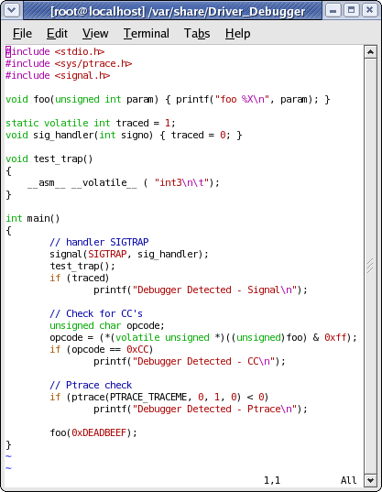
Anti-debug Example

Slide 9
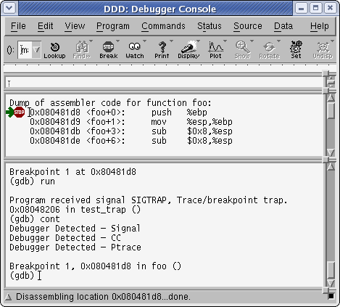
GDB Detected
Disassembled program run through GDB debugger shows debugger detected

Slide 10
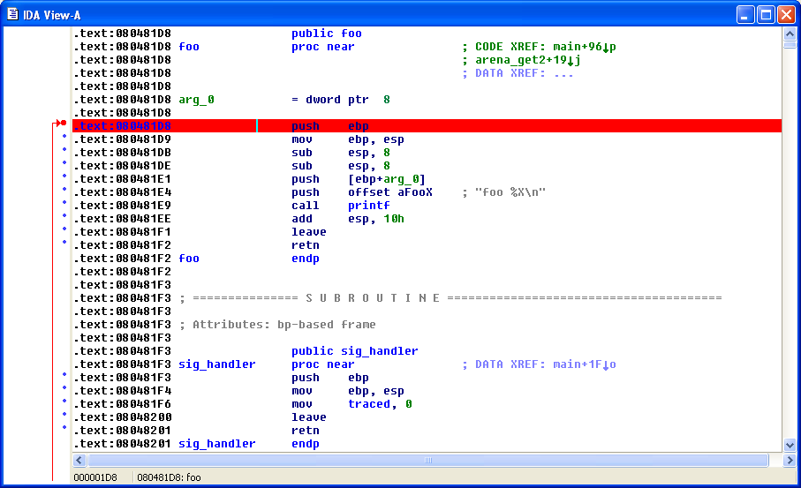
IF Debugger undetected
Add a breakpoint in the Helikaon Driver @ 0x80481D8

Slide 11
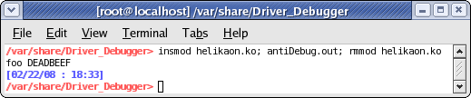
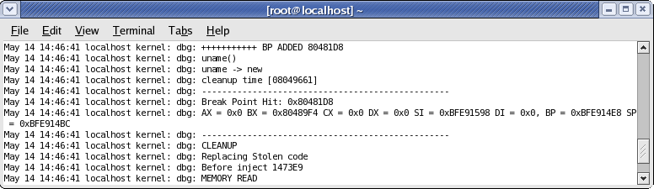
Running Helikaon
View execution state (via registers etc)
“No Debugger present or CC detected or signal detected”

Slide 12
Done at Runtime
Inject jumps to reroute code allows the Helikaon debugger to have command of running exe
Breakpoints on packed code
Code remains unmodified on file

Slide 13
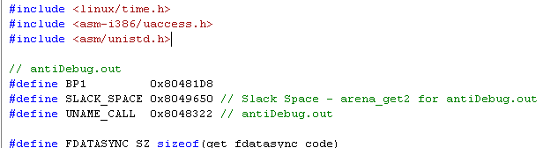
Nuts and Bolts
The driver needs three things before being compiled and loaded:
  Breakpoint address
  Slack space address (could use startup code space)
  Return address of a Syscall such as ‘uname’

Slide 14
Nuts and Bolts Cont.
The chosen Syscall should be one that executes early, say in startup code, like the Syscall to ‘uname’

Slide 15
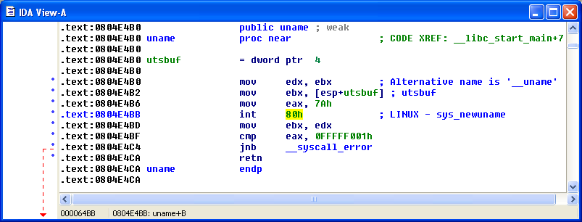
Why uname - Linux Kernel
User Process
User mode
int 80
Kernel mode
Linux Kernel
Notes:
Uname – print system information
%uname –a
Output -> Linux localhost 2.6.9-34 date etc

Slide 16
Hook Kernel via syscalls
User Process
User mode
int 80
Kernel mode
Linux Kernel
Helikaon Driver

Slide 17
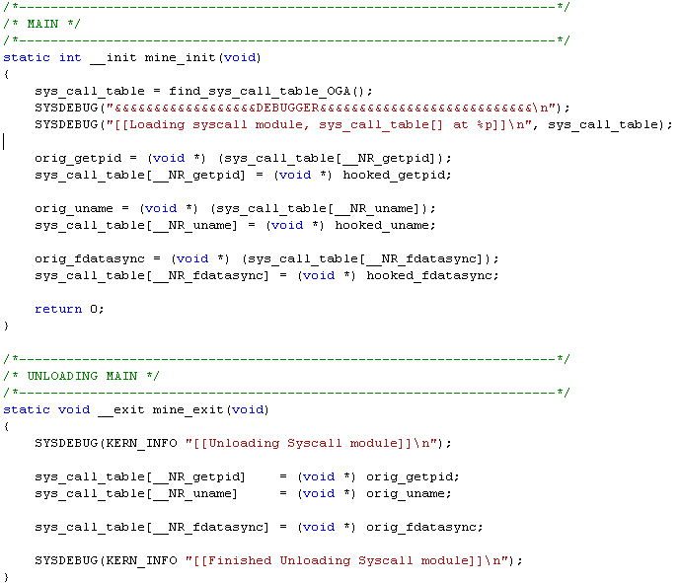
Hooking process

Slide 18
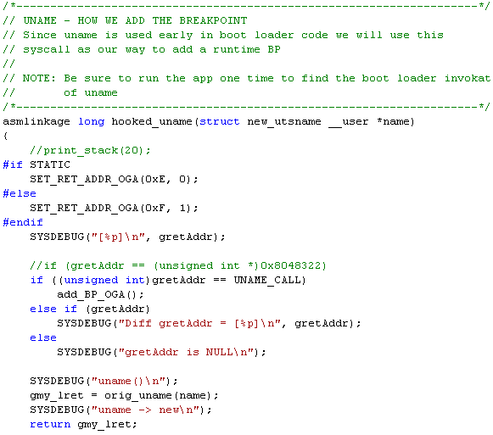
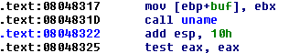
Hooked uname
Where the fun begins

Slide 19
Putting it together
Helikaon Driver tasks
1. Hook the Syscalls ‘uname’ and ‘fdatasync’ – (could be other Syscall instead).
User Process Runs
1. Syscall ‘uname’ executed in startup code.
Helikaon Driver tasks
Hooked Syscall ‘uname’ rerouted to driver (previous slide)
Save off stolen bytes (where the breakpoint will go).
From hooked Syscall inject a “JMP slackspace” into the running process where you want to add the breakpoint.
Copy breakpoint handler code into slack space.
Breakpoint Hit – User Process tasks
When EIP hits the “JMP slackspace” control will pass to slack space (handler code).
Handler code – push registers on stack.
Handler code – interrupt (generates Syscall ‘fdatasync’ – already hooked Syscall :).
Helikaon Driver tasks – hooked ‘fdatasync’
Print the registers from hooked Syscall fdatasync.
Replace stolen bytes in user process.
Optional: Modify registers or print memory.
Returns back to User Process.
User Process tasks
Still in slack space – Pop all registers that were pushed on stack.
Jump back were breakpoint was (stolen bytes have been replaced).
Continue execution.

Slide 20
Putting it Together Cont.
uname()
(1)
Startup
Main()
BP (Jmp inserted)
int 80
User Process
(8)
(5)
(4)
push regs
fdatasync()
Pop regs (10)
Jmp BP Addr (11)
Slack space
int 80
User mode
(6)
Kernel mode
Helikaon
Hooked_uname()
Steal bytes (2)
Add BP
Add Handler Code
(3)
Hooked syscalls
Linux Kernel
Hooked_fdatasync()
Print regs (7)
Replace stolen bytes
Return to Slack (9)

Slide 21
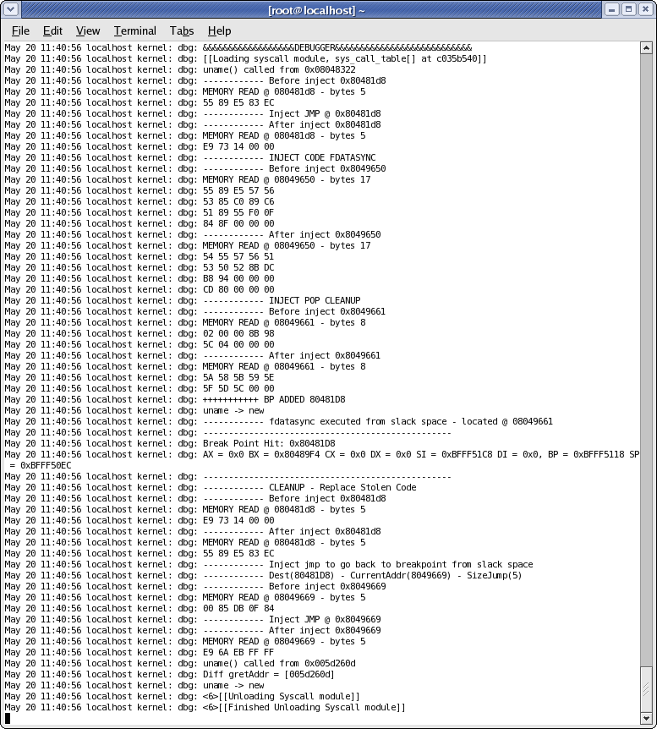
1

Slide 22
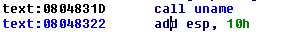
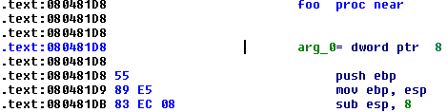
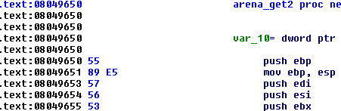
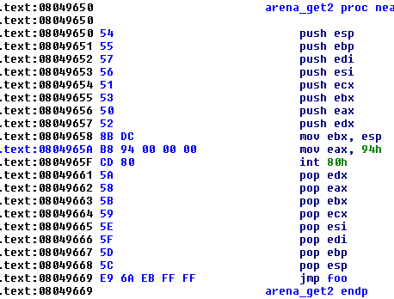
Uname executed

Slide 23
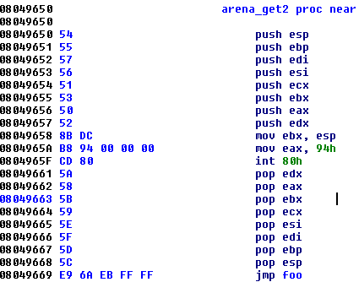
Break Point Hit
0x80481D8 JMP 0x8049650
Slack Space
Move stack pointer in EBX so I can deref. Register values

Slide 24
This and That
Encrypted code that becomes decrypted in memory could make a system call
Looped code – Replace stolen bytes in slack then JMP [bpAddr + 5]
Could reroute every instruction (instruction tracing)

Slide 25
Summary
Software that prevents a reverse engineer from dynamic analysis through means of anti-debugging measures can be thwarted using Helikaon Debugger
Utilizes ‘int 80’ to the reverse engineer’s advantage

Slide 26
Future Work
Ability to reroute instructions in other drivers
GUI front end controlled by user
Utilize shared memory instead of slack space or clean up better in slack space

Slide 27
Contact
Jason Raber
Team Lead - Reverse Engineer
937-427-7085
jraber@rri-usa.org

