Slide 1

The Coffee
Batch: 151+152
Group: 3
Members:
Lê Thị Nhật Tân
Trần Phúc Triều
Nguyễn Phi Lip

Slide 2
1
Rationale
2
Introduction
3
Application Functionality
TABLE OF CONTENTS
Application Interface
4
5
Advantages & Disadvantages
6
Development

Slide 3
1. Rationale
Revenue and expenditure management, trade has always been an important demand in the cafe and other services.
Currently, there are several training centers manage grade by paper, Excel.
From society's needs, we have created an app to manage most effectively cafe ..

Slide 4
2. Introduction
The Coffee.
Make the management become easier and quicker.
Control of all business processes, warehousing, revenues and expenditures and activities of employees.

Slide 5
2. Introduction
Decrease the time for not only the working paper but also the restoring records.
Software created with Neabeans 8.2
SQL Server2012, is used to develop management The Coffee
Library:JDBC,JDK
Language for development:java

Slide 6
3. Application Functionality
1
Search
2
Create, Read, Update, Delete
3
Statistic
4
Print

Slide 7
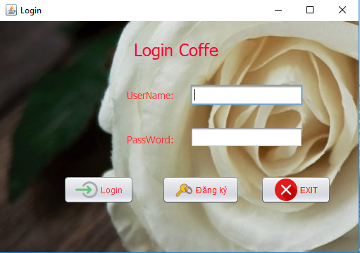
4. Application Interface
Login interface

Slide 8
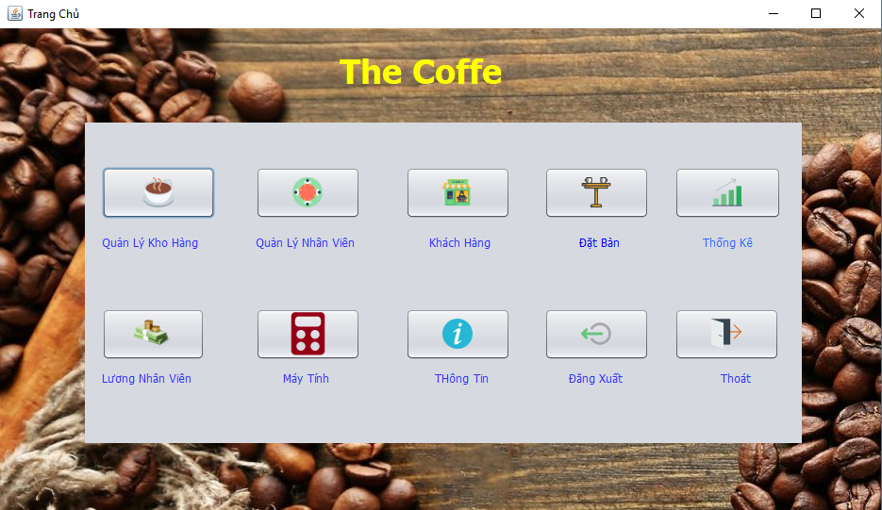
4. Application Interface
Main Form

Slide 9
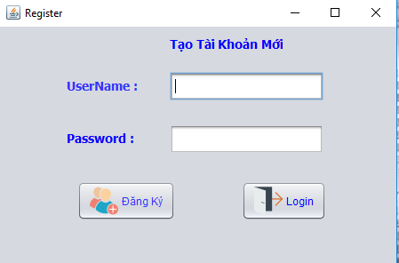
4. Application Interface
Register interface

Slide 10
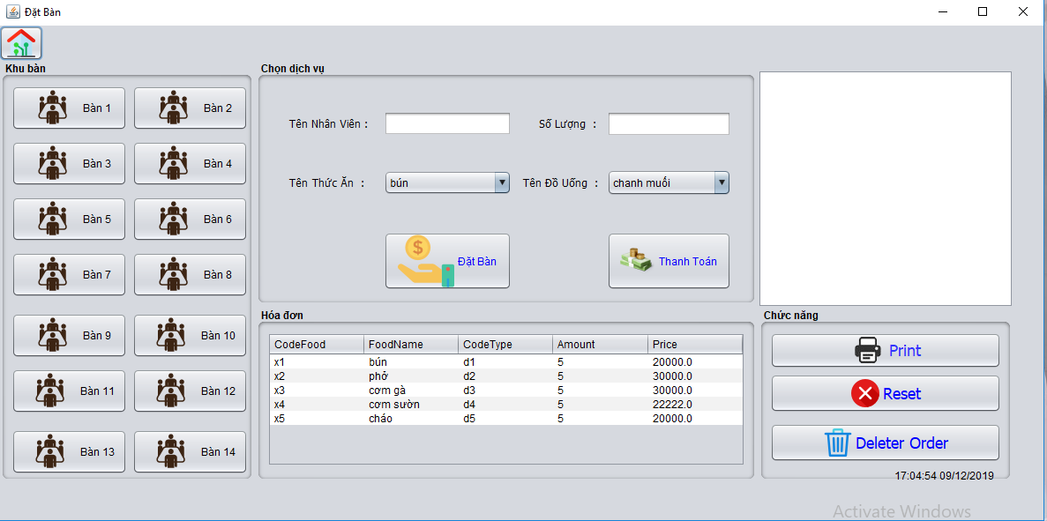
4. Application Interface
Sales interface

Slide 11
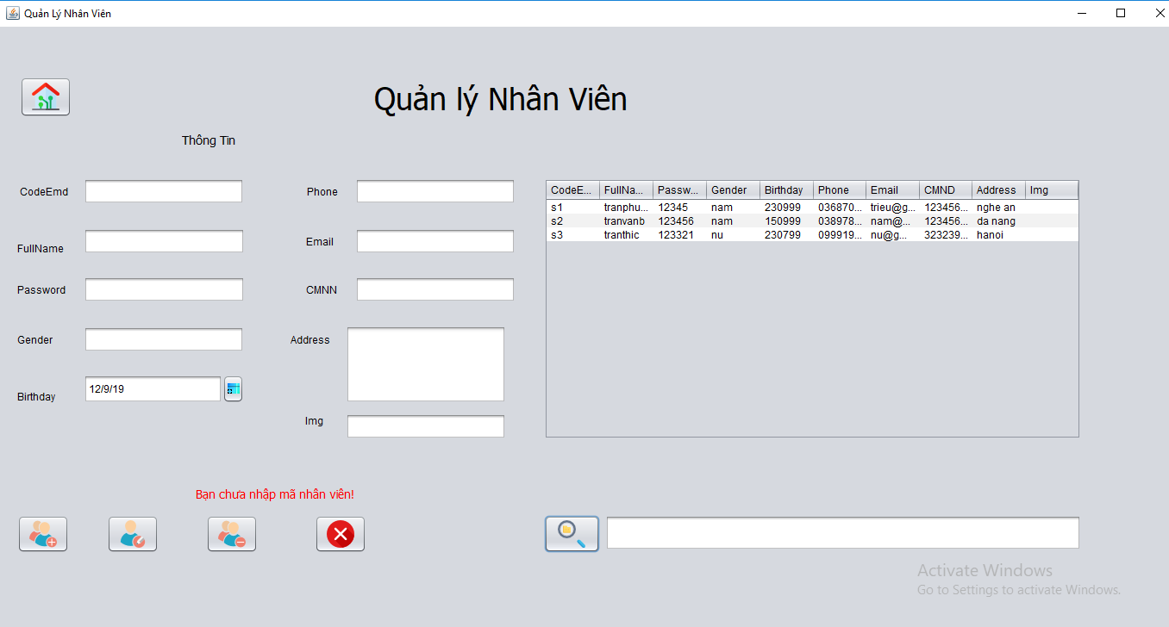
4. Application Interface
Employee manager interface

Slide 12
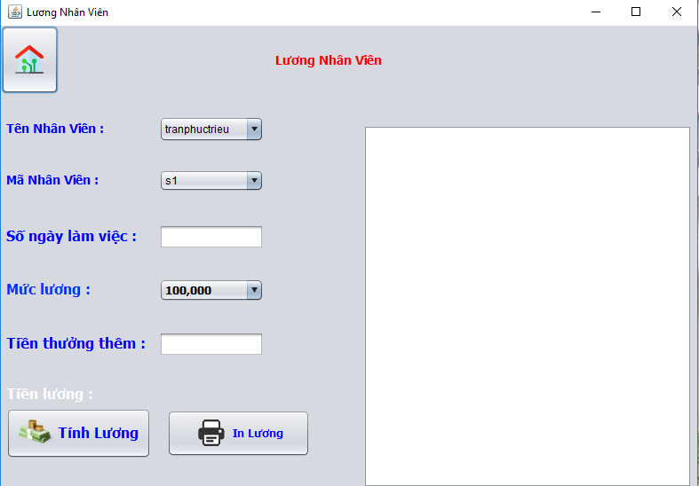
4. Application Interface
Salary interface

Slide 13
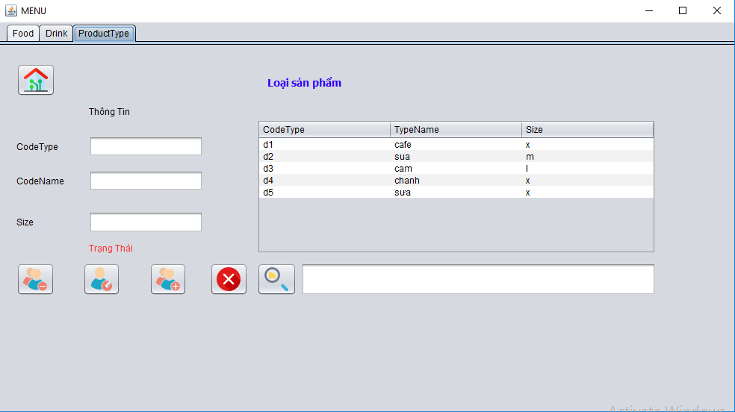
4. Application Interface
Product Type management interface

Slide 14
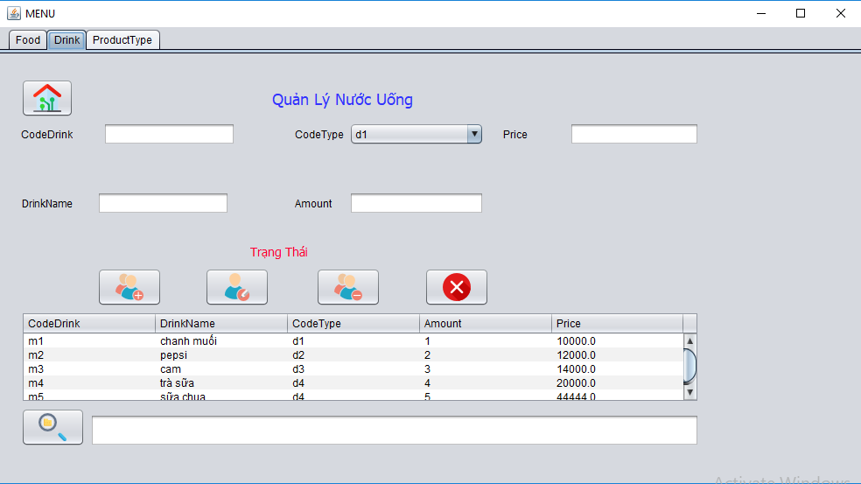
4. Application Interface
Drink management interface

Slide 15
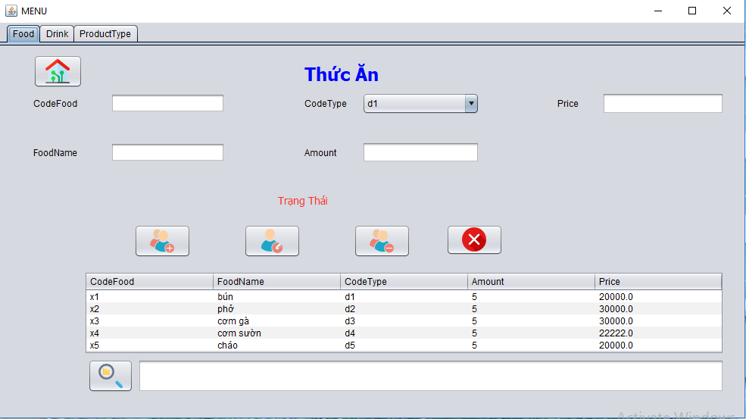
4. Application Interface
Food management interface

Slide 16
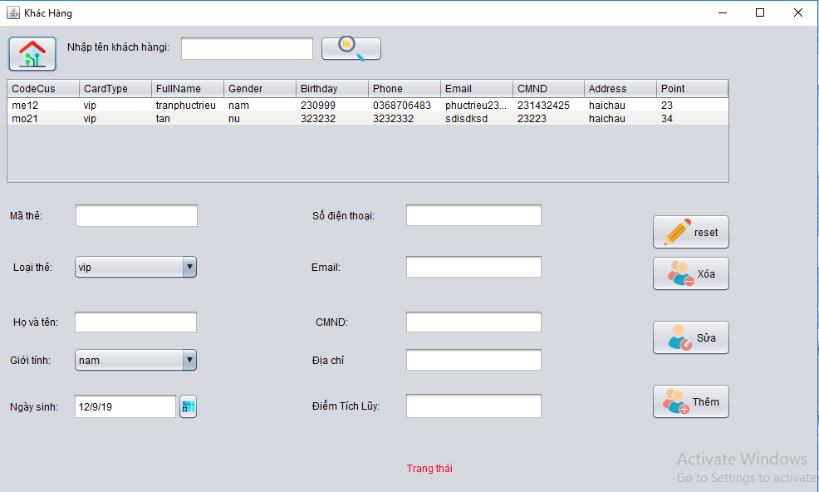
4. Application Interface
Interface Customer

Slide 17
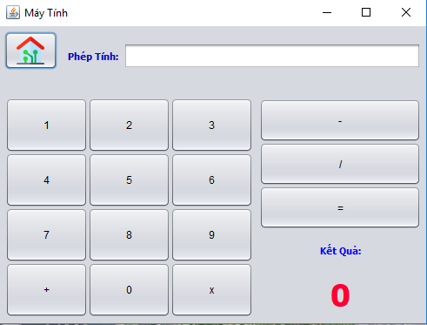
4. Application Interface
Interface calcul

Slide 18
5. Advantages & Disadvantages
A
D
V
A
N
T
A
G
E
S
Sales management very closely from the service, income and expenditure of money, inventory, employees ...
The Coffee software very easy to use, simple and intuitive, anyone can use, even if the computer is unknown.
Administrators: manage, search, statistic, print.

Slide 19
5. Advantages & Disadvantages
D
I
S
A
D
V
A
N
T
A
G
E
S
The time constraints.
Have not been equipped by complete knowledge.
we will do better.

Slide 20
6. Development
When we have earned sufficient
knowledge needed.
Improve and design a better, nicer application.

Slide 21
THANK YOU

