Slide 1
Final Presentation
Group 3
Ashutosh Singh
Trieu Vo
Yash Tadiyal
EAI 6000: Fundamentals of AI

Slide 2
Introduction / Use case
Name
Airbnb Business Case Study using ML models.
Description
Since 2008, visitors and hosts have utilized Airbnb to broaden travel options and provide a more distinctive, customized way of seeing the globe. We use predictive modeling to create price market-specific forecasts with multiple variables and use LIME and SHAP for model interpretability. The information utilized in this analysis provides the listing activity and indicators in the United States and Europe in 2021.
Actors
Customers, Hosts and Airbnb.
Organizational Benefits
Forecasts and reports to optimize the existing predictive models so that they can use data to not only improve their service and search, but their hiring practices and customer groups as well.

Slide 3
2. Explanation of the data
Original Inside Airbnb dataset: 1.2 million listings, 84 features
In this project: 821,335 listings from the US and Europe, 27 features
Features: accommodates, amenities, availability_365, bedrooms, beds, calculated_host_listings_count, host_has_profile_pic, host_id, host_identity_verified, host_name, host_response_rate, host_response_time, id, instant_bookable, last_review, latitude, longitude, maximum_nights, minimum_nights, name, neighbourhood, number_of_reviews, price, property_type, review_scores_rating, reviews_per_month, room_type

Slide 4
3. Methodology
Data Collection
Data Cleaning, Manipulation and Visualization
Data Reduction (Feature selection/extraction)
Model Building & Evaluation:
A. Linear Regression
B. Decision Tree
C. Random Forest
D. XGBoost
Model Interpretability with LIME, SHAP and Feature Importance

Slide 5
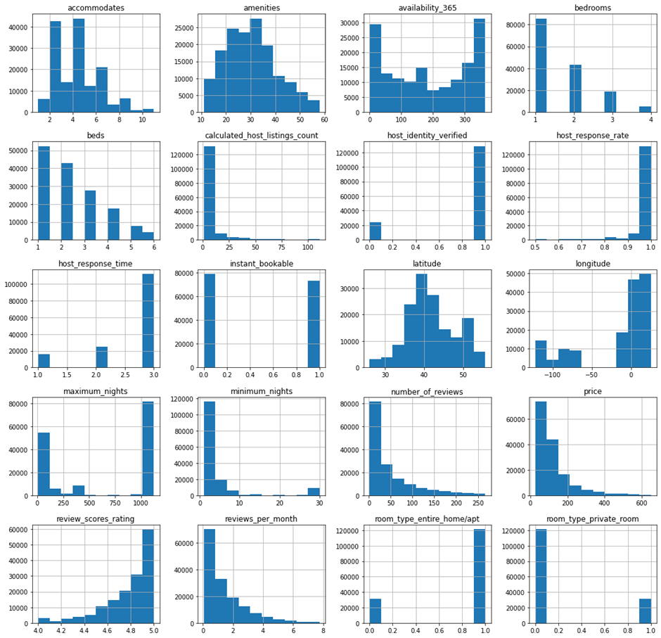
4. Data Analysis
Data Cleaning: Calculate the number, percentage of missing values, remove them: from 800,000 to over 200,000 rows.
Data Manipulation: Convert categorical into numerical features (amenities, host_has_profile_pic, host_identity_verified, instant_bookable, host_response_time, price, room_type), remove outliers (Interquartile Range): 150,000 rows.
Data Reduction: Remove unnecessary features (high cardinality or unused features): 20 features.

Slide 6
5. Modeling
Create the training set and test set with the ratio 7:3 respectively.
Having 19 predictor variables, 1 target variable (price).
The training set has 106,731 observations and the test set has 45,742 observations.
To get the best results, we decided to use RobustScaler to scale predictor variables.
In this project, we used 4 machine learning prediction models, compared their accuracy, as well as their viability and scope for the project's specific use case.
We use LIME and SHAP to interpret the model's predictions at the local and global levels.
Linear Regression: We utilize the default hyperparameter for the linear regression model.
Decision Tree: We experimented with several hyperparameters such as criteria, max_depth, and random_state before settling on criterion = "squared_error," max_depth = 10, and random_state = 42 as the best results on the test set.

Slide 7
5. Modeling
Random Forest
We tried changing different hyperparameters such as n_estimators, criterion, random_state and finally we set n_estimators = 100, random_state = 42, criterion = "squared_error" because they give us the best result on the test set.
XGBoost (Extreme Gradient Boosting)
We experimented with various hyperparameters before settling on n_estimators = 100, learning_rate = 0.08, gamma = 0, subsample = 0.75, colsample_bytree = 1, max_depth = 10 as the best results on the test set.

Slide 8
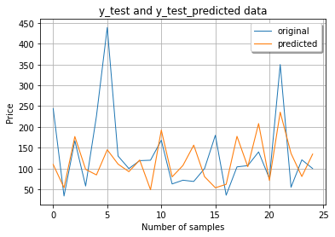
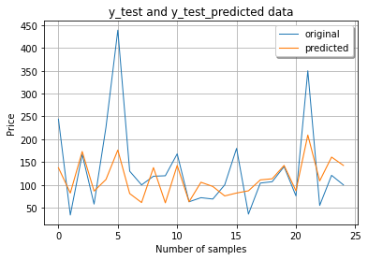
6. Results
Linear Regression
On both the training set and the test set, the Linear Regression model achieves R^2 = 0.37. This is a pretty low result, but it can show us that the model doesn’t suffer from overfitting.
Decision Tree
On the training set, the Decision Tree model achieves R^2 = 0.57, which is acceptable. On the test set, the model achieves R^2 = 0.49. This result is better than what we have tried before.

Slide 9
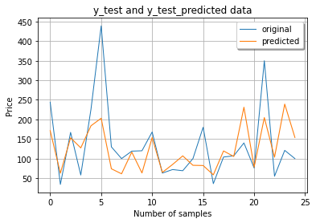
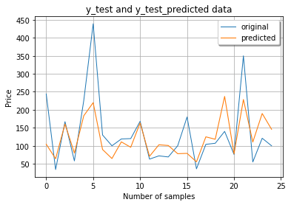
6. Results
Random Forest
On the training set, the Random Forest model achieves R^2 = 0.95, proving the model fits the training data very well. On the test set, the model gets R^2 = 0.62 after hyperparameter tuning.
XGBoost
The XGBoost model obtains R^2 = 0.8 on the training set, which is a decent performance. The model has R^2 = 0.64 on the test set. This outcome surpasses that of the Random Forest model.

Slide 10
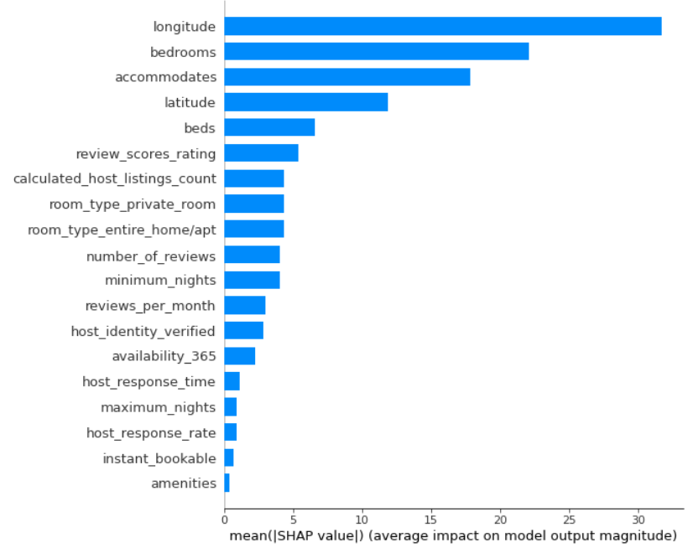
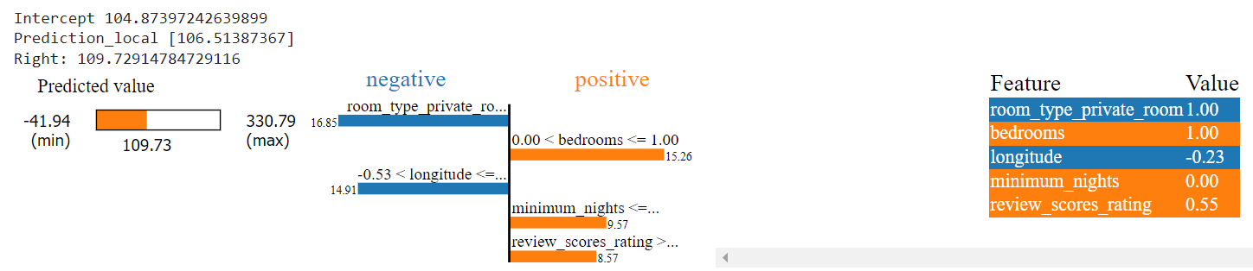
6. Result
Linear Regression

Slide 11
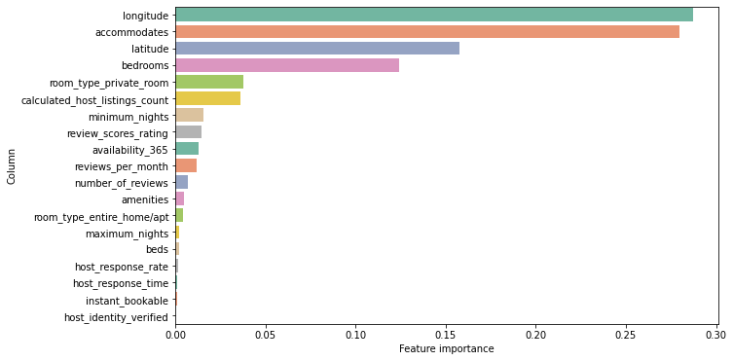
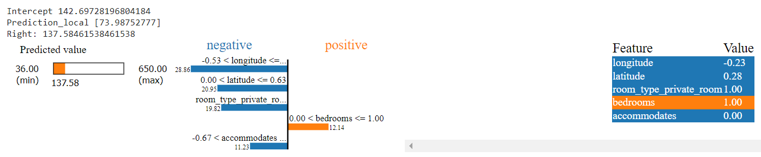
6. Result
Decision Tree

Slide 12
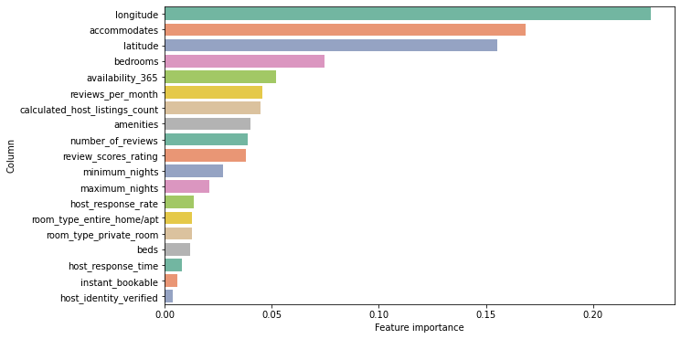
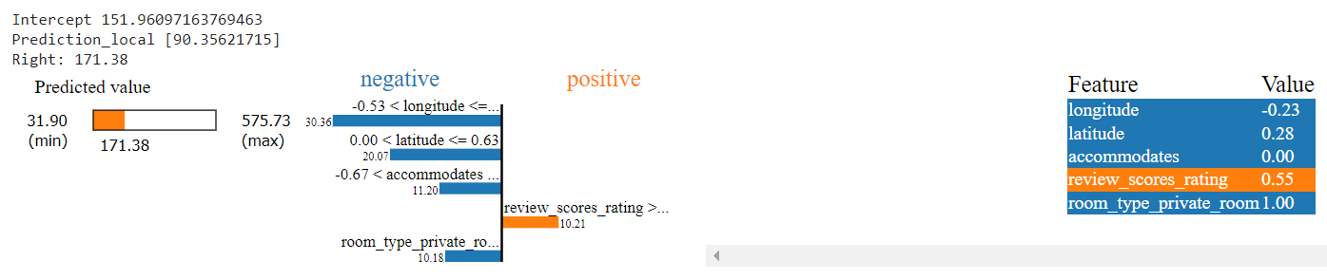
6. Result
Random Forest

Slide 13
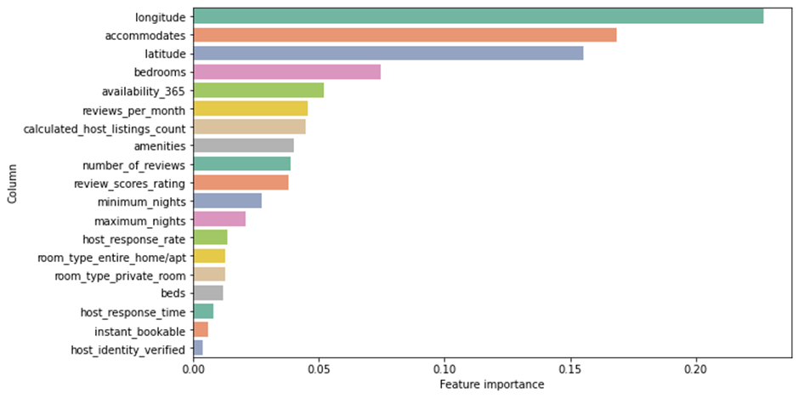
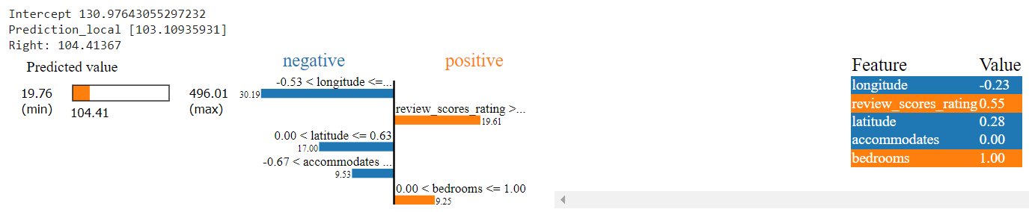
6. Result
XGBoost

Slide 14
7. Conclusion
In this project, we use the Airbnb dataset with 800,000 listings and 27 features to explore.
We go through different data science steps to preprocess the data, such as Data Collection, Data Cleaning, Data Manipulation, Data Visualization, and Data Reduction.
We build 4 models to predict the price of listings. They are Linear Regression, Decision Tree, Random Forest and XGBoost. The XGBoost and Random Forest models give the highest R^2 score on the test set (0.64 vs. 0.62).
We use LIME, SHAP and Feature Importance to find out how features affect the price at the local and global levels. We have a conclusion that 4 features longitude, latitude, accommodates and bedrooms affect the price most.

Slide 15
Thank You!

