Slide 1


Spotify Track Popularity Analysis & Prediction
Group 4
Trieu Vo
Abid Khan
Ashutosh Singh
ALY6040 – Data Mining
Prof. Joseph Reilly

Slide 2
Table of Contents
Introduction
Business Problems and question for Analysis
Data Exploration & Research
Methodology Tools and Technology
Model Building
Conclusion & Takeaways

Slide 3

Introduction
Spotify is a revolution in the music industry since it changed how people listen to music forever.
It has over 158 million paid subscribers in 178 countries
Our data set has nearly 600,000 tracks with 20 unique features
We use these multiple features to find solutions to our business questions
Exploratory Data Analysis
We select useful features and try to build three pipelines
Tools and Mechanism Used: Logistics Regression, Random Forest, XGBoost

Slide 4
Business Problems and question for Analysis
What is the overall trend and impact of notable events on the music industry?
Who are the most popular artists in the dataset?
What are the most popular songs in the dataset?
What types of machine learning models do well on this dataset?
What characteristics most clearly characterize a popular song?

Slide 5
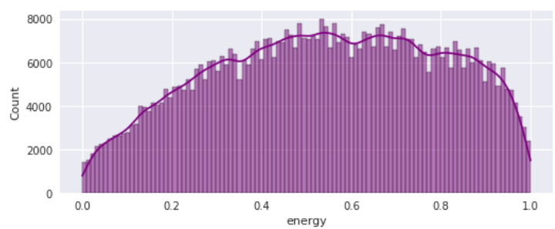
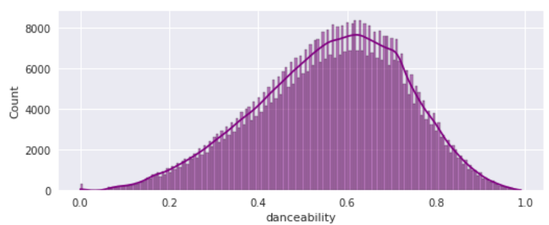
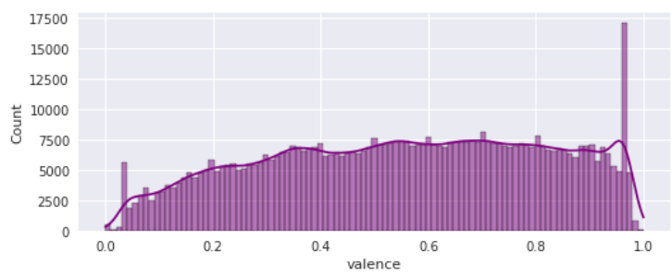
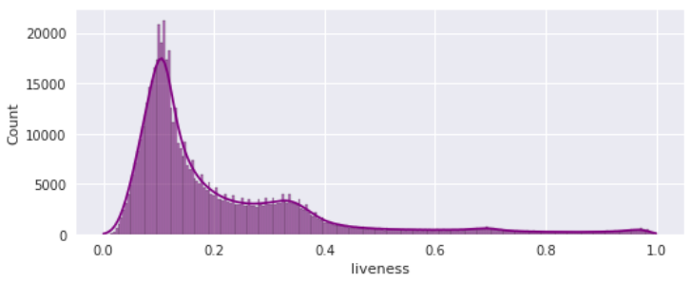
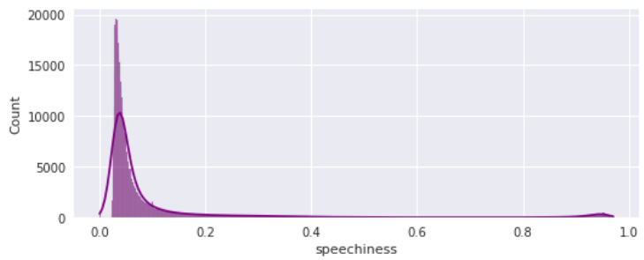
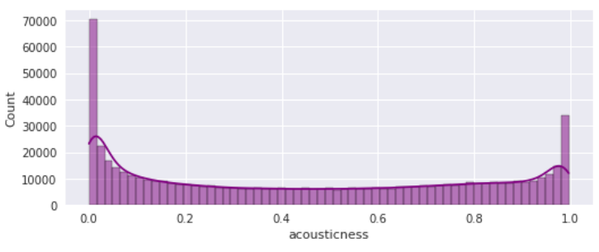
Data Exploration & Research
id
name
popularity
duration_ms
explicit
artists
id_artists
release_date
danceability
energy
key
loudness
mode
speechiness
acousticness
instrumentalness
liveness
valence
tempo
time_signature

Slide 6
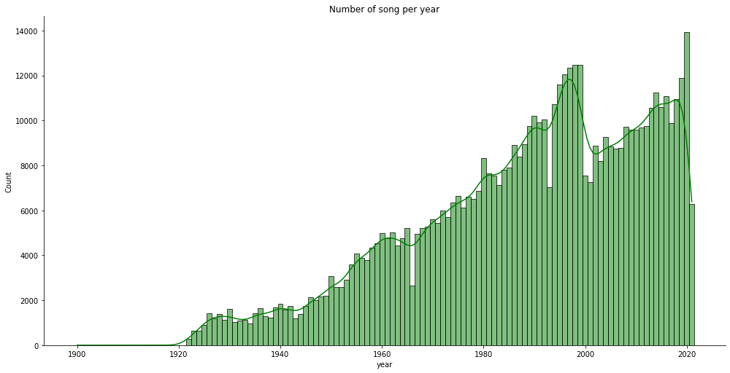
Data Exploration & Research
What is the overall trend and impact of notable events on the music industry?

Slide 7
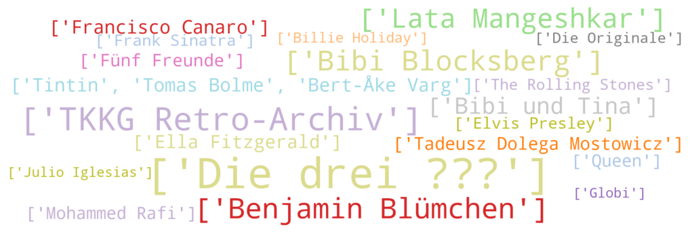
Data Exploration & Research
Who are the most popular artists?

Slide 8
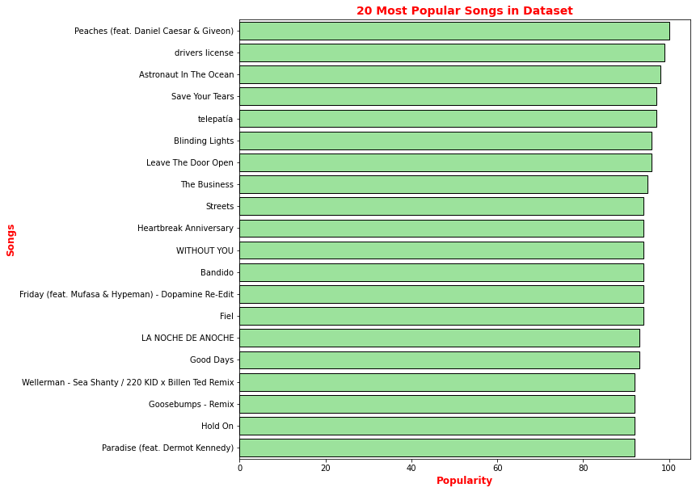
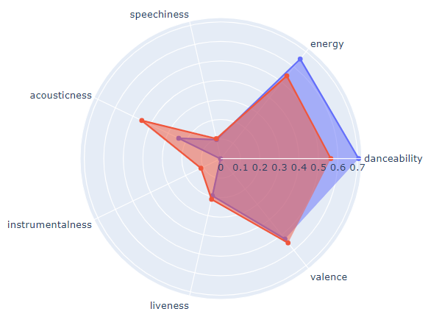


Data Exploration & Research
Guess the most popular songs?

Slide 9
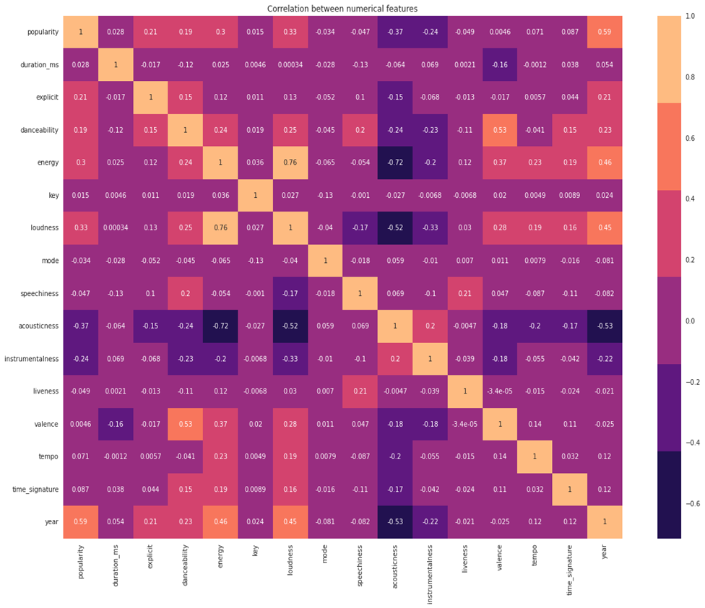
Methodology Tools and Technology
Feature Selection
Resampling
Building Pipeline

Slide 10
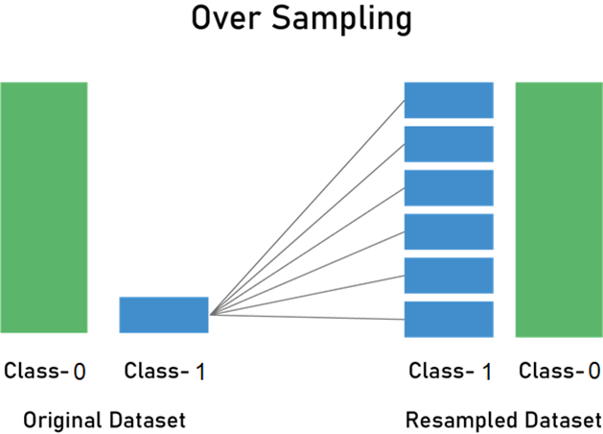
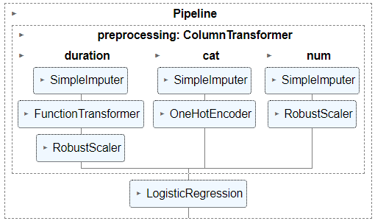
Methodology Tools and Technology
Resampling
Building Pipeline

Slide 11
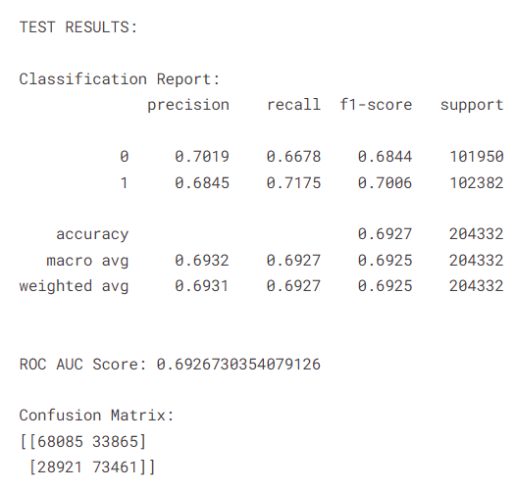
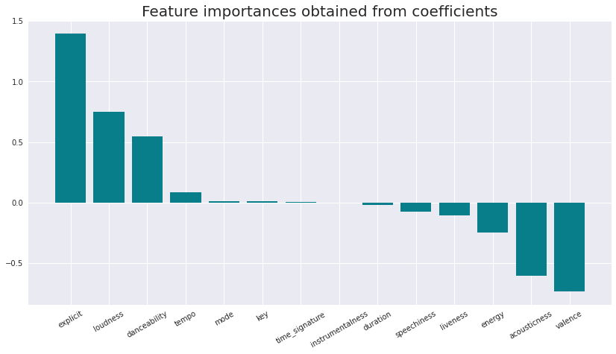
Model Building
Logistic Regression: simple classification algorithm
C=100, penalty = 'l2', solver = 'lbfgs'

Slide 12
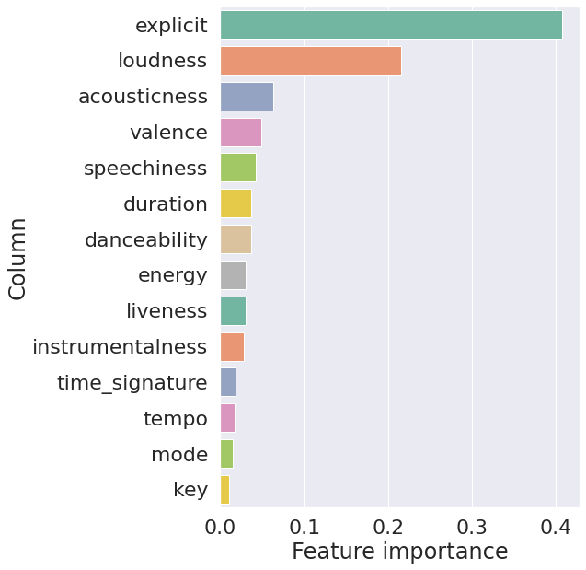
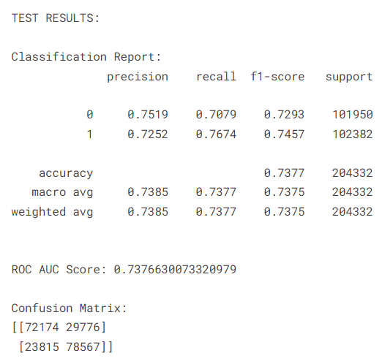
Model Building
XGBoost: gradient boosting
n_estimators = 100, gamma = 0.5, max_depth = 6, learning_rate = 0.1

Slide 13
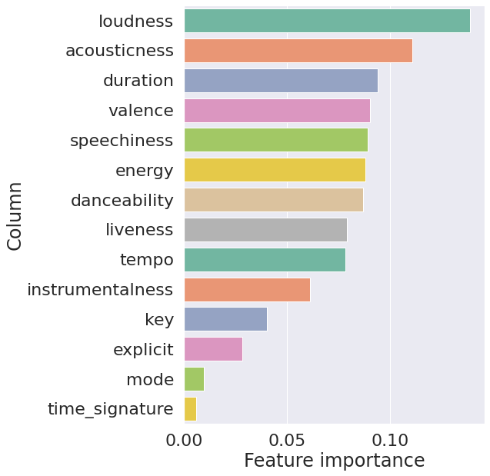
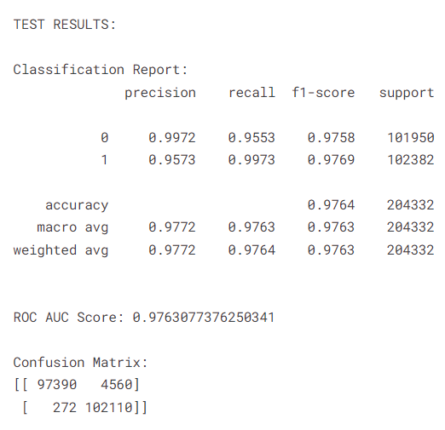
Model Building
Random Forest: ensemble learning
n_estimators = 300, max_features = 'sqrt', max_depth = 50, bootstrap = True

Slide 14
Conclusion
Model Name | Accuracy | Accuracy (Hyperpara-Tuning)
Logistic Regression | 69.27% | 69.26%
XGBoost | 73.77% | 72.41%
Random Forest | 97.64% | 96.37%
Accuracy for the models was calculated between the y_test and y_predict
We can be 97% sure about our songs’ popularity by using the Random Forest classification model.
Pipelines are very useful to automatically transform the features of data.
Loudness, energy, valence, acousticness, and explicit have the greatest influence on popularity.
Recommendation:
In future we will utilize spotify APIs to fetch more data and more features like genre (rock, pop, jazz, rap), region (nation) to perform our analysis.
We would also like to use Artificial Neural Network, SVM and K-Nearest Neighbor to perform our analysis.

Slide 15
References
Education, I. C. (2020, December 8). What is Random Forest? What Is Random Forest? | IBM. Retrieved October 25, 2022, from https://www.ibm.com/cloud/learn/random-forest
Spotify &mdash; About Spotify. (2022, October 25). Spotify. Retrieved October 25, 2022, from https://newsroom.spotify.com/company-info/
Peixeiro, M. (2020, May 19). The Complete Guide to Resampling Methods and Regularization in Python | by Marco Peixeiro | Towards Data Science. Medium. Retrieved October 25, 2022, from https://towardsdatascience.com/the-complete-guide-to-resampling-methods-and-regularization-in-python-5037f4f8ae23
Harode, R. (2020, April 23). XGBoost: A Deep Dive into Boosting | by Rohan Harode | SFU Professional Computer Science | Medium. Medium. Retrieved October 25, 2022, from https://medium.com/sfu-cspmp/xgboost-a-deep-dive-into-boosting-f06c9c41349
Spotify Datasets. (n.d.). Spotify Datasets | Kaggle. Retrieved October 25, 2022, from https://www.kaggle.com/datasets/lehaknarnauli/spotify-datasets

Slide 16
Thank you & Questions?

