Slide 1
request_device www

Slide 2
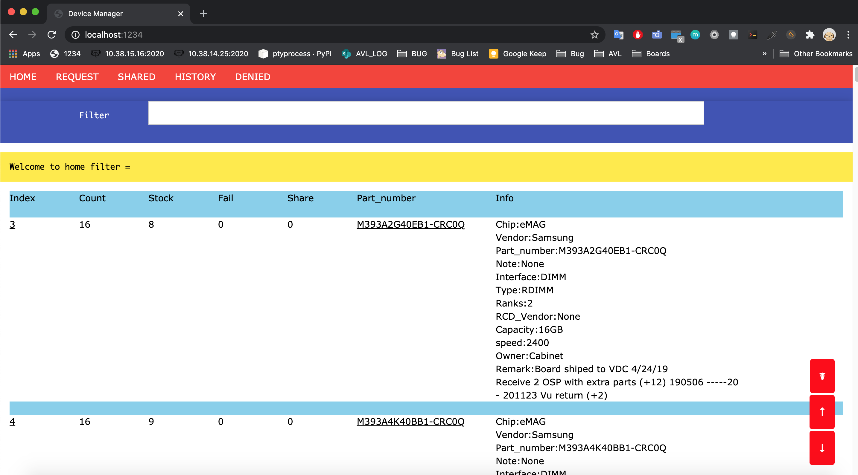
1 . Home page

Slide 3
1 . Home page
@User request device /home --> Search --> /share --> /request_submit --> /submit_info →email
@Admin approved device /home --> /page_request --> /page_request_submmit -->approved
→email/backup database --> Update device count → Move in Shared
page
@User return device /home --> /page_shared --> page_shared_submit -->page_shared_return
→email/backup database → Adjust device count → Show in history page
@history /home --> /page_history --> List device retured
@Admin denied device /home --> /page_denied -->/page_denied_submit→email

Slide 4
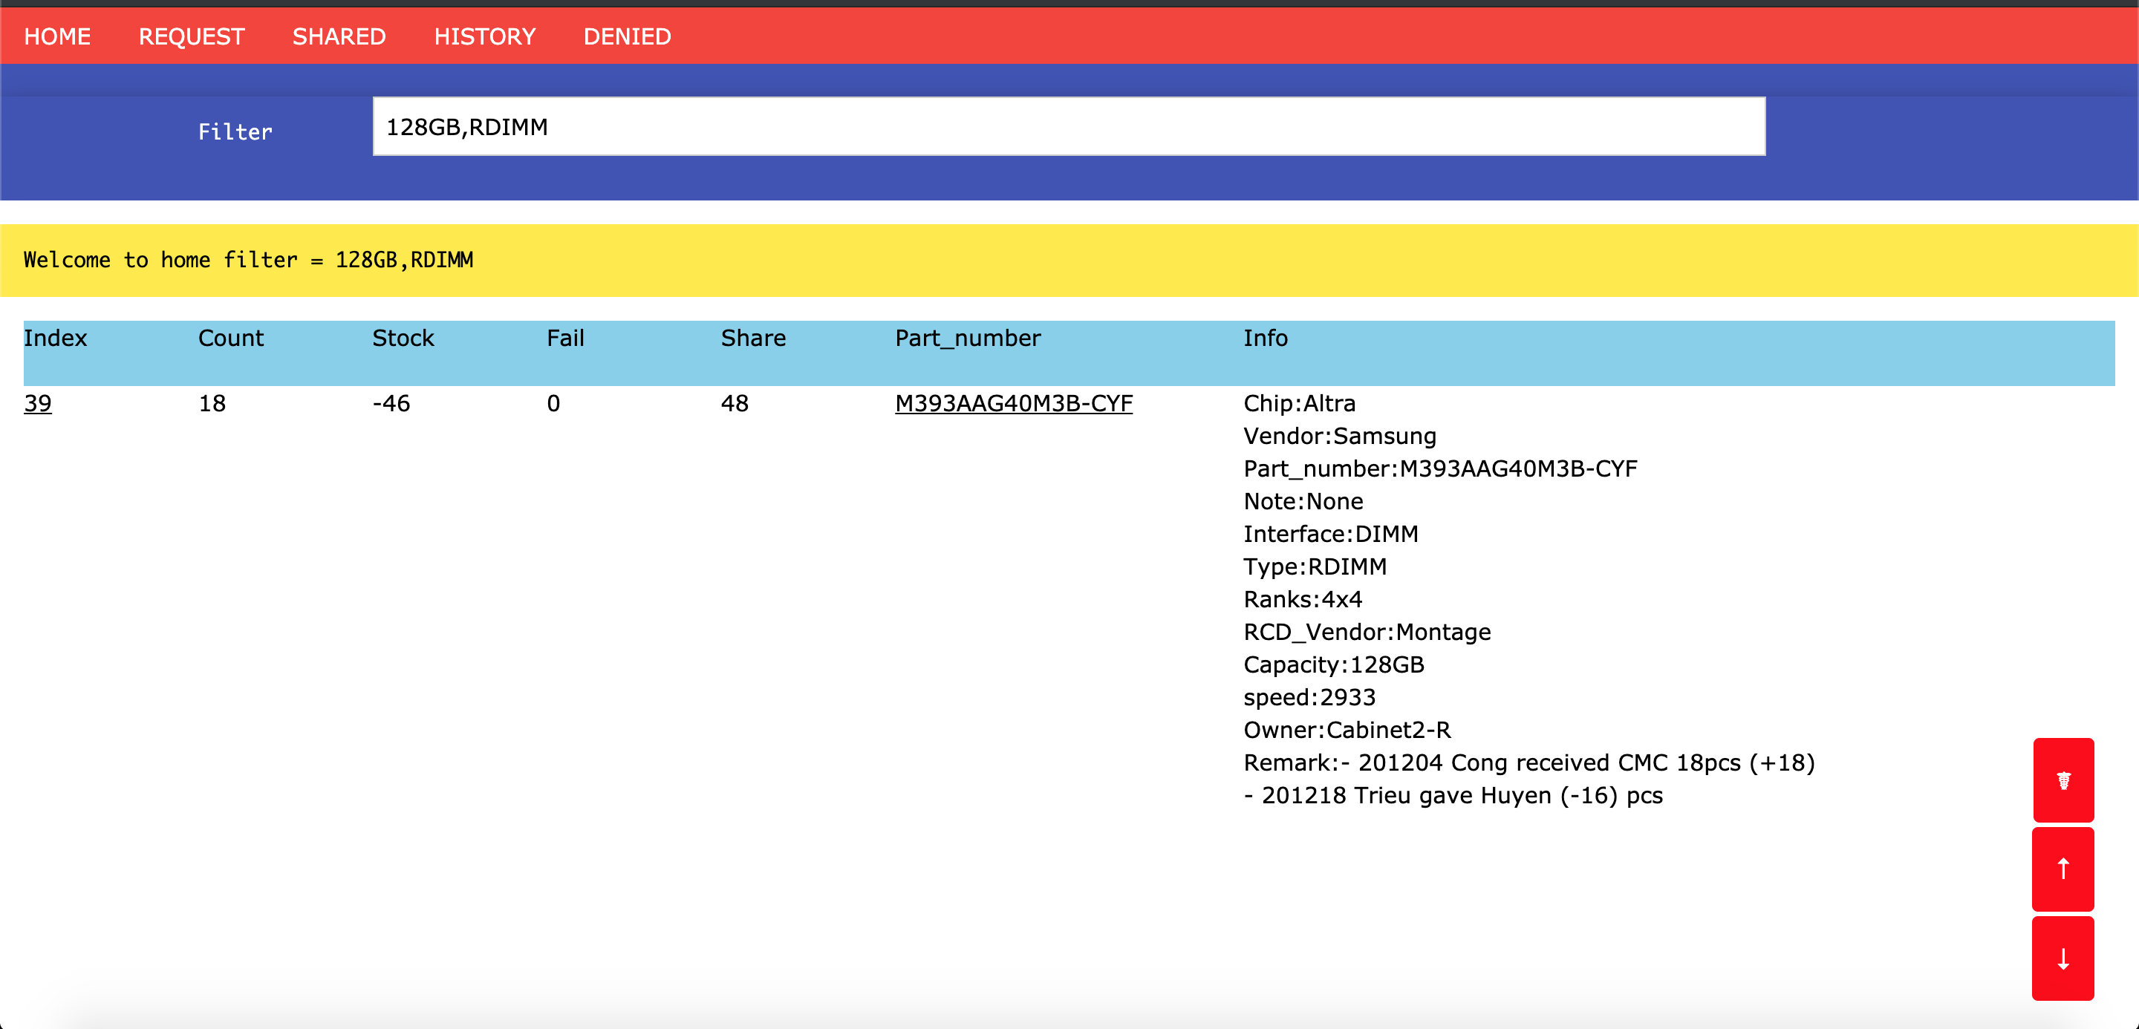
1 . Search device

Slide 5
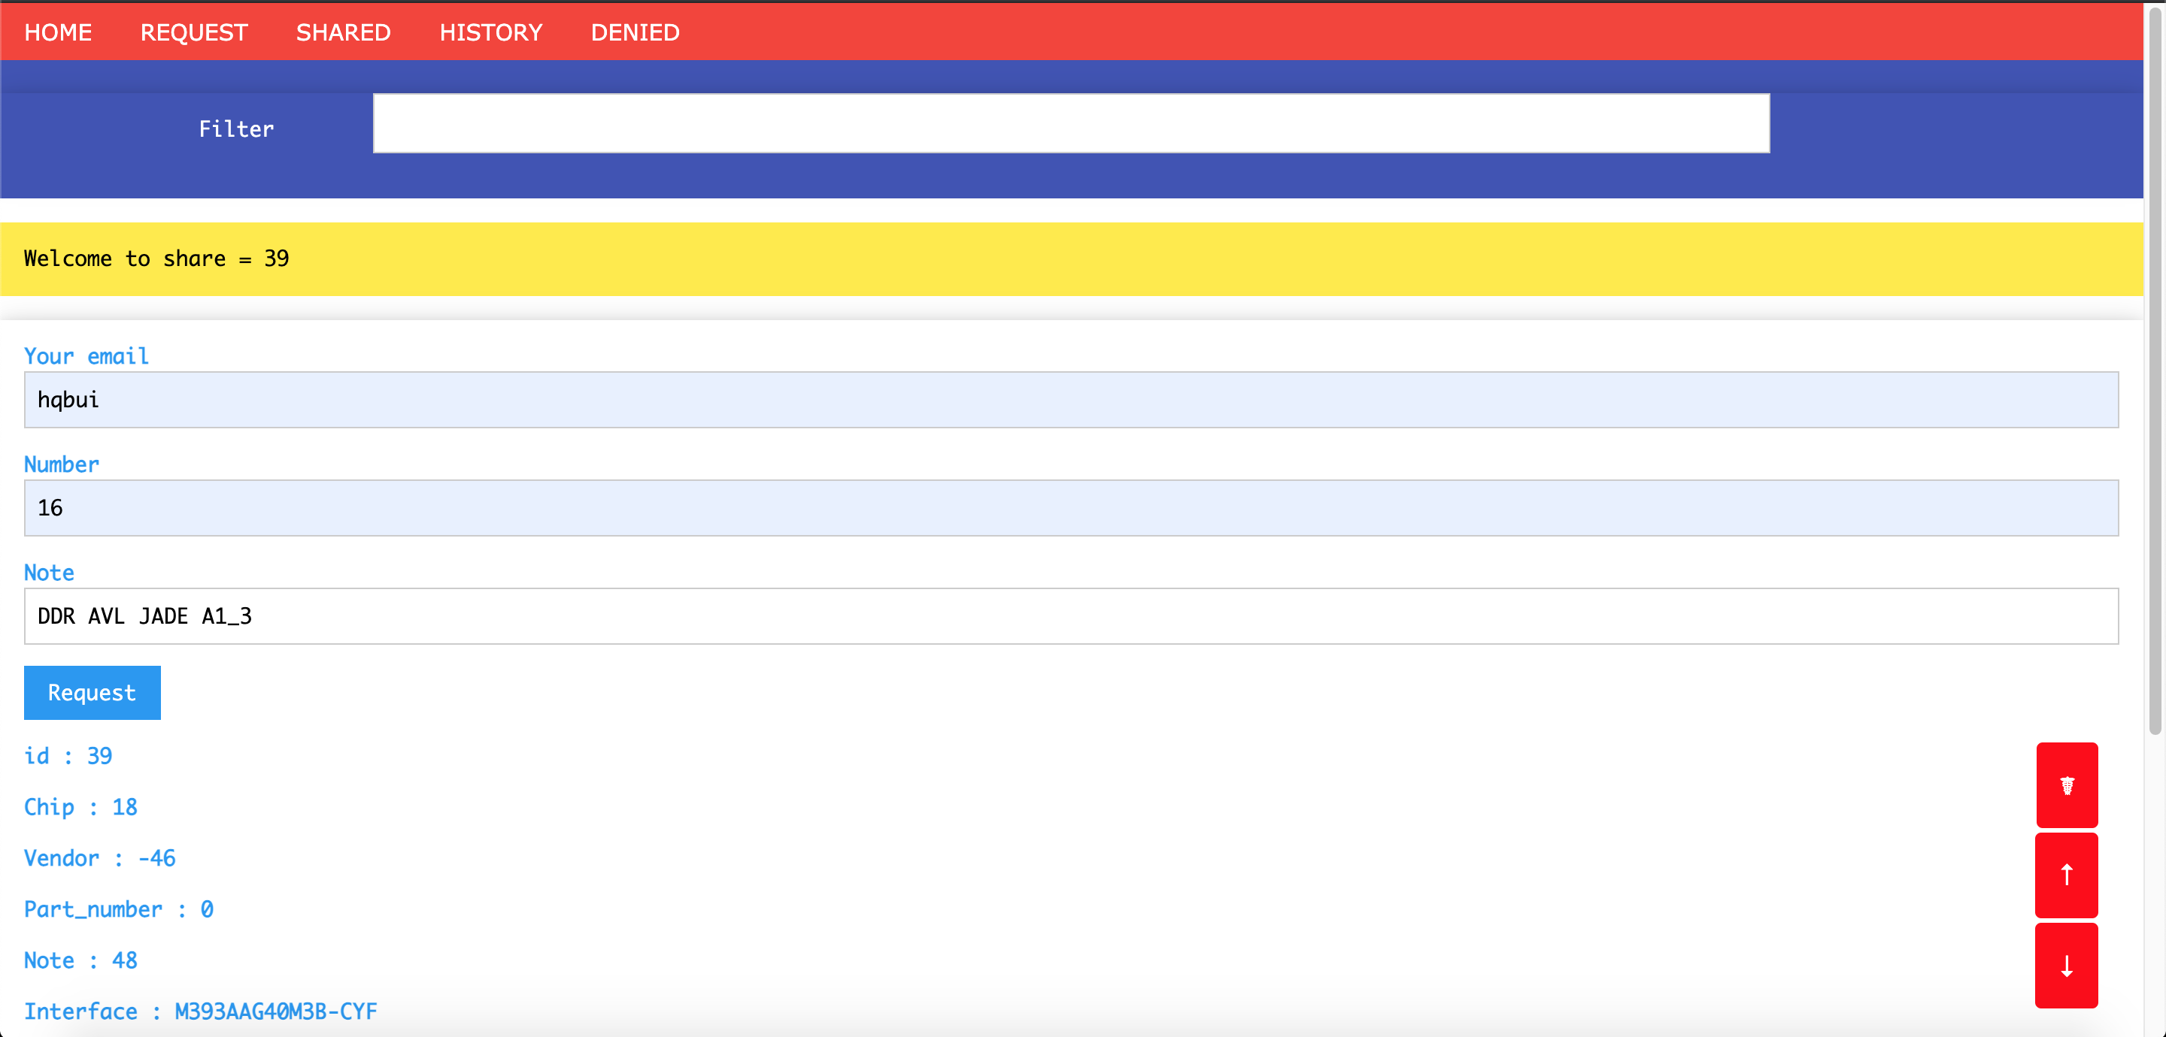
1 . User request device

Slide 6
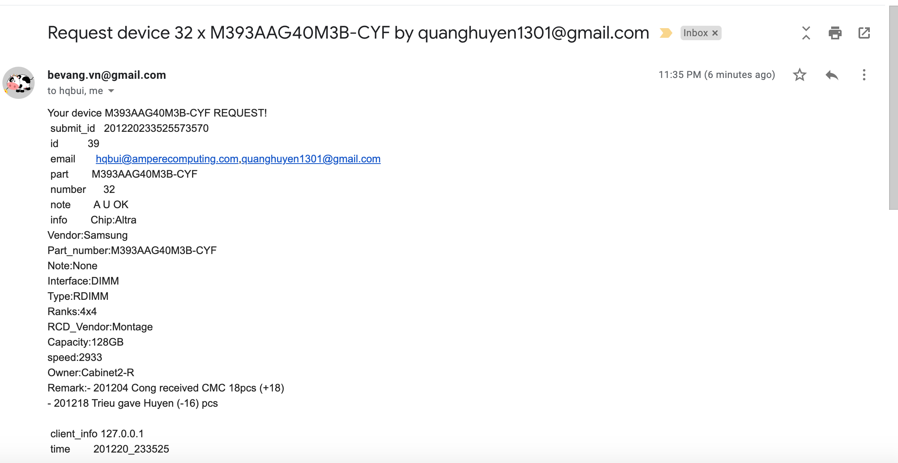
1 . Email request to user/admin

Slide 7
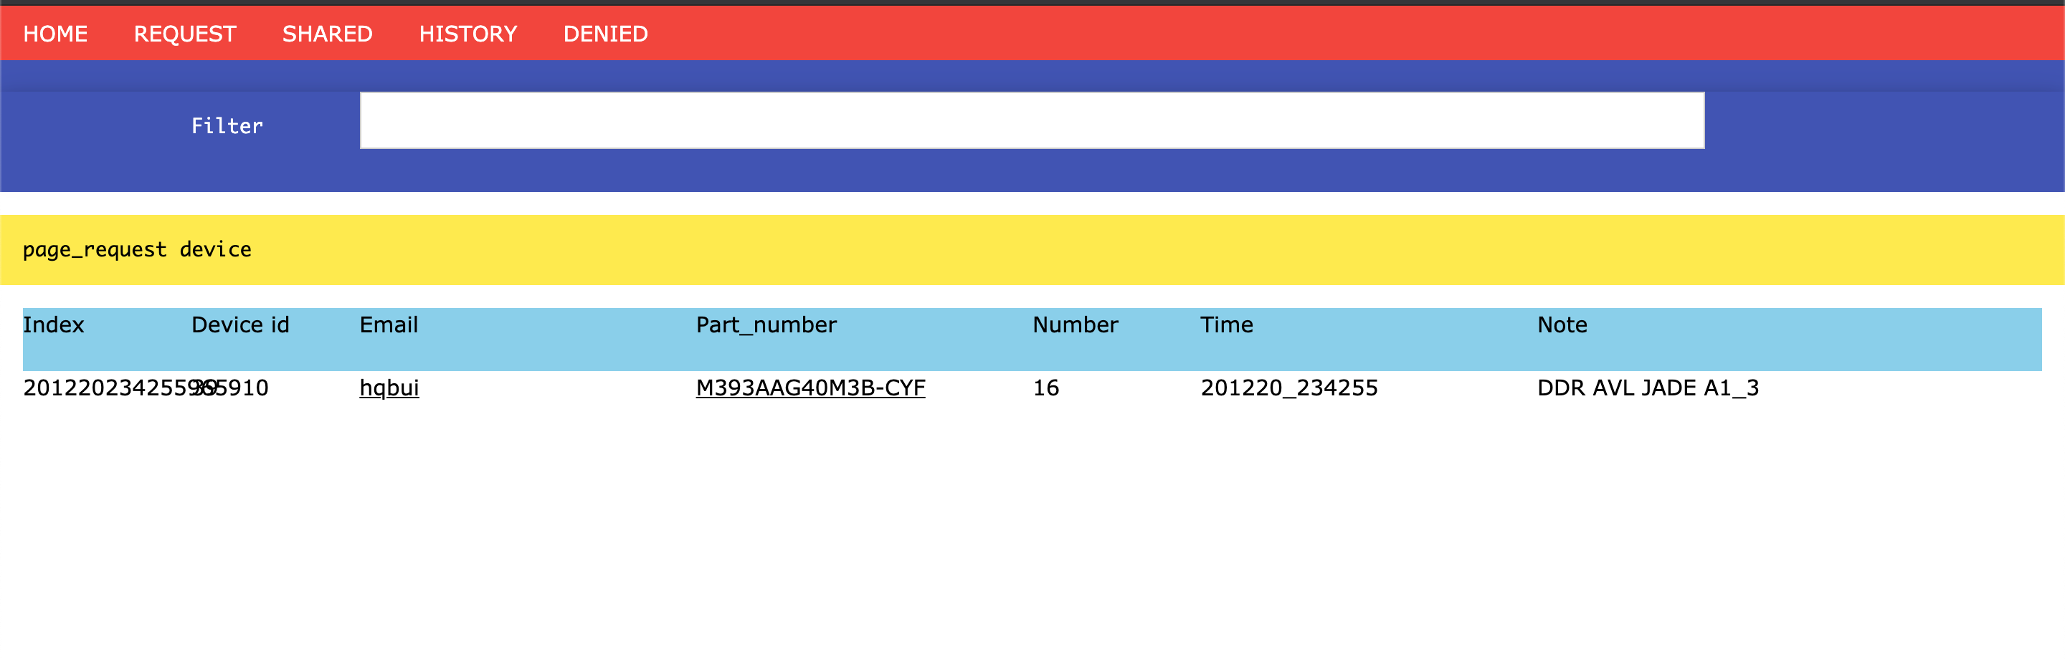
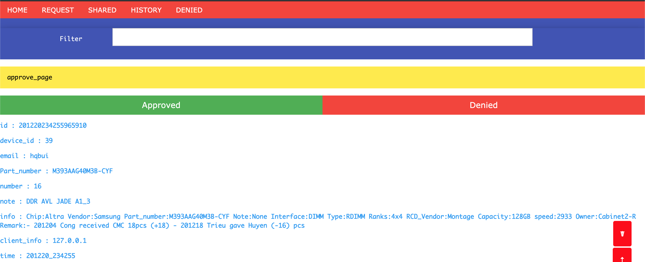
1 . Admin approved |denied

Slide 8
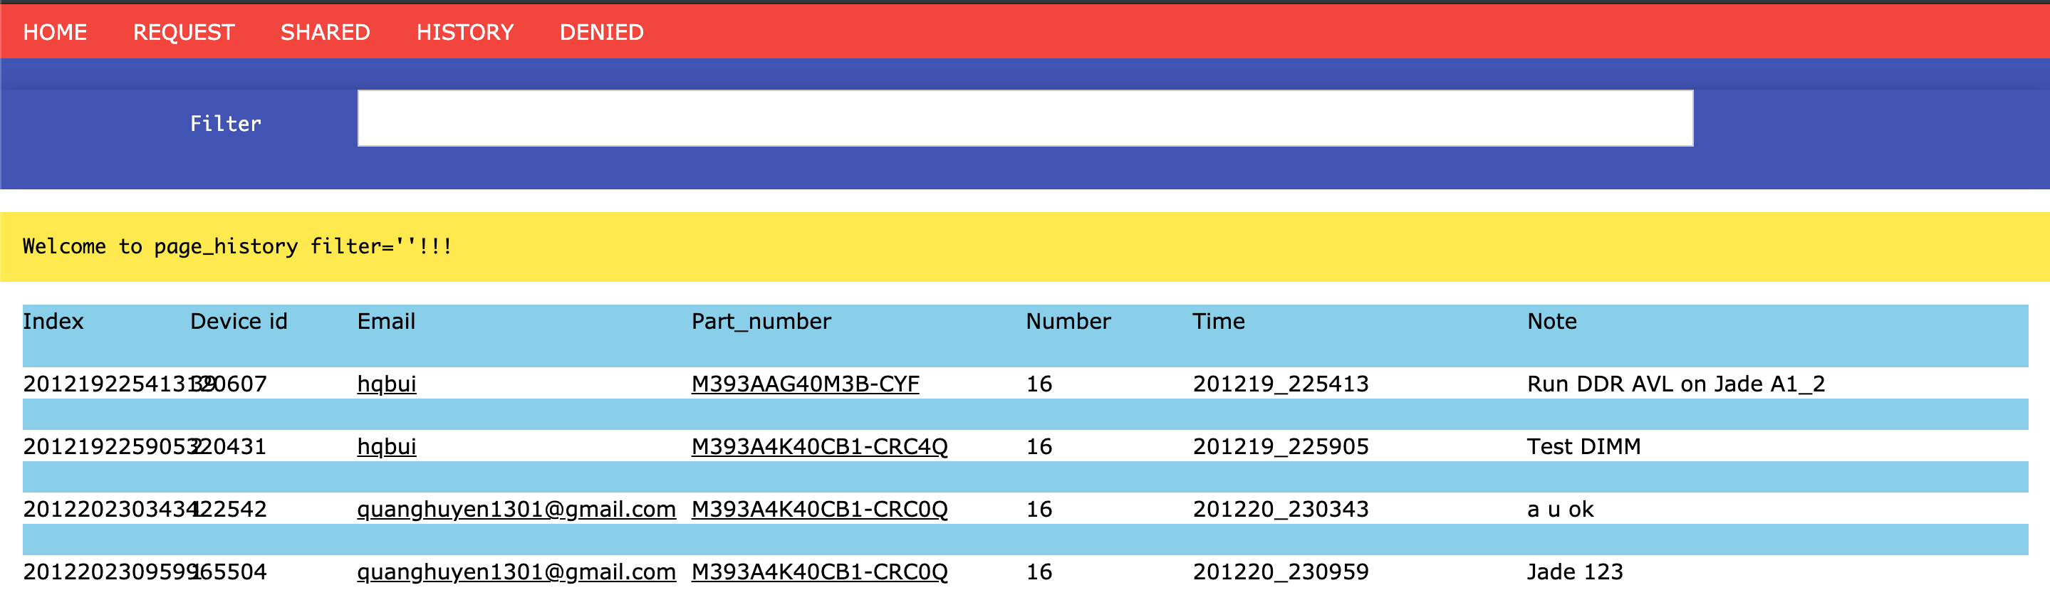
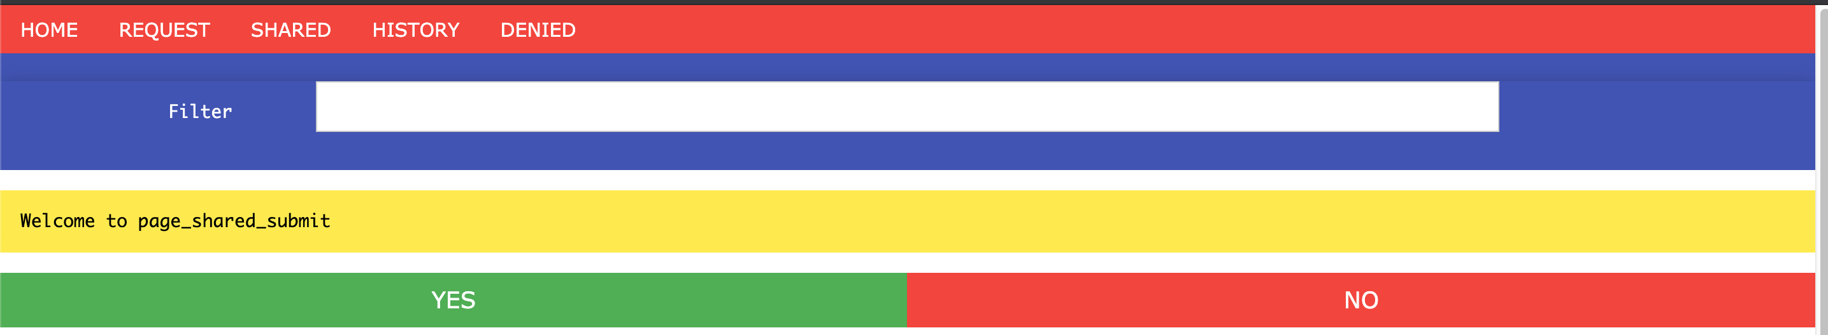
1.Shared list and return DIMM

Slide 9
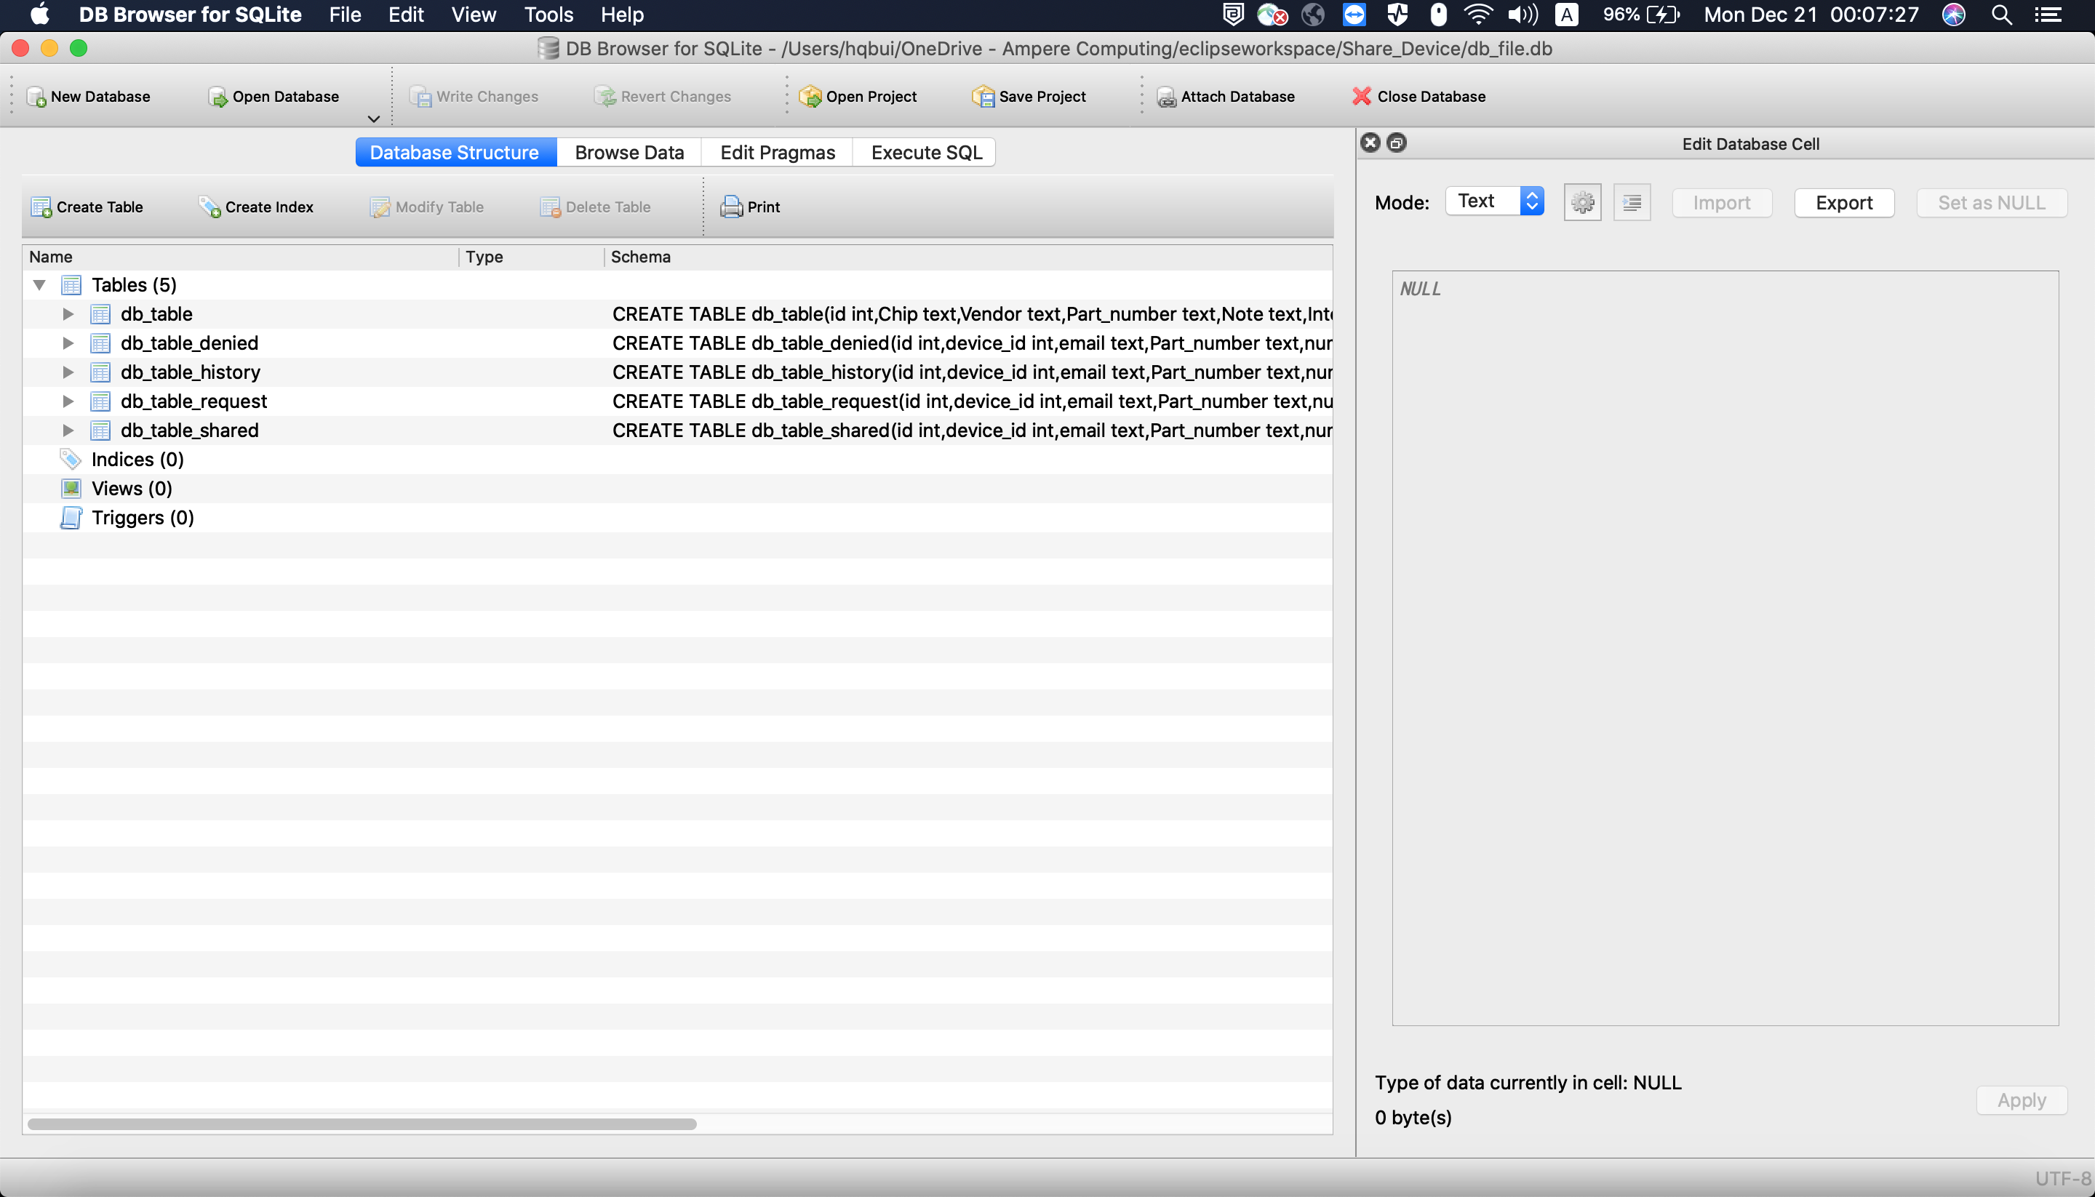
1.Database https://sqlitebrowser.org/

Slide 10
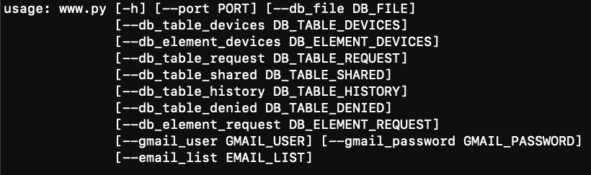
1.How to start
sudo apt install python sudo apt install python-pip
sudo pip install flask
#admin configure
echo {{Your_IP}} > admin.cfg #Start web python ./www.py #args

Slide 11
Thank You!

