Slide 1
Project Architecture - Gophur
Amruth, Jack, Zane, Josh, Trieu, Hilario

Slide 2
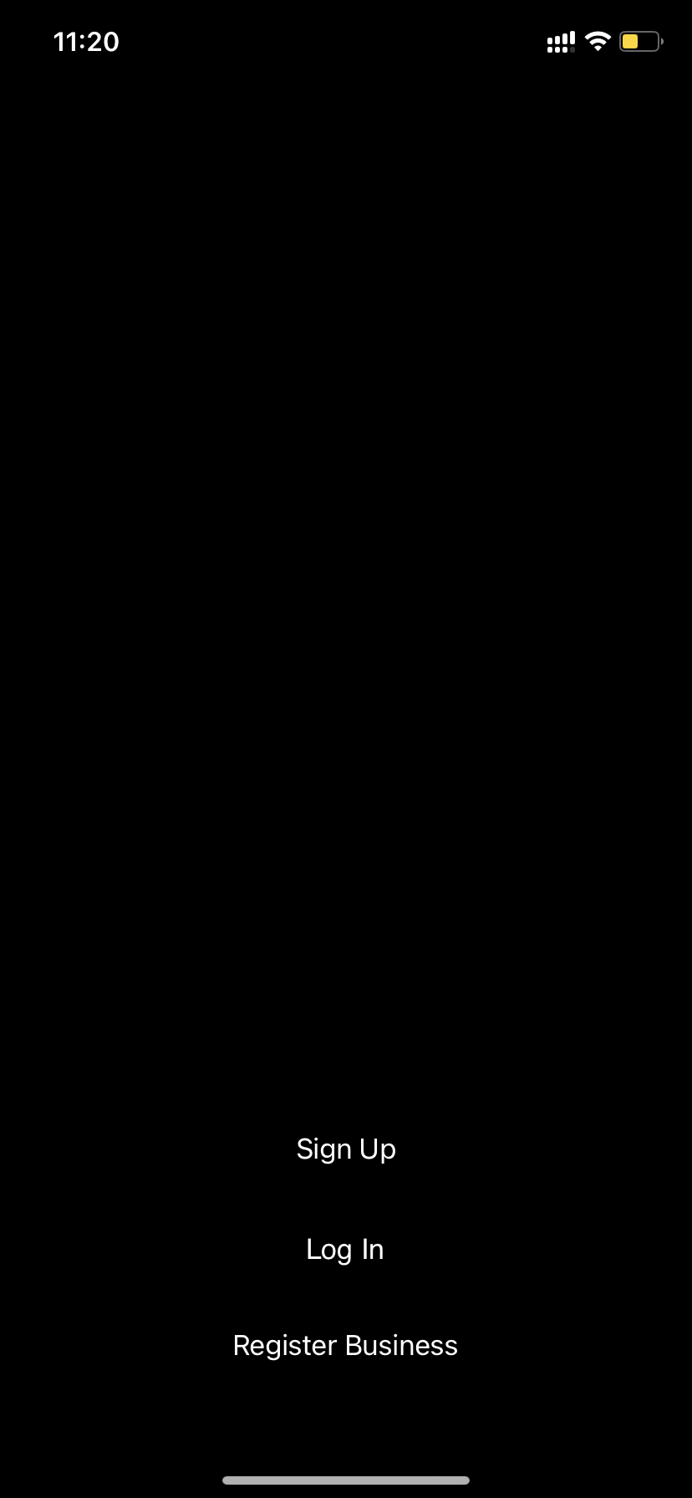
Prototype for the signup/login screen that appears when the app is first launched

Slide 3
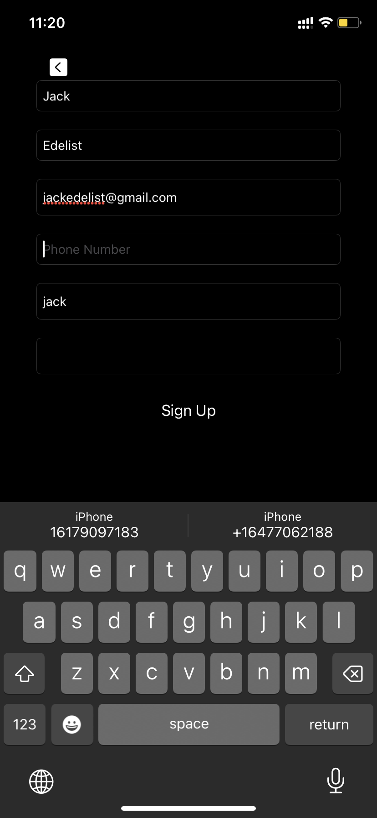
Sign up screen that shows up when users create new accounts

Slide 4
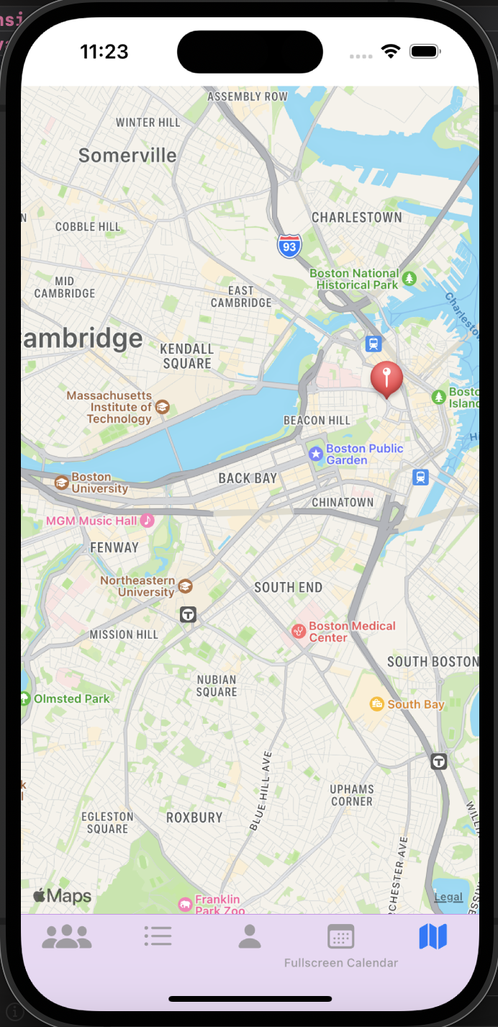
Map screen that displays user’s current location. Can be found on the bottom right hand corner of the screen

Slide 5
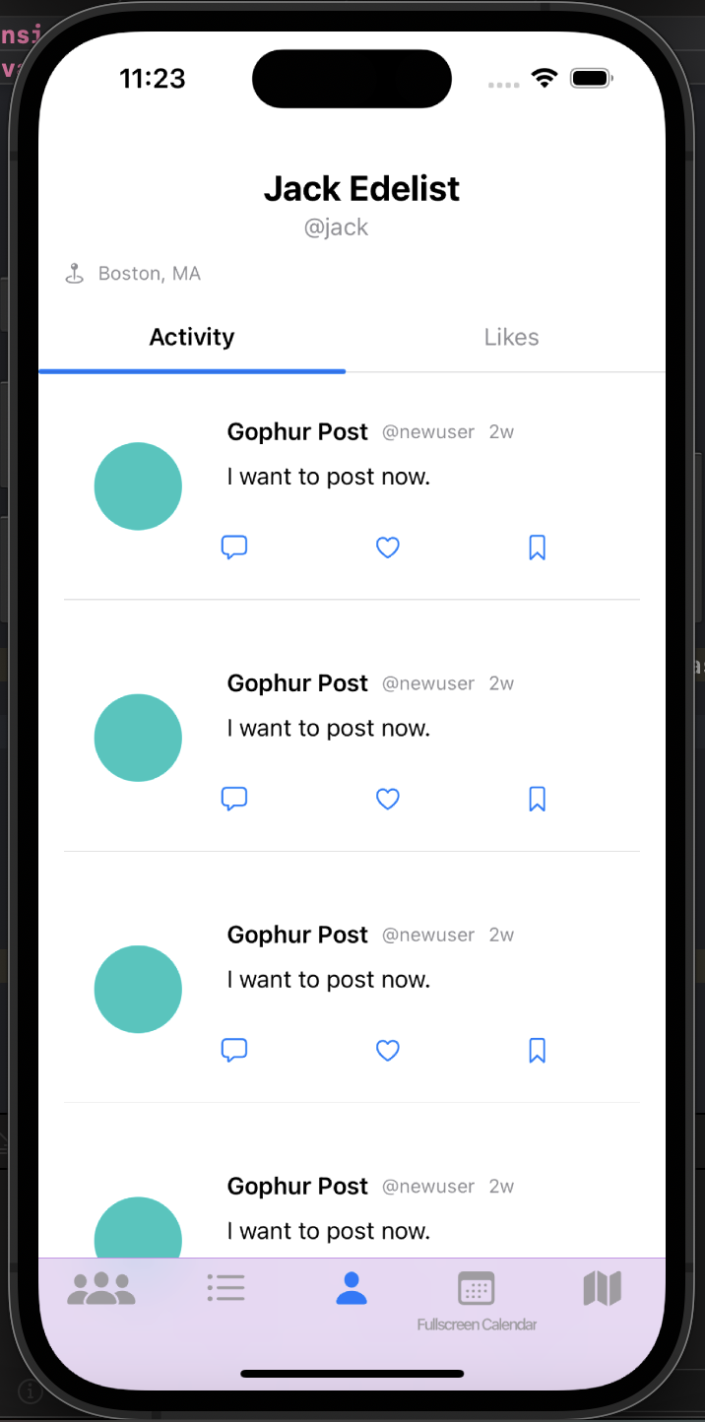
Feed view. Located on the bottom of the screen

Slide 6
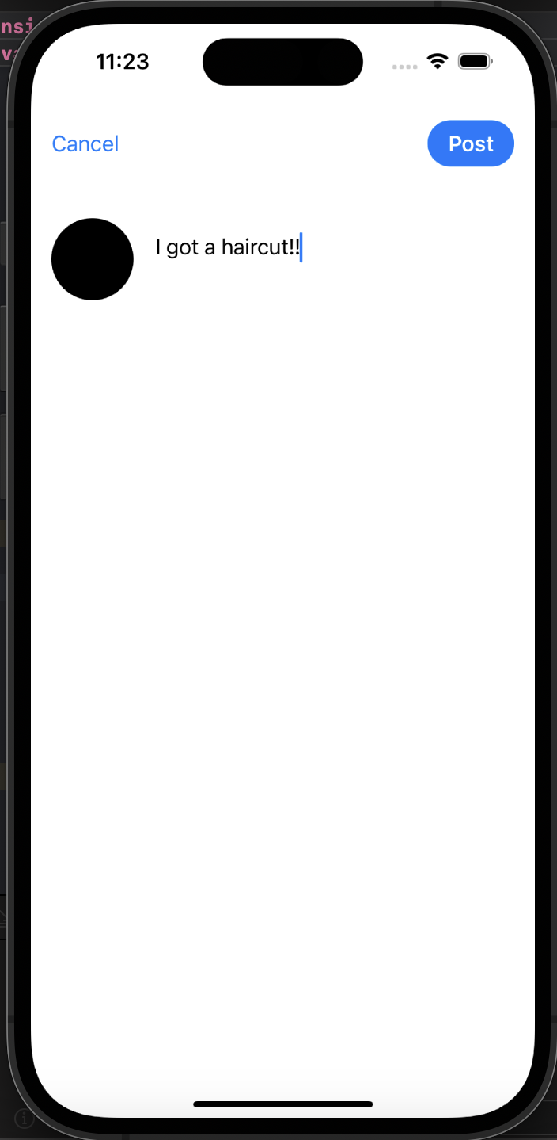
Post view when users create posts

Slide 7
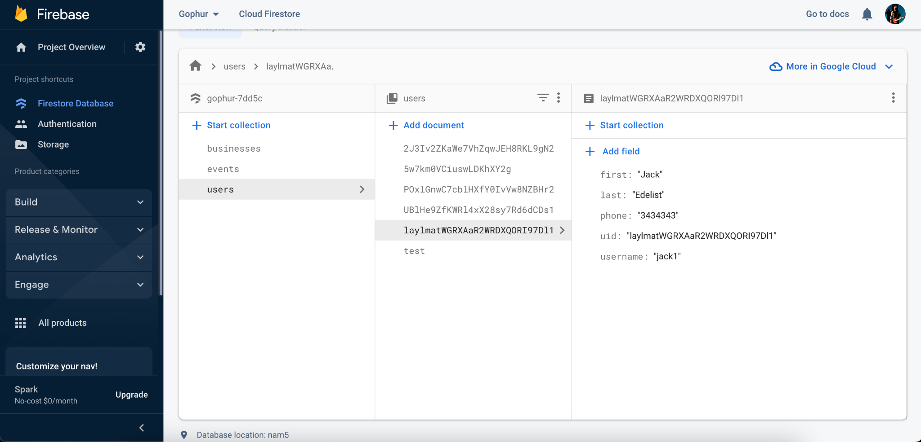
A sample screenshot of the Firebase database with a sample user’s full name, phone, id, and username

