Slide 1


Battery management system for small electric vehicle
University "Politehnica" of Timișoara
Computer Science Faculty
Bachelor program: Computers and Information Technology
BACHELOR THESIS
Coordinator:
Ș.l. Dr. Ing. Răzvan Bogdan
Candidate:
Robert-Nicolas TRIF
Timișoara,June 2024

Slide 2
The thesis aims to develop an efficient and safe charging system for electric vehicle battery packs. The system focuses on balanced charging to prevent overheating and overcharging which can shorten battery lifespan and affect vehicle performance.
Thesis purpose
Monitor battery parameters using a mobile application
Dynamically charge the batteries using a step-down converter
Provide overcharging and overheating protection
Ensure precise movement of the electric vehicle using a motor driver and actuators preventing unwanted collisions
Implement a notifications system which alerts user about batteries status
1/11

Slide 3
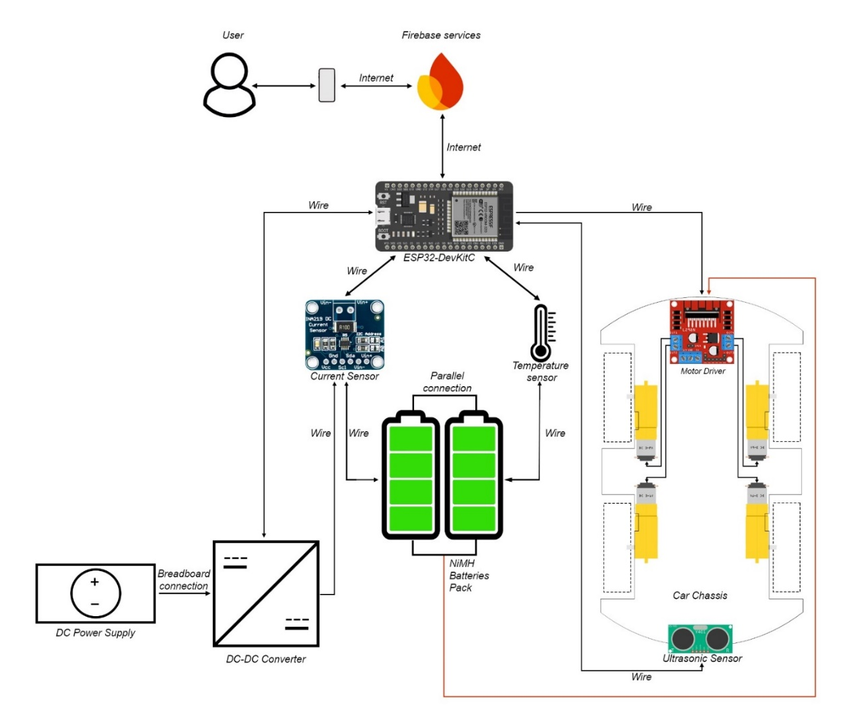
The project can be divided in 3 essential parts:
Proposed solution
ESP32-DevKitC control unit connected to all electrical components
Mobile Application which uses Expo and React Native
Google Cloud Services as Firebase Realtime Database and Firebase Functions
2/11

Slide 4
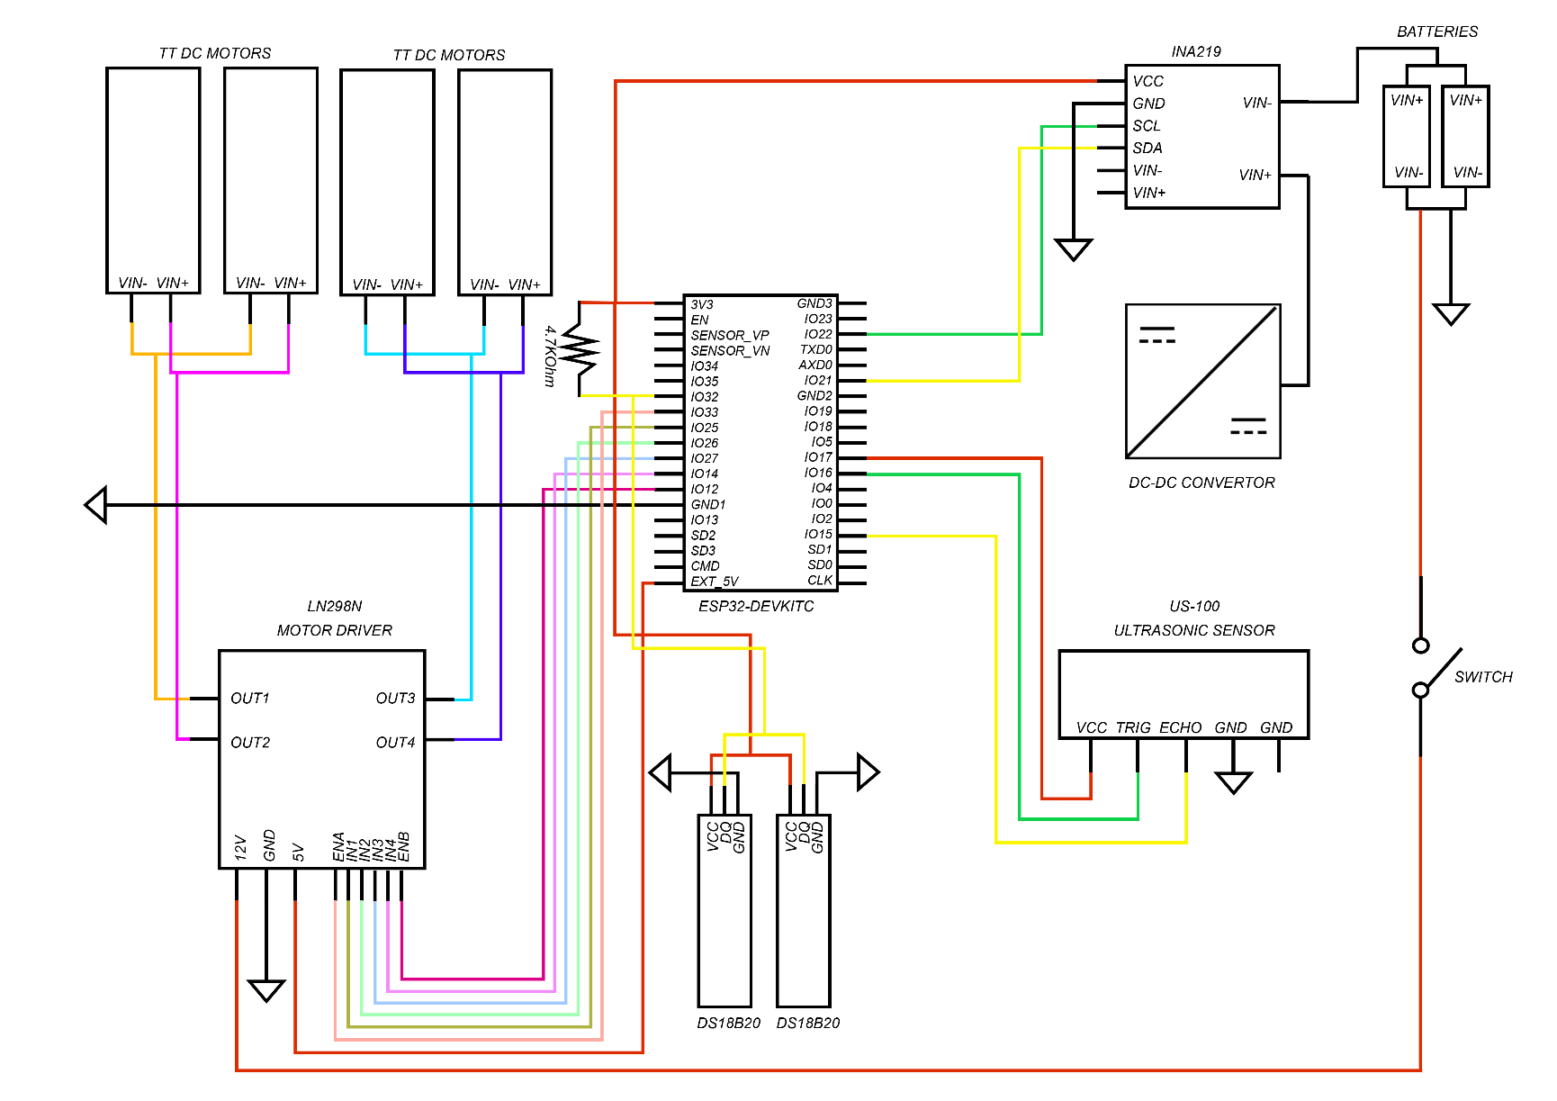
ESP32 Architecture
3/11

Slide 5
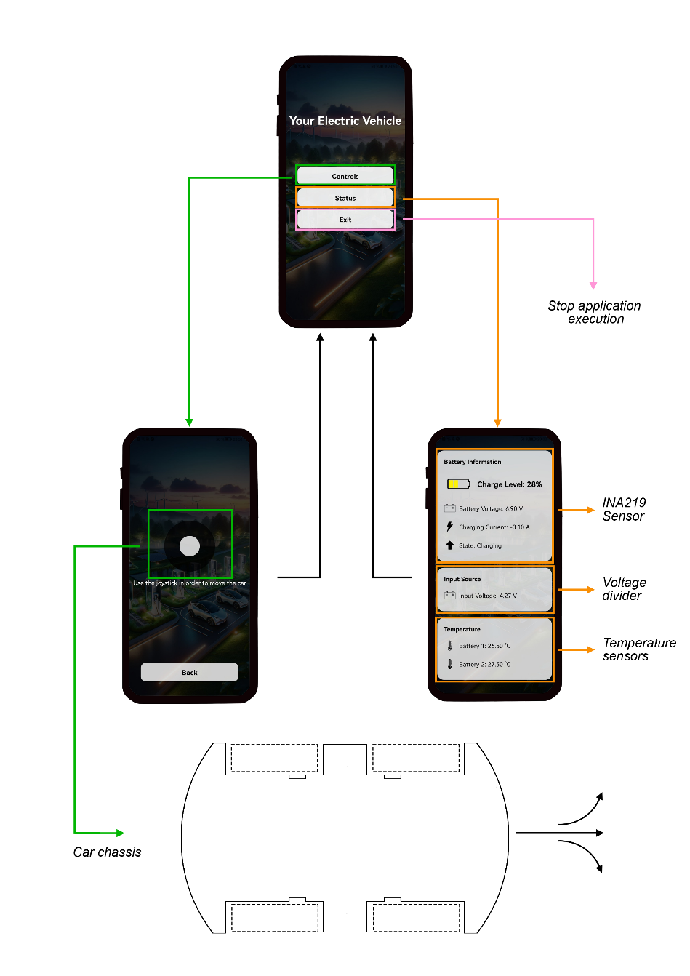
Mobile Application Architecture
4/11

Slide 6
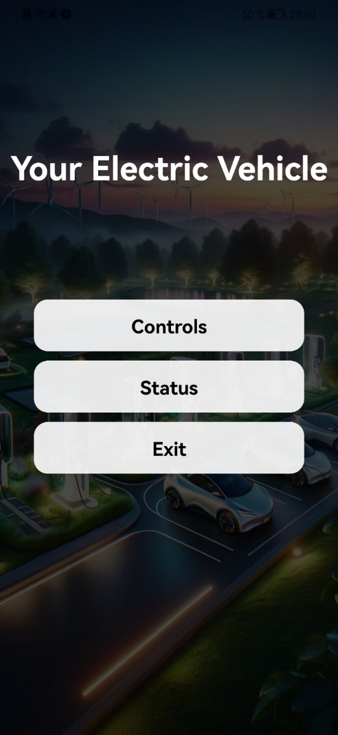
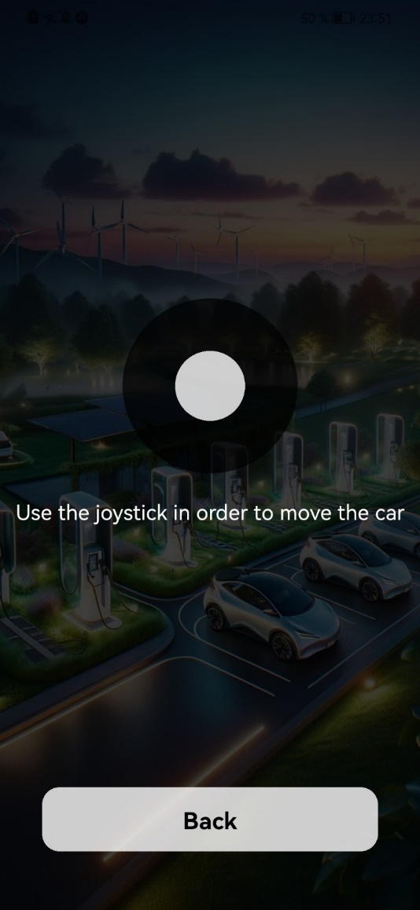
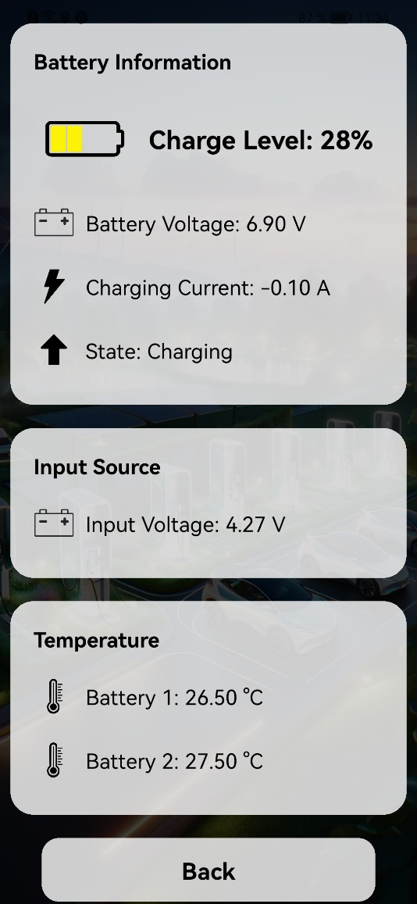
User Interface
5/11

Slide 7


Data management
Multiple nodes in the Realtime Database: sensors, controls, notification and token
Firebase considered a buffer zone as the mobile application and ESP32-DevKitC communicate through it
Automated notification receival via Firebase Functions
6/11

Slide 8
System testing
The system cannot be concluded as functional until the following testing methods are applied:
To ensure the Android application functions without errors or unexpected behaviour, it needs to be thoroughly tested.
Testing the data obtained from measurements made by sensors through the ESP32 code to ensure accuracy and reliability.
To conclude that the vehicle charging operates correctly, the step-down converter must undergo verification testing.
7/11

Slide 9
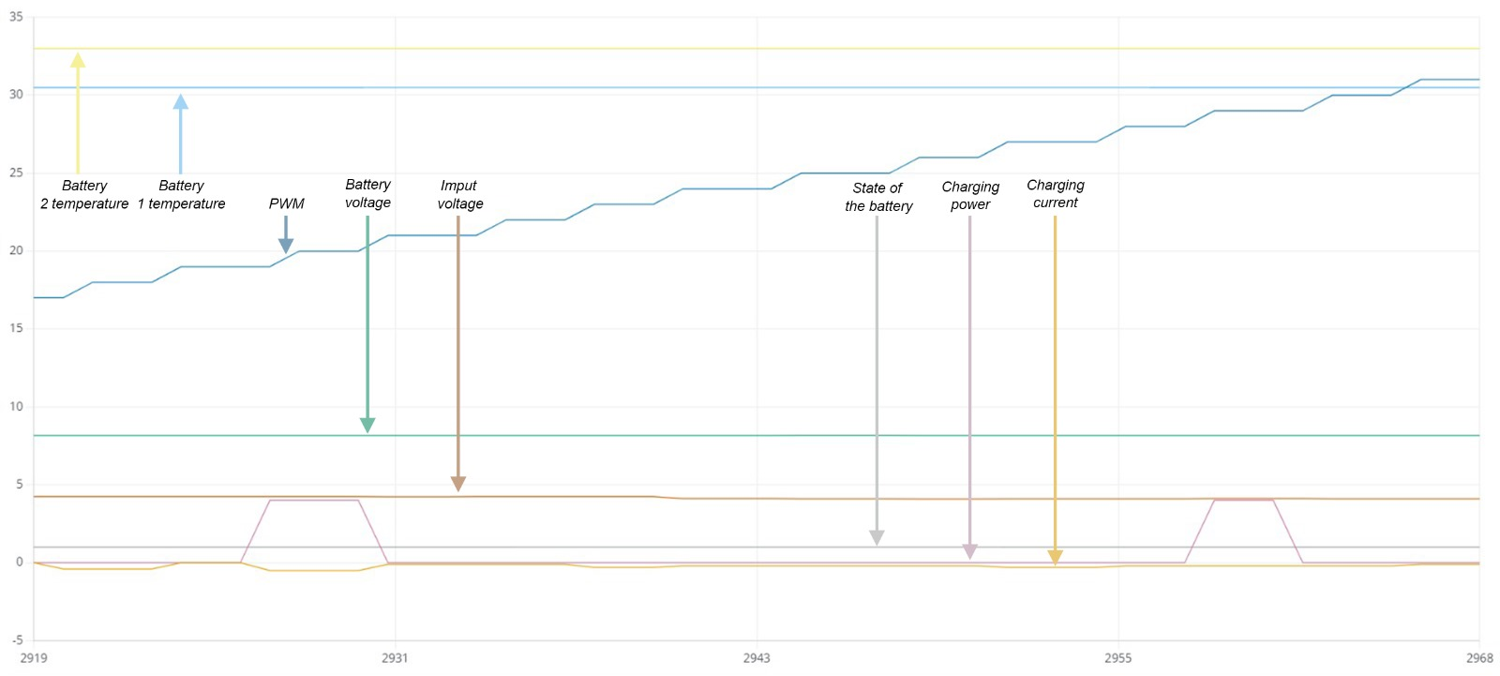
Testing results
8/11

Slide 10
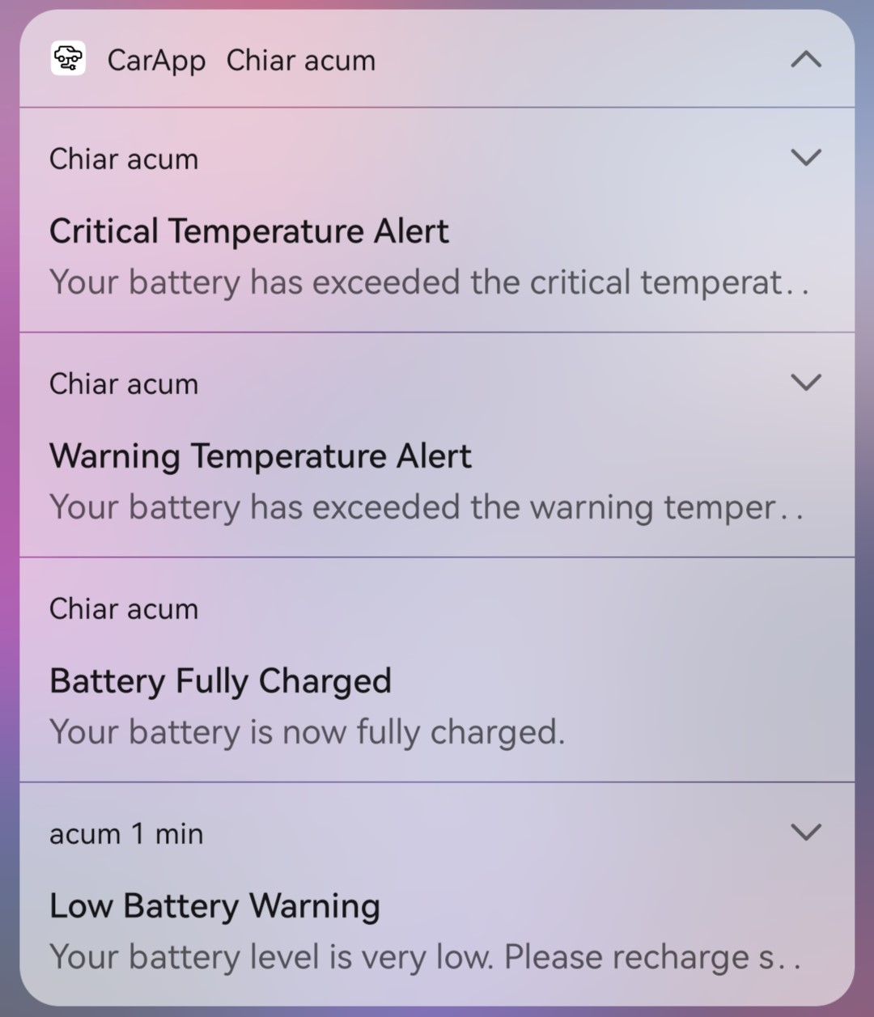
Testing results
8/11

Slide 11
Conclusions
In conclusion, the developed system exemplifies the integration of advanced battery management and control systems within a compact and efficient setup.
The developed system exemplifies the integration of advanced battery management and control systems within a compact and efficient setup. By providing overcharging protection, real-time notifications, and an intuitive control interface, this system sets a new standard for battery-powered device management, ensuring both safety and performance.
9/11

Slide 12
Future improvements
Following the completion of this project and its verifications, there are areas for potential future improvements that can be made:
Bringing the system closer to the standards used in electric vehicle production, including components related with AC elements inside the Battery Management System (BMS).
Implementing a sophisticated algorithm to store and utilize collected data for training and testing a Machine Learning model capable of predicting battery health.
Implementation of an authentication system for the mobile application
Implementation of a battery energy consumption monitoring system
10/11

Slide 13
Final
Thank you for your attention!
11/11

