Slide 1
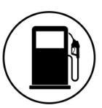
Fuel Finder
Trif Robert-Nicolas, Vasiliu Cristina

Slide 2
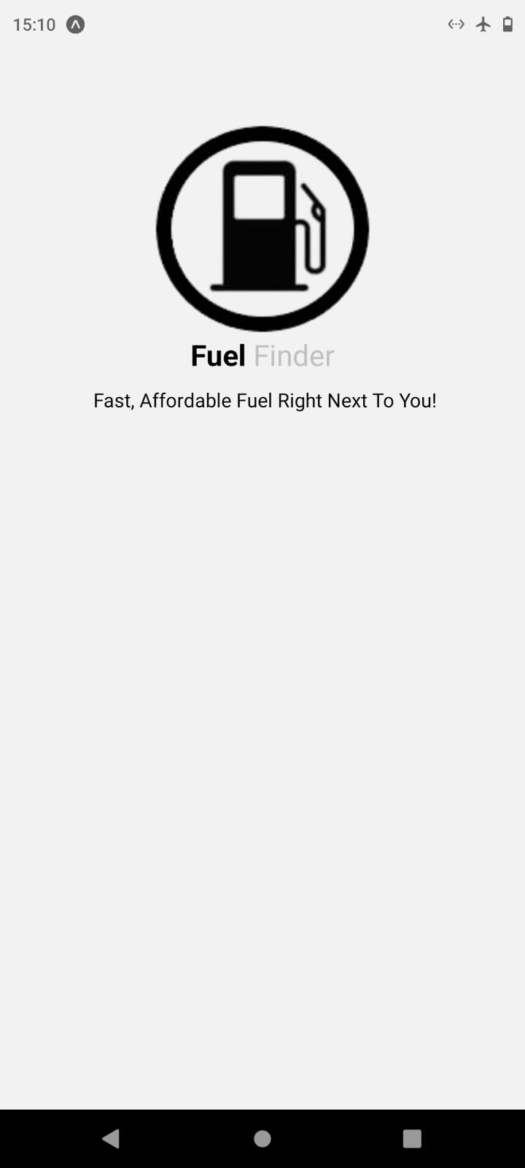
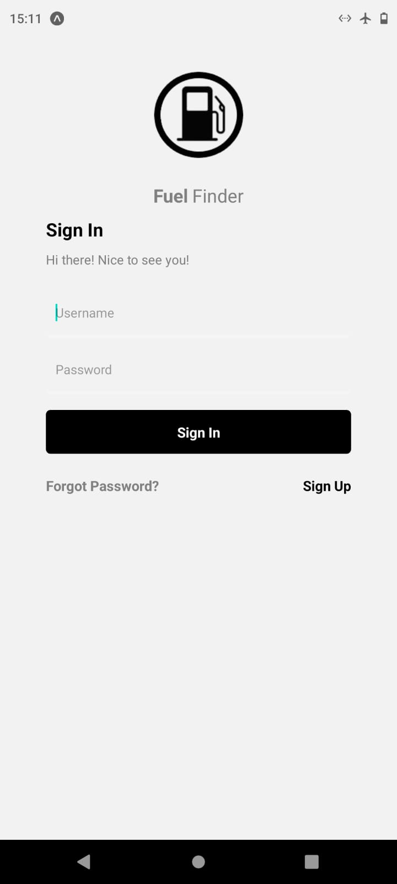
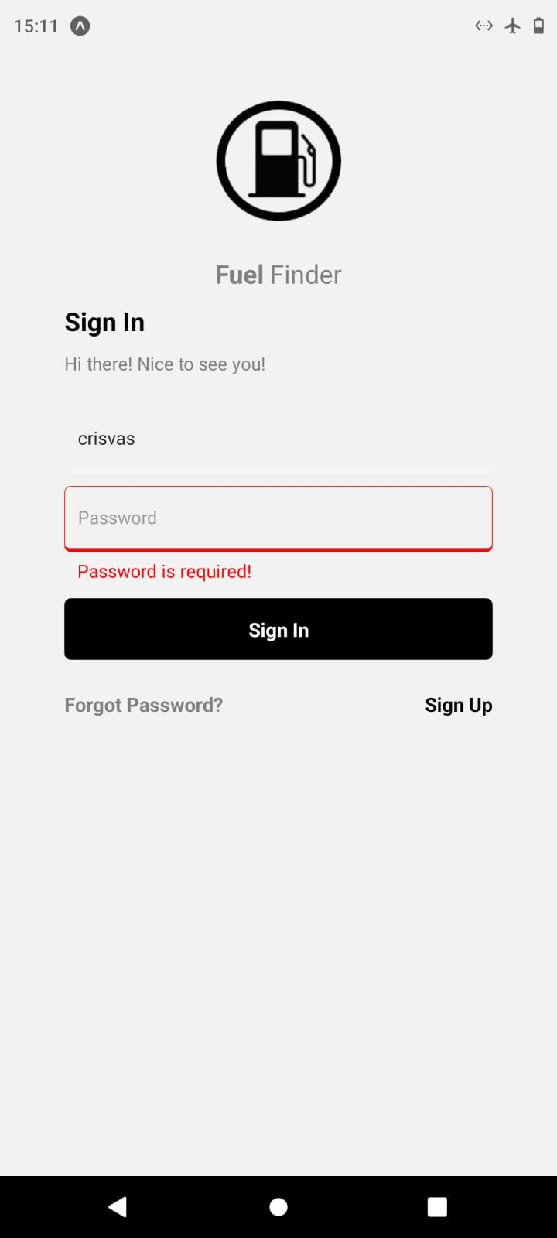
Intro & Sign In
Home page takes you to the ‘Sign In’ page.
Here the user will log in using its username and password. There are two boxes on the bottom ‘forgot password’ and ‘sign up’ (if the user doesn’t already have an account).
After successfully logging in, the user will be taken to the main page.

Slide 3
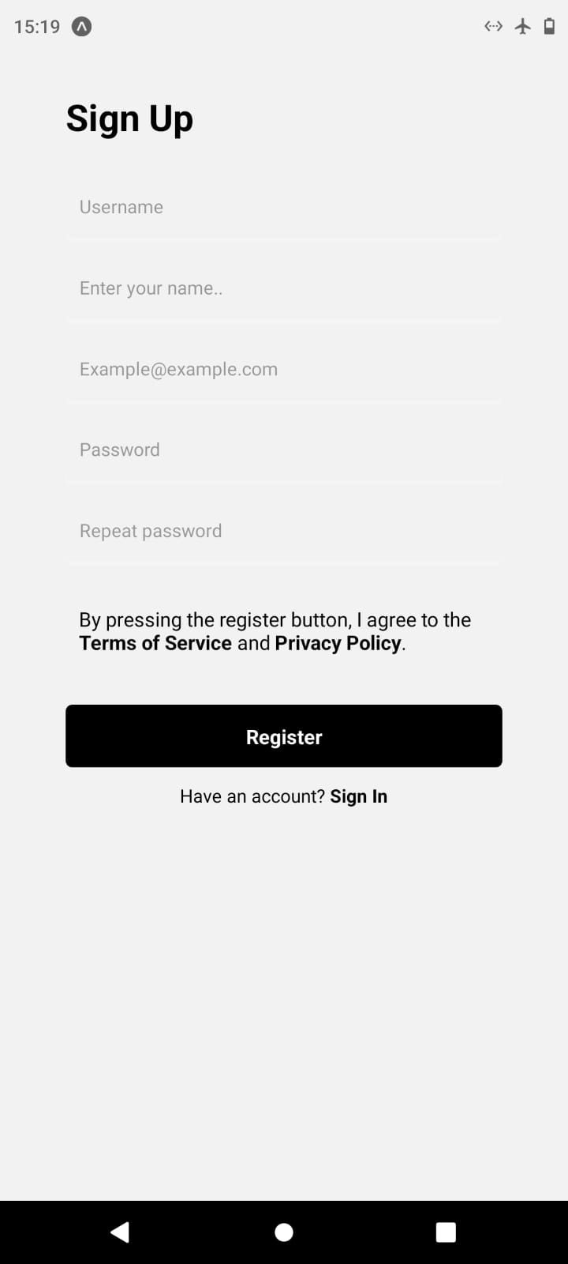
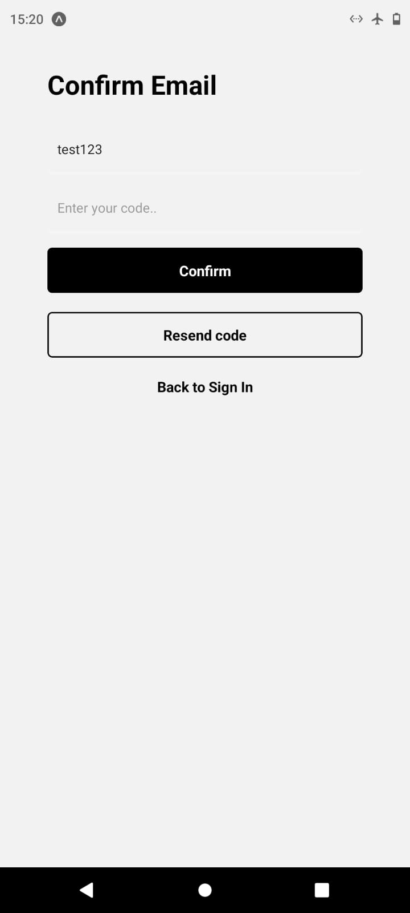
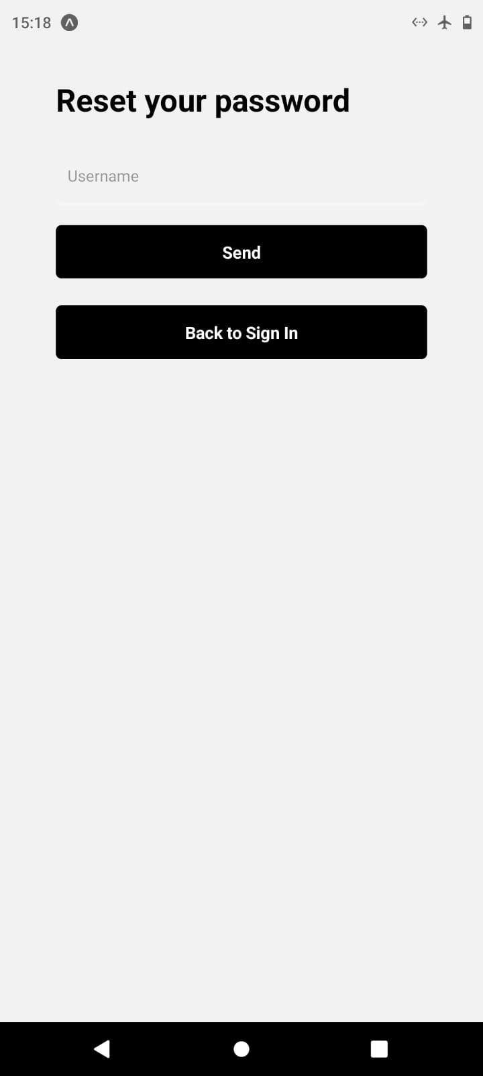
Sign Up, Confirm Email, Reset Password
After inputting credentials the user will receive an email with a verification code. The user will have to put that code in the app to finish the registration process.
After creating an account, the user will have to go back to the sign in page.
A user also has the option to reset its password.

Slide 4
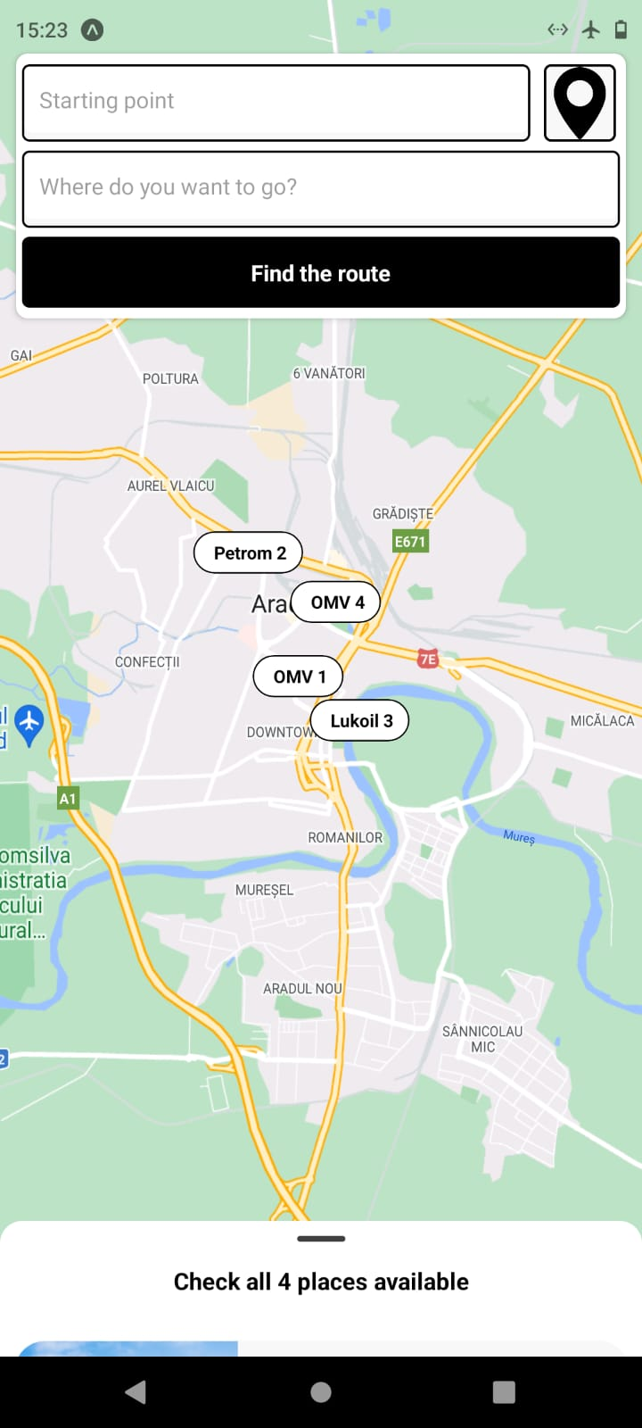
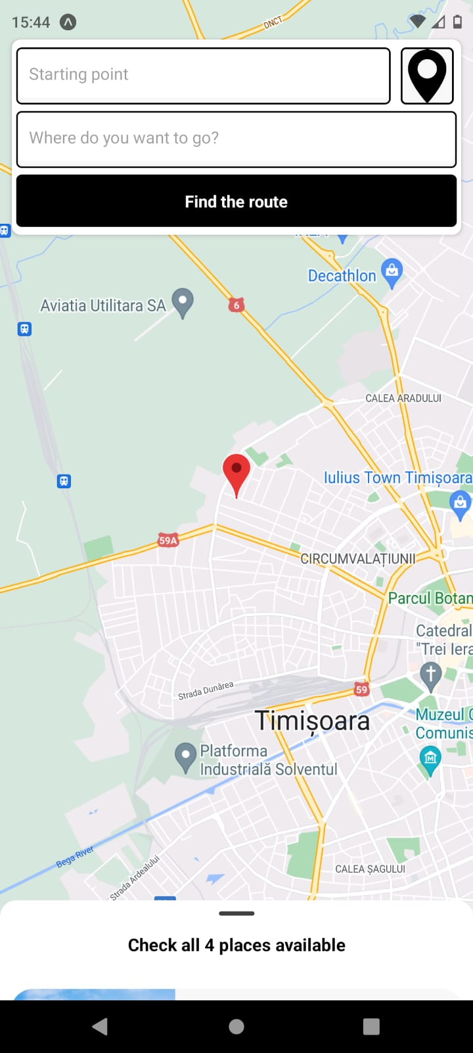
Main page
This is the main page. The user can find routes by entering the starting and ending point, see it’s current location or see petrol stations by swiping up
By pressing this icon, the user can see it’s current location on the map

Slide 5
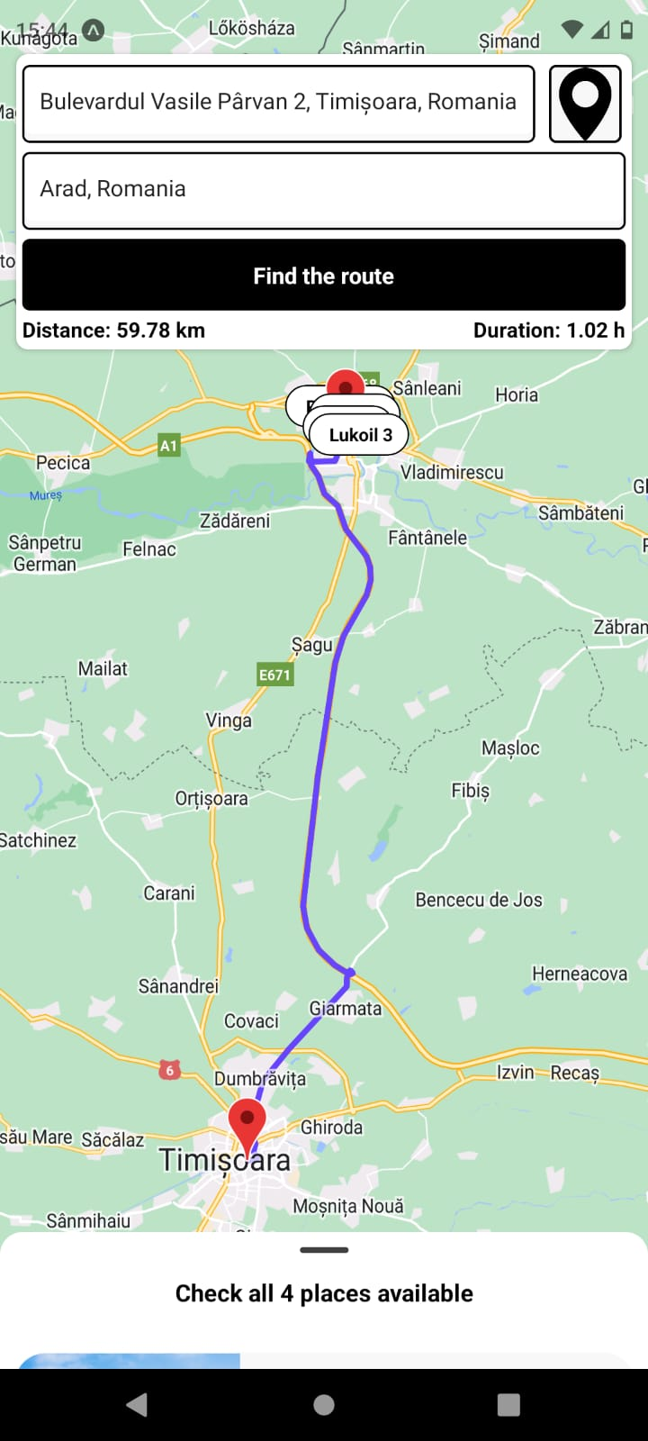
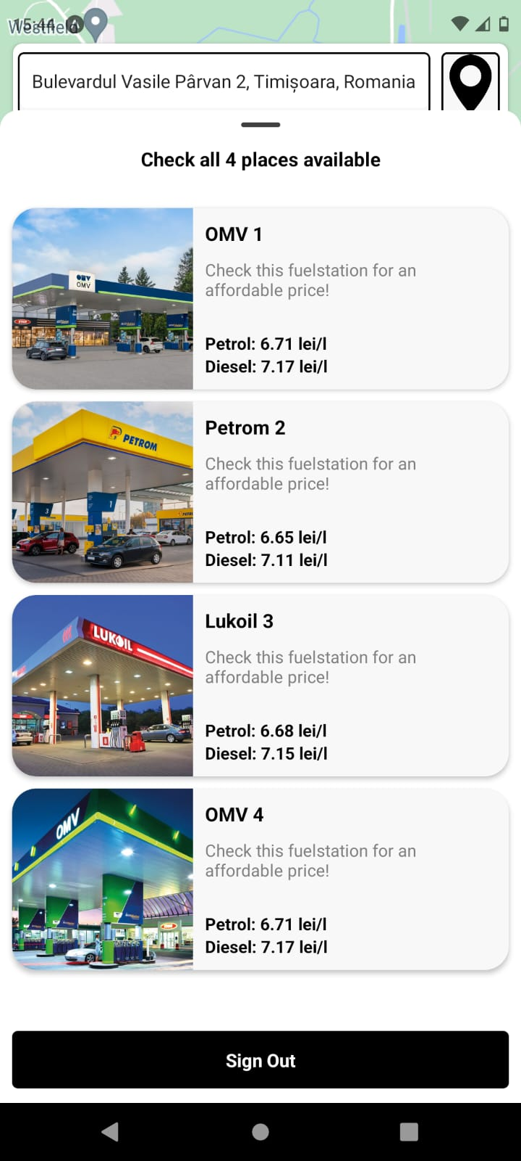
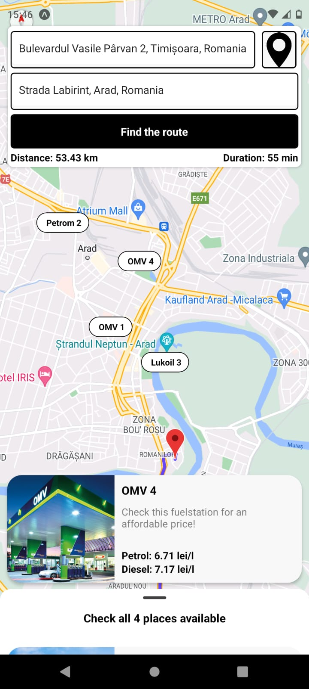
Main page
The user can see the distance from point A to B and an approximate duration
By swiping up the user can see a list of fuel stations.

Slide 6
FuelFinder is a functional app that can find your location, compute distances between 2 points and estimates the travel time.
Technologies used: React-native, Expo, JavaScript, AWS (Amplify and Cognito), Google APIs.
Achievements: Design skills using JavaScript, how to use and integrate APIs, how to create an authentication system.

