Slide 1
Accelerating Genetic Algorithm Processing for Application in Game Artificial Intelligence
By: James Choa
Holvin Tiu
Adviser: Walfrido David Diy

Slide 2
Chapter 1
Genetic algorithm (GA) is one of the many types of AI techniques but is hampered by time
Objective: show the performance gains of using a GPU to optimize the AI with the use of genetic algorithm
Question: How much faster can the GPU based application generate an optimized AI gene as compared to a CPU based implementation?

Slide 3
Chapter 1
Scope: average running time
Limitations: only the fitness process will be parallelized.
Various applications found in various fields.
While there are studies that account for GA acceleration through the GPU and GA in games, there aren't any studies done to combine these two fields.

Slide 4
Chapter 2
GA is a time consuming process
GPUs more powerful in terms of FLOPS than CPUs
Several computers can be used to accelerate GA computation
Nvidia CUDA was introduced to take advantage of the parallel nature of GPUs
GA in the game of snake
GA in the game of asteroids
Using Verlet integration to indicate position

Slide 5
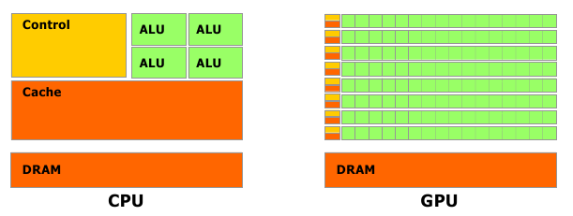
Chapter 3
CPU vs GPU

Slide 6
Chapter 3
Genetic algorithm
Fitness function
Individual
Generation
Optimizer
Physical Time
Variables of the Study: running time and AI performance

Slide 7
Chapter 4
Fedora 14 Linux
gcc 4.4.4 compiler suite
Boost 1.44.0 libraries
Nvidia CUDA 3.2 SDK
CMake 2.8 build system
ClanLib 2.2.5 game engine
R 2.12.1

Slide 8
Chapter 4
2D tank game
Goal is to survive all scenarios
Will take note of five elements: Bullet heading, Bullet position, Distance state, AI thrust, AI heading
Used 1024 individuals
Used 54 scenarios
AI will check for bullet status every 30 frames
AI will get 1 point for every scenario it survives
Will only end in two conditions: evading tank gets shot or fired bullet reaches maximum distance

Slide 9
Chapter 4
Genetic Evolution
Used 4 different seeds and ran each seed 10 times
3 kinds of data: seed tag, processor tag, and time
Used a 2 way ANOVA
Null hypothesis: speed of CPU = speed of GPU

Slide 10
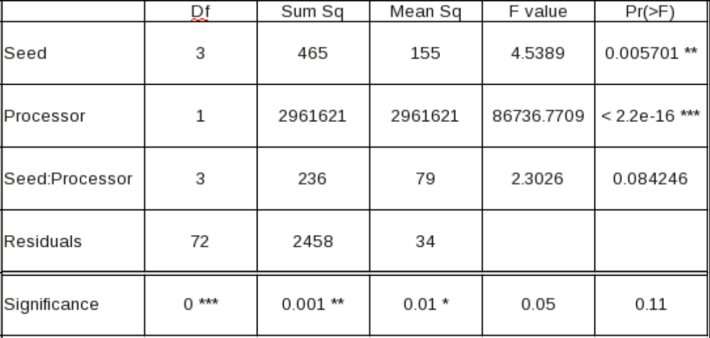
Chapter 5
24 generations

Slide 11
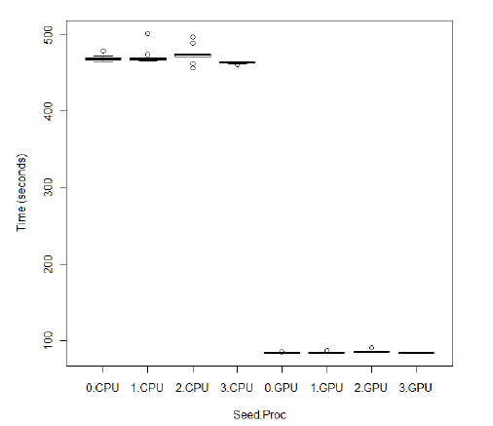
Chapter 5

Slide 12
Chapter 6
Data was not a type 1 error
GPU is faster than CPU
Further optimization still possible for both the CPU and GPU.

