Slide 1
Accelerating Genetic Algorithm Processing for Applications in Game
Artificial Intelligence
By: James Choa
Holvin Tiu
Adviser: Walfrido David Diy

Slide 2
Introduction
Genetic algorithm (GA) is one of the many types of AI techniques
Significant time needed
GPU architectures lend themselves very well to GAs

Slide 3
Objective
To illustrate the performance gains of using a GPU to optimize the AI with the use of genetic algorithm

Slide 4
Research Question
- How do we structure the game such that most of the code may be shared
between the actual game and the offline tool that utilizes the GPU?
- How much faster can the GPU based application generate an optimized
“AI gene” as compared to a CPU based implementation?

Slide 5
Scope and Limitations
Scope:
  -The average running time of the applications
Limitation:
  -Not measuring the time/effort required to modify/optimize the application

Slide 6
Significance
- GA applications found in manufacturing industry, traffic control, and Game AI
- While there are already studies that account for genetic algorithms accelerated through the GPU and genetic algorithms in games, there aren't any studies done to combine these two fields.

Slide 7
Review of Related Literature
- Genetic algorithm is a time-consuming process when handled by CPUs.
- GPUs more powerful in terms of floating point operations per second (FLOPS) than CPUs
- Several computers can be used to accelerate genetic algorithm computation.
- Nvidia Compute Unified Device Architecture (CUDA) was introduced to take advantage of the parallel nature of GPUs

Slide 8
Review of Related Literature
- Genetic algorithm in the game of snake
  For optimizing the snake AI
  For optimizing the level
- Genetic algorithm in the game of asteroids

Slide 9
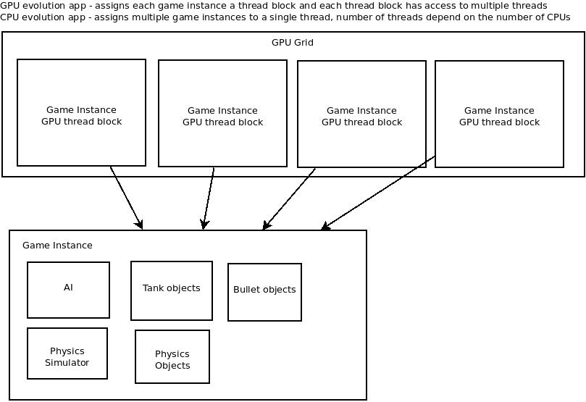
Framework

Slide 10
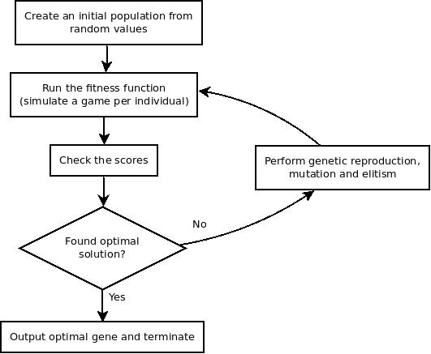
Framework

Slide 11
Components
- Running time: The time it takes for an optimal solution to be found (not the same as game time)
- AI performance: Currently refers to the length of time the AI can survive in a game instance

Slide 12
Methodology
- Will have 2 versions, CPU and GPU
- tools, libraries, and other systems that will be used:
  Fedora 13
  gcc 4.4.4 compiler suite
  Boost 1.43.0 libraries
  Nvidia CUDA 3.1 SDK
  CMake 2.8 build system
  ClanLib 2.1 game engine

Slide 13
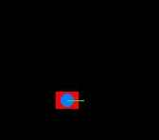
Methodology
- 2D tank game
- AI's goal is to survive
- firing sequence and rate of fire determined at the start and remain constant
- will take note of collision, direction, and distance

Slide 14
Methodology
- 3 kinds of data: fitness score of best individual, generation in which it was found, and time it took to find such individual
- will be in a table where columns are the range of fitness values (in intervals of .30), and rows represent generation.
- multiple results from same application in the same cell will have their mean value stored

Slide 15
Methodology
- Comparison only done in cells with both CPU and GPU results
- Scoring is tallied by the number of cells where runtime of one application is faster than the other.

