Slide 1
Ownership Options for Juvenile Life Insurance Policies
Sandra Napoletano CPA, CA Tax & Estate Planning Consultant Ontario Regional Marketing Centre

Slide 2
Important Considerations
This material is for information purposes only and should not be construed as legal or tax advice. Every effort has been made to ensure its accuracy, but errors and omissions are possible.
All comments related to taxation are general in nature and are based on current Canadian and U.S. tax legislation for Canadian residents, which is subject to change.
For individual circumstances, consult with legal or tax professionals.

Slide 3
Agenda
Why buy life insurance for children?
Underwriting considerations & tax rules
Personal ownership
Trust ownership
Corporate ownership
New “Cascading” illustration tool & marketing pieces

Slide 4
Why Buy Life Insurance on a Child?
Premiums are cheaper than for adults
Locks in insurability
Savings plan for child’s future benefit
Avoid probate fees (DB bypasses estate)
Tax efficient transfer of wealth from one generation to the next
Tax-advantaged financial product
Intergenerational tax rollover rules

Slide 5
Limitations of the Strategy
Exempt test policy limits amount of accumulated cash value
Strategy should be considered for long term outlook of a child of a high net worth family

Slide 6
Tax Rules – Intergeneration Tax-Free Transfers
Tax rules allow a tax-free transfer of an interest in a policy to a child under certain conditions:
Life insured must be a child/grandchild of the policy owner
Transfer is made to a child of the policyholder (does not have to be the child whose life is insured)
Interest in the policy must be transferred for no consideration
Transfer can not be made under the terms of a will of the parent/grandparent (will give rise to a taxable disposition)
Transfer must be inter-vivos or by successor owner designation
Proceeds of disposition is ACB to transferor
Cost is ACB to transferee

Slide 7
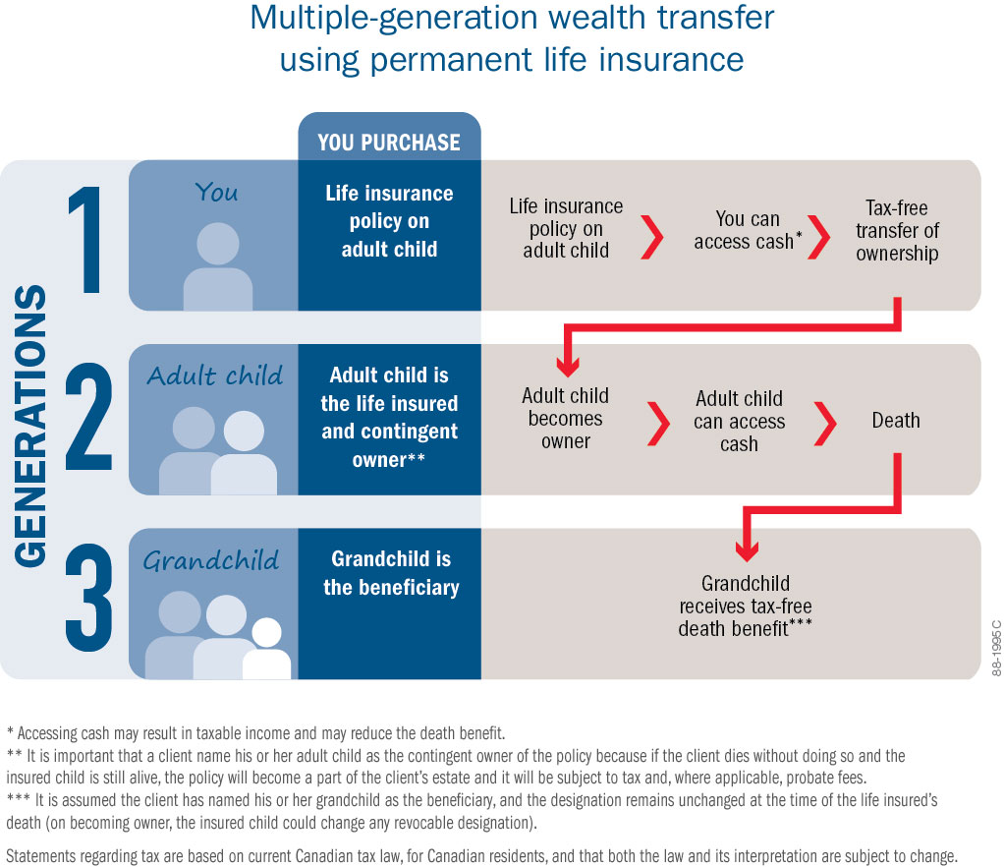
How It Works
Notes:
The cascading strategy can work with various combinations of insured person, transferee and beneficiary, subject to meeting the rules of the Income Tax Act (for more information about the cascading strategy and the various combinations refer to the Advisor sales aid). However, the most common and simple scenario that achieves the desired tax and transfer of wealth results is the example in the diagram.
Let’s walk through the example as if you’re the grandparent and generation one.
You purchase a tax-advantaged permanent life insurance policy on your adult child (the insured person and generation two). You name him or her the contingent owner, referred to as a “subrogated” owner in Quebec. You name your grandchild (generation three) the beneficiary.
The cash value in the policy grows on a tax-advantaged basis. While owner of the policy, you can access the policy’s cash value should it be needed.
The policy ownership can be transferred to your child tax-free at your death or sooner, should you choose.
It is recommended that the policy be transferred to an adult child. A minor child can be named contingent (subrogated) owner of the policy. However, a tutor or guardian of property will be responsible for holding the policy until the minor becomes an adult.
This strategy assumes that when a universal life insurance policy is transferred, any value in a side account is also transferred. The owner should provide for the distribution of any side account value to the new owner in his or her will, if the transfer is to take place on the owner’s death. The same issue applies to participating life insurance policy with a premium deposit account.
Once the policy is transferred, the new owner (the adult child) may access the cash value. This money can be used to help buy a home, supplement retirement or fund the education of your grandchildren.
When the insured person dies, the death benefit is paid to your grandchild tax-free – assuming your grandchild is still then the beneficiary (e.g., your child, as owner, could change the beneficiary).
The death benefit does not incur estate administration tax (probate fees).
In most provinces the death benefit paid does not become public.

Slide 8
Our Product Selection
Permanent life insurance policies only available
UL: AI, 10 pay, 15 pay, 20 pay COI
Participating whole life (most popular) with ADO

Slide 9
Underwriting Considerations
Applicants/future owners must be parents, grandparents or legal guardians
All siblings should be insured for similar amounts of coverage or premiums – cultural particularities are recognized
Face amount <$250,000, NO need to review parents’ insurance coverage
Face amount >$250,000, generally one parent should have at least twice the amount of insurance in force as applied for on the child; OR
It is acceptable if the parents have the same amount of coverage as the child and the premium amount is substantially higher on the parent’s policy
Coverage up to $1.5M as long as at least one parent has at least 2x as much coverage as the child.

Slide 10
Personal Ownership

Slide 11
Personal Ownership
Simple
Personal after-tax dollars pay premiums
Creditor protection is available
An irrevocable beneficiary designation is made; or
A specified family member of the life insured is named as beneficiary (spouse, child, grandchild or parent)
Life insurance intergeneration tax rollover available (unique to life insurance!!!)
After transfer control may be maintained through an irrevocable beneficiary designation of portion of death benefit

Slide 12
Personal Ownership
Intergenerational tax rollover (cascading strategy):
Policy transferred to transferor’s “child”
and
Child of either transferor or transferee is the life insured
“Child” includes grandchild

Slide 13
Personal Ownership
Cascading
GP
P
Life Insured
C
Rollover available
Rollover not available

Slide 14
Personal Ownership
Cascading
GP
P
Life Insured
C
Rollover available
Rollover not available

Slide 15
Personal Ownership
Considerations with Cascading Strategy
Child must be only life insured under policy or last surviving
No rollover if parent/policyowner dies and policy is transferred via will (MUST NAME CONTINGENT OWNER)
Consider making “child” contingent owner
no rollover if the contingent owner was a trust for the benefit of the child

Slide 16
Trust Ownership

Slide 17
Trust Ownership
Parent funds a trust and the trust buys life insurance on a child
Child is beneficiary of the trust
Parent/grandparent is trustee
Trust is owner, pays premium and is beneficiary of the policy

Slide 18
Trust Ownership
More complicated & costly
Separates control and beneficial interest
As trustee, parent retains control of the policy
Generally, high rate after-tax dollars pay premiums
Creditor protection generally not available
Rollover of policy to beneficiary available at 21 years deemed disposition

Slide 19
Trust Ownership
Trusts work well for owning life insurance policies:
21 year deemed disposition of capital property tax rule does not apply to a life insurance policy
Allows to keep control of the policy for a long time
Great for legacies to grandchildren by purchasing life insurance on parents (i.e. the client’s children)
If policy is purchased on child or grandchild the trust can generally “roll out” policy to a trust beneficiary
Disabled child beneficiary (limits control)

Slide 20
Corporate Ownership

Slide 21
Corporate Ownership
Allure is having corporate dollars pay the insurance premium
Issue of eventually getting the policy in the child’s hands
Perhaps policy should remain corporately owned
Underwriting ; insurable interest - policies on immediate family members are underwritten as if personally owned
Creditor protection available if policy in Holdco

Slide 22
Corporate Ownership
Tax Implications
Premiums not deductible for tax purposes
Capital dividend account available
Death benefit – ACB = CDA credit
No shareholder benefit provided corporation is owner, premium payor and beneficiary
Policy can be distributed to a shareholder as a dividend-in-kind

Slide 23
Corporate Ownership
When a policy is transferred from the corporation to shareholder:
Consider tax consequences to corporation & shareholder

Slide 24
Corporate Ownership
Consequences to the corporation:
Transfer is a deemed disposition
Proceeds = Cash Surrender Value
Policy gain = Cash Surrender Value in excess of ACB
Taxed as passive income at 46.17%

Slide 25
Corporate Ownership
Consequences to the shareholder:
FMV of policy taxable as either
Regular income
Employment income (corporation gets deduction); or
Shareholder benefit (no deduction)
New policy ACB equals policy FMV
Dividend income (preferable)
Policy distributed as a dividend in kind
Policy’s new ACB equals policy CSV
FMV is not determined by Canada Life – recommended that the shareholder obtain an independent valuation of the policy from a third party (business valuator).

Slide 26
Corporate Ownership
What is the FMV of a life insurance policy?
paragraph 40 of CRA doc IC 89-3: factors be considered when valuing a life insurance policy include:
CSV
policy loan value
face value of the policy
state of health of the life insured and their life expectancy
conversion privileges
other policy terms and replacement value.

Slide 27
Corporate Ownership
Two main methods of calculating FMV
The actuarial present value method
FMV = PV of future benefits – PV of future premiums
2. The replacement cost method
FMV = PV of premiums payable for a hypothetical new policy with the same features as the existing policy – PV of premiums payable for the existing policy
See Fair Market Value of Life Insurance Policies, Canadian Institute of Actuaries, September 2013

Slide 28
Corporate Ownership
Policy details post-transfer
CSV: $70,000
ACB: $70,000 CSV +30,000
FMV: $100,000
Consequences to shareholder:
$100,000 income inclusion
Shareholder
Life
Policy
Consequences to corporation:
$NIL policy gain
Policy details pre-transfer
CSV: $70,000
ACB: $90,000
FMV: $100,000
Corporation

Slide 29
Case Study
William is 44 and an incorporated surgeon
Kate is 44 and an ER physician, not incorporated
They have 4 children:
M13
M11
M 8
F 5
William established a trust for the children to own the non-voting shares of his PC

Slide 30
Case Study
Kate and William each have their own participating whole life insurance policies
They would like each of their children to have his/her own par policy as well
Willing to pay $10,000 for each child for 10 years

Slide 31
Case Study
Estate Achiever Max 20, PUAs
$10,000 annual premium x 10 years
Maximum ADO
 | Basic Coverage | ADO
M13 | $471,603 | $3,612
M11 | $505,324 | $3,487
M8 | $552,383 | $3,358
F5 | $587,557 | $3,525

Slide 32
Case Study
Personally owned or corporately owned?
Personally owned / Trust owned
Paid with after tax dollars
Tax free rollover to child
Corporately owned
Paid with cheaper after-tax dollars
Dividend-in-kind of policy to child

Slide 33
Case Study
The Plan
The PC is owner, premium payor and beneficiary of each policy for at least 10 years
Transfer policy to child as dividend-in-kind at year 10 or age 18 whichever is later

Slide 34
Case Study
Why incorporate? Tax efficient dollars used
Income required to pay one $10,000 premium
 | Tax Rate | Pre-Tax Income Required
PC | 15.5% | $11,835
Individual | 49.53% | $19,813
 | Difference | $7,979
 | x10 | $79,790
 | x4 | $319,160

Slide 35
Case Study
What’s the cost of transferring the policy to the children?
Depends on FMV at time of transfer
Let’s assume:
Policy’s FMV at year 10 = Policy CSV

Slide 36
Case Study: Policy FMV = CSV
 | M13 | M11 | M8 | F5
Age at Transfer | 23 | 21 | 18 | 18
Cumulative Tax Savings | $79,790 | $79,790 | $79,790 | $79,790
Tax Cost to PC on Transfer | $0 | $0 | $0 | $0
Income Inclusion to Child on Transfer* | $70,090 | $69,401 | $68,672 | $82,544
Tax Cost to Child on Transfer* | $7,079 | $6,917 | $6,746 | $10,948
Net Cost Savings | $72,711 | $72,873 | $73,044 | $68,842
Total Cost Savings |  |  |  | $287,490
* See “Considerations” slide

Slide 37
Tax Strategy at Age 18 and Onwards
Child can make partial surrenders to fund TFSA
$5,500 is surrendered each year from age 19 – 23
No policy gain, ACB > CSV
$27,500 extracted tax-free over 5 years
Growth in TFSA is tax-free
Withdrawal from TFSA tax-free

Slide 38
Case Study
Considerations:
Child is new owner of policy (make parent a small % irrevocable beneficiary)
Child has other income at the time of transfer
Health of child at time of transfer; FMV calculation
Changing tax rules
Parent dies in the 10 yr funding period (name successor owner or appoint guardian of property)

Slide 39
Summary
Juvenile policies are a great way to transfer wealth over multiple generations of family
Corporate owned juvenile policy can be a compelling option in the right circumstances
Lower cost premiums
Tax efficient transfer of wealth accumulation in a policy

Slide 40
Cascading Illustration Tool
Available on RepNet
Helps position your case
Customize child policy illustration vs. alternative investment
Illustrates how much wealth you are keeping in the family
Illustrate access to CSV for future use by parent or child
Client brochure
Advisor sales guide

Slide 41
Questions?
Thank you!

Slide 42
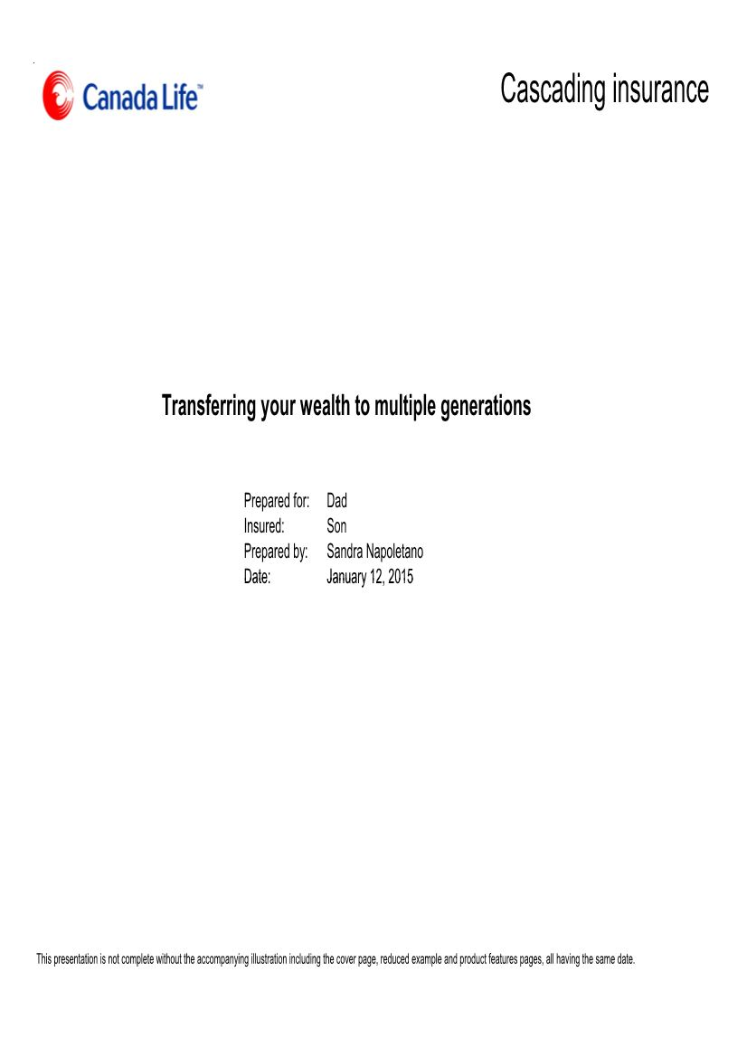

Slide 43
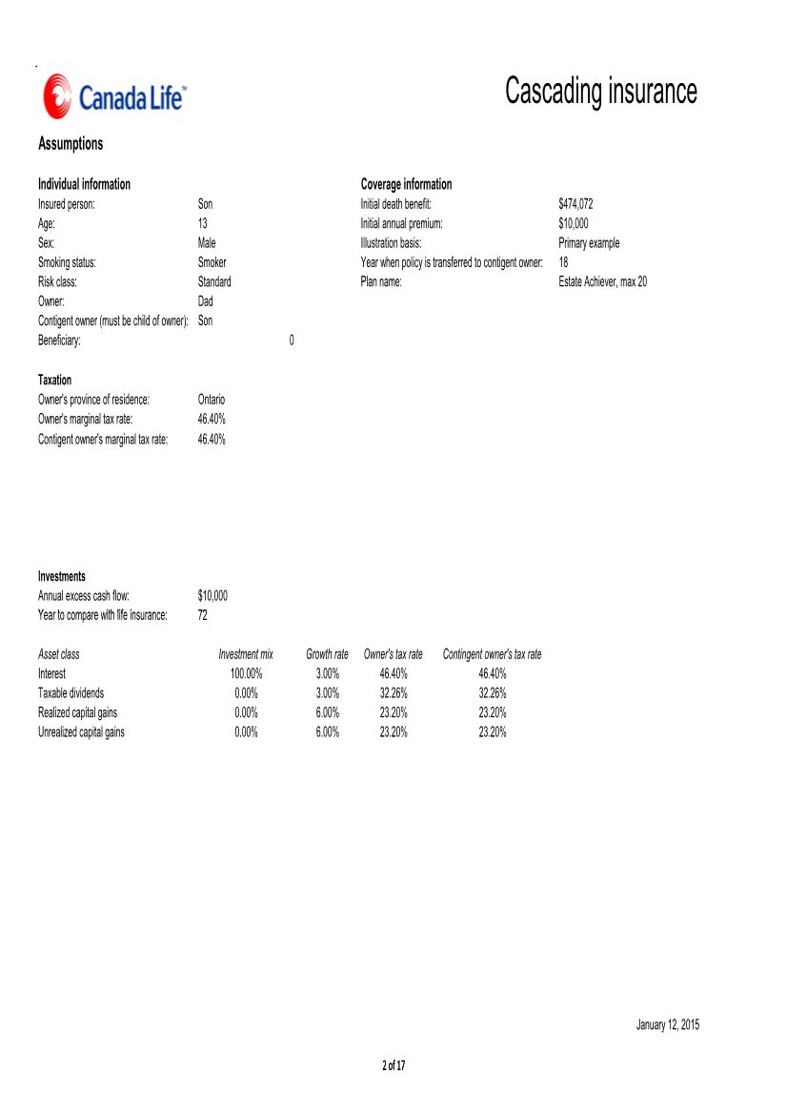

Slide 44
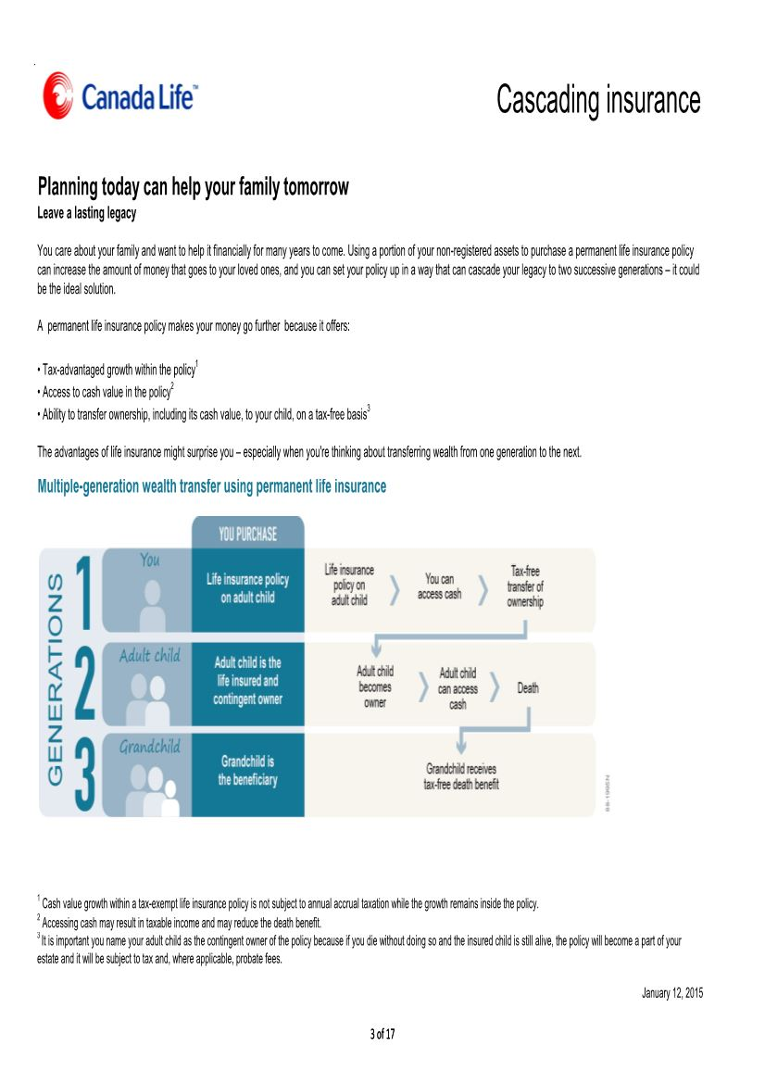

Slide 45
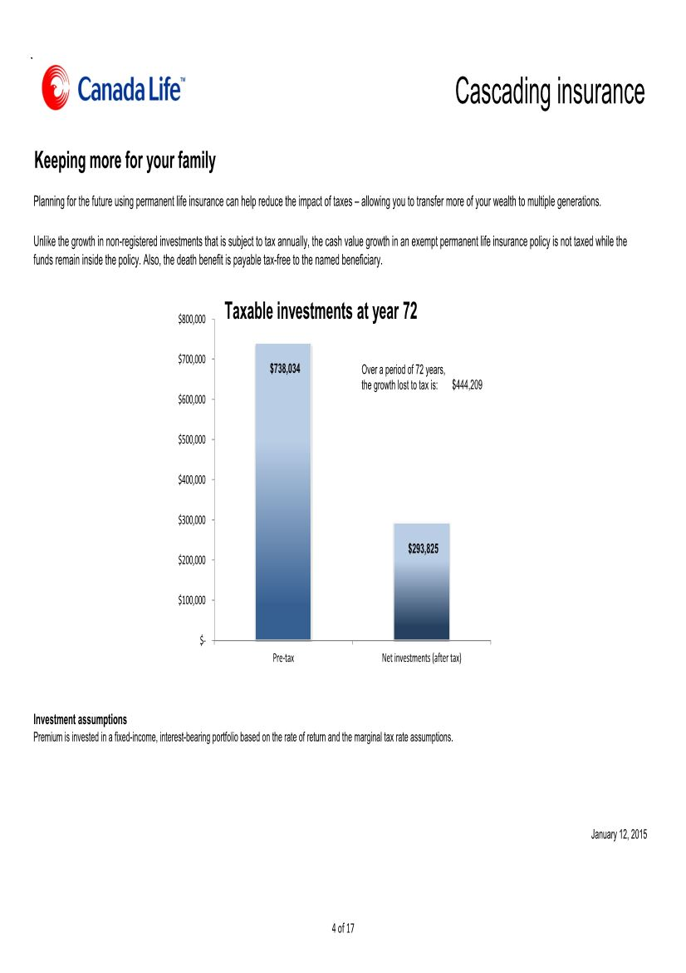

Slide 46
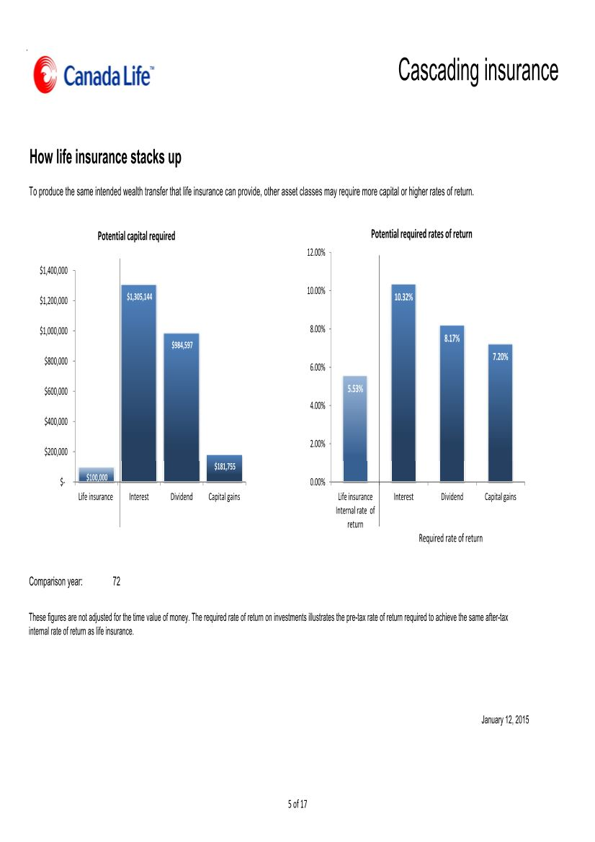

Slide 47
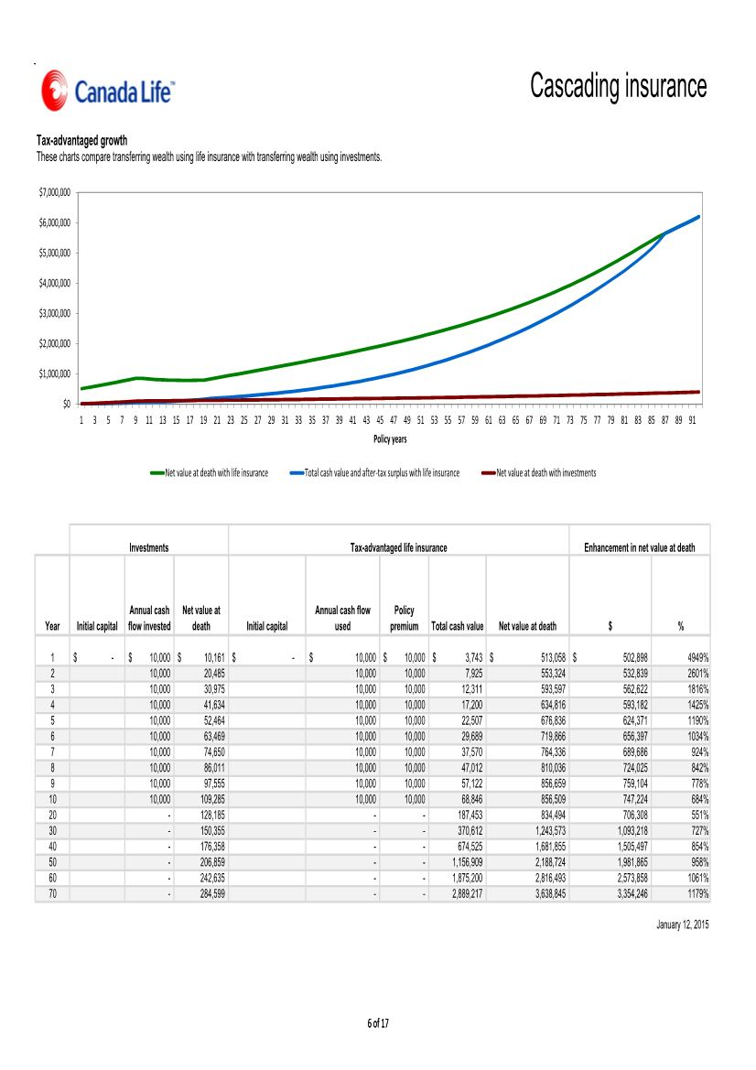

Slide 48
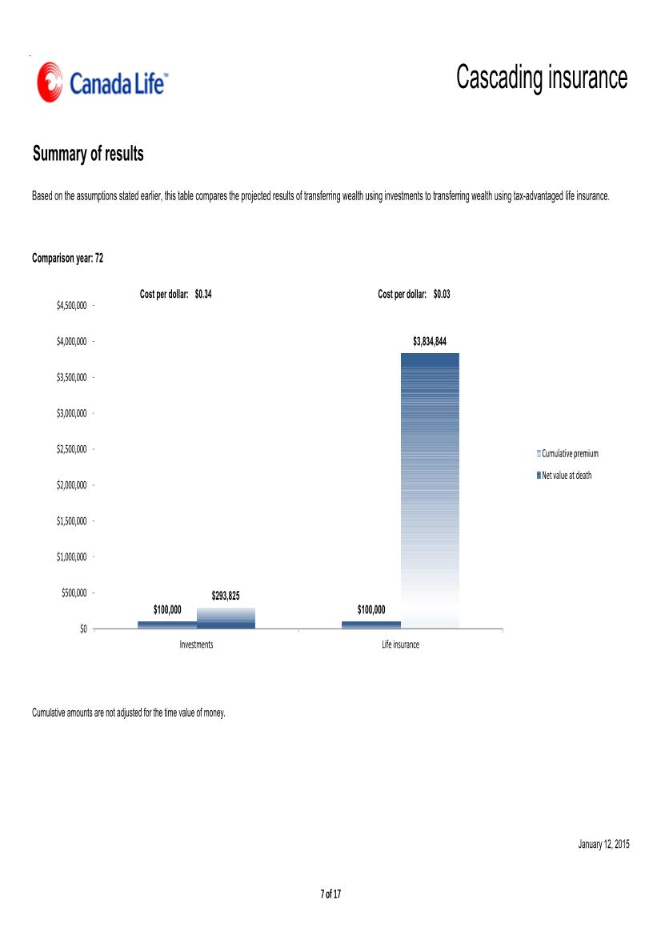

Slide 49
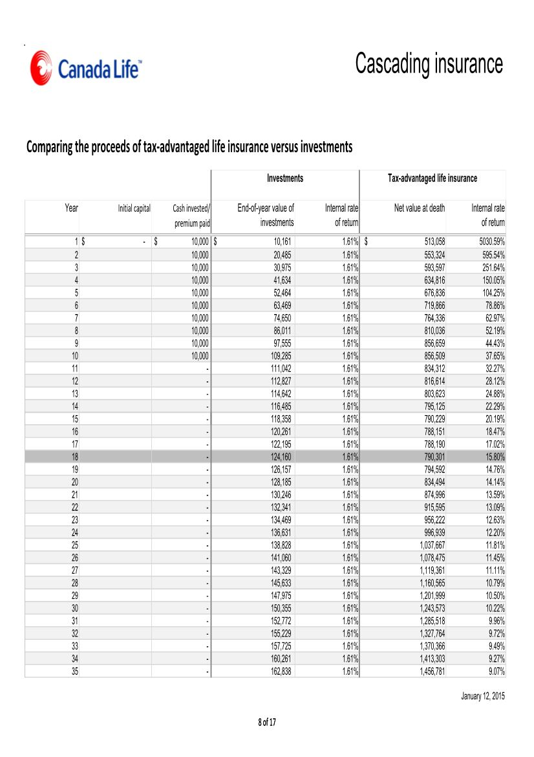

Slide 50
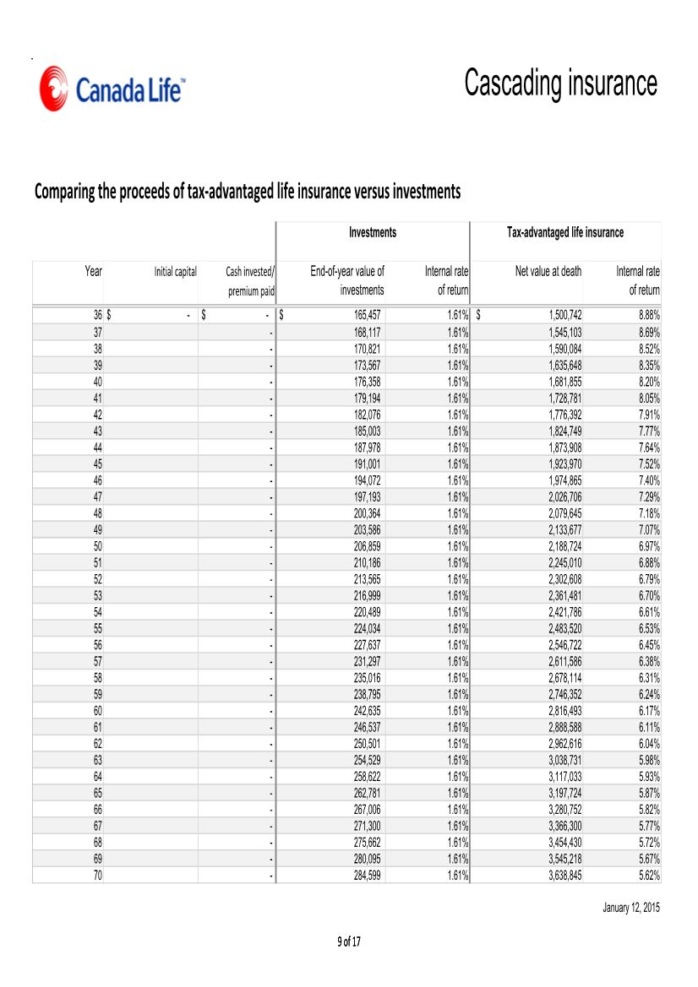

Slide 51
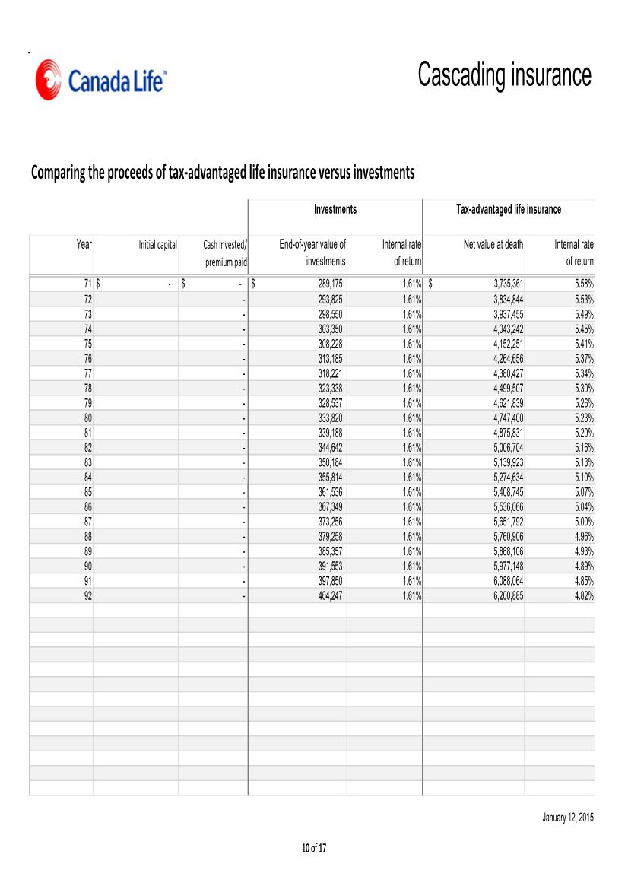

Slide 52
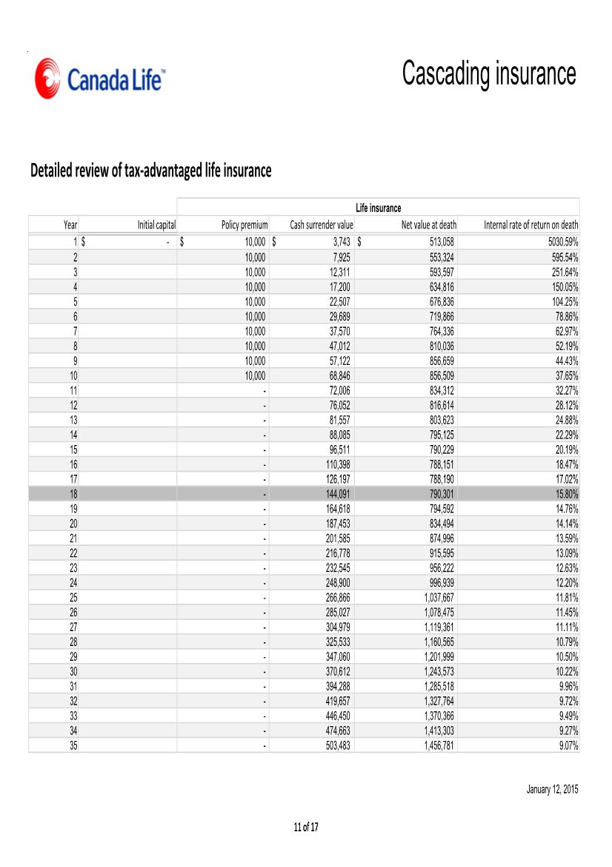

Slide 53
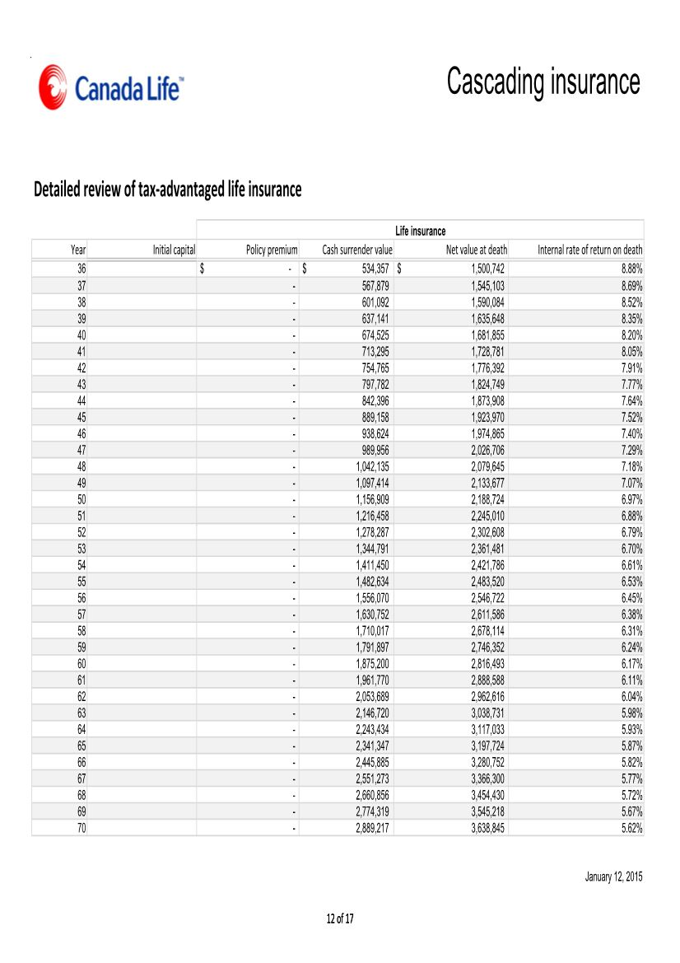

Slide 54
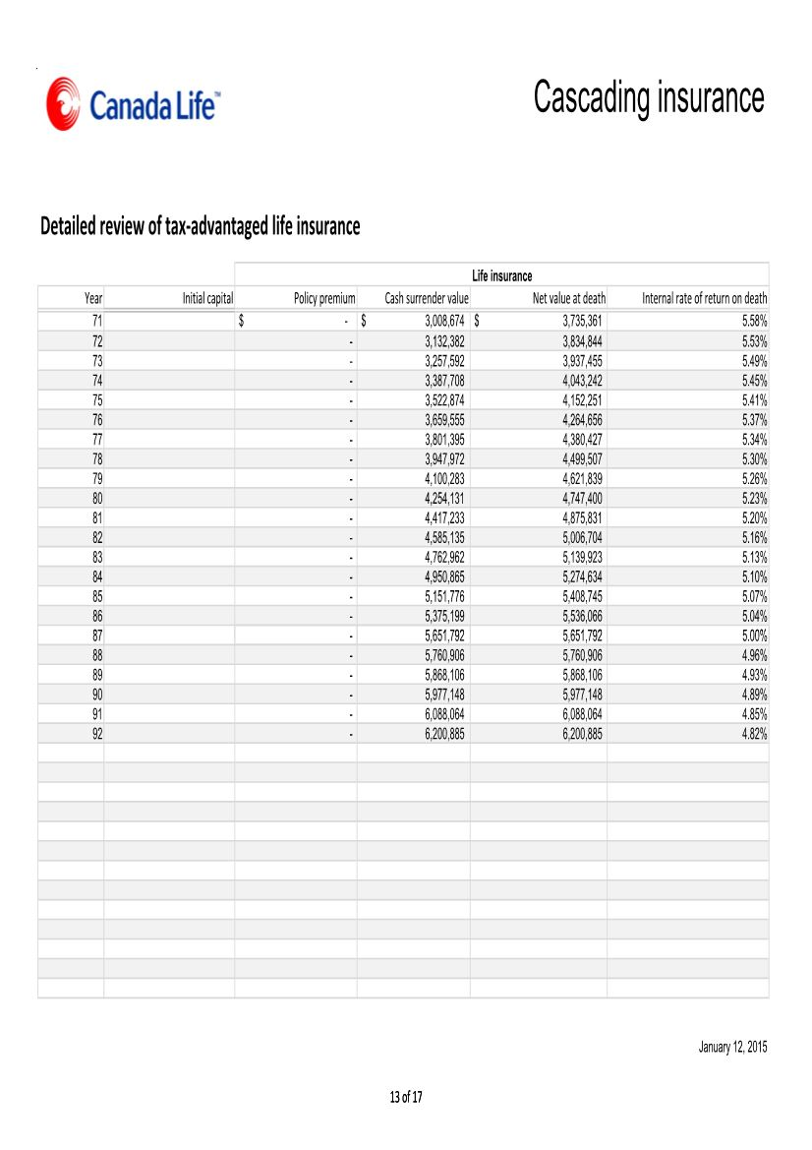

Slide 55
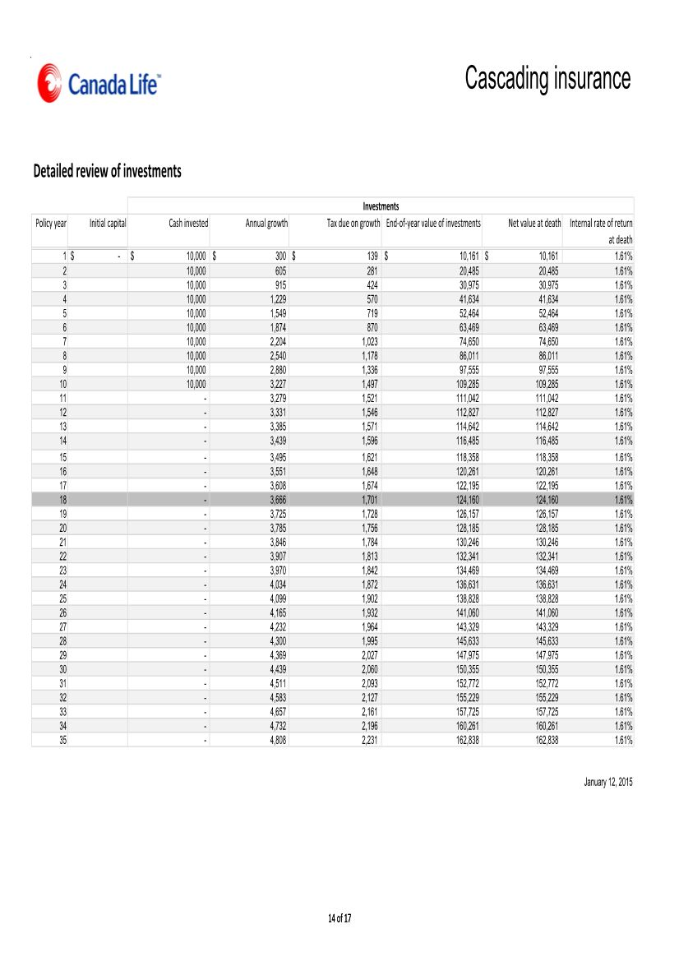

Slide 56
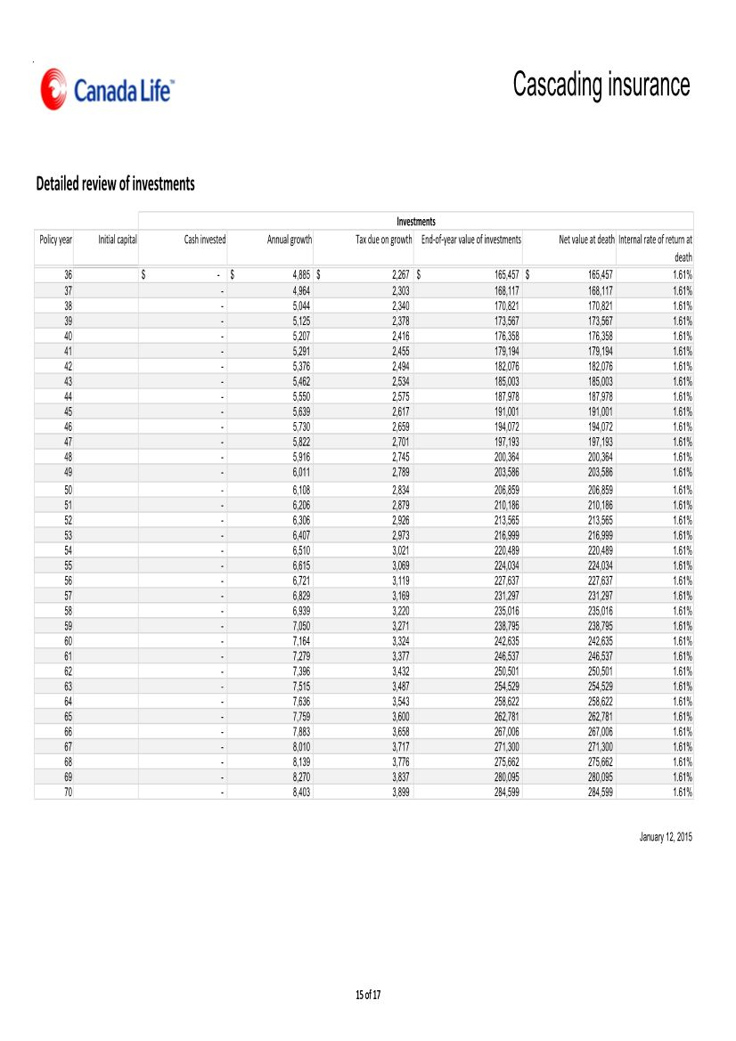

Slide 57
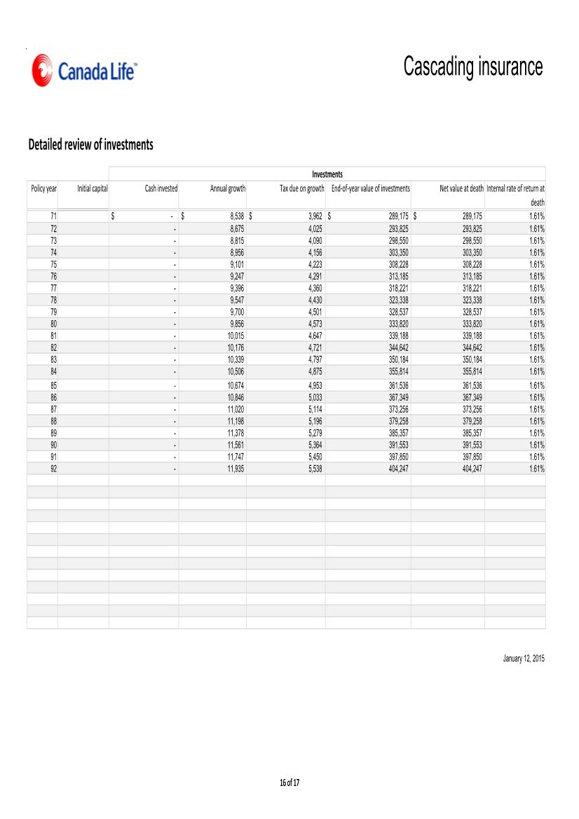

Slide 58
