Slide 1
Demand and Supply of Health Insurance
Chapter 8

Slide 2
WHAT IS INSURANCE?
Insurance provides a way for individuals to smooth consumption over different states of the world.
  For example, suppose you have a good state of the world and a bad state of the world. Your consumption in the good state of the world is much higher than that in the bad state. However, you can enter into a contract for a price (a premium) that allows you to increase your consumption in the bad state of the world, but does lower your consumption in the good state of the world (because of the premium you pay).
  Whether it makes sense for someone to buy the contract will depend on their preferences as well as the premium, we will discuss that later in the lecture today.

Slide 3
Insurance in healthcare markets
In most countries, individuals do not pay for healthcare directly. A government program or an insurance company will pay for most the care and perhaps the patient will only pay a small portion of the bill.
Healthcare expenditures can be quite large and it cannot be determined ahead of time when they will be needed, so insurance can provide an important service to consumers.

Slide 4
Risk versus Uncertainty
Economists distinguish between risk and uncertainty:
  Risk is something you can quantify, the probability that you have a car accident is 0.02
  Uncertainty is something you cannot quantify, e.g., suppose the U.S. government shuts down doesn’t pay the interest in its debt and drags the world economy into global apocalypse
With uncertainty there is nothing you can do except hope for the best, but with risk you can turn to insurance to protect yourself from losses

Slide 5
Insurance Terminology
Premium, Coverage—When people buy insurance policies, they typically pay a given premium for a given amount of coverage should the event occur.
Coinsurance and Copayment—Many insurance policies, particularly in the health insurance industry, require that when events occur, the insured person share the loss through copayments. This percentage paid by the insured person is the coinsurance rate. With a 20 percent coinsurance rate, an insured person, for example, would be liable (out of pocket) for a $30 copayment out of a $150 charge. The insurance company pays the remainder.

Slide 6
More Insurance Terminology
Deductible—With many policies, some amount of the health care cost is paid by the insured person in the form of a deductible, irrespective of coinsurance. In a sense, the insurance does not apply until the consumer pays the deductible. Deductibles may be applied toward individual claims, or, often in the case of health insurance, they may be applied only to a certain amount of total charges in any given year.
Exclusions—Services or conditions not covered by the insurance policy, such as cosmetic or experimental treatments.

Slide 7
Even More Insurance Terminology
Limitations—Maximum coverages provided by insurance policies. For example, a policy may provide a maximum of $3 million lifetime coverage.
Pre-Existing Conditions—Medical problems not covered if the problems existed prior to issuance of insurance policy. Examples here might include pregnancy, cancer, or HIV/AIDS.
Pure Premiums—The actuarial losses associated with the events being insured.
Loading Fees—General costs associated with the insurance company doing business, such as sales, advertising, or profit.

Slide 8
RISK AND INSURANCE
Expected Value
Suppose Elizabeth considers playing a game in which a coin will be flipped. If it comes up heads, Elizabeth will win $1; if it comes up tails, she will win nothing.
With an honest coin, the probability of heads is one-half (0.5), as is the probability of tails. The expected value, sometimes called the expected return, is:
ER = (probability of heads) x (return if heads, $1) + (probability of tails) x (return if tails, 0) = $0.50

Slide 9
In General
With n outcomes, expected value E is written as:
E = p₁R₁ + p₂R₂ + … + p_{n}R_{n}
where p_{i} is the probability of outcome i, (that is p₁ or p₂, through p_{n}) and R_{i} is the return if outcome i occurs. The sum of the probabilities p_{i} equals 1.

Slide 10
Actuarially Fair Insurance Policy
When the expected benefits paid out by the insurance company are equal to the premiums taken in by the company the insurance policy is called an actuarially fair insurance policy.

Slide 11
Marginal Utility of Wealth and Risk Aversion
Suppose that the coin flip in the previous example is changed so that the coin flip yields $100 or nothing, but Elizabeth is now asked to pay $50 to play.
This is an actuarially fair game but Elizabeth may choose not to play because the disutility of losing money may exceed the utility of winning a similar amount.

Slide 12
Utility of Wealth
The utility of wealth function pictured on the next slide exhibits diminishing marginal utility and describes an individual who is risk averse, that is, will not accept an actuarially fair bet.

Slide 13
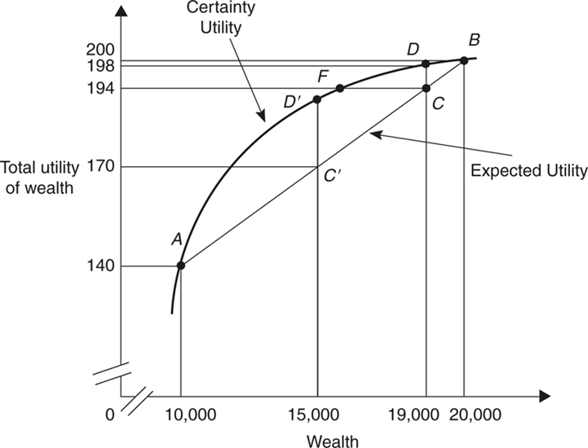
Expected Utility

Slide 14
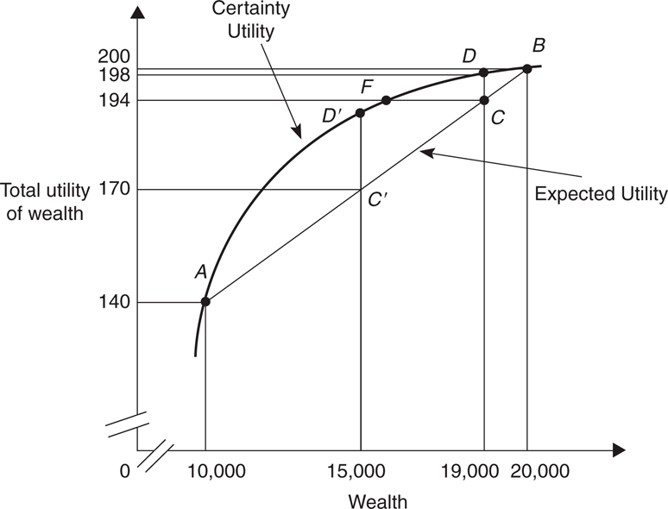
Purchasing Insurance
Suppose that Elizabeth can buy an insurance policy costing $1,000 per year that will maintain her wealth irrespective of her health.
Is it a good buy? We see that at a net wealth of $19,000, which equals her initial wealth minus the insurance premium, her certainty utility is 198. Elizabeth is better off at point D than at point C, as shown by the fact that point D gives the higher utility.
Notes:
194 is typo, should be 197, the expected utility computed in the fake numerical example.

Slide 15
Fake numerical example
The following numerical example corresponds to the previous diagrams; State 1 is the good state and wealth is 20000 with probability 0.95 and State 2 is the bad state with wealth 10000 and probability 0.05; u(w) is the utility function
Generally, the functional form for u(w) is specified, but this example is based on the numbers in the text where no functional form is specified

Slide 16
Fake numerical example
EU=p*u(20000)+(1-p)*u(10000)
=0.95*u(20000)+0.05*u(10000)
=0.95(200)+0.05(140)
=190+7
=197

Slide 17
Real numerical example
State 1 is the good state and wealth is 20000 with probability 0.95 and State 2 is the bad state with wealth 10000 and probability 0.05; u(w) is the utility function and is such that u(w)=ln(w)
log preferences are quite common, some other choices might include quadratic preferences u(w)=w²

Slide 18
Real Numerical Example
EU=p*ln(20000)+(1-p)*ln(10000)
=0.95*ln(20000)+0.05*ln(10000)
=0.95*9.8035+0.05*9.2103
=9.8688

Slide 19
Mathematically, an individual would buy insurance if the expected utility the person gets if they buy insurance is bigger than the expected utility if they just faced the potential states of the world without insurance
  U(Wealth in good state – premium)> EU

Slide 20
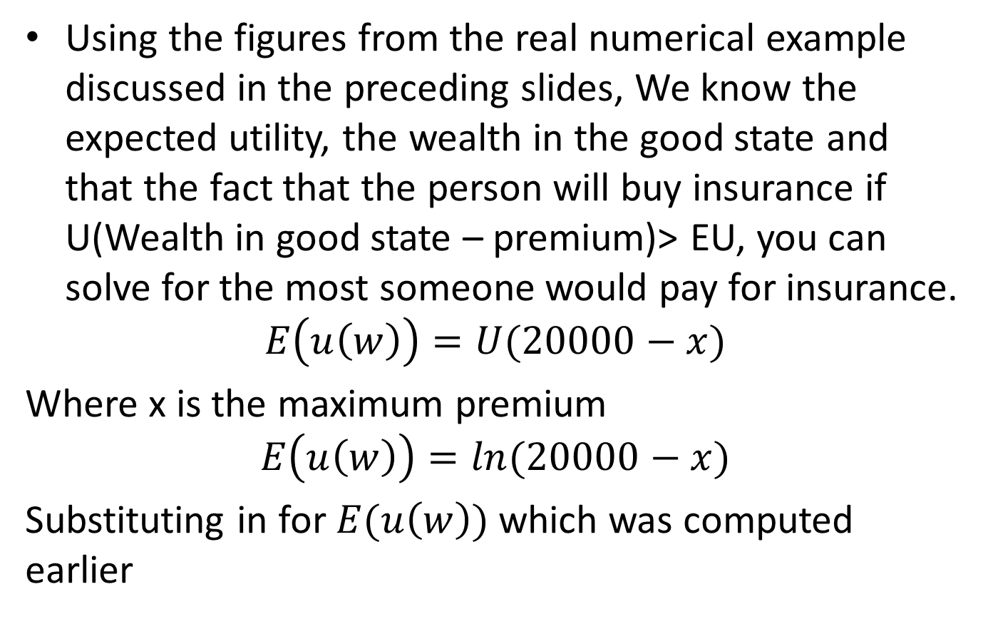
What’s the Most An Individual Would Pay for Insurance
  Using the figures from the real numerical example discussed in the preceding slides, We know the expected utility, the wealth in the good state and that the fact that the person will buy insurance if U(Wealth in good state – premium)> EU, you can solve for the most someone would pay for insurance.
  $$E\left(u\left(w\right)\right)=U(20000−x)$$
  Where x is the maximum premium
  $$E\left(u\left(w\right)\right)=ln(20000−x)$$
  Substituting in for $E(u\left(w\right))$ which was computed earlier

Slide 21
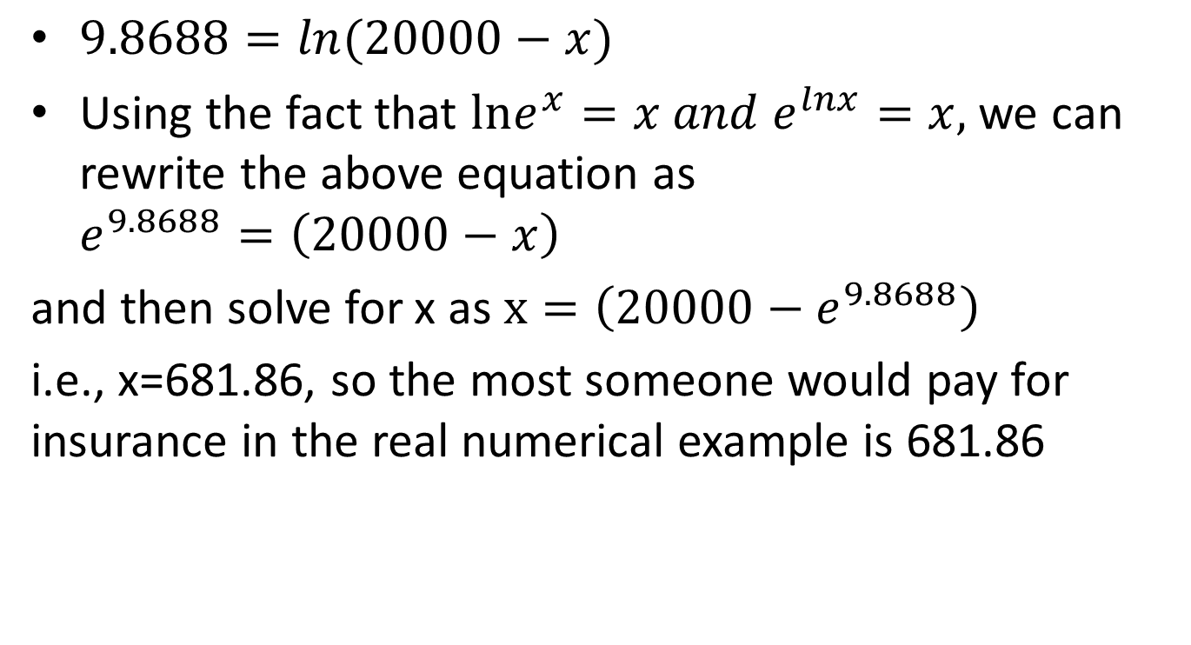
What’s the Most An Individual Would Pay for Insurance
  $9.8688=ln(20000−x)$
  Using the fact that $lne^{x}=x and e^{lnx}=x,$ we can rewrite the above equation as $e^{9.8688}=\left(20000−x\right)$
  and then solve for x as $x=\left(20000−e^{9.8688}\right)$
  i.e., x=681.86, so the most someone would pay for insurance in the real numerical example is 681.86

Slide 22
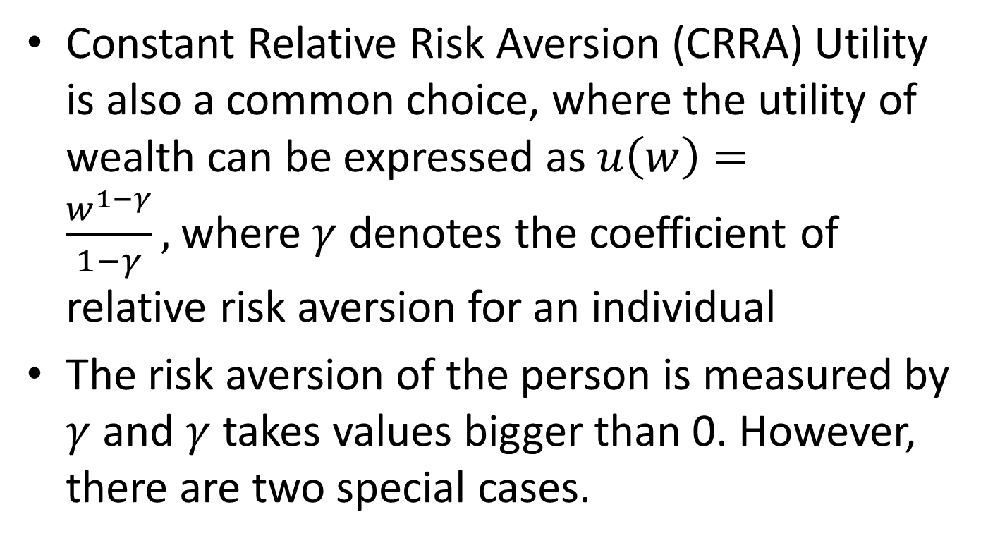
Another Common Functional Form
Constant Relative Risk Aversion (CRRA) Utility is also a common choice, where the utility of wealth can be expressed as $u\left(w\right)=\frac{w^{1−γ}}{1−γ},$where $γ$ denotes the coefficient of relative risk aversion for an individual
The risk aversion of the person is measured by $γ$ and $γ$ takes values bigger than 0. However, there are two special cases.

Slide 23
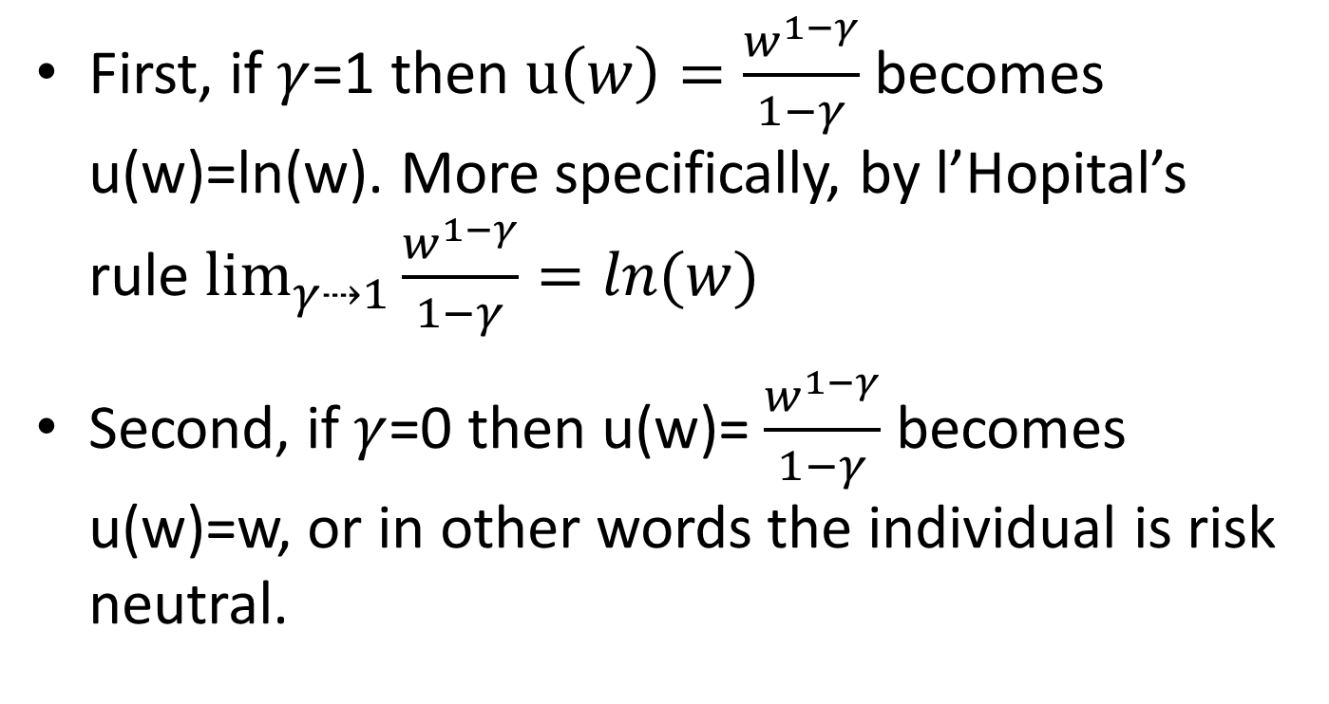
First, if $γ$=1 then $u\left(w\right)=\frac{w^{1−γ}}{1−γ}$ becomes u(w)=ln(w). More specifically, by l’Hopital’s rule $\lim_{γ⇢1}{\frac{w^{1−γ}}{1−γ}}=ln(w){}$
Second, if $γ$=0 then u(w)= $\frac{w^{1−γ}}{1−γ}$ becomes u(w)=w, or in other words the individual is risk neutral.

Slide 24
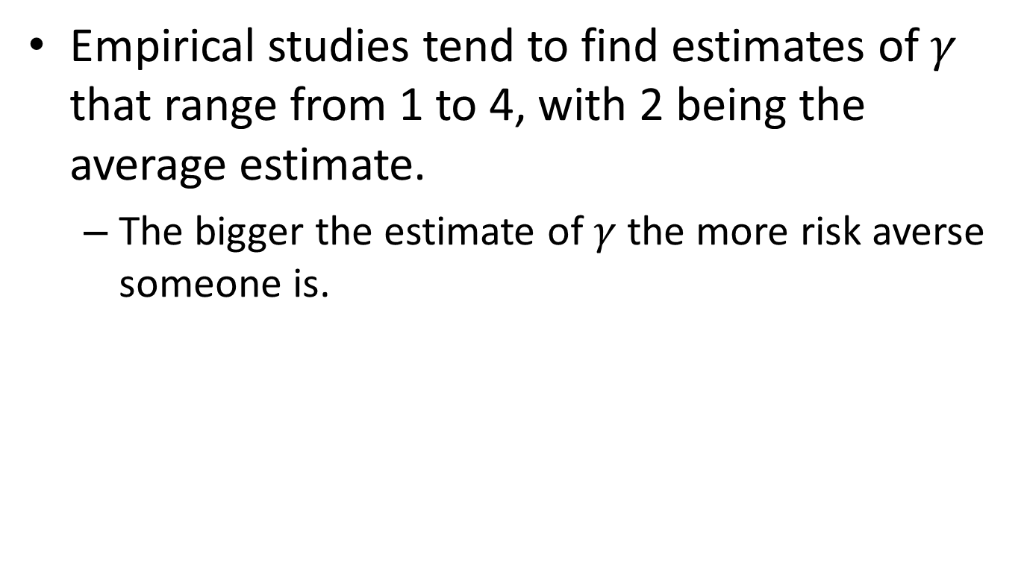
Empirical studies tend to find estimates of $γ$ that range from 1 to 4, with 2 being the average estimate.
  The bigger the estimate of $γ$ the more risk averse someone is.

Slide 25
What Does this Analysis Tell Us?
Insurance can be sold only in circumstances where the consumer is risk averse.
Expected utility is an average measure.
If insurance companies charge more than the actuarially fair premium, people will have less expected wealth from insuring than from not insuring. Even though people will have less wealth as a result of their purchases of insurance, the increased well-being comes from the elimination of risk.
The willingness to buy insurance is related to the distance between the utility curve and the expected utility line.

Slide 26
THE DEMAND FOR INSURANCE
How Much Insurance?
We address Elizabeth’s optimal purchase by using the concepts of marginal benefits and marginal costs. Consider first a policy that provides insurance covering losses up to $500.
The goal of maximizing total net benefits provides the framework for understanding her health insurance choice.

Slide 27
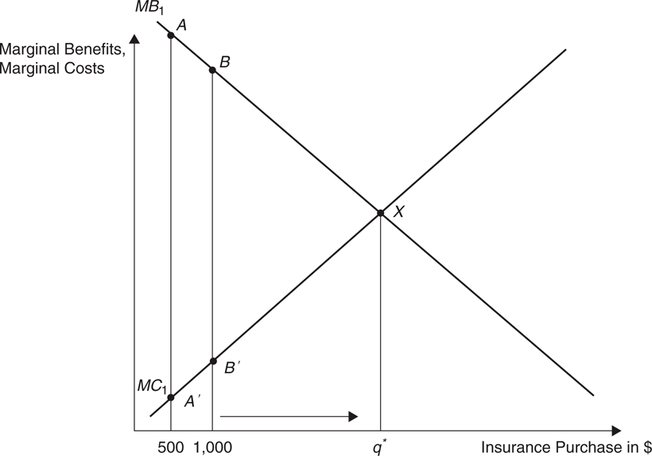
How Much Insurance?
Her marginal benefit from the $500 from insurance is the expected marginal utility that the additional $400 ($500 minus the $100 premium) brings. Her marginal cost is the expected marginal utility that the $100 premium costs. If Elizabeth is averse to risk, the marginal benefit (point A) of this insurance policy exceeds its marginal cost (point A).

Slide 28
How Much Insurance?
The marginal benefits of the next $500 in insurance will be slightly lower (point B) and the marginal costs slightly higher (point B’).
Total net benefits will be maximized by expanding insurance coverage to where MB = MC, at q’.

Slide 29
The Effect of a Change in Premiums on Insurance Coverage
Suppose the premium rises to 25% instead of 20%.

Slide 30
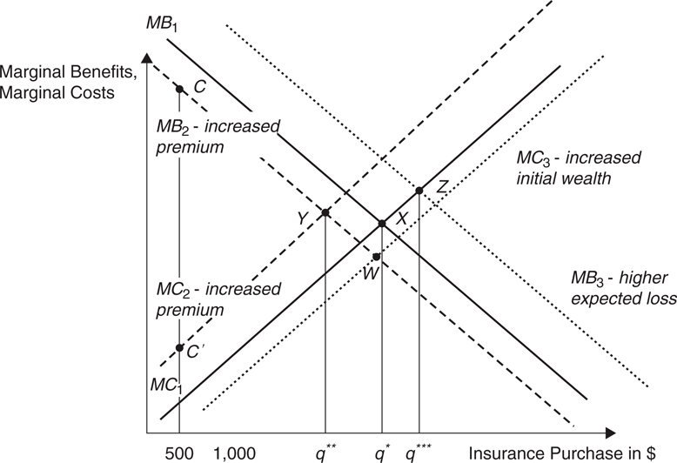
Increase in Premium
Elizabeth’s marginal benefit curve shifts to the left to MB₂ and the marginal cost curve shifts to the left to MC₂.
Elizabeth’s insurance coverage will fall to q’’.

Slide 31
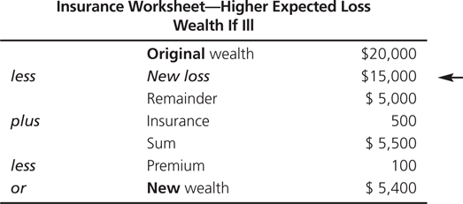
Effect of a Change in the Expected Loss
Back to the original example, with a premium of 20%, how will Elizabeth’s insurance coverage change if the expected loss increases from $10,000 to $15,000, if ill?

Slide 32
Increase in Expected Loss
Elizabeth’s marginal benefit curve shifts to the right at MB₃ but the marginal cost curve remains unchanged at MC₁.
Elizabeth’s insurance coverage will increase to q’’’.

Slide 33
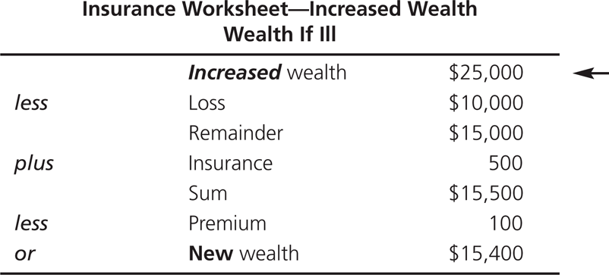
Effect of a Change in Wealth
Suppose Elizabeth was starting with a wealth of $25,000 instead of $20,000.

Slide 34
Increase in Wealth
The marginal benefit curve will shift to the left to MB₂ and the marginal cost curve will shift to the right to MC₃ and Elizabeth’s insurance coverage will be identified with point W, which could end up being to the right or left of q’.

Slide 35
THE CASE OF MORAL HAZARD
What is Moral Hazard?
So far, we have assumed that the amount of the loss was fixed—that it did not change merely because people bought insurance. However, in many cases, buying insurance lowers the price per unit of service at the time that the services are purchased. If people purchase more service due to insurance, then many of the insurance propositions just presented must be modified.

Slide 36
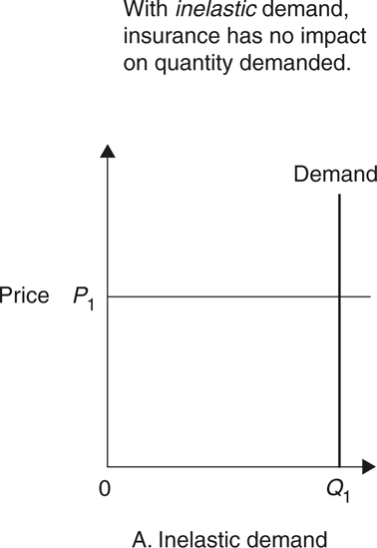
Figure 8-4 Demand for Care and Moral Hazard
Suppose Elizabeth faces a probability of .5 that she will contract Type I diabetes and without insulin, she will die.
Her demand for insulin will be perfectly inelastic and she will purchase insurance to cover expenditures P₁Q₁.

Slide 37
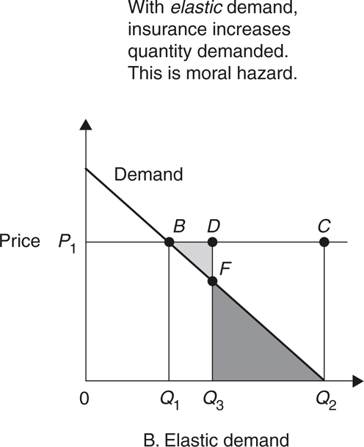
Figure 8-4 Demand for Care and Moral Hazard
Consider, instead, Elizabeth’s demand for dermatological care.
If she purchases insurance that pays her entire loss, then this insurance makes treatment (ignoring time costs) free. Because the marginal price to Elizabeth is zero, she would demand Q₂ units of care for a total cost of care of P₁Q_{2.}
Moral Hazard

Slide 38
Predictions of Economic Theory Concerning Health Insurance
Deeper (more complete) coverage for services with more inelastic demand.
Development of insurance first for those services with the most inelastic demand, and only later for those with more elastic demand.

Slide 39
Effects of Coinsurance and Deductibles
FIGURE 8-4 Demand for Care and Moral Hazard
A deductible of $700 would mean that Elizabeth must pay the first $700 of expenses out-of-pocket. This would lead her to purchase Q₃ units of health care rather than Q₂, therefore the introduction of deductibles and counteract the impact of moral hazard.

Slide 40
HEALTH INSURANCE AND THE EFFICIENT ALLOCATION OF RESOURCES
Efficient Allocation of Resources
The efficient allocation of society’s scarce resources occurs when the incremental cost of bringing the resources to market (marginal cost) equals the valuation in the market to those who buy the resources (marginal benefit).
If the marginal benefit is greater (less) than the marginal cost, one could improve society’s welfare by allocating more (fewer) resources to the sector or individual, and less (more) resources to other sectors.

Slide 41
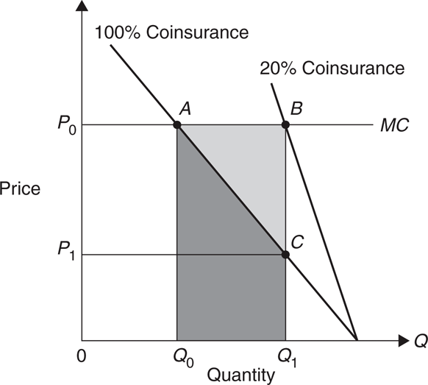
No Insurance
With marginal cost P₀ and no insurance the consumer will demand Q₀ units of care and the consumer’s marginal benefit will be equal to the marginal cost.
Figure 8-5 Health Care Demand with Insurance

Slide 42
20% Coinsurance
Figure 8-5 Health Care Demand with Insurance
With 20% coinsurance, the price in the market is reduced to P₁ and Q₁ units will be demanded.
The marginal benefit measured by point C will not fall below the marginal cost measured at B.

Slide 43
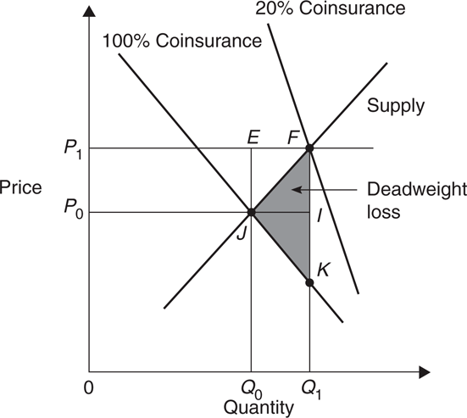
Deadweight Welfare Loss
The deadweight loss comes from a misallocation of resources among goods (i.e., more health care is provided than should be, according to consumer preferences). The deadweight loss from the insurance-induced overproduction of health services can be measured as triangle FKJ.
Figure 8-7 The Effect of Insurance Cost Sharing with Upward-Sloping Supply

Slide 44
The Demand for Insurance and the Price of Care
Martin Feldstein (1973) was among the first to show that the demand for insurance and the moral hazard brought on by insurance may interact to increase health care prices even more than either one alone.
More generous insurance and the induced demand in the market due to moral hazard lead consumers to purchase more health care.

Slide 45
The Welfare Loss of Excess Health Insurance
Insurance policies impose increased costs on society because they lead to increased health services expenditures in several ways:
  increased quantity of services purchased due to decreases in out-of-pocket costs for services that are already being purchased; increased prices for services that are already being purchased; increased quantities and prices for services that would not be purchased unless they were covered by insurance; or increased quality in the services purchased, including expensive, technology-intensive services that might not be purchased unless covered by insurance.

Slide 46
Empirical Estimates of Welfare Loss
Martin Feldstein found that the welfare gains from raising coinsurance rates from .33 to .50 would be $27.8 billion per year in 1984 dollars.
Feldman and Dowd (1991) estimate a lower bound for losses of approximately $33 billion per year (in 1984 dollars) and an upper bound as high as $109 billion.
Manning and Marquis (1996) sought to calculate the coinsurance rate that balances the marginal gain from increased protection against risk against the marginal loss from increased moral hazard, and find a coinsurance rate of about 45 percent to be optimal.

Slide 47
Policy Implications of Welfare Analysis
The preceding analysis suggests that insurance imposes welfare costs on society because of a misallocation of resources.
  Increase in quantity of healthcare services that are purchased because of insurance lowering the cost at point of purchase (without insurance these extra units would not be consumed).
One implication then becomes why should society bother with health insurance?

Slide 48
There are other reasons to provide insurance for healthcare
  Income redistribution, government provided healthcare is paid for with tax revenues, those who have higher incomes pay more taxes that can be used to fund healthcare for people who would not otherwise be able to afford it
  Protects population from losses (efficiency)
  Equity (everyone is treated the same and has the same opportunity to obtain healthcare)

