Slide 1


خــبرات دوليـــة ... رؤيـــة محليــــة
Global Knowledge.. Local focus

Slide 2

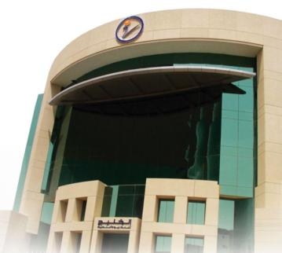

Al Khaleej
Training
and
Education
General Info
Number Of Employees
1,400
Number Of Instructors
750
Number Of Classrooms
350
Number Of PCs
4,500
2,500
Number Of Corporate Clients
More than
Number Of Trainees
48,000
More than
Al Khaleej Tower - Head Office
Riyadh -Olaya street

Slide 3

Our Vision
To be the clients’ first choice through their journey of knowledge.
رؤيـتــنــا
أن نكــــون اختيــاركــــم الأول خــلال رحــلتكم في البــحث عن المعرفــــة
Our
Mission
We are an empowered and inspiring team of professionals shaping the future of human resources and organizational development in our community, through global experience with a local focus.
رسالـتــنـا
نحن فـريق من المحترفين المؤهلين نساهـم في وضـع الأسـس لتـطـوير الموارد البـشـريـة والأعمـال مـن خلال ما نمـلكه مـن خبرات دوليـة لتطوير مجتمعنا بما يتـلاءم ونظرته المـحليـة.

Slide 4
Al Khaleej Locations
in
Saudi Arabia
Men & Ladies 2009
82
Tabouk 1
Haeel
1
Al Jubail 4
Dammam
4
Al Khobar 4
Buridah
2
Madinah 4
Ahsa 4
Onaiza 2
Jeddah
6
Riyadh 14
Makkah
4
Taif
2
Baha
2
Yanbaa2
Maheel 2
K. Mushait
4
Abha 4
Najran 4

Slide 5


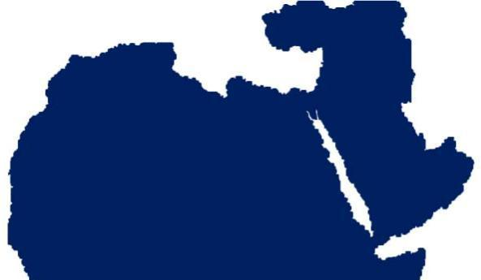










New Horizons 13
Al Khaleej
Locations
in the Middle
East
Direct English 6
Kuwait
Qatar
Egypt
Dubai
Syria
Bahrain
Oman
Yemen
Libya

Slide 6


Al Khaleej Locations
And
Affiliations Worldwide
Chicago
New York
London
Washington
Utan
California
Cairo
Alexendria
Libya
California Utah Washington NewYork
Chicago Cairo London Alexendria Libya

Slide 7










Al Khaleej
Training
and
Education
Our Training
Activities
Computer Training
English Language Teaching
Advance IT Training
Management Training
Leadership Training
e-Learning Training
Stock & Forex Training
Marine Training
Hospitality &Tourism Training
Pingu’s English
Hairdressing
KWADER

Slide 8


New
Horizons
Computer
Training
New Horizons has become the largest training center throughout the Kingdom
Innovative Training Solutions for Companies and Individuals
New Horizons is officially recognized by the largest world manufacturing companies of Software.

Slide 9














New
Horizons
Computer
Training
Our Programs
Short Courses and Applications
3 Months & 6 Months programs
Diploma
Internet Database Networking,
Programming Courses
Other Programs

Slide 10


Direct English
English Language
Teaching
Direct English develops the skills of the Saudi Citizen to acquire a good command of English language.
Very easy English Language Teaching style.
It is a Program that is designed to suit the pace of the learner.

Slide 11

Direct English
English Language
Teaching
Our Programs
Foundation
Regular Courses
Consolidated Certificate
Diploma Program
Grammar
Reading
Writing Skills
TOEFL Preparation Course
TOEIC Preparation Course
Special Courses for VIP
Medical English Course
Business English Course
Bank English Course

Slide 12


Platinum
Center
Advance IT
Training
Solutions
Advance Computer Training
Presenting advanced workshops and courses in the high-end operation systems, Information security, Conducting computer projects in cooperation with the largest pioneering companies in the world in this field.

Slide 13

Platinum
Center
Advance IT
Training
Solutions
Our Programs
Sun (Solaris & JAVA)
Cisco
PMP (Project Management Professional)
HP
Citrix
Information Security Training

Slide 14




Al Khaleej
e-Learning
Anytime ;
Any where
Learning
providing the various solutions whether thru e-Learning on the internet or on the local networks .
More than 2000 courses on-line

Slide 15


Our
Programs
Management
Training
TAKNIAT is specialized in Management Training and Development.
It aims at introducing and providing programs to administrative audiences in the different levels of the management.
In co-operation with regional and international recognition parties
Our Programs
Executive Certificate
Certificate in Competence
Certificate of Attendance
Soft Skills – Fundamental Series

Slide 16


Crestcom
Crestcom polled business leaders in more than 50 countries to identify the skills they would most like to see addressed in a management training course.
Management
Training
Some our Training Courses
HOW TO PROVIDE GOLD STANDARD CUSTOMER SERVICE – Lisa Ford
MANAGING THE VELOCITY FACTOR – Jim Cathcart

Slide 17


OTA
Stocks
and
Forex
Training
Al Khaleej Financial Services, Master Franchise in Middle East from OTA
To deliver the most comprehensive financial education experience through the most effective tools, techniques, and strategies
Courses for Stocks,
& Currencies
Students trade ‘live’ in the class with OTA’s accounts to get practical experience.
All instructors are professional traders in the Financial Markets.
Nominated by NASDAQ as the preferred partner for education provider.

Slide 18


Specialized training on Marine Safety and Security for individuals, locals and international corporate
Scientific sessions focused on the practical side of the Marine training
Training on safety and dealing with emergencies
Technical skills and professionalism necessary vocational training
Training that simulates natural marine conditions
M&O
ARABIA
Marine
Training

Slide 19


Bengu’s English
English for young children
English for young children of 4 -10+ years
Provides a stimulating, fun and safe environment
Has flexible classes to best suit your child’s needs and abilities
Develops fundamental creative and educational skills
Uses an extensive range of multimedia learning and support materials
Employs qualified, bilingual, native English speakers

Slide 20



Al-Dhiafa
Hospitality & Tourism
Training
Al-Dhiafa is training and qualifying workers in the Tourism field, which is considered the fastest-growing project.
In Partner ship with edexcel international.

Slide 21


Formul’A
Women Hair
Dressing
and Makeup
Training
Vocational training programs for women in the area of Hair-cutting and Makeup art s
An international Brand and a training experience extending to more than 25 years in the area
A scientific training Supported and coupled by practical training
The Courses levels are ranged from beginners to advanced.
The Courses Subjects are so various from Hair-cutting to the advanced art of makeup

Slide 22


Kawader
Recruitment
Provides services for the public and private sector establishments and those who are seeking employment
Providing appropriate employment solutions.

Slide 23



Dubai
Our Partners
Fast Lane:
Fast lane is providing Cisco training
which is based in Dubai
e Arts:
e Arts is specialized in content development, LMS, Based in Dubai & Jordan

Slide 24



Dubai
Our Partners
Applied Digital Media Services (ADMS):
ADMS is established to provide graphics and animation media training. ADMS is affiliated with the U.S based future media Concept.
Al Khaleej Financial Services (KFS):
KFS is the master franchise for the ME for Online Trading Academy (OTA).
OTA is a U.S based franchise approved by NASDAC providing.

Slide 25


Cairo
Our Partners
Franklin Covey M.E:
A Company specialized in Franklin Covey Leadership and personal development training.
Al Khaleej Training and Technology:
A training company specializing in computer training ( New Horizons ), with 4 locations in Cairo.

Slide 26


Security
Certified
Program (SCP)
Provide, what IT Security’s professional needs to protect a network in today’s volatile market, by practical and theory training, to help individuals and organizations in more then 40 countries to improve their security.
U.S

Slide 27

Our
International
Awards
2000 Excellence Award from New Horizons Centers
2000 The Best Oracle-Recognized Training Center
2001 The Best Training Centre at the levels of Europe
and the Middle East,
2001 from New Horizons International.
2001 Award for the Best Performance from Direct English
International Centers.
2001 The Best Microsoft Recognized Training Centre
2001 The Best Oracle – Recognized Training Centre
2001 Master Franchise of the year – New Horizons
2002 The Best Training Centre at the level of Europe
and the Middle-East, from New Horizons International Group.
2002 The Best Microsoft Recognized Training Centre.
2002 The Award of Excellence, from New Horizons International.
2002 The Best Training Centre at the level of Europe
and the Middle East, from New Horizons International.
2002 The Best Training Centre at the level of Europe
and the Middle-East, from New Horizons International.
2002 The Best Microsoft Recognized Training Centre.

Slide 28
Our
International
Awards
2002 The Award of Excellence, from New Horizons International Company.
2002 The Best Training Centre at the level of Europe and the Middle East, from New Horizons International Group.
2002 The Best Microsoft-Recognized Training Centre
2002 The Award for Excellence, by New Horizons Centers.
2004 The Best Microsoft – Recognized Training Centre, by Microsoft Company
2005 The Best Training Centre at the level of Europe and the Middle East, by New Horizons International Group.
2005 The Best Training Centre at the International Level, by New Horizons International Group.
2005 The Best Oracle-Recognized Training Center
2006 The Best Microsoft-Recognized Training Centre
2007 Middle East & Africa Location of the Year
2007 The Best Private Training Center award from
ECDL Foundation
2008 The Best Microsoft – Recognized Training Centre, by Microsoft

Slide 29

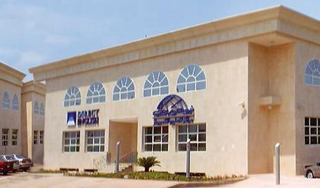
Jeddah Men Branch

Slide 30
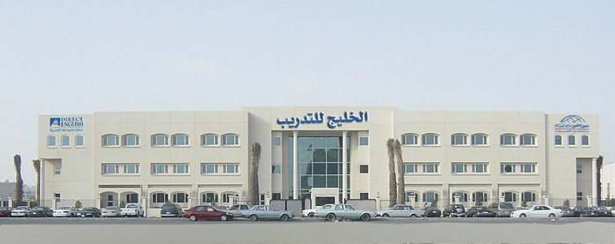
Al Khober Men Branch

Slide 31
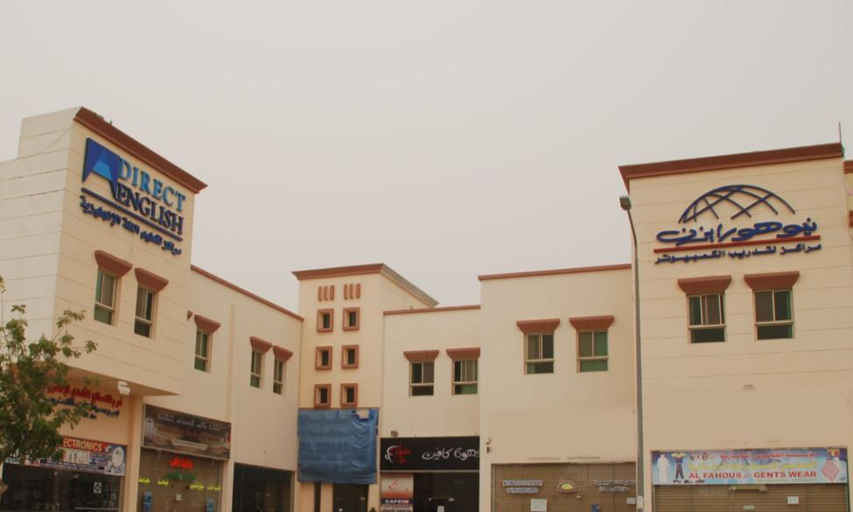
Jubail Men Branch

Slide 32
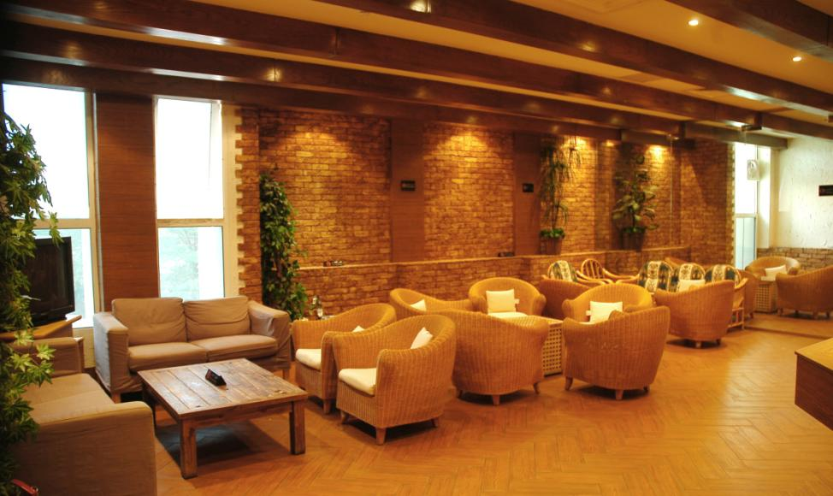

Slide 33
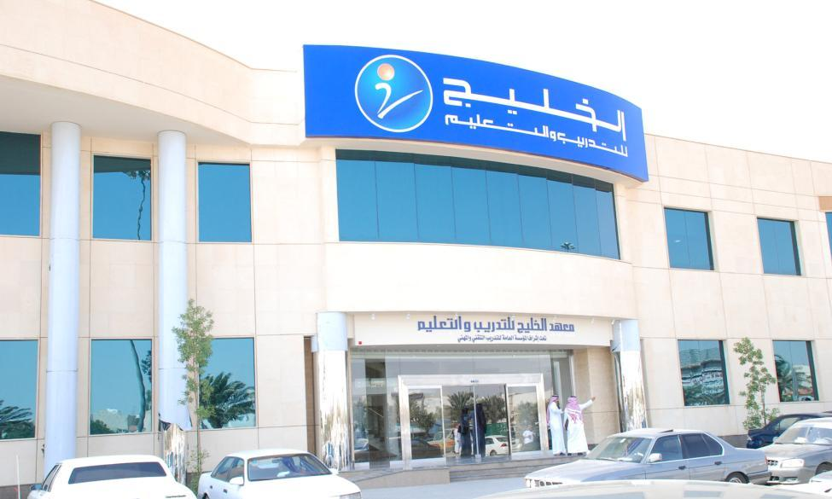
Rawdah Men Branch

Slide 34
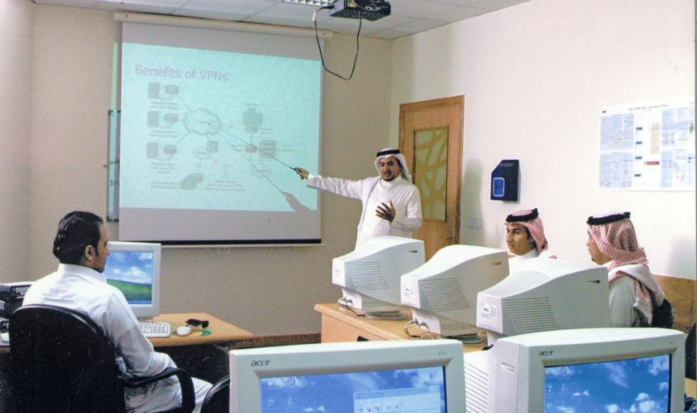

Slide 35
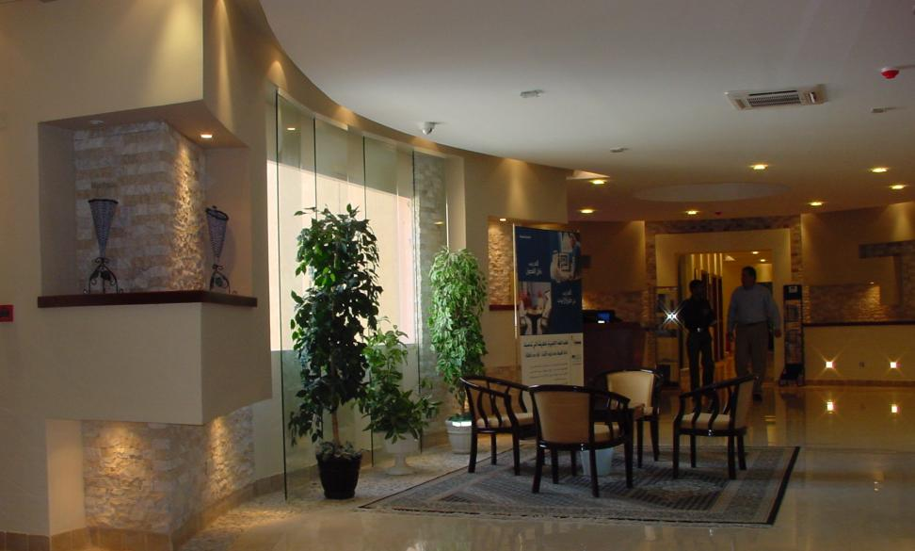
Direct English Sulaimania Men Branch

Slide 36
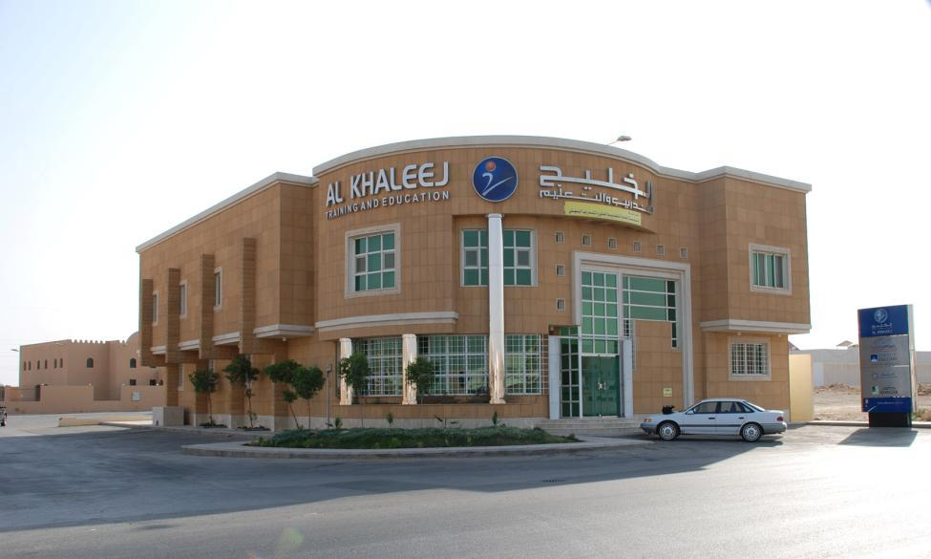
Swaidi Men Branch

Slide 37
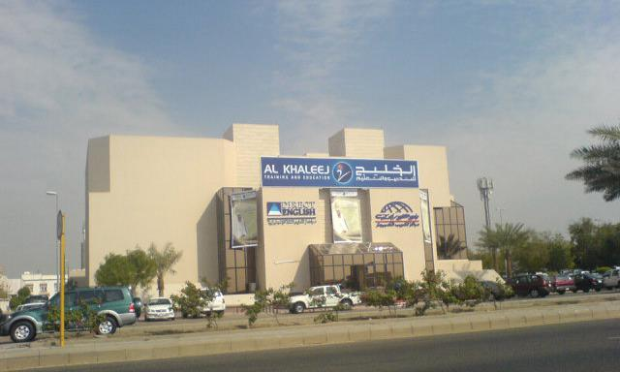
Jeddah Sari Men Branch

Slide 38
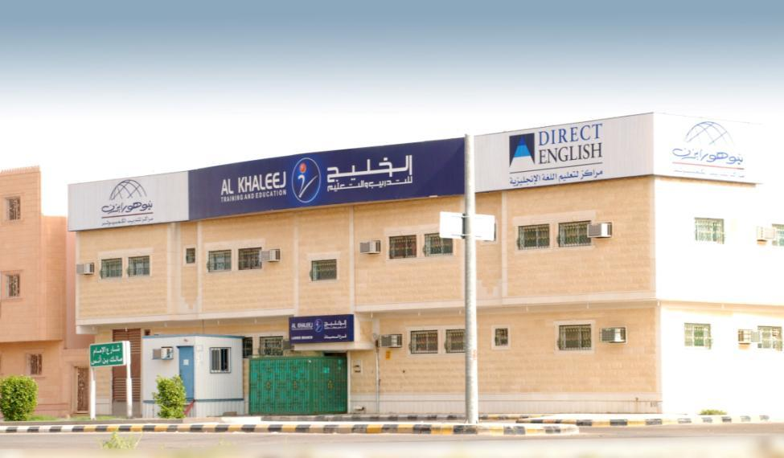
AlKharj Men Branch

