Slide 1

Crop Insurance Premium Rating
Barry J. Barnett
Department of Agricultural Economics

Slide 2
What is a Premium Rate?
Premium rate = premium / liability (or premium per dollar of liability).
Insured’s total premium = premium rate × insured’s liability (liability = dollar amount of protection).
Crop insurance producer premium = total premium × (100% - % subsidy).
How does one calculate a premium rate?

Slide 3
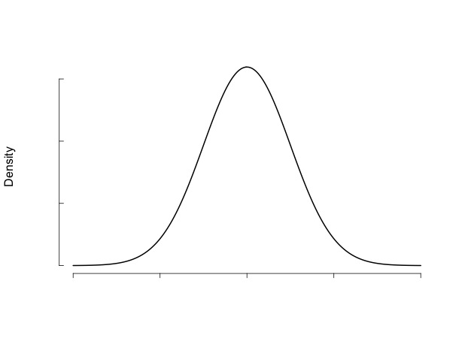
Premium Rate for 70% Coverage
Yield or revenue distribution
70% Coverage

Slide 4
Premium Rate Varies with Coverage Level
70% Coverage
50% Coverage

Slide 5
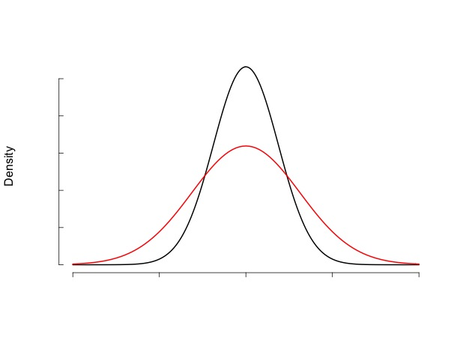
Higher Risk Implies Higher Premium Rate
70% Coverage

Slide 6
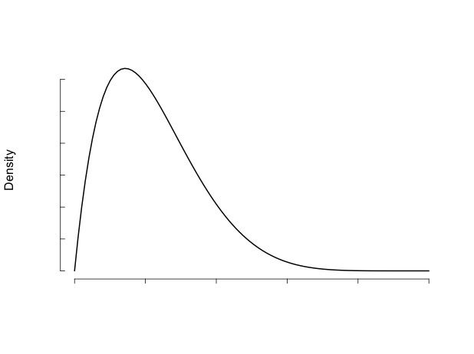
Higher Moments Also Matter
70% Coverage

Slide 7
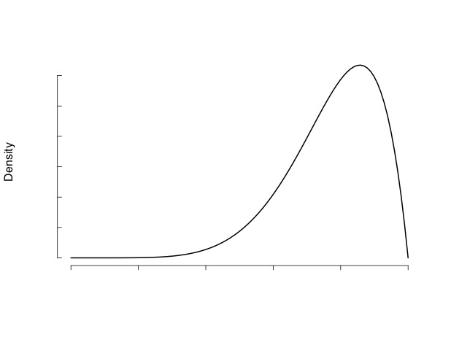
Higher Moments Also Matter
70% Coverage

Slide 8
Yeah but . . .
We never actually observe unit-level yield or revenue distributions.

Slide 9
What we Actually Observe (unit-level products)
Maximum of 10 years of unit-level yield data.

Slide 10
So Now What?
Obviously 10 observations is insufficient to fit a probability distribution.
Instead, these observations are used to estimate the central tendency of the yield distribution for the insured unit.
Can be large errors in estimating the central tendency with only 10 observations – especially for riskier crops/regions.

Slide 11
So How are Crop Insurance Premium Rates Actually Calculated?
Details are mathematically tedious and vary somewhat across products.
Which translated means, “I don’t really know.”
Focus on high-level concepts rather than details.

Slide 12
Loss Cost
Loss cost = indemnity/ liability.
Impossible to predict loss cost for a given year.
Actuarially-fair premium rate = E(Loss Cost).
Rather than trying to fit a distribution for each insured unit, actuaries generally attempt to estimate the E(Loss Cost) for various classifications of insured units.

Slide 13
Premium Rate Loads
Private-sector total premium rate = Actuarially-fair rate + loads.
Loads reflect factors such as administrative cost, product research and development, cost of contingent capital, return on equity, and ambiguity regarding the estimate of E(Loss Cost).
Crop insurance only adds a reserve load and a catastrophic loss load.

Slide 14
So How is E(Loss Cost) Estimated?
For yield insurance products:
E(Loss Cost) varies by crop.
E(Loss Cost) varies by region.
E(Loss Cost) varies by production practices.
E(Loss Cost) varies by types/varieties.
E(Loss Cost) could even vary by producer or even by parcel.
For revenue insurance products, there are also:
Differences in price risk for different crops and differences in price-yield correlation for different crops and regions – all of which impact E(Loss Cost).

Slide 15
Estimating Yield Insurance E(Loss Cost)
E(Loss Cost) for 65% coverage is estimated empirically for specific crop/county combinations using 20 years of historical loss cost data.
Will later adjust premium rates for policy-specific factors such as type, practice, and producer or parcel characteristics.
Historical revenue insurance loss cost data must be converted to a yield insurance basis.
Historical loss cost experience for all coverage levels must be converted to a 65% coverage level basis.

Slide 16
Estimating Yield Insurance E(Loss Cost)
Until recently a simple average of the historical loss cost data were used to generate a 65% coverage level yield insurance E(Loss Cost) for the crop/county.
Implicitly assumes each historical loss cost outcome has equal probability.
Now a weighted average is used where each historical loss cost outcome is weighted by a probability derived from climate division weather data available from 1895-present.

Slide 17
Catastrophe Loading
For each county/crop combination in the state, catastrophic historical losses are removed from county experience. The average catastrophic experience across all counties in the state is then added back into the E(Loss Cost) estimate for each county/crop combination.

Slide 18
Revenue Insurance Premium Rates
Iman and Conover simulation procedure:
Assumption of censored normal distribution with variance that would generate the 65% coverage yield E(Loss Cost).
Assumption of lognormal price distribution with predicted price (from futures market) and implied price volatility (from options market).
Empirically estimated area yield-price correlation.
Simulate both yield and revenue E(Loss Cost) at 65% coverage. Difference is the revenue load which is added to earlier calculated yield premium rate.

Slide 19
Other Adjustments
Mathematical formulas are used to infer premium rates for other coverage levels relative to the premium rate for 65% coverage.
Conceptually, imposing structure on the underlying yield distribution.
Imposed structure is based on historical loss experience at different coverage levels.
Mathematical formulas (based on historical loss experience) are used to adjust premium rates for differences in E(Loss Cost) across different types and practices.

Slide 20
Other Adjustments
Premium rates are initially calculated at the optional unit level. Formulas are used to adjust those premium rates for basic or enterprise units.

Slide 21
Risk Differences Across Insured Units for a Crop/County/Type/Practice
May be due to differences in soil quality, drainage, producer ability, etc.
In some cases (e.g., high risk land in a flood plain) explicit premium rate loads are applied.
In other cases (where differences are not easily attributable to a specific factor):
For a given county/crop/type/practice combination, E(Loss Cost) for insured units is assumed to be lower (higher) the higher (lower) the estimate of yield central tendency (APH yield).

Slide 22
What we Actually Have (area products)
Fulton County, KY Soybeans

Slide 23
How is E(Loss Cost) Determined?
Not by actual historical loss cost data.
Products have not existed long enough.
Instead a backcast simulation process is employed.
For area yield insurance, use historical NASS yield data to simulate what the loss cost would have been had the product been in place.
For area revenue insurance, also take into account implied price volatility and yield-price correlation.

Slide 24
How is E(Loss Cost) Determined?
The yield distribution may not be stationary.
1- or 2-knot spline trend adjustment.
Deviations from central tendency may be heteroskedastic. If so, correction procedures are used.
How many years of historical data are sufficient to reflect the probability distribution?
Weather weighting?
Challenges:
Data sources (reduced NASS reporting).
Changing composition of types/practices within a county. NASS data may not be type/practice-specific.

Slide 25
In the Words of Forrest Gump
“That’s all I have to say about that.”

