Slide 1



Ontario Bass nation Premium Bass boat Insurance program
“The Better Plan you deserve”

Slide 2
Stoneridge Insurance Brokers (Barrie)
Stoneridge, formerly JC Mitchell Insurance Brokers has a long history of over 38 years in supporting central Ontario and beyond.
Stoneridge Insurance brokers is a member of a network of 9 brokerages in central Ontario
Randy Spenceley as a member, can not only look after you with the best boat insurance program in the industry but can also help you with all your other insurance needs including Commercial business insurance, home, car and recreational needs. We have in-house specialist who can look after all your life insurance, disability investment needs as well. We can consolidate all your needs under one office.

Slide 3
Pacific marine insurance managers
As one of Canada’s fastest growing boat insurers, Pacific Marine Underwriting are experts in pleasurecraft marine insurance across Canada with offices in B.C, Ontario, and Quebec. Providing secure, competitive and comprehensive boating insurance you can trust for over 50 years. Insurance brokers can depend on our experience, service quality and convenient online solutions to provide their clients with exceptional customer service.

Slide 4
Insurance Terms
Replacement cost
Agreed value
Actual Cash value acv
Liability
Personal effects
Navigational limits
Lay up period

Slide 5
Option #1 Express Program
Includes: Covers up to $40,000 total value and 30 feet in length (Boat, motor, trailer, accessories, electronics. Etc.) for a fixed price.
Requires NO Application, NO Survey No Signature, regardless of how old the boat is.
Does require pictures of front, rear, both sides and 1 of interior.
Can be paid by Credit Card, if required monthly payment options are available
Fully automated process completed online in minutes from start to finish
Can accommodate up to 2 claims in last 5 years.
No Theft Exclusion
Newly acquired vessel coverage of up to $40,000

Slide 6


Slide 7
Coverage:
Agreed value on total or constructive total losses for the first 9 years of the vessel from the manufacturing date
Replacement Cost on partial losses of age of vessel
Maximum vessel speed 60 mph
$250 Deductible
$2,000,000 Liability Included, up to $5,000,000 available upon request
$1,000,000 Uninsured boater and water skiing liability
Standard Navigational Limits (40 degrees to 52 degrees) with NO Option of Southern or extended navigational limits (some exceptions may apply)
NOTE: The premium is non-refundable unless boat is sold or substituted

Slide 8
OBN Express Program includes the following benefits at no additional charge.
$5,000 Personal Effects Coverage, increased from standard $2,000 (Can be increased based on individual members requirements for additional charge)
$1,000 Loss of Use Expense
$2,000 Reimbursement for Emergency Expenses
$1,000 Search and Rescue Expenses
Protection Plus Extension: It is hereby understood and agreed that payment of the first covered loss under this Policy, occurring during the existing Policy term, will not affect your Policy Premiums and Deductibles at Subsequent renewals.

Slide 9
Option #2 Standard Program
Includes: No limit on values, any size boat can be written
Boats with speeds over 60 MPH can be quoted
Requires completion of an application
$2,000,000 Liability included, up to $5,000,000 available upon request
Flexible payment options including 1 pay or monthly payments
Available Extended Navigation coverage below 40 degrees, including trailering

Slide 10
Coverage:
Agreed Value on total loss regardless of age of vessel
Replacement cost on partial loss regardless of age of vessel
Minimum deductible is $500 or 1% of the insured limit (the greater of the 2)
No Theft Exclusion
Newly acquired vessel coverage up to $500,000
Protection Plus Extension: It is hereby understood and agreed that payment of the first covered loss under this Policy, occurring during the existing Policy term, will not affect your Policy Premiums and Deductibles at Subsequent renewals.

Slide 11
OBN Standard Program Includes The Following Benefits at no Additional Charge
$5,000 Personal Effects Coverage (Can be increased based on individual members requirements for additional charge)
$1,000 Loss of Use Expense
$2,000 Reimbursement for Emergency Expenses
$1,000 Search and Rescue Expense
Protection Plus Extension: It is hereby understood and agreed that payment of the first covered loss under this Policy, occurring during the existing Policy term, will not affect your Policy Premiums and Deductibles at Subsequent renewals.

Slide 12
Available discounts
Experience, up to 9 years and over 10 years
Claims Free, up to 5 years and up to 10 years
Age of Operator, 50 years and over
Safety Courses, Canadian Yachting Association and Power Squadron
Boat over $100,000
Deducible Options, 2X and 3X, max.

Slide 13
Possible security strategy
Pacific marine is working on Security Options for OBN members including a possible offering from a company called TAG that offers to microchip the member’s boat for a fee, possibly refundable fee and a discount on their boat insurance. Under development as we speak but show’s clearly that Pacific Marine and StoneRidge Insurance Brokers want to protect the members, their boats, and the program.

Slide 14
Boat & Personal Effects Security
Other less expensive Security Options that a discount can be received for, that are commonly used now, are:
1) Parked overnight, chain through trailer wheel around frame to prevent trailer & boat being stolen, photos required.
2) Tongue and Receiver locks, commonly used now, photo’s required
3) Locks on Rod and Tackle lockers on board boat, photo’s required
4) Use of Lock R Bar system to protect Personal Effects
NOTE: If no Anti-Theft measures are taken, the theft deductible will be doubled. Also note that most marine companies exclude Theft from coverage.

Slide 15
Claims
24/7 CLAIMS SERVICE IN CANADA AND THE US
24/7 ON WATER TOWING REIMBURSEMENT.
VERMIN DAMAGE INCLUDED
FIRST PAYER ON PERSONAL EFFECTS CLAIMS NOT YOUR HOMEOWNERS POLICY

Slide 16
ALSO!
I can insure any of the other boats that OBN members have! Please bring me your pontoon boats, sail boats, aluminum boats, cruisers, bow riders etc.

Slide 17
Flexibility
Please remember we want to be flexible to meet your needs.
Special exceptions may be made for circumstances such as Team Ontario Boater who needs to travel with their boat to the US
Standard Navigational Limits include the inland waters of Minnesota, Wisconsin, Michigan, Ohio, New York, Vermont Boston and Maine.

Slide 18
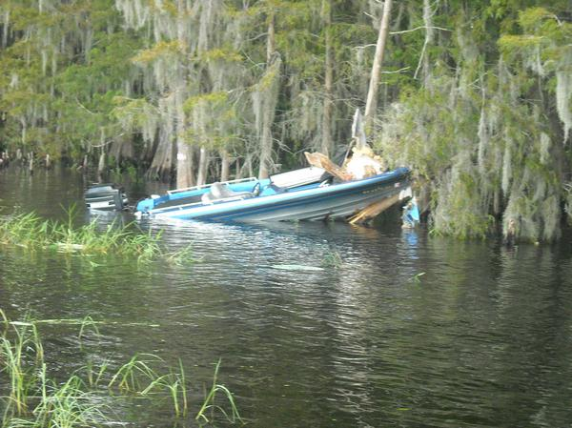
Thank you Randy Spenceley OBN premium bass boat insurance program

