Slide 1
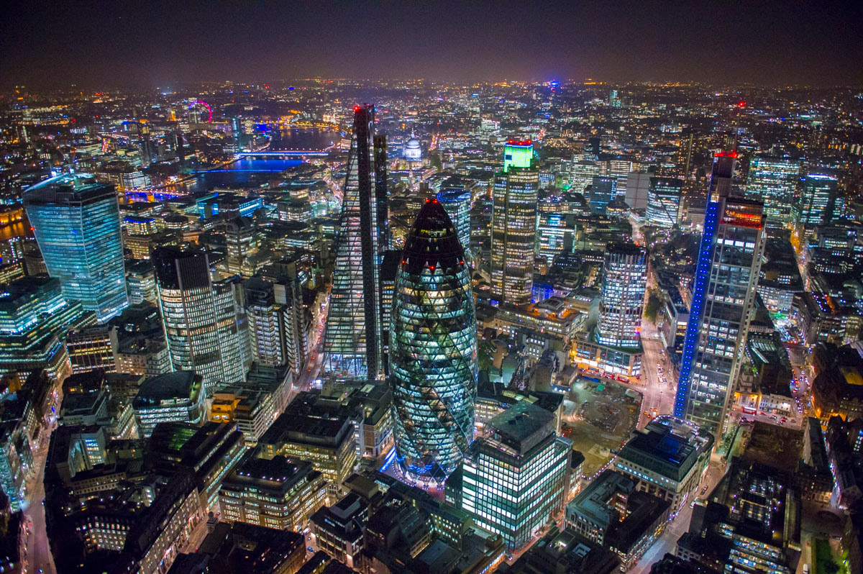
The City, an example of CBD

Slide 2
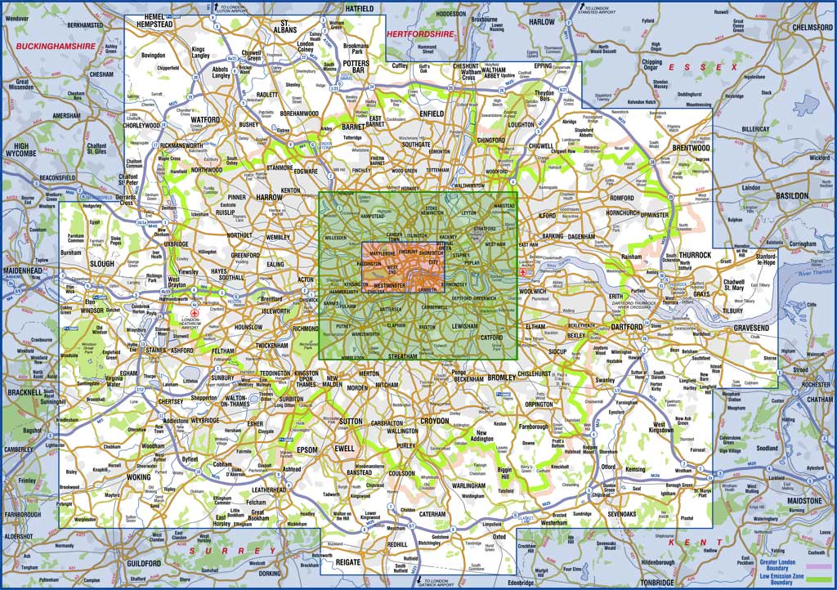
The location in London

Slide 3
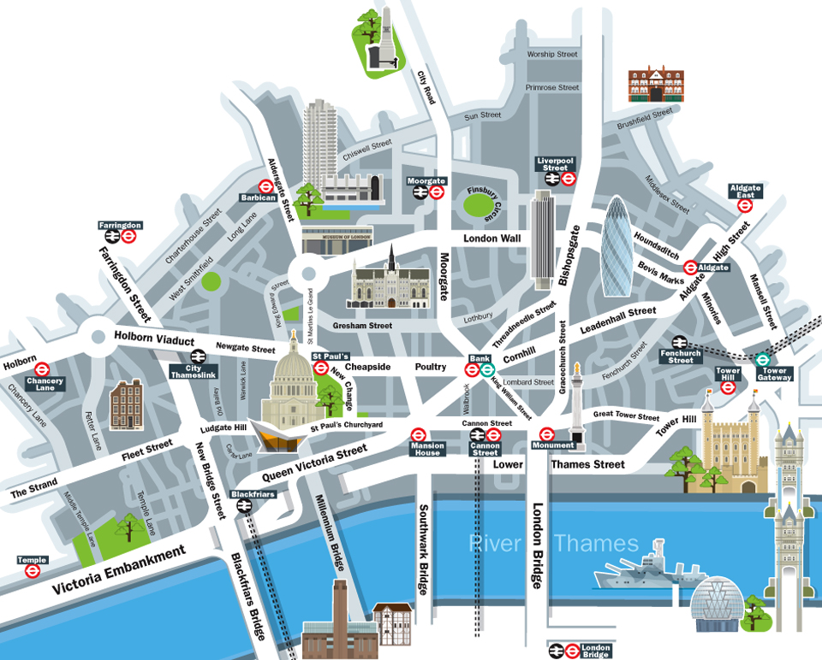
The City

Slide 4
What is a CBD ?
The CBD or Central Business District is a commercial and financial centre.
It contains the main shops, offices and financial institutions of the urban area. It is usually the most accessible (easy to get to) part of the city. Buildings tend to be tall and building density is high.

Slide 5
Financial and Business activities
The City vies with New York City as the financial capital of the world;
- 2.4% of UK GDP.
- 46.7% of the total daily turnover of London as a whole (1,85 trillion).
- £7.8 billion of exports per annum.
- 750,000 people employed in financial and business services.

Slide 6
The City concentrates the most important financial places :
- The London Stock Exchange
- Lloyd's of London (insurance)
- the Bank of England are all based in the City.
- Over 500 banks have offices in the City,
- A leading centre for foreign banks. In 2007, 245 foreign banks were present in London compared to 210 in New York, and 67 in Tokyo.

Slide 7
INSURANCE :
The UK Insurance industry is the third largest in the world after the US and Japan
accounts for around 15 % of total net exports in financial services.
Around 40,000 people are employed in the City of London by the London Market, over 15 % of the total insurance employment in the UK.
Around 10 to 15 % of the world’s insurance is arranged in the London Market based in the city, making it the world’s leading market for internationally traded insurance and re-insurance.
In 2005 gross premiums on the London Market were estimated at around £24 billion, nearly double the 1999 level.
The City of London is the only place in the world where all 20 of the largest insurance and re-insurance companies have offices.

Slide 8
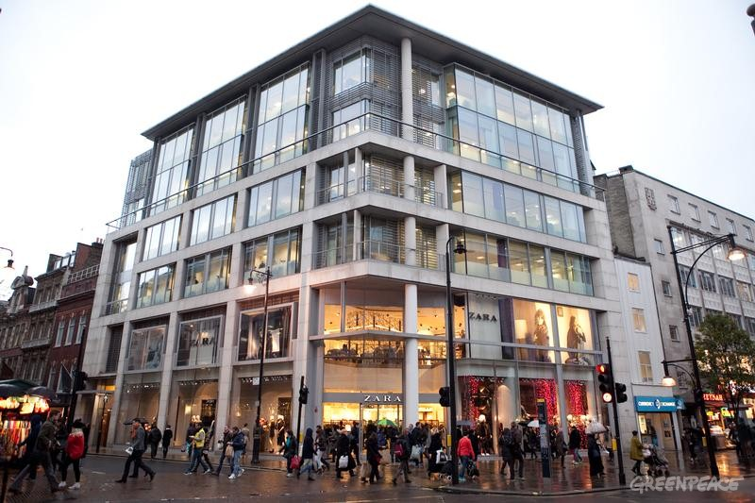
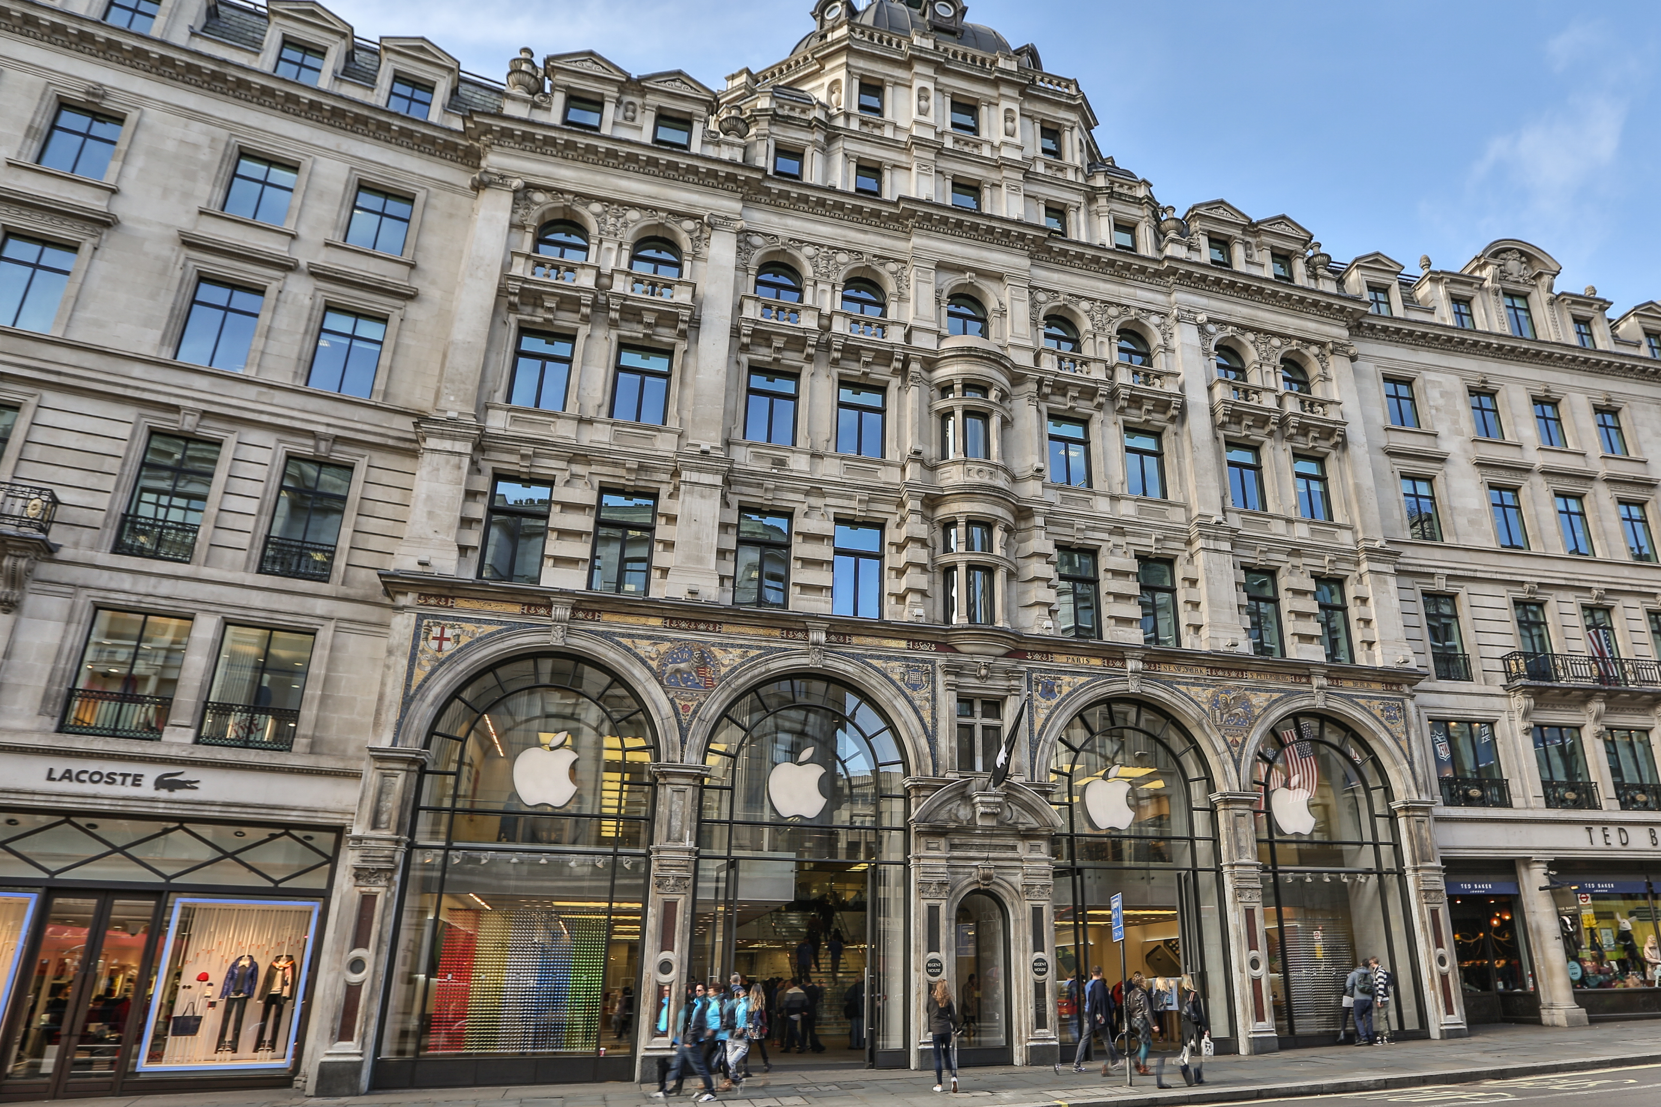
Headquarters and business activities
3 of the top four leading law firms
200 foreign law firms
Luxurious shops , hotels and restaurants,
Famous architecture cabinets,
medias, Oil and Gas firms….
Biggest Zara store anywhere in the world.
Street Apple computers
opened the only showcase
store of its kind anywhere
in Europe

Slide 9
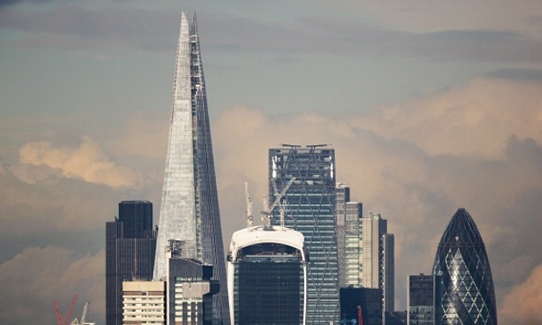
The great office buildings

Slide 10
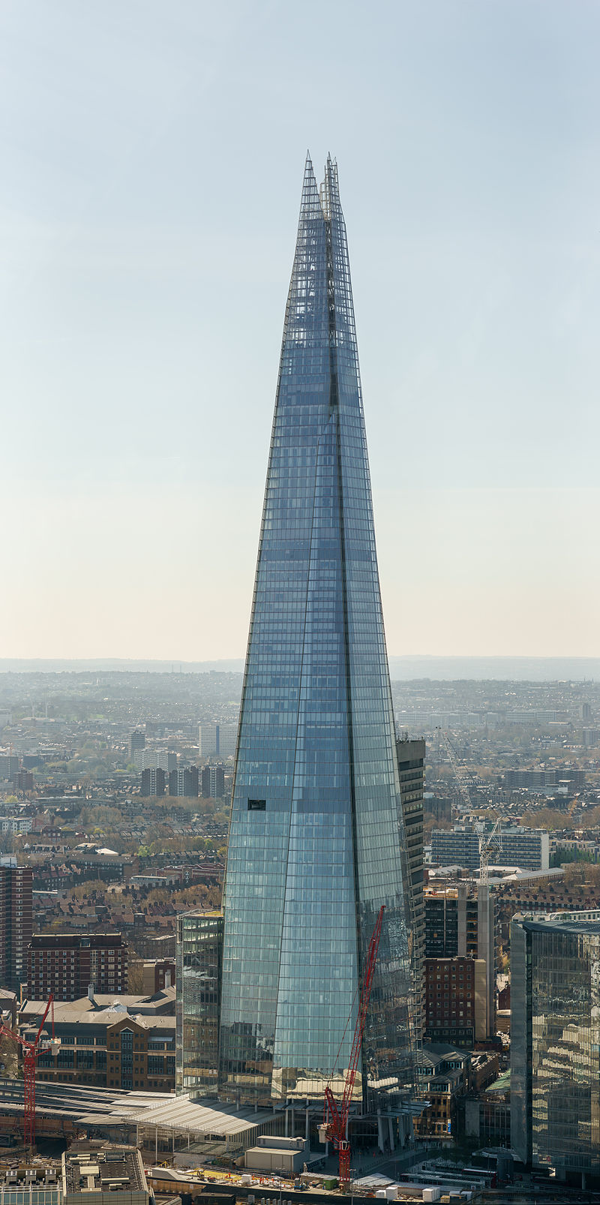
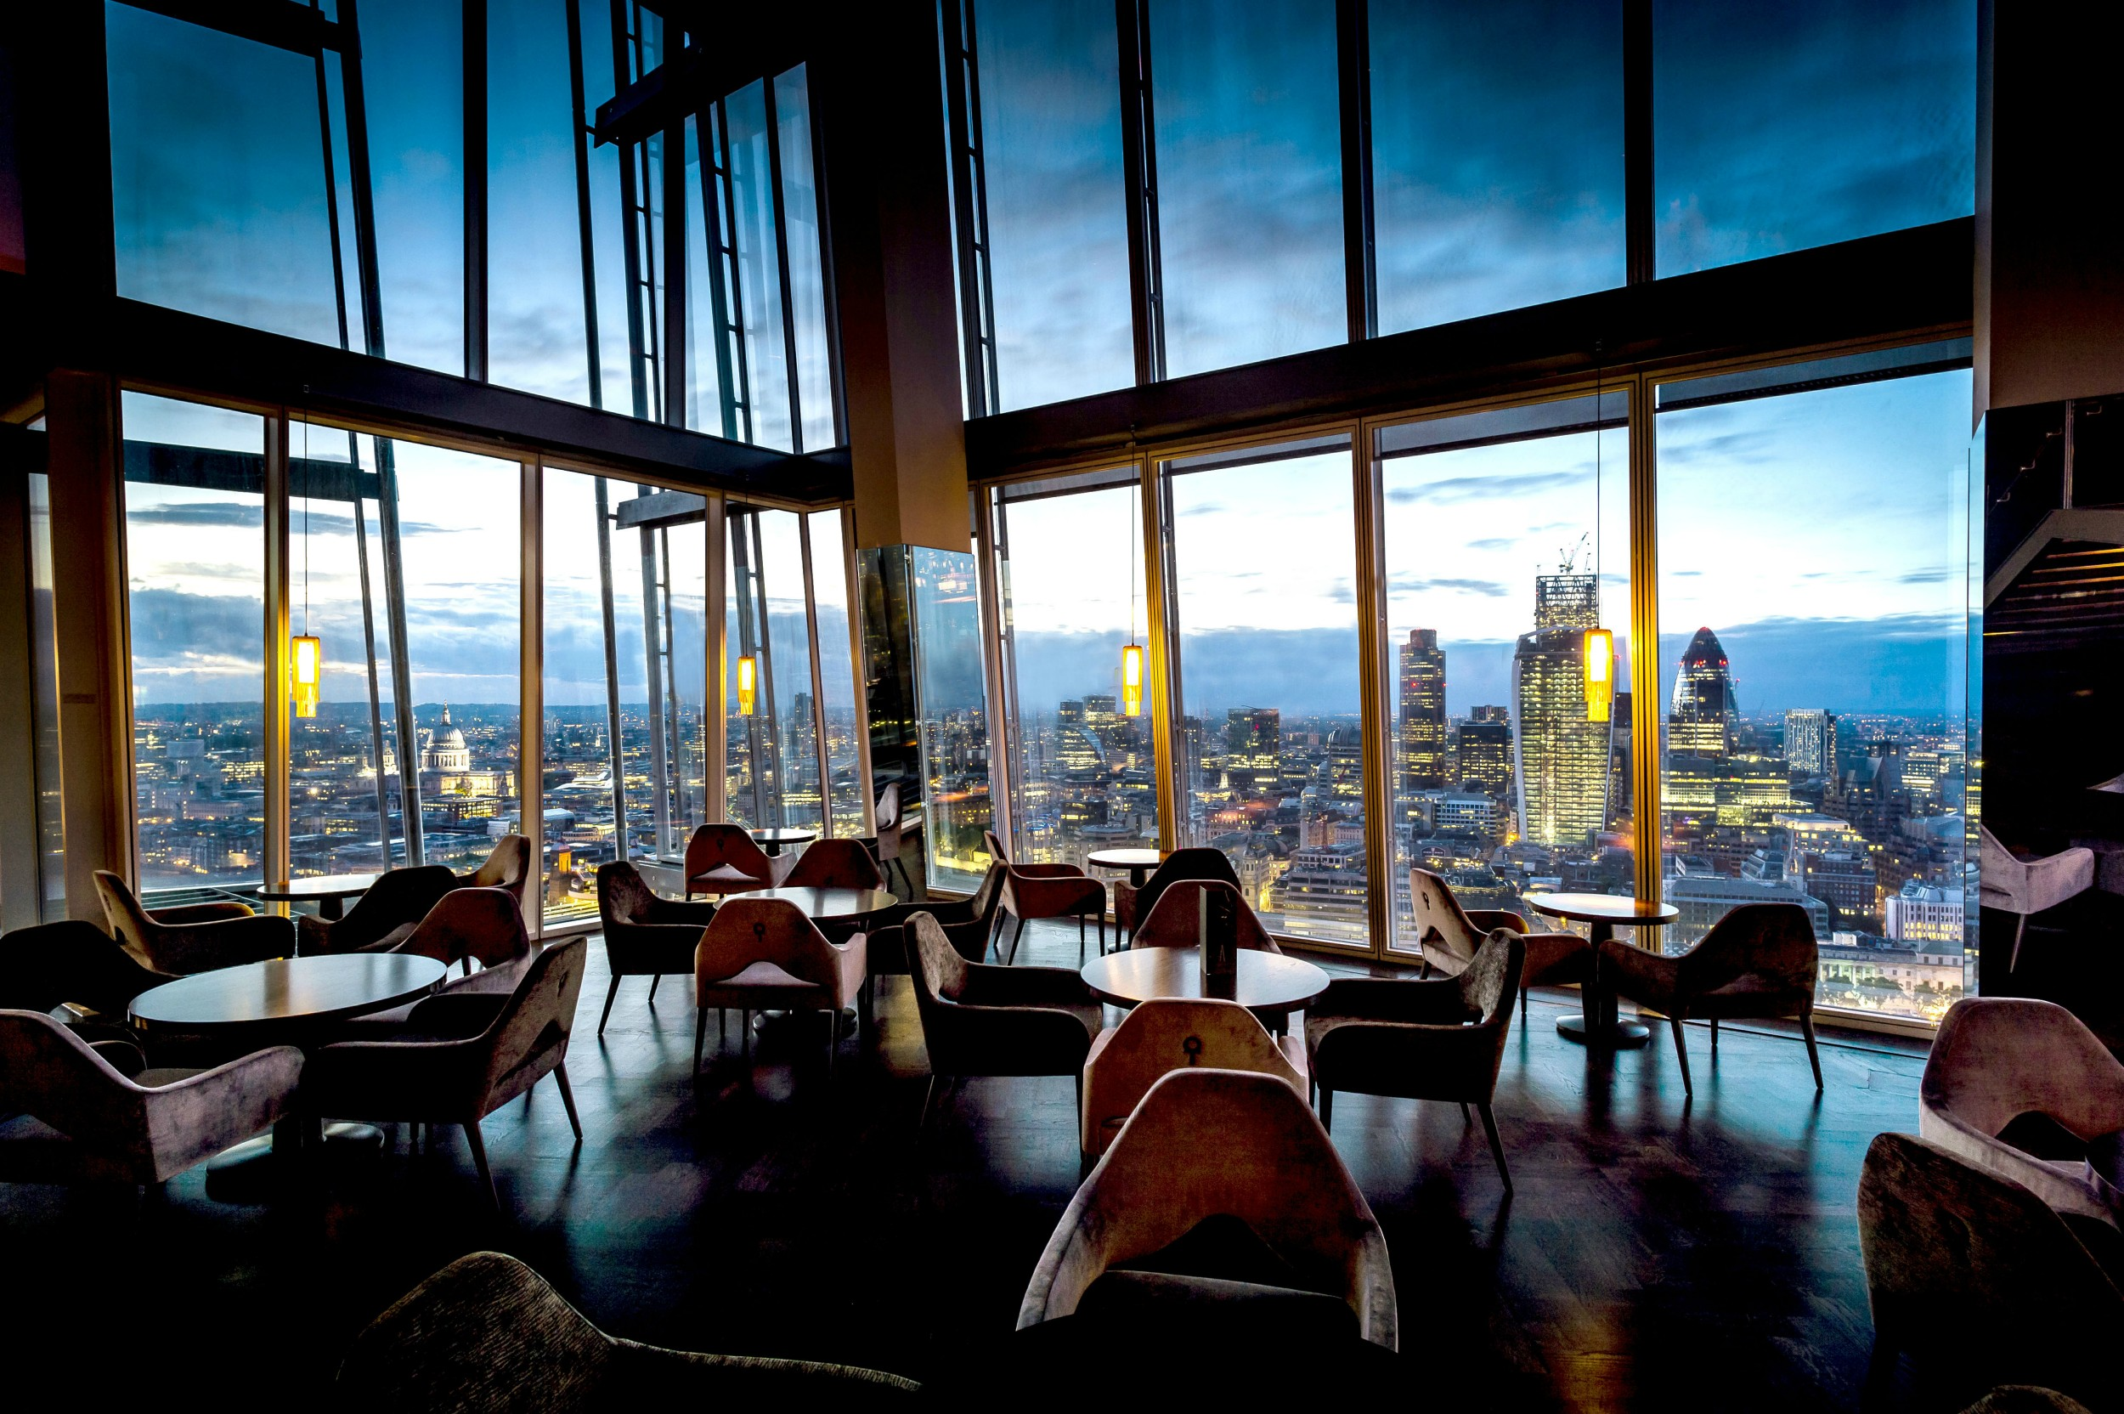
The Shard :
A half-residential, half-office Building :
Height : 306meters
Built in 2012
The tallest in London and in the UK http://www.the-shard.com/offices/

Slide 11
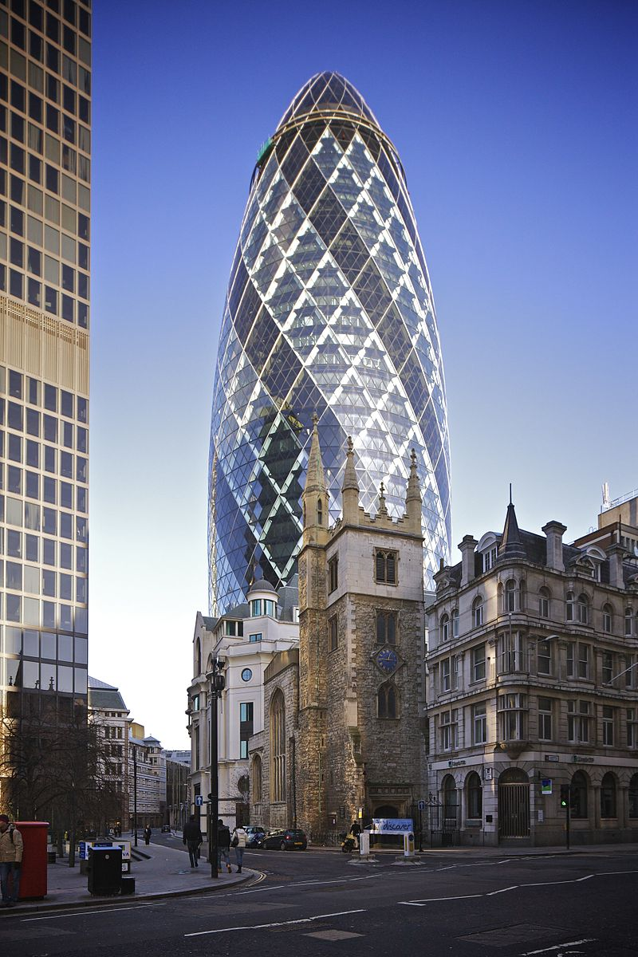
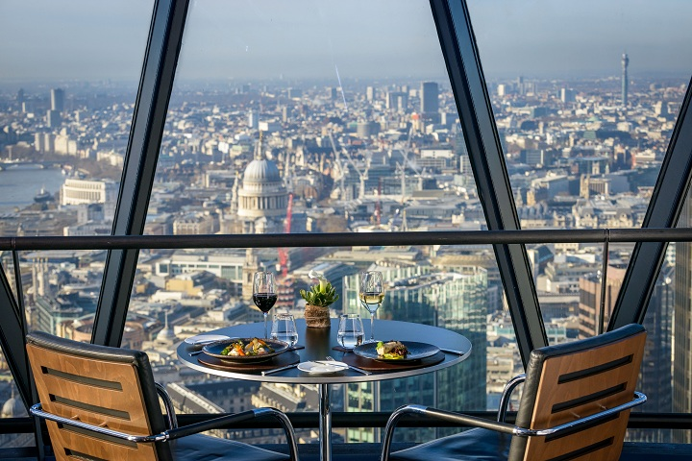
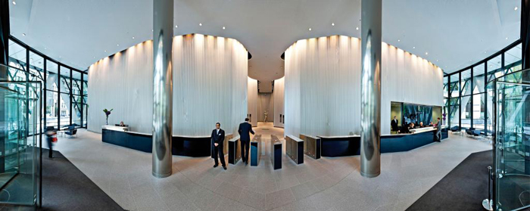
30 St Mary Axe or the “Gherkin Tower”
Height: 180meters
Built in: 2003
Owned by the international insurance company
“Swiss Re”

Slide 12


