Slide 1
MCCG Demonstration Day
IBS Application Programming Interface (API)
May 11, 2016

Slide 2




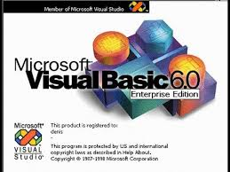




My Story

Slide 3
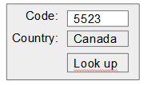


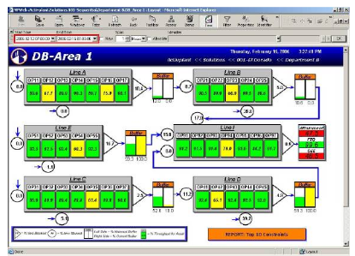
My Story of Extensibility

Slide 4
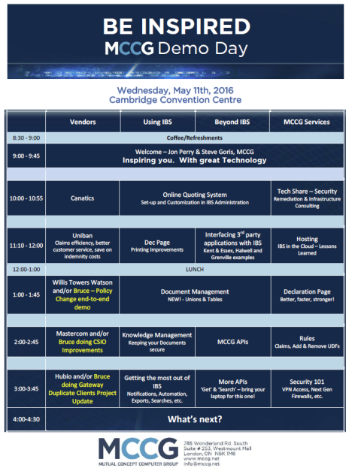
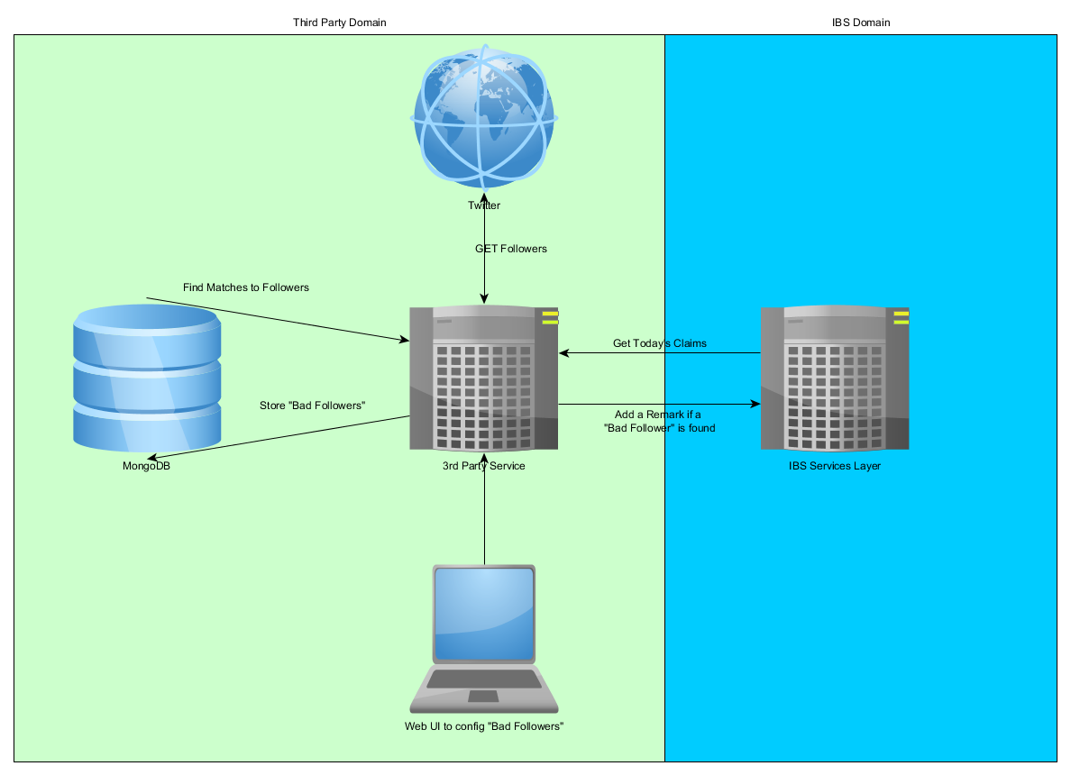
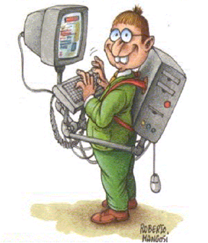


The Story of this talk

Slide 5

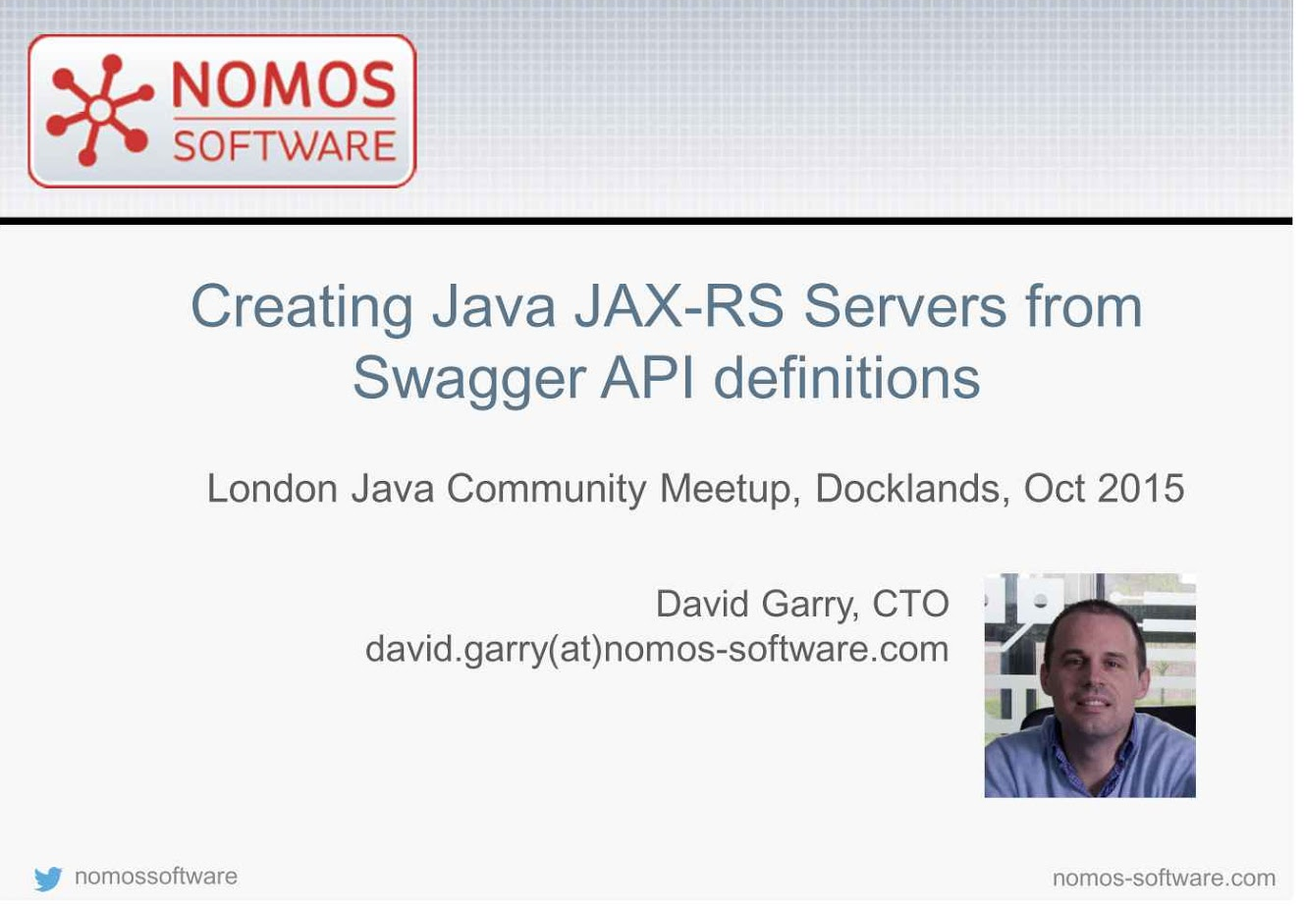
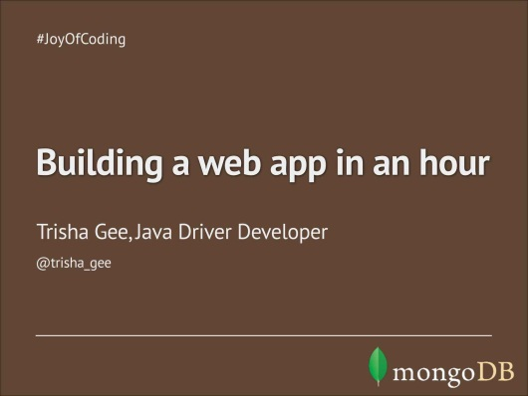

The Story of Resources

Slide 6

The Story of Not Things
Wait a sec…where is the login page?
Is there a 3rd party API doc?
What if we have a huge load?
How can we test it?
Does the code use known libraries?
Those audits…can I access them directly?
What about SoundCloud?
Is a user going to wait for this to finish?
Other languages?
Non-functional Requirements: Security, Extensibility, Documentation, Performance (Load), Performance (Perception), Quality, Maintainability

Slide 7
Our Goal

Slide 8
Staged Approach
Stage | Topic
1 | Generate our initial project
2 | Add database connectivity
3 | Add role based security
4 | Introduce queuing to our project
5 | Generate java classes from the IBS schema
6 | Add IBS authorization
7 | Connect to IBS and perform a search
8 | Integrate with social media sites
9 | Connect to IBS and add a remark
10 | Add a user interface

Slide 9
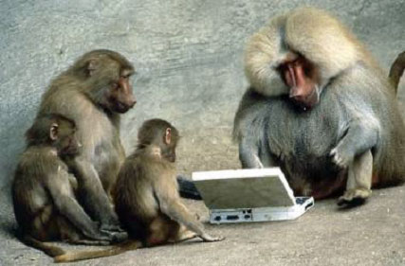
Code Time

Slide 10

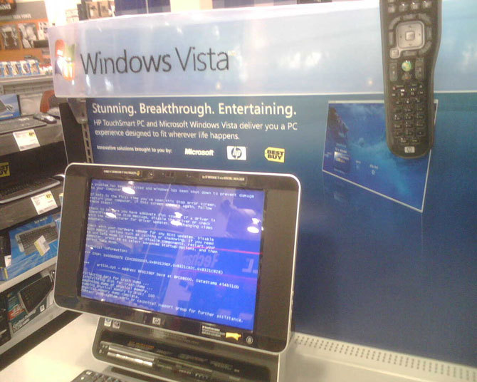
Wrap Up

Slide 11
Where to go from here?
Use your resources:
Mutuality.ca: Perfect for community support
Next steps for this project:
FormLogin: users will most likely require this or LDAP
Spring Security supports both.
Repository encapsulation
MongoDB replication: This can be configured at the MongoDB level, not code.
Break that chain: We can do more with queues!
Email notification?

